Slide 1
COMMON EVALUATION
FINAL PROJECT
Vira Oleksyuk
ECE 8110: Introduction to machine Learning and Pattern Recognition

Slide 2
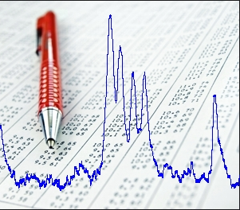
Data sets
Two speech data sets
Each has a training and a test data sets
Set 1
  10 dimensions; 11 classes
  528/379/83 – training/development/evaluation
Set 2
  39 dimensions; 5 classes
  925/350/225– training/development/evaluation
  5 sets of vectors for each class

Slide 3
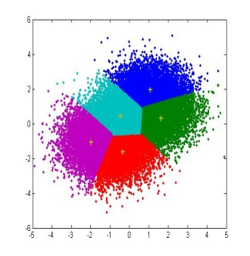
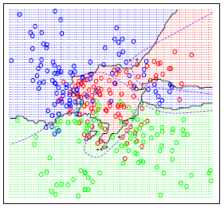
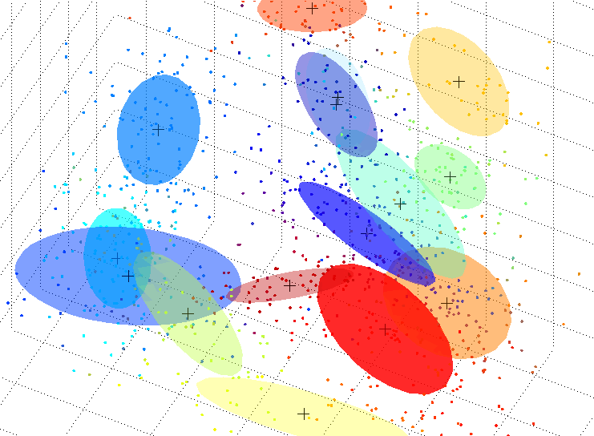
Methods
K-Means Clustering (K-Means)
K-Nearest Neighbor (KNN)
Gaussian Mixture Model (GMM)
Notes:
Why those

Slide 4

K-Means Clustering
It is a method of vector quantization, originally from signal processing, that is popular for cluster analysis in data mining.
k-means clustering aims to partition n observations into k clusters in which each observation belongs to the cluster with the nearest mean, serving as a prototype of the cluster. This results in a partitioning of the data space into Voronoi cells.
K-Means aims to minimize the within-cluster sum of squares [5]
The problem is computationally difficult; however, there are optimizations
K-Means tends to find clusters of comparable spatial extent, while the expectation-maximization mechanism allows clusters to have different shapes.

Slide 5
K-Means Clustering
Euclidean distance is used as a metric and variance is used as a measure of cluster scatter.
The number of clusters k is an input parameter needed and convergence to a local minimum may be possible
A key limitation of k-means is its cluster model. The concept is based on spherical clusters that are separable in a way so that the mean value converges towards the cluster center.
The clusters are expected to be of similar size, so that the assignment to the nearest cluster center is the correct assignment. Good for compact clusters
Sensitive to outlayers

Slide 6
K-Means Clustering
Parameters:
Euclidian distance;
k selected randomly
Results
Not much change in error from changes in parameters
 | Misclassification Error, %
Trials | Set 1 | Set 2
Trial 1 | 0.88 | 0.57
Trial 2 | 0.95 | 0.79
Trial 3 | 0.94 | 0.86
Trial 4 | 0.90 | 0.78
Trial 5 | 0.81 | 0.70
Average Error, % | 0.90 | 0.74

Slide 7
K-Nearest Neighbor
A non-parametric method used for classification and regression.
The input consists of the k closest training examples in the feature space.
The output is a class membership. An object is classified by a majority vote of its neighbors
KNN is a type of instance-based learning, or lazy learning, where the function is only approximated locally and all computation is deferred until classification.
the simplest of all machine learning algorithms.
sensitive to the local structure of the data.

Slide 8
K-Nearest Neighbor
The high degree of local sensitivity makes 1NN highly susceptible to noise in the training data. A higher value of k results in a smoother, less locally sensitive, function.
The drawback of increasing the value of k is of course that as k approaches n, where n is the size of the instance base, the performance of the classifier will try to fit to the class most frequently represented in the training data [6].

Slide 9
K-Nearest Neighbor
Results Set 1
Results Set 2

Slide 10
Gaussian Mixtures Model
Is a parametric probability density function represented as a weighted sum of Gaussian component densities.
Commonly used as a parametric model of the probability distribution of continuous measurements or features in biometric systems (speech recognition)
Parameters are estimated from training data using the iterative Expectation-Maximization (EM) algorithm or Maximum A Posteriory (MAP) estimation from well trained prior model.
Notes:
Main issues

Slide 11
Gaussian Mixtures Model
Not really a model but a probability distribution
Unsupervised
Convecs combination of Gaussian PDF
Each has mean and covarience
Good for clustering
Capable of representing a large class of sample distributions
Ability to form smooth approximations to arbitrary smoothed densities [6]
Great for modeling human speech

Slide 12
Gaussian Mixtures Model
Results
Long computations
Notes:
n statistics and machine learning, regularization methods are used for model selection, in particular to prevent overfitting by penalizing models with extreme parameter values.

Slide 13
Discussion
Current performance:
Method | Probability of error
 | Set 1 | Set 2
K-Means | 0.90 | 0.74
KNN | 0.71 | 0.25
GMM | 0.75 | 0.43

Slide 14
Discussion
What can be done:
  normalization of the data sets
  removal the outliers
  Improving on the clustering techniques
  Combining methods for better performance

Slide 15
References
[1] R.O. Duda, P.E. Hart, and D. G. Stork, “Pattern Classification,” 2nd ed., pp. , New York : Wiley, 2001.
[2] C.M. Bishop, “Pattern Recognition and Machine Learning,” New York : Springer, pp. , 2006.
[3]http://www.isip.piconepress.com/courses/temple/ece_8527/
[4] http://www.autonlab.org/tutorials/
[5] http://en.wikipedia.org/wiki/K-means_clustering
[6]http://llwebprod2.ll.mit.edu/mission/cybersec/publications/publication-files/full_papers/0802_Reynolds_Biometrics-GMM.pdf

Slide 16

Thank you!

