Slide 1
Data Classification: Gaussian Mixture Models, k Nearest Neighbor, Neural Networks, and Topological Data Analysis
Salvatore giorgi
Ece 8110 machine learning
5/12/2014

Slide 2
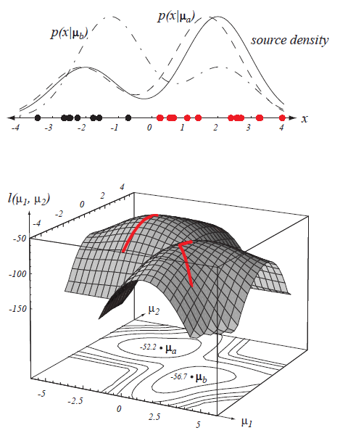
Gaussian Mixture Models
An iterative clustering method
Formed by combining multivariable Normal density components
The Matlab function we use fits data using an Expectation Maximization (EM) algorithm
Figures taken from Duda and Hart

Slide 3
Gaussian Mixture Models: Algorithm
First, we compute the sample means of each class in the training data
Use fitgmdist function for total training data with regularization parameter and a number of mixtures
Number of mixtures is always a multiple of 11 or 5, the number of classes corresponding to data set 1 and 2, respectively
The regularization parameter ensures estimated covariance matrices are positive definite
We then find the smallest distance between each class sample mean and each mixture
Assign to each mixture the class associated with this minimum distance
Use the cluster function to cluster our test data
Count number of incorrect classifications
Probability of Error = number of incorrect class assignments / number of test vectors

Slide 4
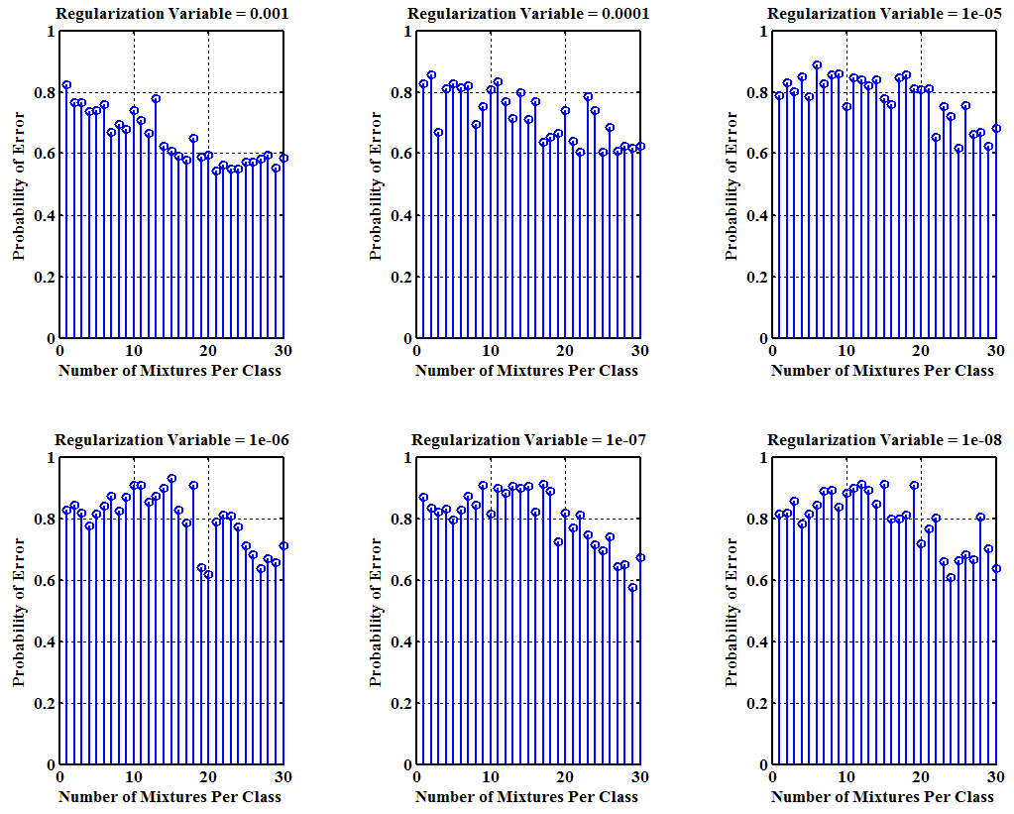
Gaussian Mixture Models: Results Data 1
Minimum Error = 54.4%
Number of Mixtures per Class = 21
Regularization Variable = 0.001

Slide 5
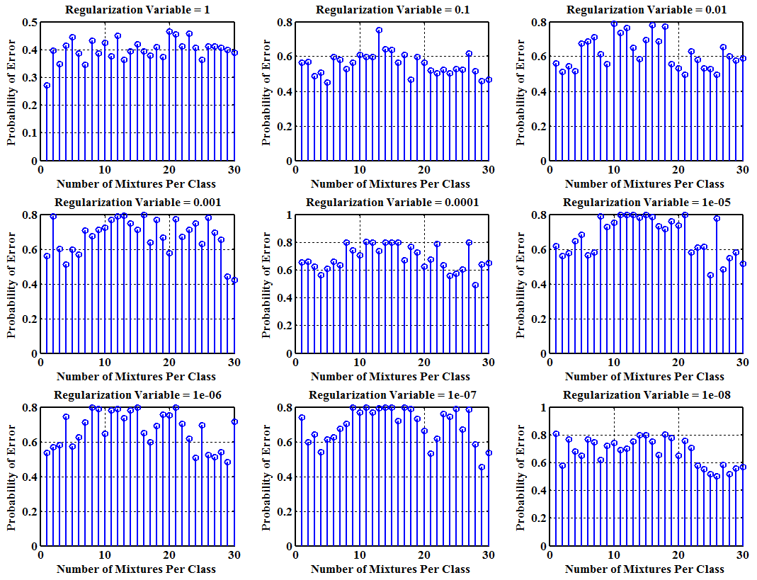
Gaussian Mixture Models: Results Data 2
Minimum Error = 27.1%
Number of Mixtures per Class = 11
Regularization Variable = 1

Slide 6
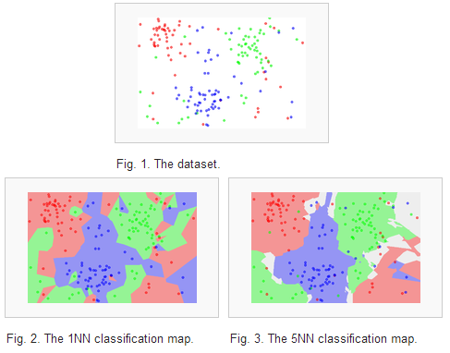
K Nearest Neighbor
A non-parametric classification method
Object is classified by majority vote of the class assignments of the k closest elements
We use a Euclidean distance metric
Figures taken from Wikipedia

Slide 7
K Nearest Neighbor: Algorithm
Use knnsearch function with training data, test data, and k
Returns a vector where each row contains index of the k nearest neighbors in training set for the corresponding row in Y
Since we know the classes of each test vector, we can assign classes to the above output based on the index
We then take a majority vote of the classes from each of the k neighbors
This majority vote is then compared to the actual class
Probability of Error = number of incorrect class assignments / number of test vectors

Slide 8
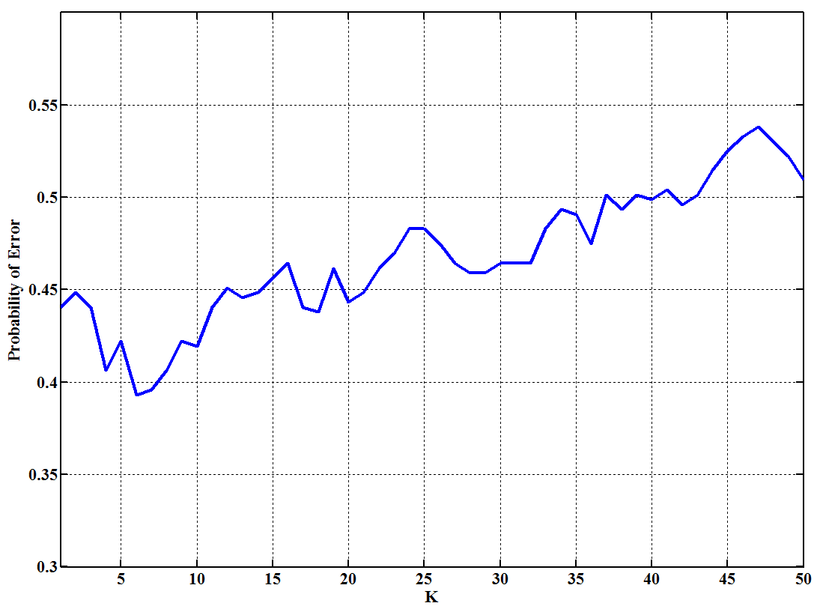
K Nearest Neighbor: Results Data Set 1
Minimum Error = 39.3%
K = 6

Slide 9
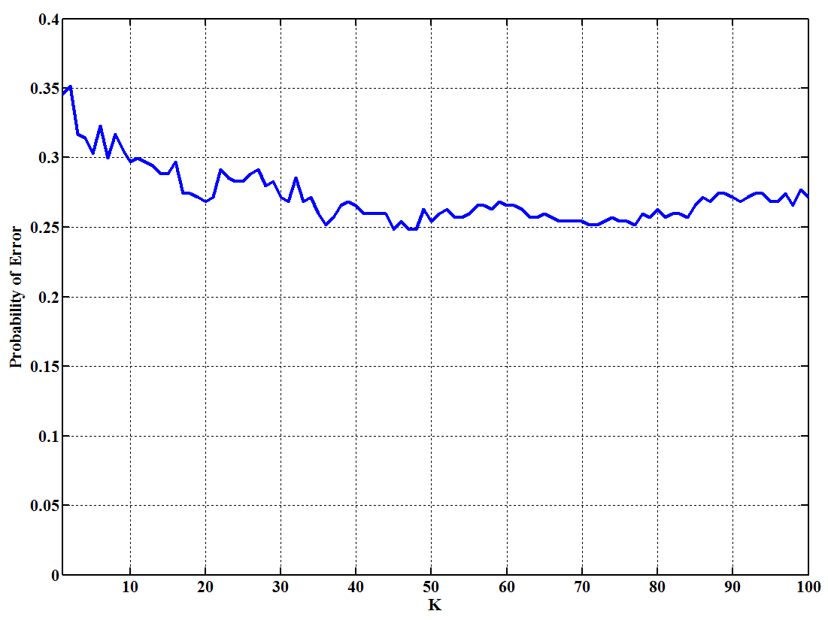
K Nearest Neighbor: Results Data Set 2
Minimum Error = 24.9%
K = 45, 47, and 48

Slide 10
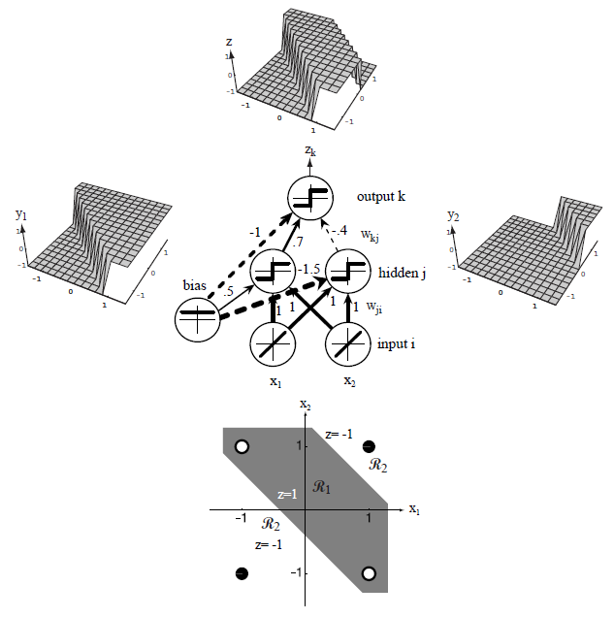
Neural Networks
A computational model inspired by Neuroscience
A large number of simple computational devices are interconnected
Proven that a neural network with an arbitrary number of hidden layers, each containing a sigmoidal neural function, can approximate any N-dimensional continuous function
Figures taken from Duda and Hart

Slide 11
Neural Networks: Algorithm
Architeture and Neural Functions kept constant
Single hidden layer with Tansig neural function / Single output layer with Softmax neural function
Vary number of neurons in hidden layer: [1, 5, 10, 100, 1000, 10000]
Training data is split into three sets: training set, validation set, and test set
Vary percentage of training set: [60, 70, 80, 90, 95]
Remaining data split 50/50 between validation and test set
Vary training function: [trainlm, trainbr, trainscg, trainrp]

Slide 12
Neural Networks: Results Data Set 1
 | Percentage of Data Used for Training
Number of Neurons in Hidden Layer |  | 60 | 70 | 80 | 90 | 95
 | 1 | 71.0 | 72.3 | 71.2 | 72.6 | 70.7
 | 5 | 56.5 | 58.8 | 56.5 | 50.9 | 56.2
 | 10 | 48.6 | 54.9 | 55.4 | 43.8 | 50.4
 | 100 | 40.4 | 44.1 | 42.5 | 43.0 | 42.0
 | 1000 | 48.8 | 45.9 | 45.1 | 44.6 | 46.4
 | 10000 | 71.2 | 69.1 | 77.0 | 68.3 | 87.9
These results are for the Scaled Conjugate Gradient Back Propagation (trainscg) training method, which is the default setting.

Slide 13
Neural Networks: Results Data Set 2
 | Percentage of Data Used for Training
Number of Neurons in Hidden Layer |  | 60 | 70 | 80 | 90 | 95
 | 1 | 58.0 | 57.7 | 56.3 | 56.6 | 56.6
 | 5 | 24.3 | 25.1 | 25.7 | 32.6 | 26.0
 | 10 | 21.7 | 22.3 | 22.6 | 24.0 | 31.4
 | 100 | 24.0 | 24.6 | 24.9 | 23.4 | 25.4
 | 1000 | 28.0 | 30.0 | 25.7 | 28.3 | 28.0
 | 10000 | 31.4 | 30.3 | 28.3 | 26.0 | 28.3
These results are for the Scaled Conjugate Gradient Back Propagation (trainscg) training method, which is the default setting.

Slide 14
Comparison of GMM, kNN, and NN
DATA SET 1
GMM: 54.4%
kNN: 39.3%
NN: 40.4%
DATA SET 2
GMM: 27.1%
kNN: 24.9%
NN: 21.7%

Slide 15
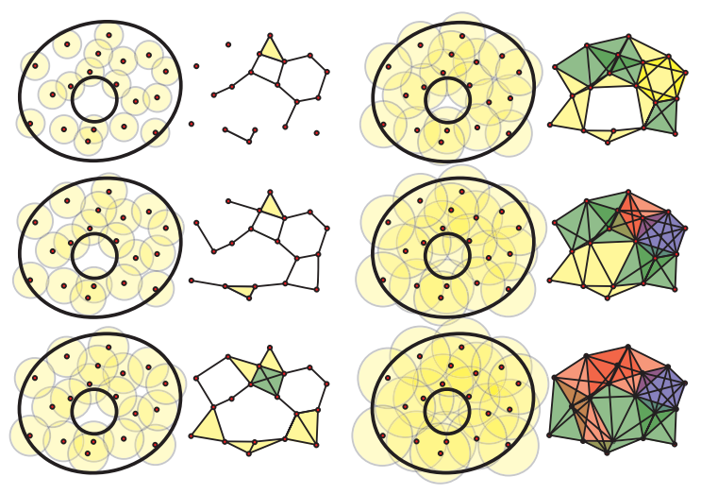
Topological Data Analysis
How does one visualize high dimensional data?
Can one infer high dimensional structure from low dimensional representations?
How can one infer global (possibly continuous) structure from local discrete points?
Tools from Algebraic Topology can attempt to answer these questions, using the JavaPlex software within Matlab
Image taken from Robert Ghrist ‘Barcodes: The Persistent Topology of Data’

Slide 16
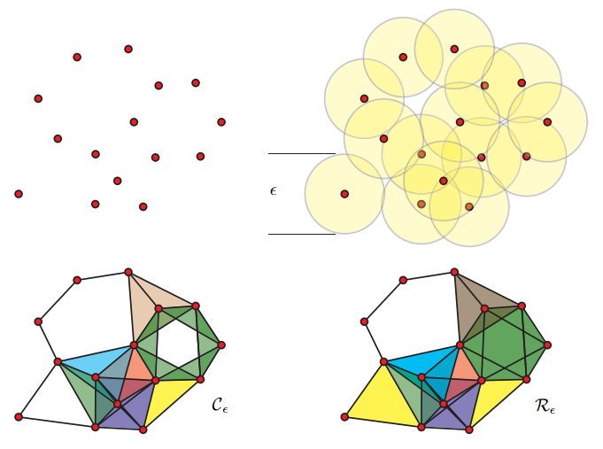
Topological Data Analysis: Preliminaries
Simplicial Complex
A space formed by gluing together points, lines, and faces.
Homology Group
For a space X and integer k we assign a vector space H_{k}(X). For a continuous function on spaces
f: X →Y, we get a map on homology groups
H_{k}(f): H_{k}(X) → H_{k}(Y)
Betti Number
Rank of the Homology Group. Informally, the kth Betti Number refers to the number of k dimensional holes in a space.
Image taken from Robert Ghrist ‘Barcodes: The Persistent Topology of Data’

Slide 17
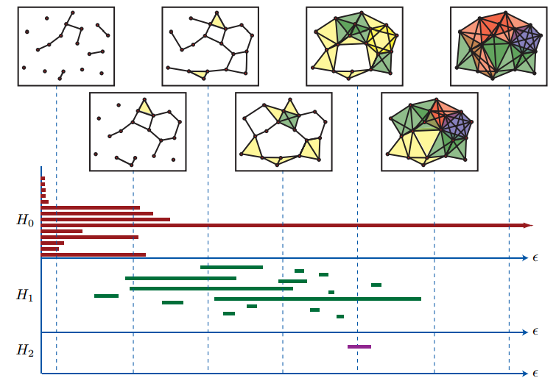
Topological Data Analysis: Preliminaries
Filtered Complex
A collection of ordered complexes, which is ordered by containment.
Persistent Homology
Computation of topological features of a space at different spatial resolutions.
Barcodes
Way of viewing the persistence as the spatial resolution increases.
Image taken from Robert Ghrist ‘Barcodes: The Persistent Topology of Data’

Slide 18
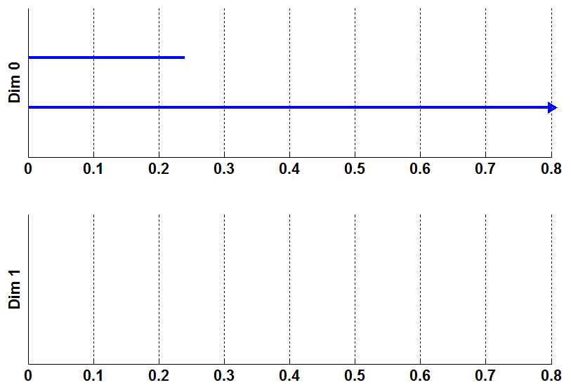
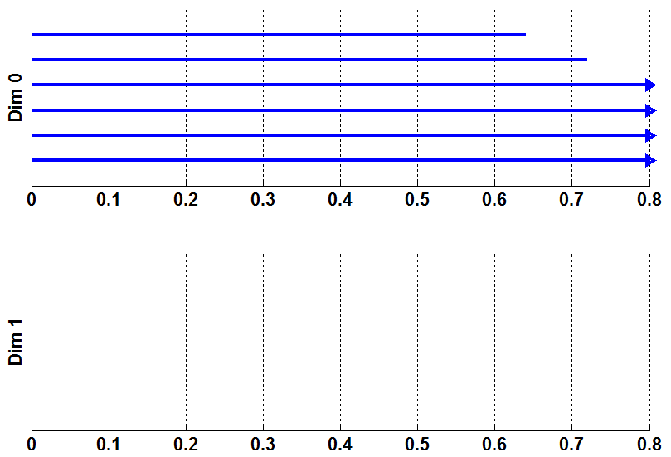
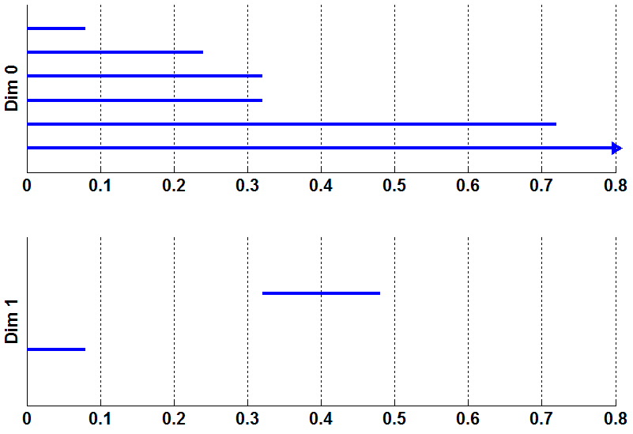
Topological Data Analysis: Results
Fig: Total Training Set
Fig: Class 1 in Training Set
Fig: Class 7 in Training Set
Class | Total | 1 | 2 | 3 | 4 | 5 | 6 | 7 | 8 | 9 | 10 | 11
0-Betti Number | 1 | 4 | 3 | 2 | 3 | 1 | 1 | 1 | 2 | 3 | 3 | 3

Slide 19
Thank you.
Questions?

