Slide 1
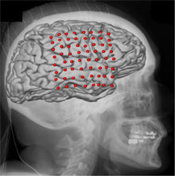
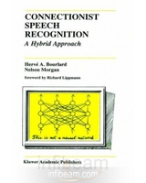
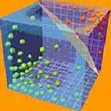
LECTURE 33: HYBRID ARCHITECTURES
Objectives:
Word Graph Generation
Lattices
Hybrid Systems
Resources:
ISIP: Search
URL:
Notes:
MS Equation 3.0 was used with settings of: 18, 12, 8, 18, 12.

Slide 2
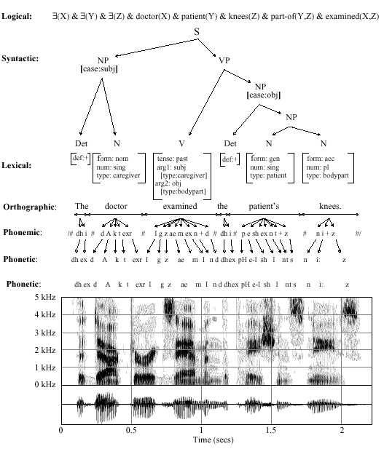
Integrating Domain Knowledge

Slide 3
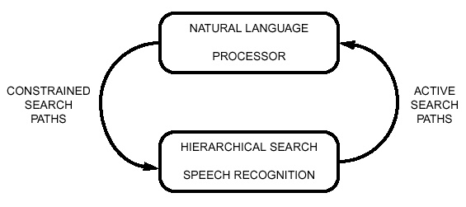
Loose Coupling of Systems

Slide 4
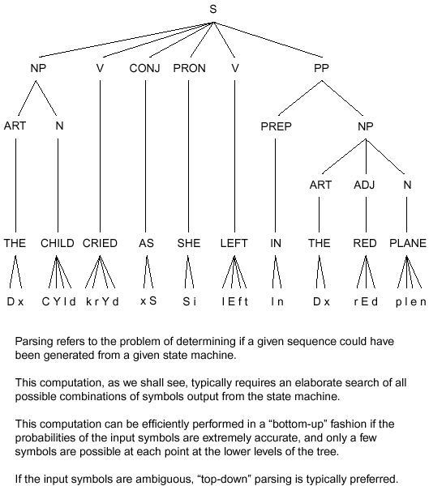
Classification of Systems

Slide 5
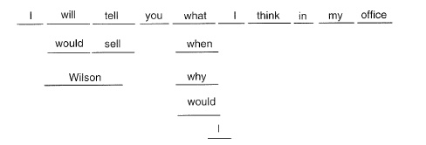
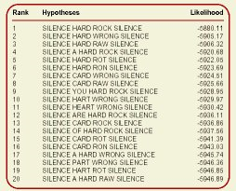
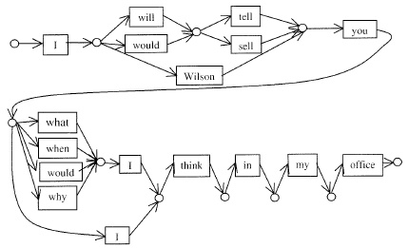
Time-Synchronous Stack Decoding

Slide 6
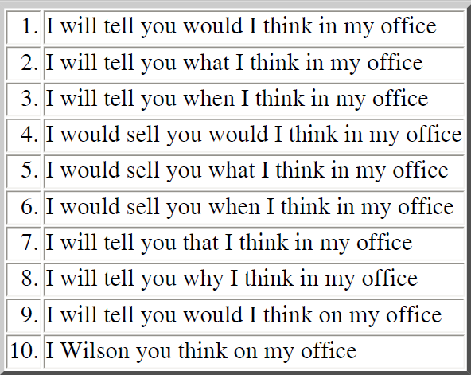
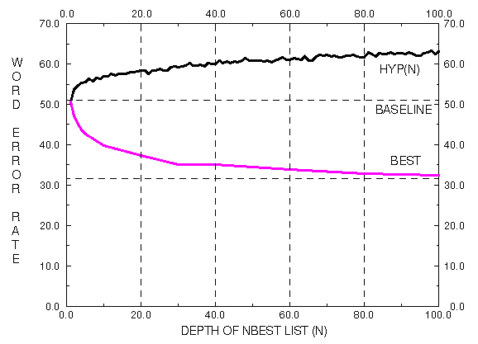
N-Best Lists

Slide 7
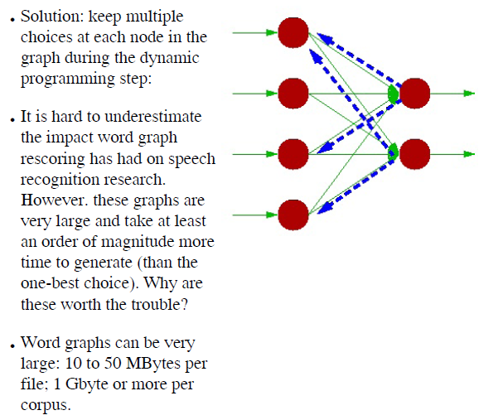
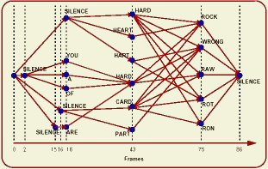
Lattice Generation

Slide 8
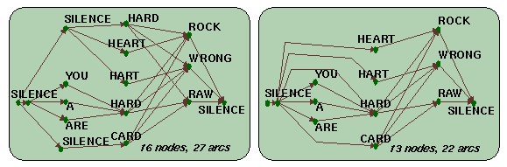
Word Graph Generation and Compaction

Slide 9
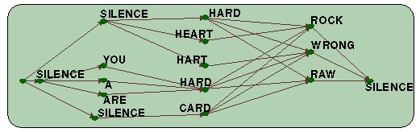
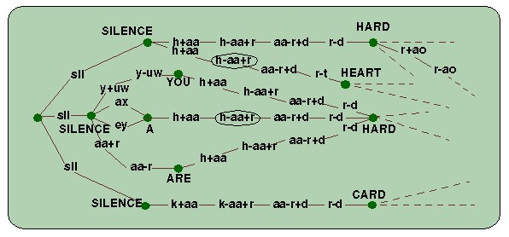
Rescoring Using Word Graphs

