Slide 1
Deploying Neural Network Architectures using PyTorch
Nabila Shawki
Neural Engineering Data Consortium
Temple University

Slide 2
Outline
Machine Learning/Deep Learning Pipeline
A Brief Introduction to PyTorch
Data Preparation
Model Design and Training
Decoding
Hyperparameter Tuning
Evaluation

Slide 3
Machine Learning/Deep Learning Pipeline
To successfully design and implement a machine learning model, researchers often follow the steps below:
Data collection
Data Preparation
Designing and training model
Evaluation
We will explore these steps using PyTorch.
Notes:
https://valohai.com/machine-learning-pipeline/
https://www.kaggle.com/pouryaayria/a-complete-ml-pipeline-tutorial-acu-86
https://machinelearningmastery.com/pytorch-tutorial-develop-deep-learning-models/

Slide 4
A Brief Introduction to PyTorch
PyTorch is a machine and deep learning library by Facebook’s AI Research Lab (FAIR).
PyTorch has gained popularity among the research community as it is easy to develop and debug machine learning models in PyTorch.
Nowadays, all state-of-the-art models and more are available in PyTorch and easy to integrate with any pipeline.
With proper seeding, PyTorch can generate reproducible models.
Like Tensorflow, a machine learning library by Google, PyTorch works with tensors which can be thought of as matrices with higher dimensions. These are equivalent to ndarrays in NumPy.
There are other deep learning framework available. For example, MATLAB can be used to design and train models.
Keras is a high-level API library that uses TensorFlow as backend and suitable for beginners. It is straightforward to build and test models using Keras. However, it can be difficult to debug in Keras.
Notes:
https://cs230.stanford.edu/blog/pytorch/
https://heartbeat.fritz.ai/10-reasons-why-pytorch-is-the-deep-learning-framework-of-future-6788bd6b5cc2
https://pytorch.org/tutorials/beginner/basics/tensorqs_tutorial.html

Slide 5
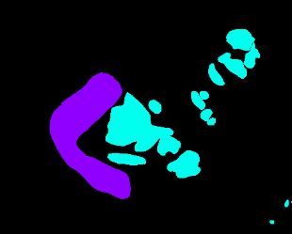
Data Collection and Preparation
The data in real world is messy. One needs to collect and prepare data in order to make the best use of machine learning models.
For example, the Whole Slide Images (WSIs) can be as big as 89262 x 208796 in size with multiple levels.
It is infeasible to train models with such data. We extract patches from the useful parts before we can move forward to train a model.
For this course, the text files need to be parsed and, the labels and the features need to be separated.
Annotated Slide
Mask
Extracted Patches

Slide 6
Batch Processing for Model Training
Once data preparation is complete, it needs to be fed to the model in minibatches.
PyTorch provides Dataset and DataLoader classes to streamline that process.
Custom Datasets can be implemented as per user requirement.
A Dataset class must have three functions:
__init__
__len__
__getitem__
DataLoader uses the Dataset class to retrieve labels and samples.
Notes:
https://pytorch.org/tutorials/beginner/basics/data_tutorial.html

Slide 7
Model Design and Implementation in PyTorch
Models are designed as classes in PyTorch with a forward function.
A loss function and an optimizer with a learning rate must be selected to train the model.
Special functions like optimizer.zero_grad(), loss.backward(), and optimizer.step(), model.train(), model.eval(), and context managers are essential in PyTorch to train a model.
We normally use three types of data sets:
Training set
Development set
Evaluation set
20-25% of the training set data should be separated for validation.
The best weights can be chosen based on loss, error rate, or accuracy.
Once the model is trained, we decode and score the development set.
When the score of dev set is satisfactory, we then decode and score the eval set.
Notes:
https://pytorch.org/tutorials/beginner/basics/data_tutorial.html
https://pytorch.org/tutorials/beginner/transfer_learning_tutorial.html

Slide 8
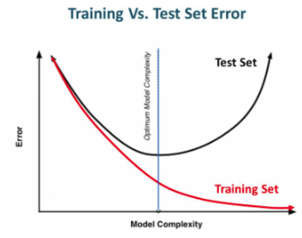
Hyperparameter Tuning
Hyperparameters play a crucial part on the performance of the model.
Simply seeding the random number generators with different initial values can impact the performance of the model.
Hyperparameters include but not limited to:
By carefully selecting these hyperparameters and using techniques like early stopping and validation, we can avoid overfitting and underfitting.
Learning rate Number of epochs Batch Size | Optimizer selection Number of layers Dropout Layers
Notes:
https://medium.com/@jorgesleonel/hyperparameters-in-machine-deep-learning-ca69ad10b981
https://medium.com/@jorgesleonel/bias-variance-in-machine-learning-656a1b58e1c9

