Slide 1

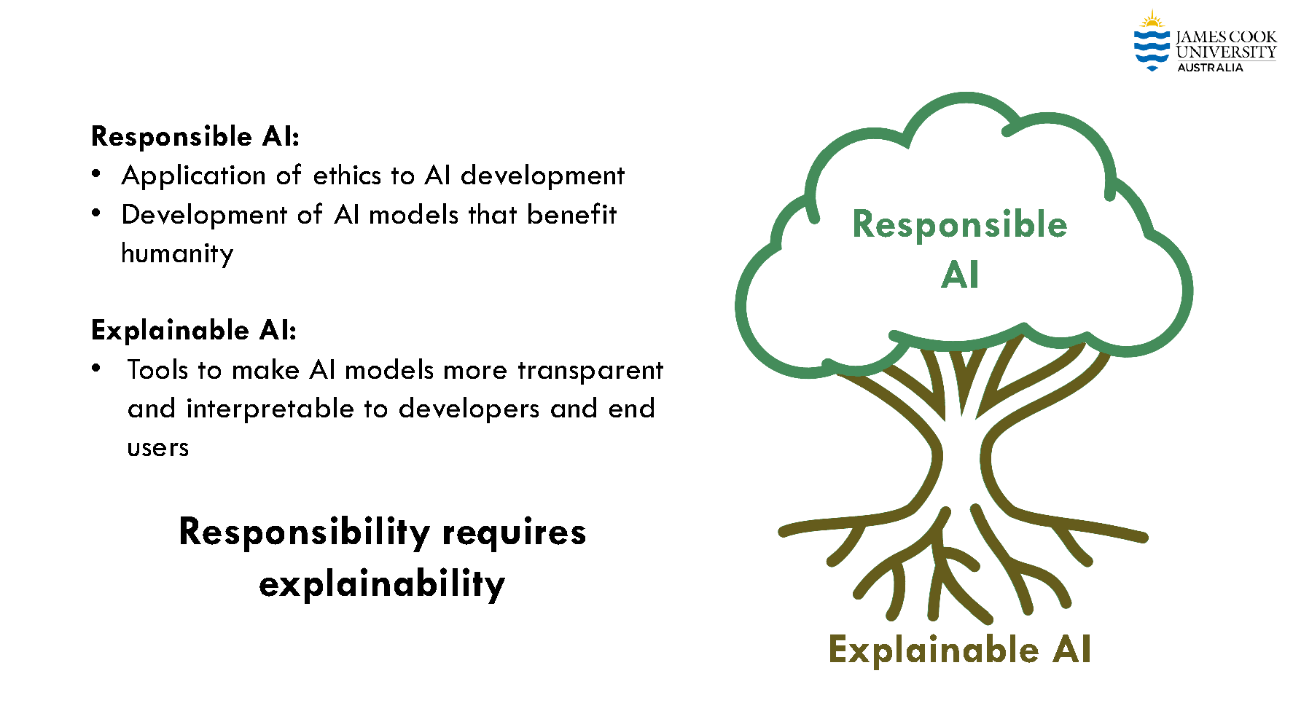
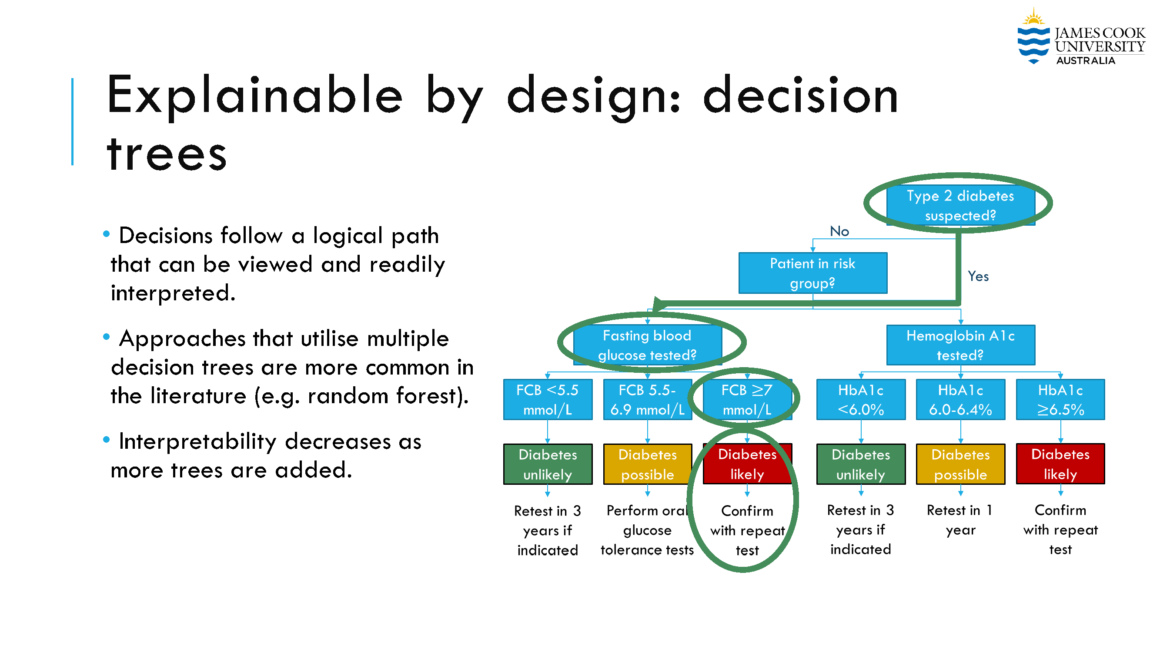
Lecture 37: Explainability in AI
Objectives:
Explainability
Responsibility
Fairness
Six Principles of Responsible AI
Video:
Baker, IEEE SPMB 2024
Resources:
Baker: Explainability in AI
Hoiem: Ethics of AI

