Slide 1
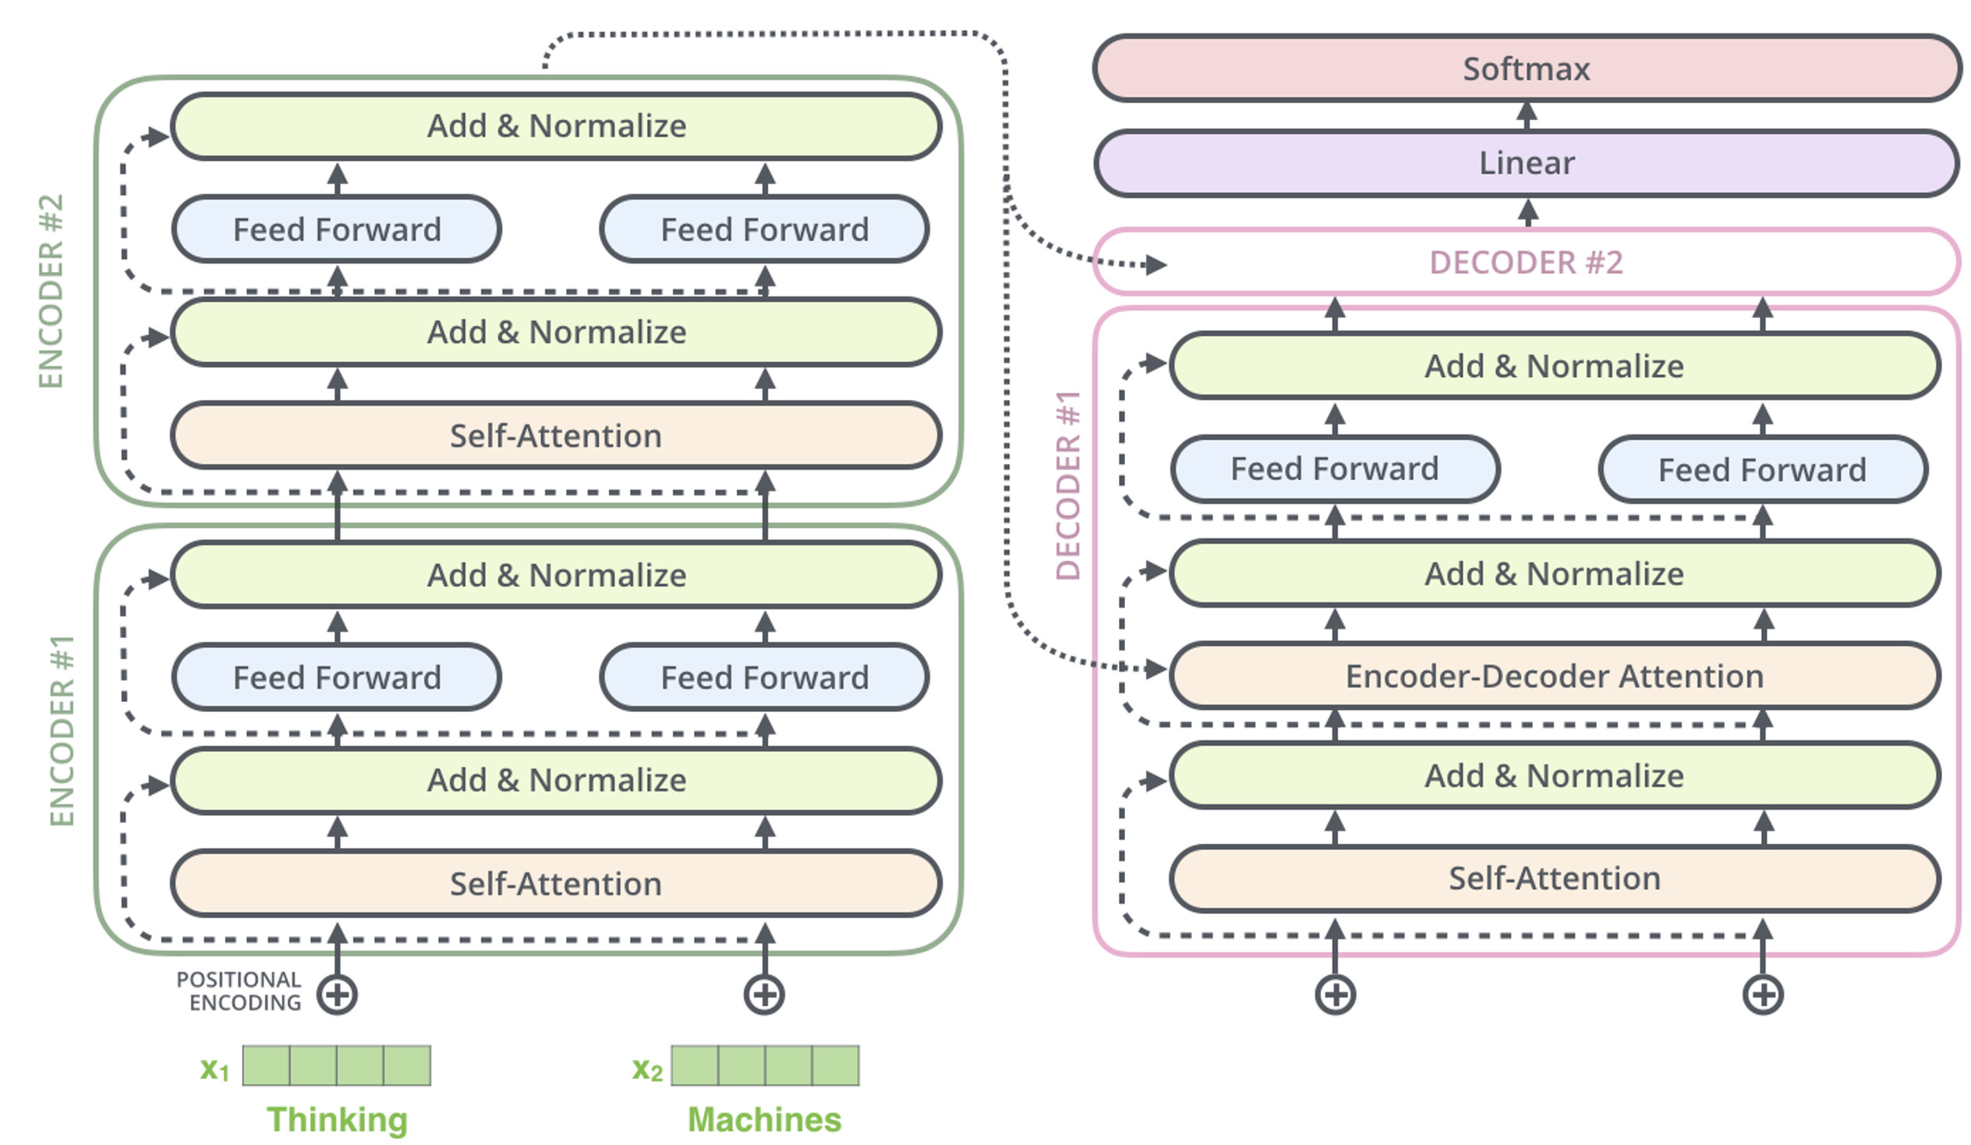
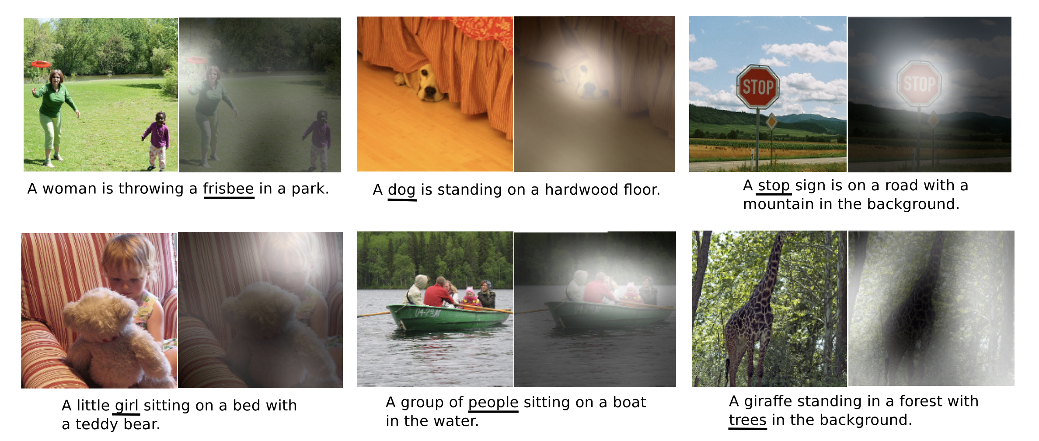
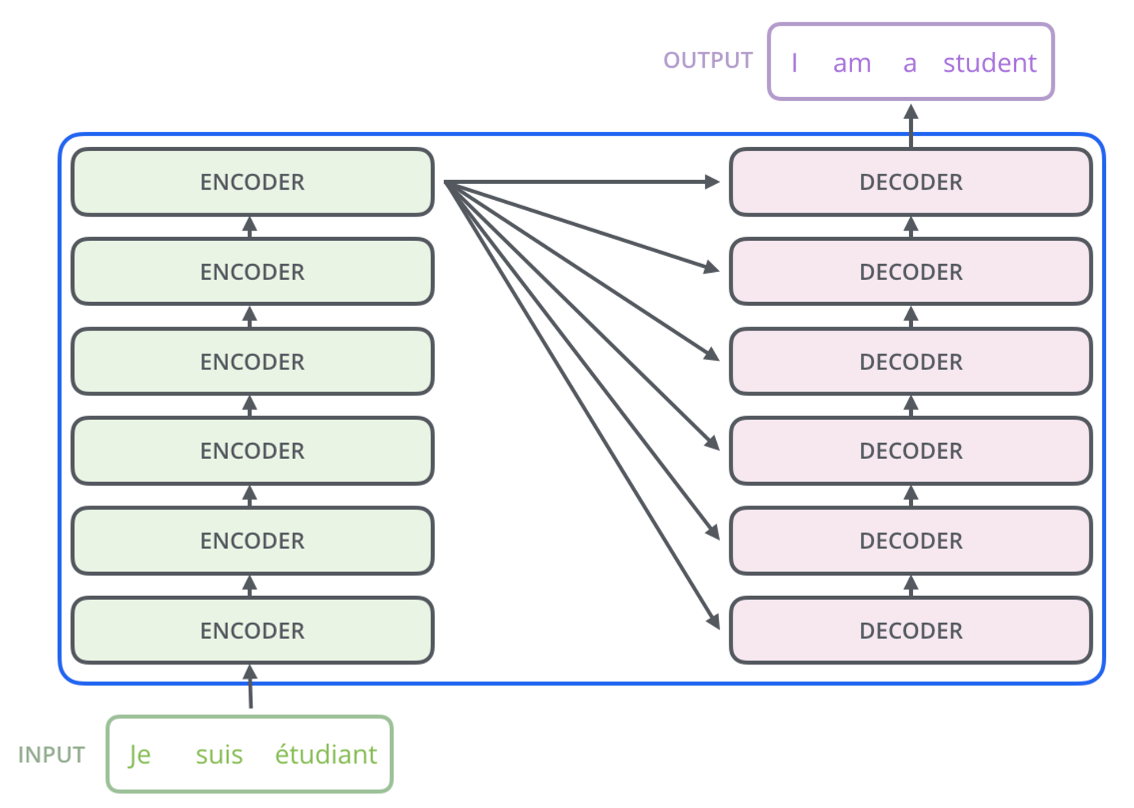
Lecture 36: Transformer Architectures
Objectives:
Alternate Transformer Architectures
Modeling Long-Term Context
Resources:
Wiki: Transformers
Medium: What is a Transformer?
A.K.: Modeling Sequences
M.L.: Deep Learning for Biotech
S.W.: Deep Learning

Slide 2
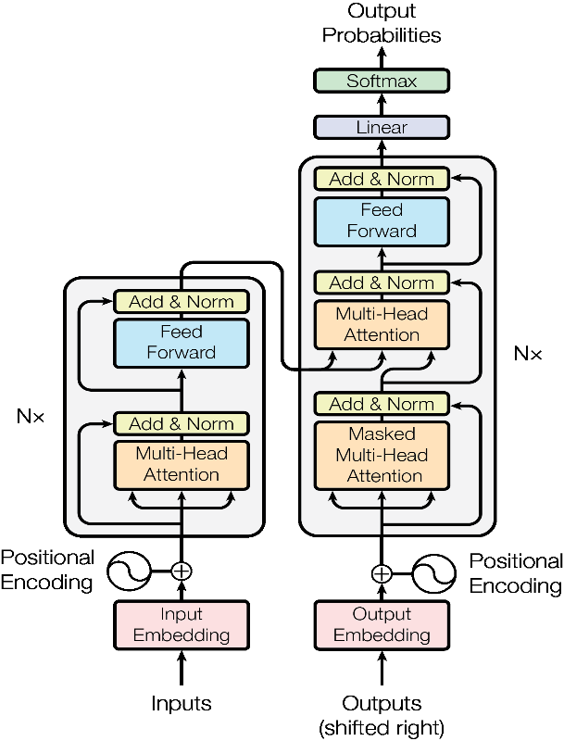
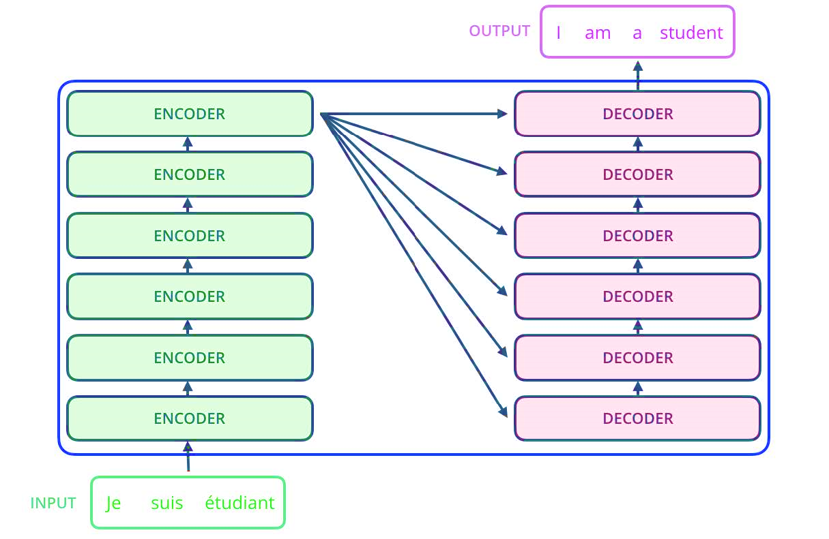
A Typical Transformer Network
Encoder:
Decoder:

Slide 3
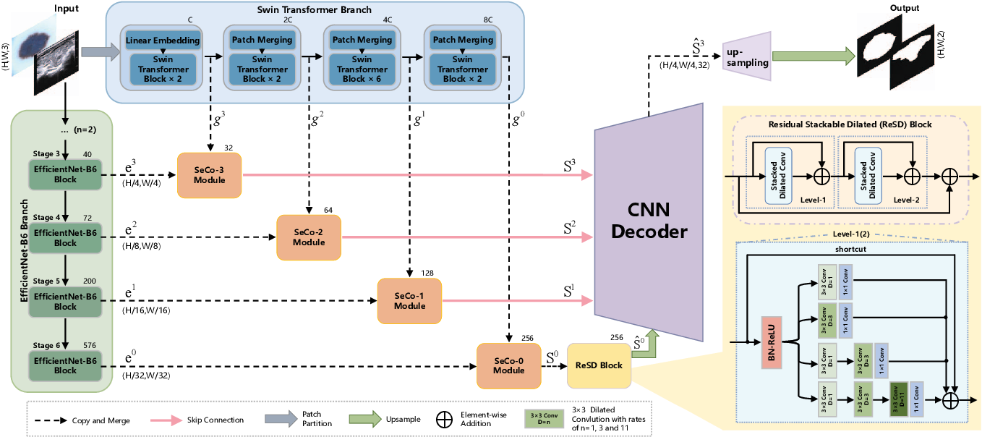
LogTrans
Dual-branch design with Separate-Combiner (SeCo) module
Biomedical image segmentation
Enhanced accuracy and robustness

Slide 4
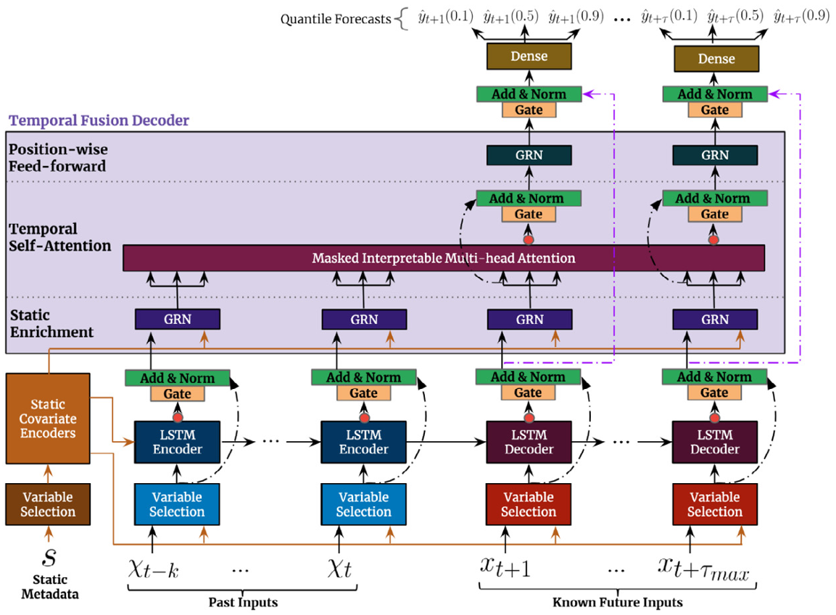
Temporal Fusion Transformer
Gated Residual Networks, LSTM, Multi-Head Attention
Time series forecasting
Superior forecasting abilities, handles missing data

Slide 5
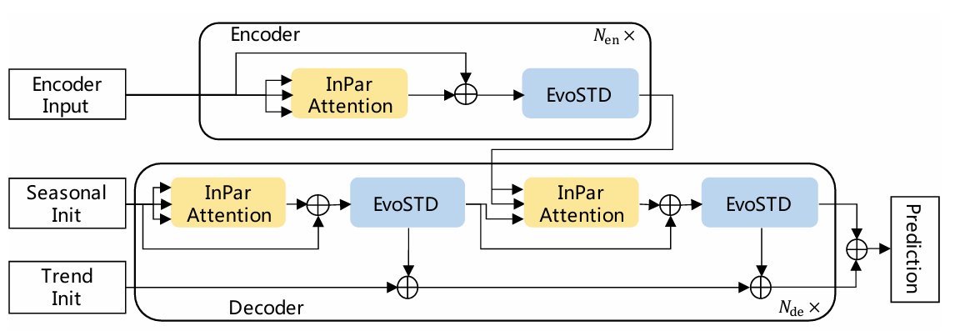
InParformer
Interactive Parallel Attention
Long-term time series forecasting
Efficiency and interpretability in forecasting

Slide 6
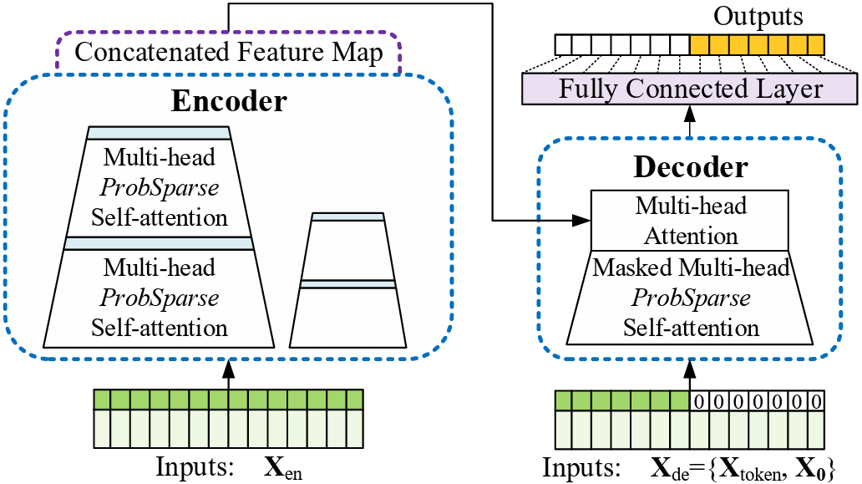
Informer
ProbSparse self-attention, distilling
Long-term series forecasting
Reduced computational complexity, high performance

Slide 7
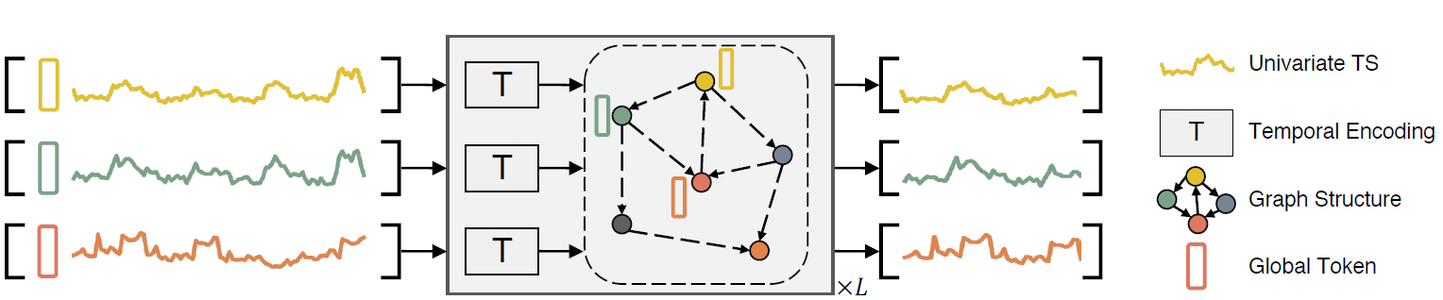
Series Aware Framework
SageFormer leverages graph structures to discern and model complex rela-tionships between different series
Captures diverse temporal patterns while filtering out redundant information
Integrates seamlessly with existing transformer-based models, enhancing their ability to understand inter-series relationships
This integration enriches the models without significantly increasing complexity.
Through extensive experiments on real-world and synthetic datasets, SageFormer demonstrates superior forecasting performance compared to contemporary state-of-the-art approaches.

Slide 8
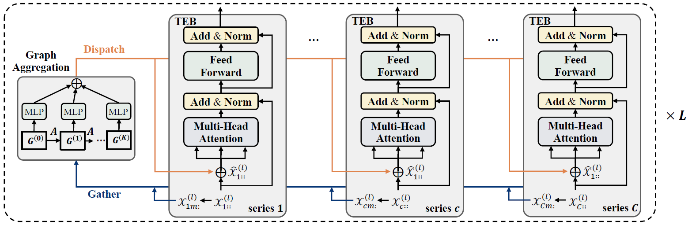
SageFormer
Unlike in traditional Transformer architecture where input token are obtained by projecting input time series in a patch, the Sageformer integrates global tokens to enhance series awareness.
It uses an iterative message-passing process.
Graph Structure Learning employs end-to-end learning of the adjacency matrix to capture relationships across series without prior knowledge.
Features versatility.

Slide 9
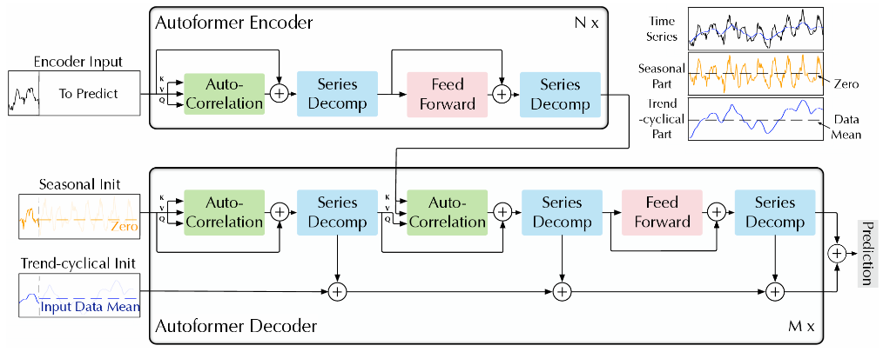
Autoformer
Decomposition architecture, Autocorrelation
Time series forecasting
Improved accuracy on periodicity and dependencies

Slide 10
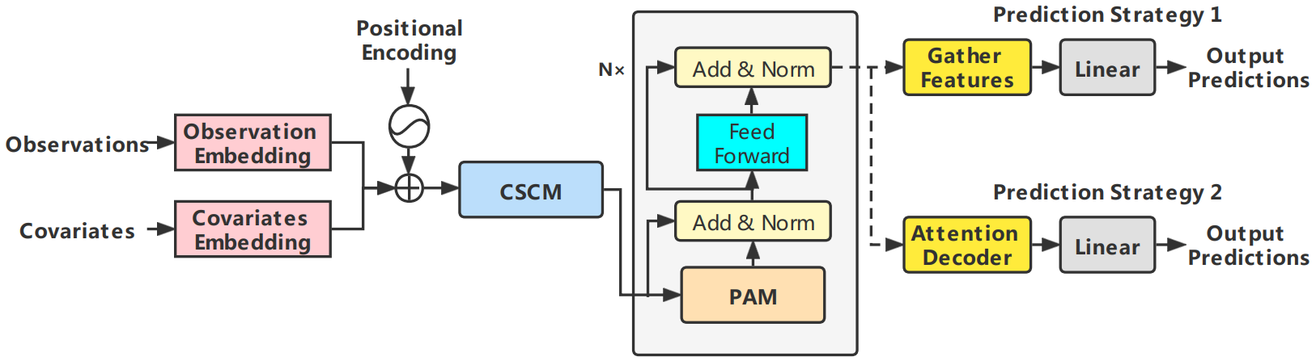
Pyraformer
Pyramidal attention mechanism
Time series forecasting
Efficient long-range dependency capture

Slide 11
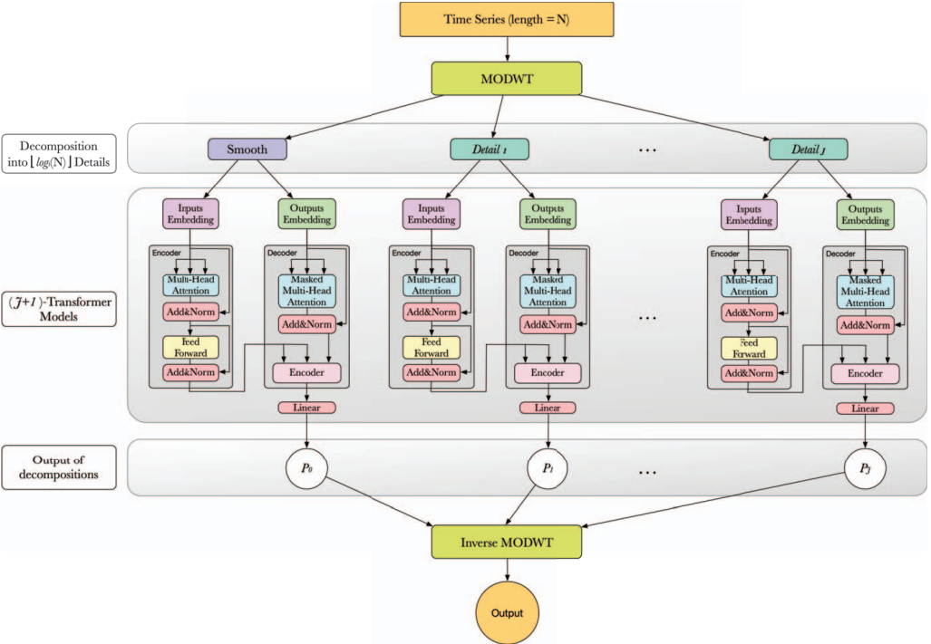
W-Transformer
Wavelet-based preprocessing
Non-stationary time series forecasting
Effective capture of local and global dependencies

Slide 12
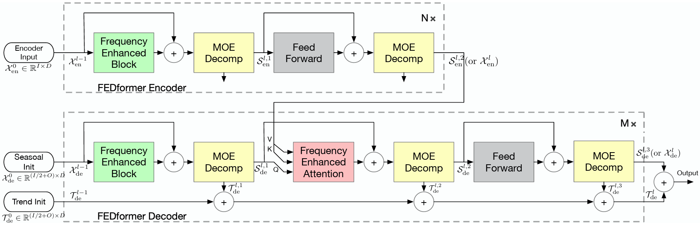
Fedformer
Seasonal-trend decomposition, frequency domain analysis
Long-term series forecasting
High efficiency and accuracy

Slide 13
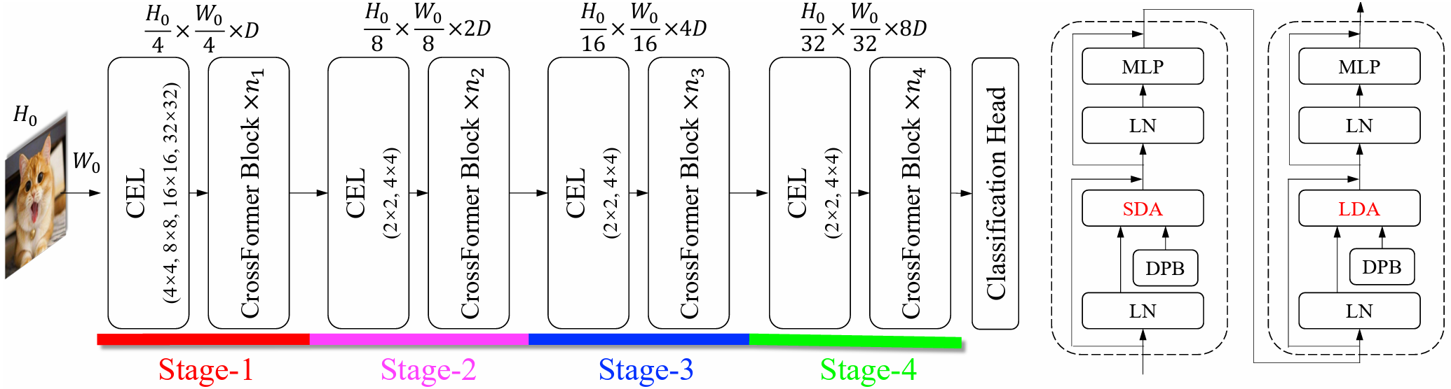
Crossformer
Cross-scale attention mechanisms
Image classification and segmentation
Efficient processing of features across scales

Slide 14
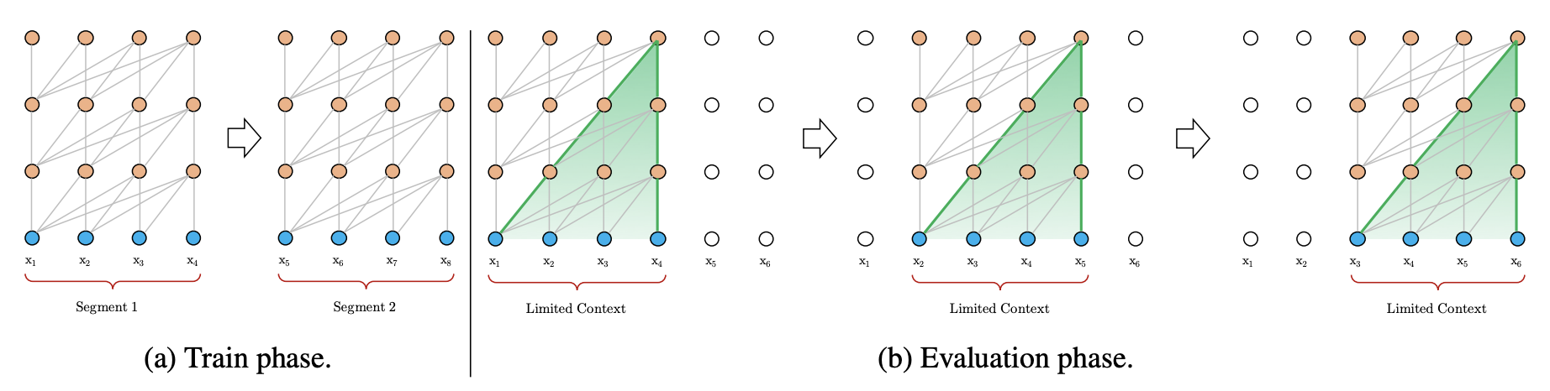
Transformer-XL
Segment-level recurrence, relative positional encoding
Language modeling
Capture of longer-term dependencies, improved performance

Slide 15
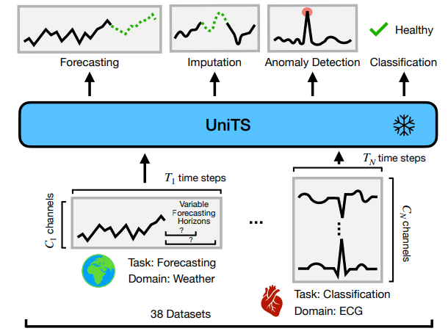
UniTS
Unified Transformer-based time series model
Supports a universal task specification as well as domain specification, accommodating classification, forecasting, imputation, anomaly detection

Slide 16
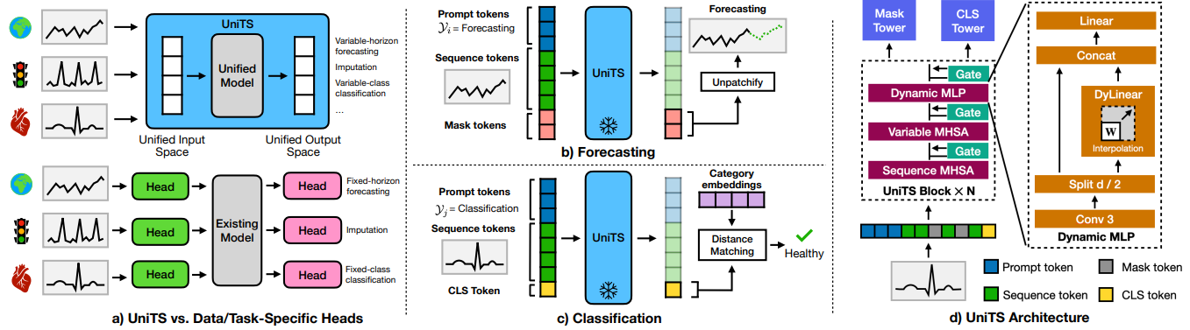
UniTS
Unified Transformer-based time series model
Supports a universal task specification as well as domain specification, accommodating classification, forecasting, imputation, anomaly detection

Slide 17
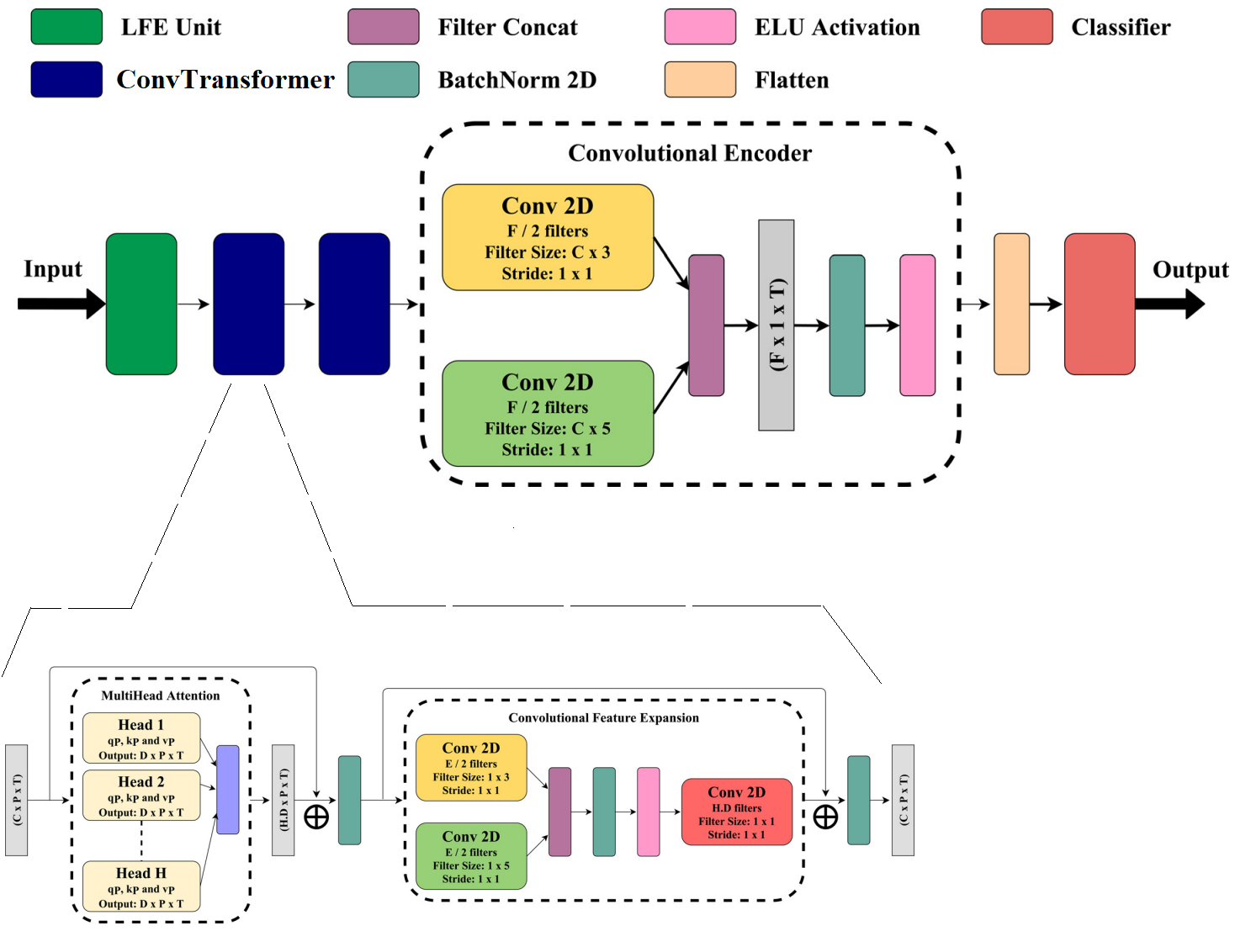
EEG Conv

Slide 18
EEG-ConvTransformer
Designed for EEG data
Replaces the MLP block with a Feature Expansion Block
Integrates numerous convolutional blocks

Slide 19
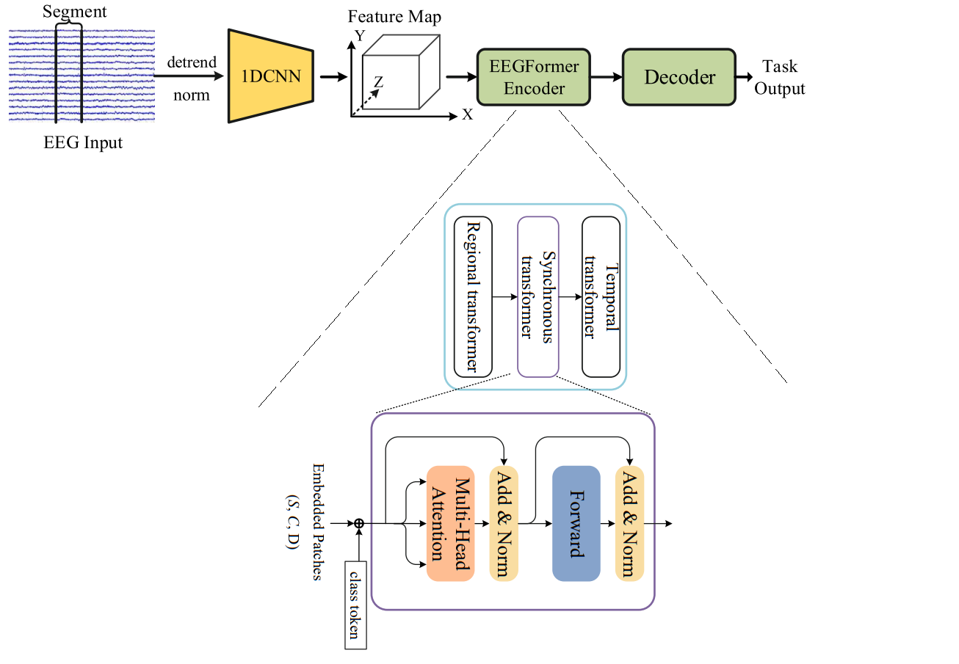
EEGFormer
Similar to EEG-ConvTransformer
The input is first processed by a depth-wise CNN (1DCNN) unit to conduct preliminary feature extraction from the raw data.
The output of the 1DCNN unit then passes through the EEGformer Encoder, which comprises three transformer units for feature extraction from different dimensions.
EEGformer uses a traditional transformer architecture without modifications.

Slide 20
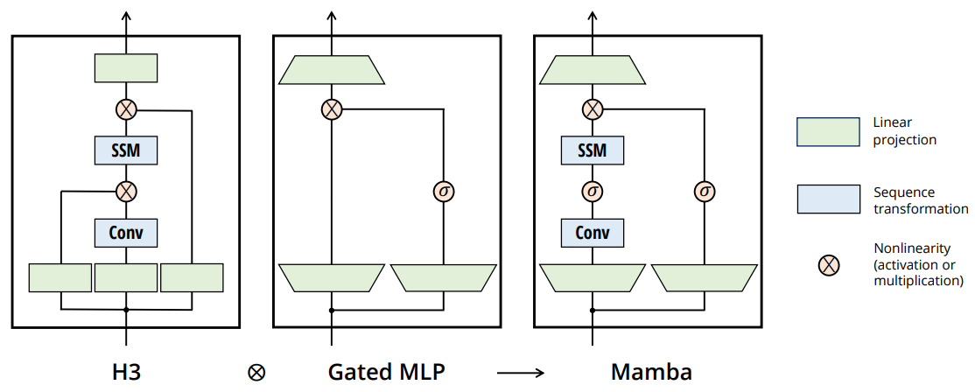
Mamba
Developed to enhance the efficiency of the Transformer architecture.
While the self-attention mechanism in Transformers is powerful, it comes with a high computational cost due to its quadratic complexity.
In contrast, Mamba can model long-sequence dependencies like the Transformer but with a near-linear computational complexity, resulting in significantly higher speed and efficiency.
Growing interest in using Mamba for time series analysis.

Slide 21
Summary
Introduced a large assortment of transformer architectures designed to efficiently model context.

