Slide 1
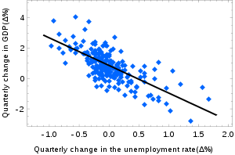
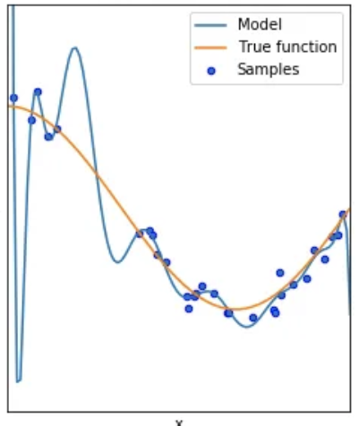
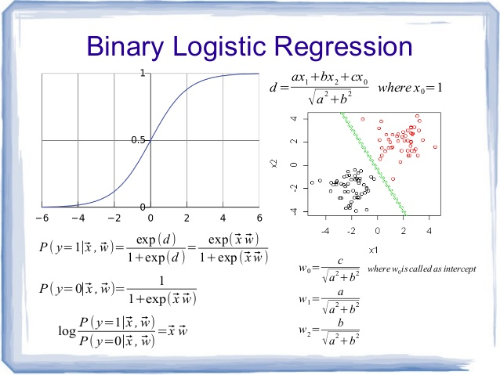
Lecture 27: Linear and Logistic Regression
Objectives:
The Linear Regression Model
Least Squares Solution
The Logistic Regression Model
Multiclass Logistic Regression
Resources:
Textbook (Sections 3.1 – 3.A)
RealPython: Linear Regression in Python
RealPython: Logistic Regression in Python

Slide 2
Notes
See Sections 3.1- 3.A in the textbook.

Slide 3
Summary
Linear regression using simple metrics like mean square error often results in closed-form solutions for optimal parameters.
Many alternate forms of linear regression exist including linear prediction and least mean-square error analysis.
It is closely related to maximum likelihood parameter estimation if we assume Gaussian statistics.
Logistic regression is used to convert binary data, or categorical data, to a form that enables application of regression techniques.

