Slide 1
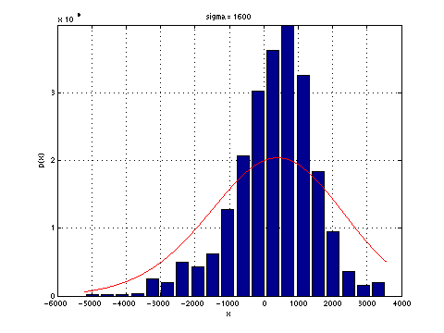
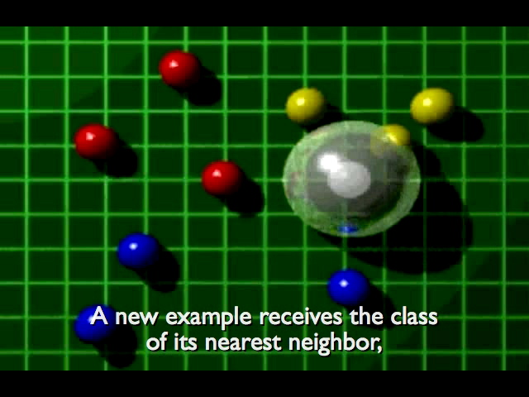
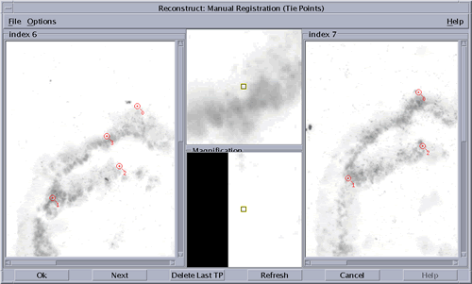
Lecture 19: Introduction to Nonparametric Techniques
Objectives:
Density Estimation
Parzen Windows
k-Nearest Neighbor
Properties of Metrics
Resources:
Textbook (Sections 2.1, 2.2)
Sellner: Parzen Windows
Teknomo: K-Nearest Neighbor Rule
TutorialsPoint: KNN Tutorial

Slide 2
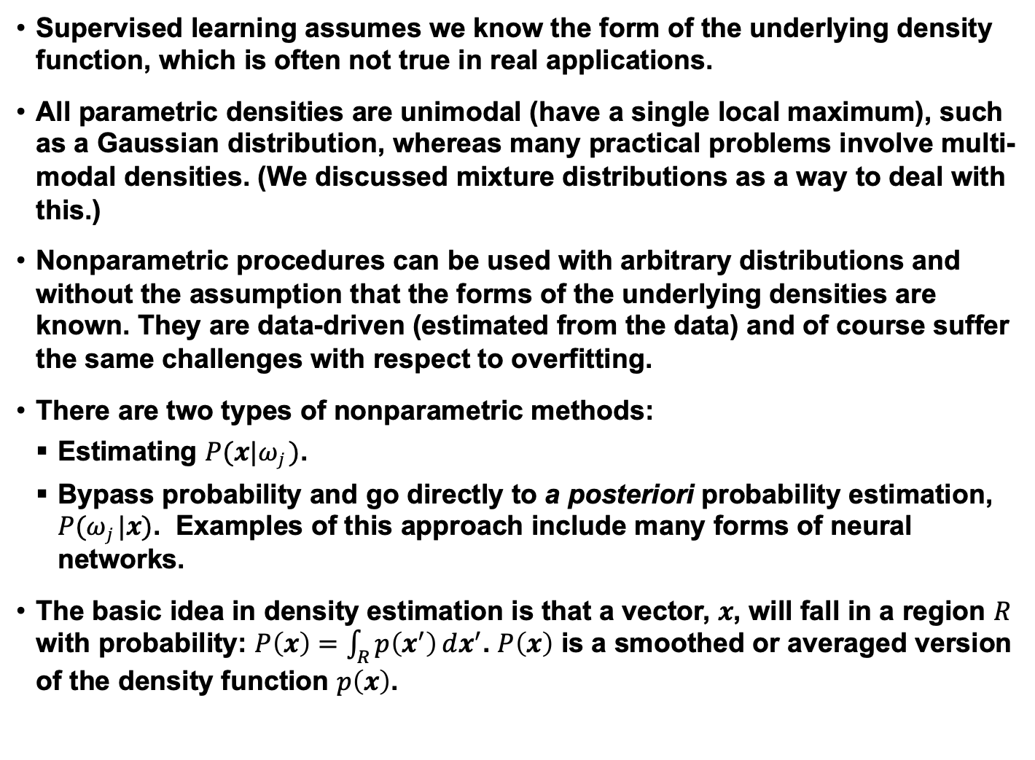
Principles of Density Estimation
Supervised learning assumes we know the form of the underlying density function, which is often not true in real applications.
All parametric densities are unimodal (have a single local maximum), such as a Gaussian distribution, whereas many practical problems involve multi-modal densities. (We discussed mixture distributions as a way to deal with this.)
Nonparametric procedures can be used with arbitrary distributions and without the assumption that the forms of the underlying densities are known. They are data-driven (estimated from the data) and of course suffer the same challenges with respect to overfitting.
There are two types of nonparametric methods:
  Estimating $P(x|ωj )$.
  Bypass probability and go directly to a posteriori probability estimation,
  $P(ωj |x)$. Examples of this approach include many forms of neural networks.
  The basic idea in density estimation is that a vector, $x$, will fall in a region $R$ with probability: $P\left(x\right)=\int_{R}{p\left(x^{′}\right)ⅆx^{′}}$. $P\left(x\right)$ is a smoothed or averaged version
  of the density function $p\left(x\right)$.

Slide 3
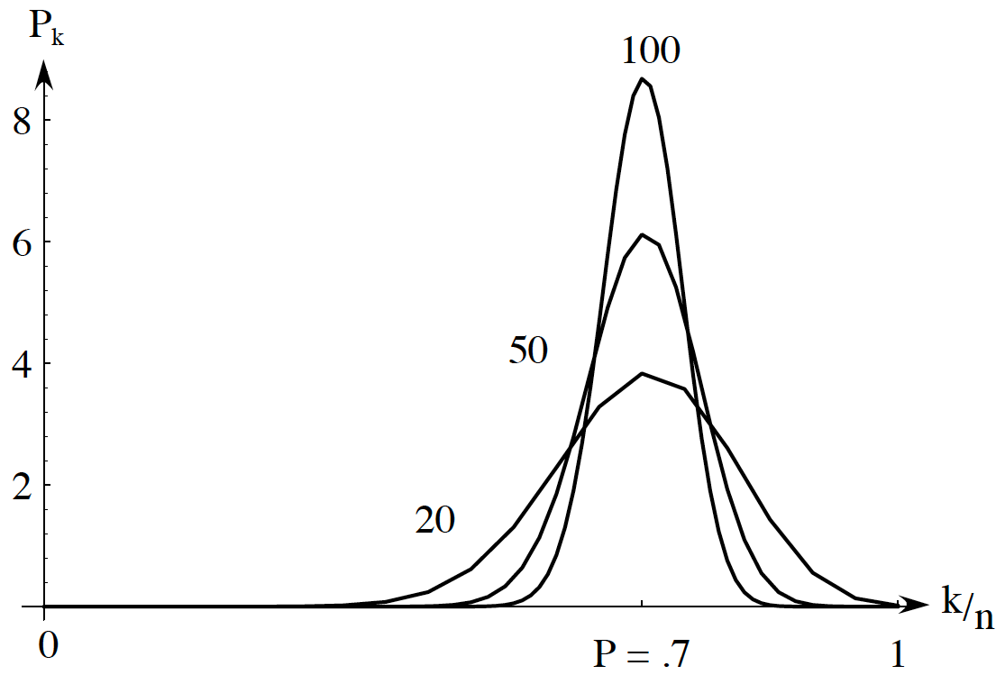

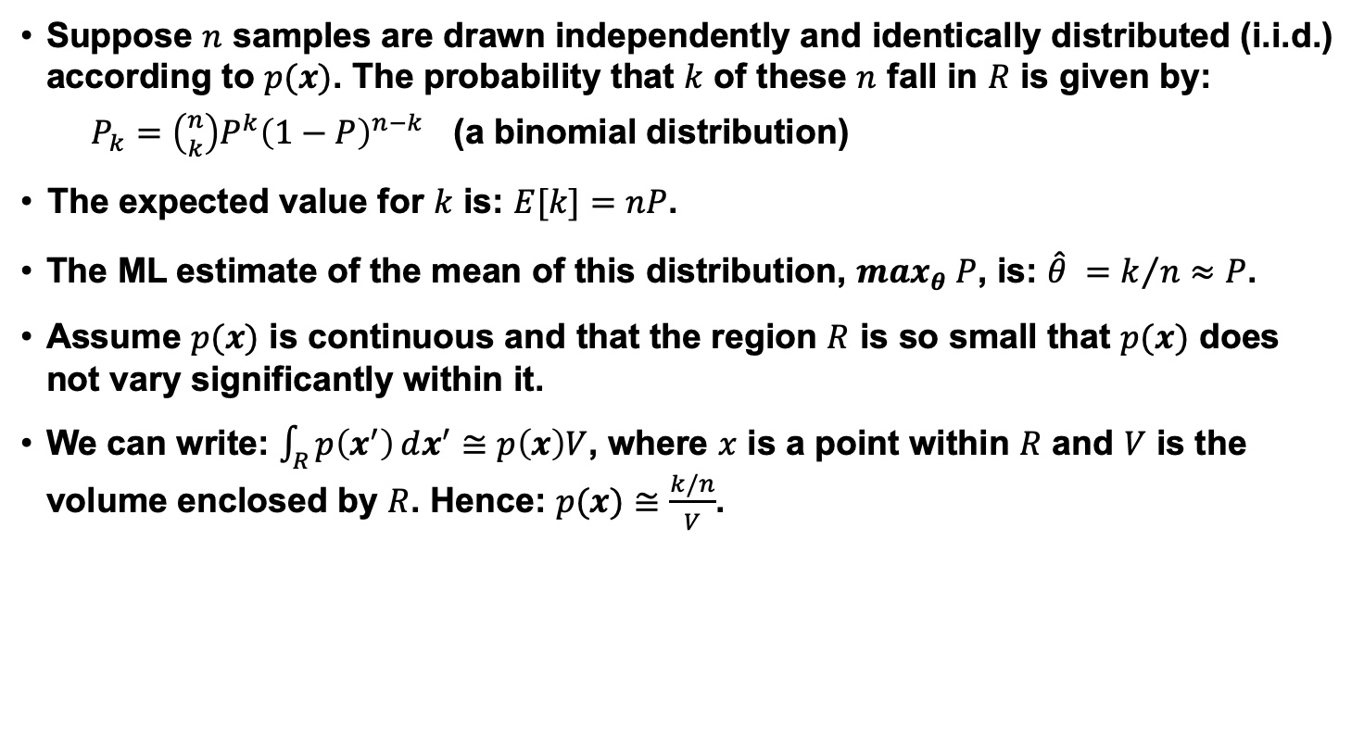
Motivation Based on a Binomial Distribution
  Suppose $n$ samples are drawn independently and identically distributed (i.i.d.) according to $p(x)$. The probability that $k$ of these $n$ fall in $R$ is given by:
  $P_{k}=\left({n \atop k}\right)P^{k}{\left(1−P\right)}^{n−k}$ (a binomial distribution)
  The expected value for $k$ is: $E[k]=nP$.
  The ML estimate of the mean of this distribution, $\max_{θ} P$, is: $\hat{θ} =k/n≈P$.
  Assume $p(x)$ is continuous and that the region $R$ is so small that $p(x)$ does not vary significantly within it.
  We can write: $\int_{R}{p\left(x^{′}\right)ⅆx^{′}}≅$ $p\left(x\right)V$, where $x$ is a point within $R$ and $V$ is the volume enclosed by $R$. Hence: $p(x)≅\frac{k/n}{V}$.
The probability $P_{k}$ of finding $k$ patterns in a volume where the space averaged probability is $P$ as a function of $k/n$.
  The true probability, $P$, was chosen to be $0.7$. We see the binomial distribution peaks strongly at the true probability, and the variance shrinks as n increases.

Slide 4
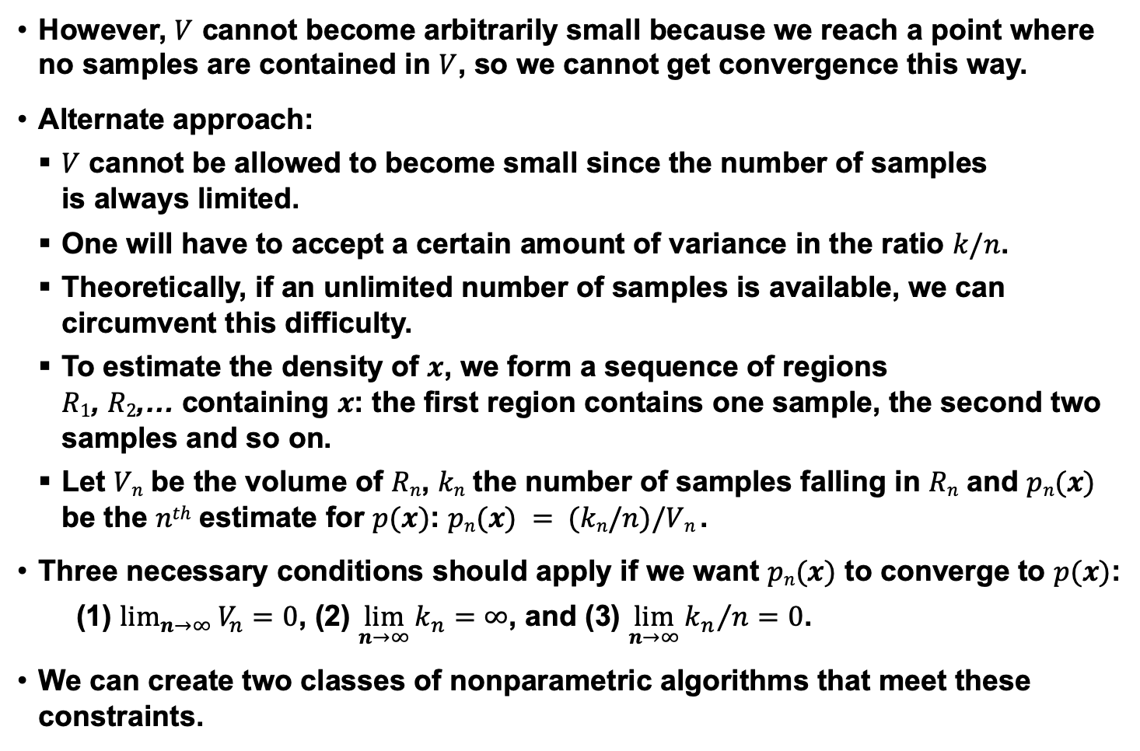
Principles for Defining a Volume (Bin Size)
  However, $V$ cannot become arbitrarily small because we reach a point where no samples are contained in $V$, so we cannot get convergence this way.
  Alternate approach:
  $V$ cannot be allowed to become small since the number of samples
  is always limited.
  One will have to accept a certain amount of variance in the ratio $k/n$.
  Theoretically, if an unlimited number of samples is available, we can circumvent this difficulty.
  To estimate the density of $x$, we form a sequence of regions
  $R1$, $R2$,… containing $x$: the first region contains one sample, the second two samples and so on.
  Let $Vn$ be the volume of $Rn$, $kn$ the number of samples falling in $Rn$ and $pn(x)$ be the $nth$ estimate for $p(x)$: $pn(x) = (kn/n)/Vn$.
  Three necessary conditions should apply if we want $pn(x)$ to converge to $p(x)$:
  (1) $\lim_{n→∞}{V_{n}=0}$, (2) $\lim_{n→∞}{k_{n}=∞}$, and (3) $\lim_{n→∞}{{k_{n}}/n=0}$.
  We can create two classes of nonparametric algorithms that meet these constraints.

Slide 5
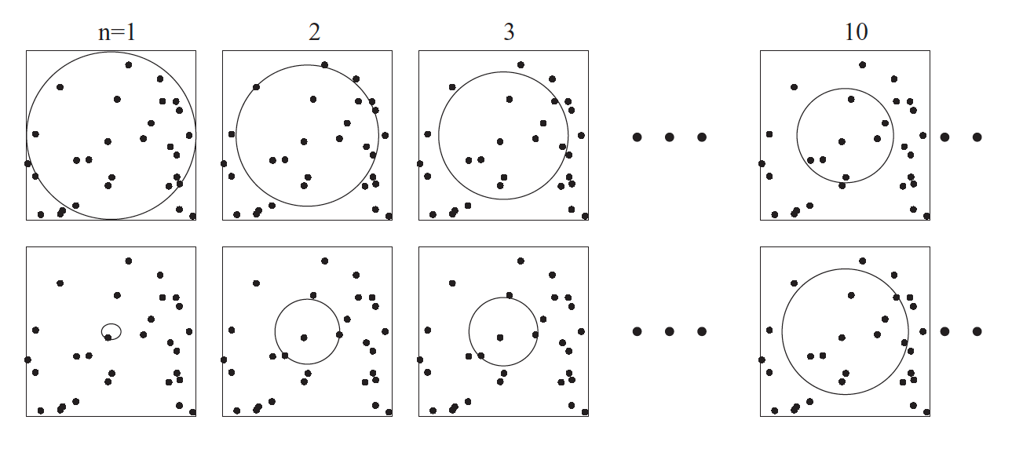
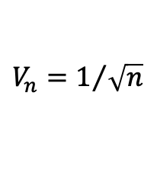
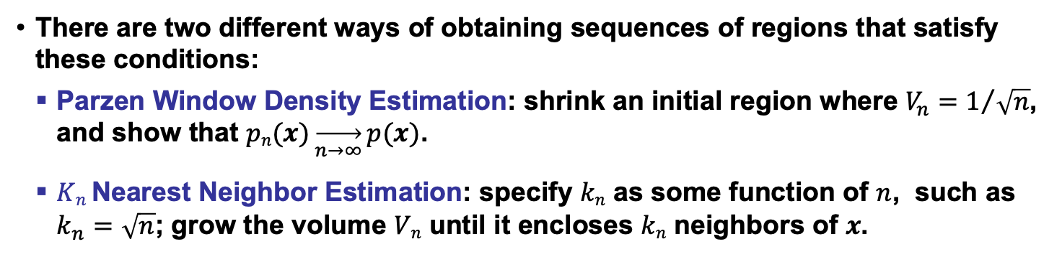

Methods for Defining a Volume Size
  There are two different ways of obtaining sequences of regions that satisfy these conditions:
  Parzen Window Density Estimation: shrink an initial region where $V_{n}=1/{\sqrt{n}}$, and show that $pn(x)\overset{→}{n→∞}p(x)$.
  $Kn$ Nearest Neighbor Estimation: specify $kn$ as some function of $n$, such as $k_{n}=\sqrt{n}$; grow the volume $Vn$ until it encloses $kn$ neighbors of $x$.
$$V_{n}=1/{\sqrt{n}}$$
$$k_{n}=\sqrt{n}$$

Slide 6
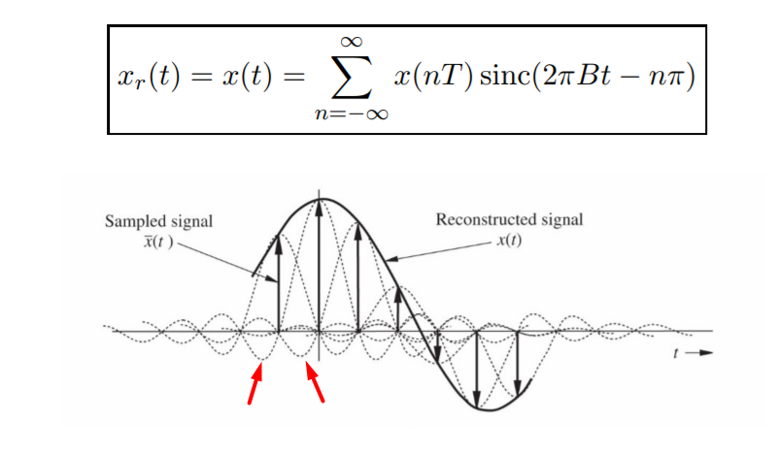
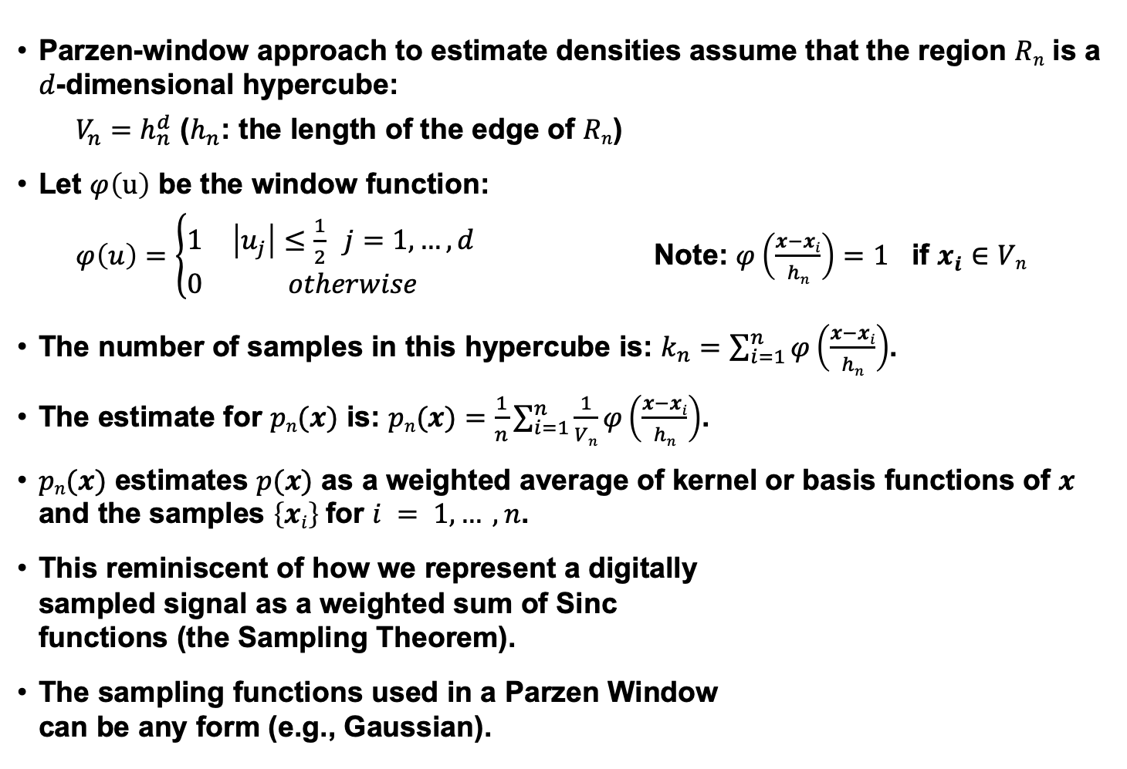
Parzen Windows
  Parzen-window approach to estimate densities assume that the region $Rn$ is a $d$-dimensional hypercube:
  $V_{n}=h_{n}^{d}$ ($h_{n}$: the length of the edge of $Rn$)
  Let $φ\left(u\right)$ be the window function:
  $φ\left(u\right)=\left\{\begin{matrix}1 & \left|u_{j}\right|≤\frac{1}{2} j=1,…,d \\ 0 & otherwise\end{matrix}\right.$ Note: $φ\left(\frac{x−xi}{hn}\right)=1$ if $x_{i}∈Vn$
  The number of samples in this hypercube is: $k_{n}=\sum_{i=1}^{n}{φ\left(\frac{x−xi}{hn}\right)}$.
  The estimate for $pn(x)$ is: $pn(x)=\frac{1}{n}\sum_{i=1}^{n}{\frac{1}{Vn}φ\left(\frac{x−xi}{hn}\right)}$.
  $pn(x)$ estimates $p(x)$ as a weighted average of kernel or basis functions of $x$ and the samples $\left\{xi\right\}$ for $i = 1,… ,n$.
  This reminiscent of how we represent a digitally
  sampled signal as a weighted sum of Sinc
  functions (the Sampling Theorem).
  The sampling functions used in a Parzen Window
  can be any form (e.g., Gaussian).

Slide 7
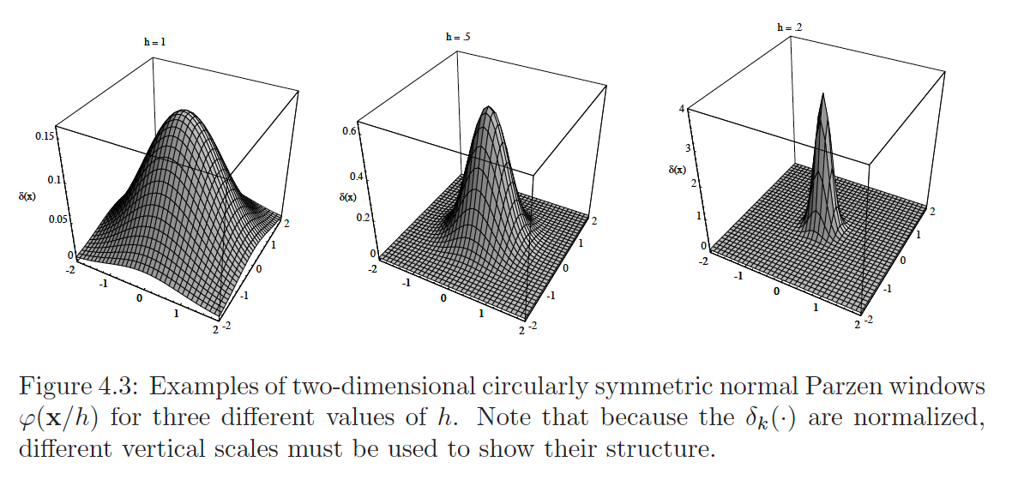
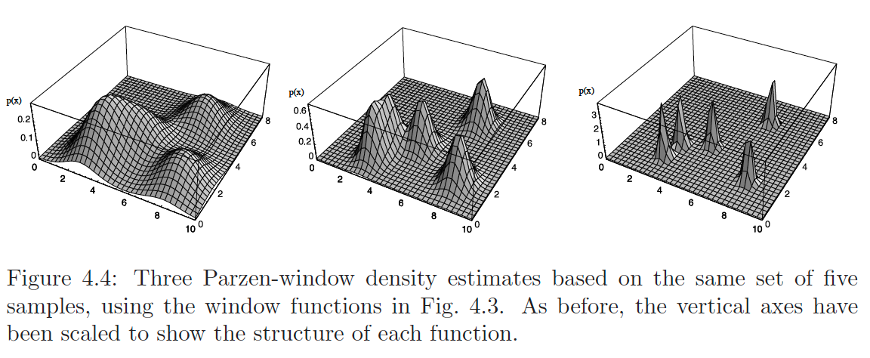
Gaussian Kernels

Slide 8
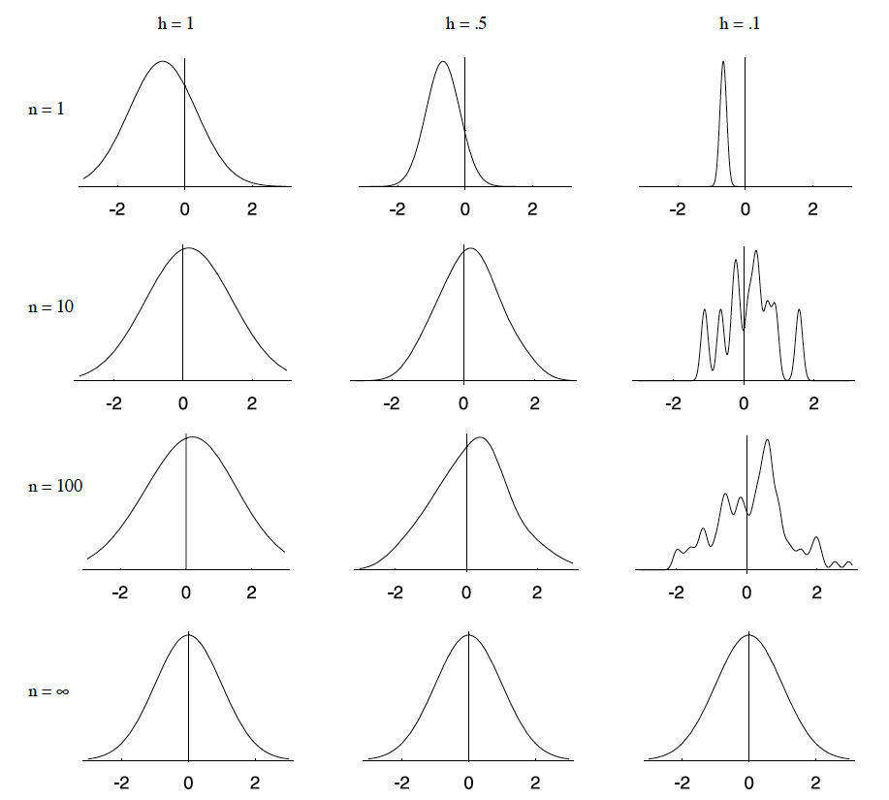
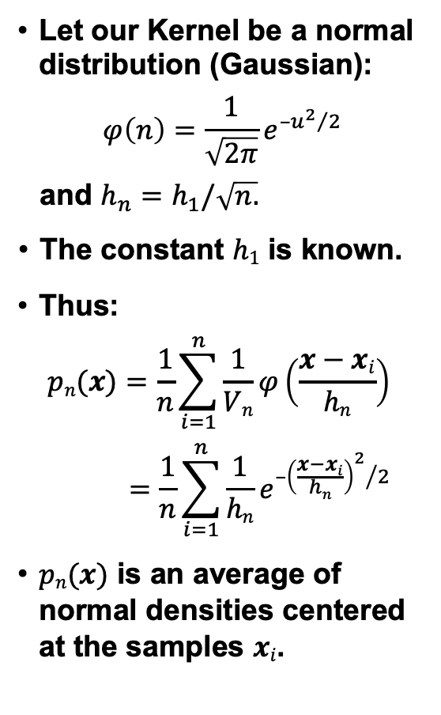
Example: Parzen Window Using A Gaussian Kernel
    Let our Kernel be a normal distribution (Gaussian):
    $$φ\left(n\right)=\frac{1}{\sqrt{2π}}e^{{{–u}^{2}}/2}$$
    and $h_{n}=h_{1}/\sqrt{n.}$
    The constant $h1$ is known.
    Thus:
    $$pn(x)=\frac{1}{n}\sum_{i=1}^{n}{\frac{1}{Vn}φ\left(\frac{x−xi}{hn}\right)}$$
    $$=\frac{1}{n}\sum_{i=1}^{n}{\frac{1}{hn}e^{{{–\left(\frac{x−xi}{hn}\right)}^{2}}/2}}$$
    $pn(x)$ is an average of normal densities centered at the samples $xi$.

Slide 9
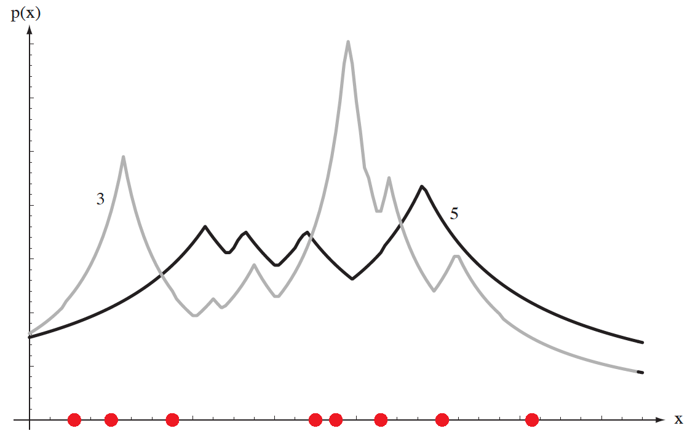
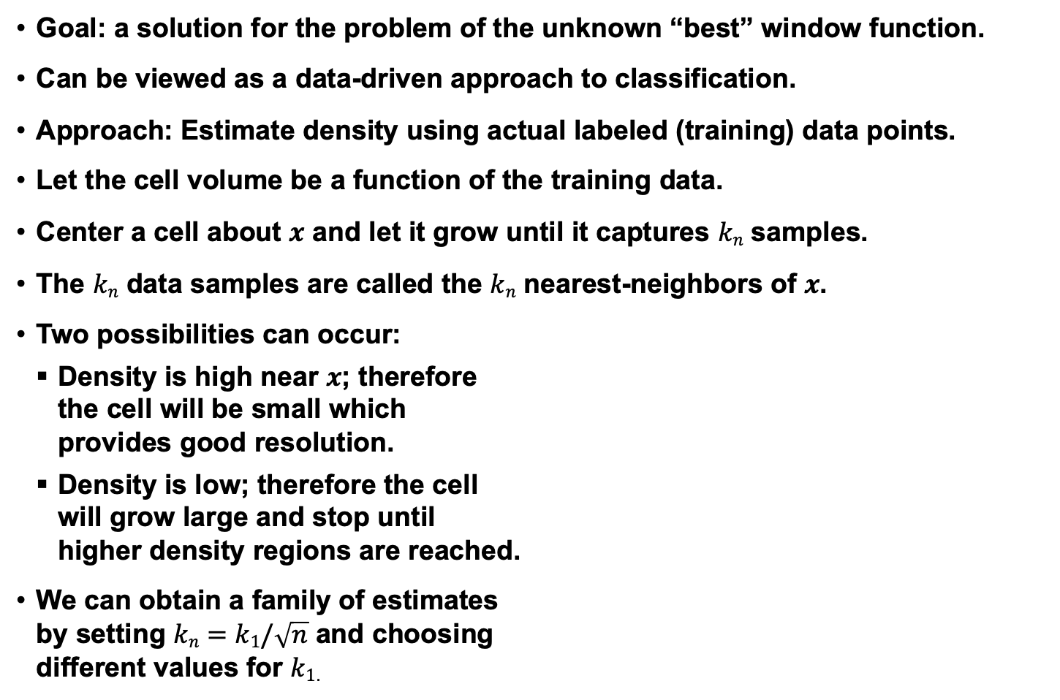
Alternate Approach: Nearest Neighbor Estimation
  Goal: a solution for the problem of the unknown “best” window function.
  Can be viewed as a data-driven approach to classification.
  Approach: Estimate density using actual labeled (training) data points.
  Let the cell volume be a function of the training data.
  Center a cell about $x$ and let it grow until it captures $kn$ samples.
  The $kn$ data samples are called the $kn$ nearest-neighbors of $x$.
  Two possibilities can occur:
  Density is high near $x$; therefore
  the cell will be small which
  provides good resolution.
  Density is low; therefore the cell
  will grow large and stop until
  higher density regions are reached.
  We can obtain a family of estimates
  by setting $kn=k1/\sqrt{n}$ and choosing
  different values for $k1$.

Slide 10
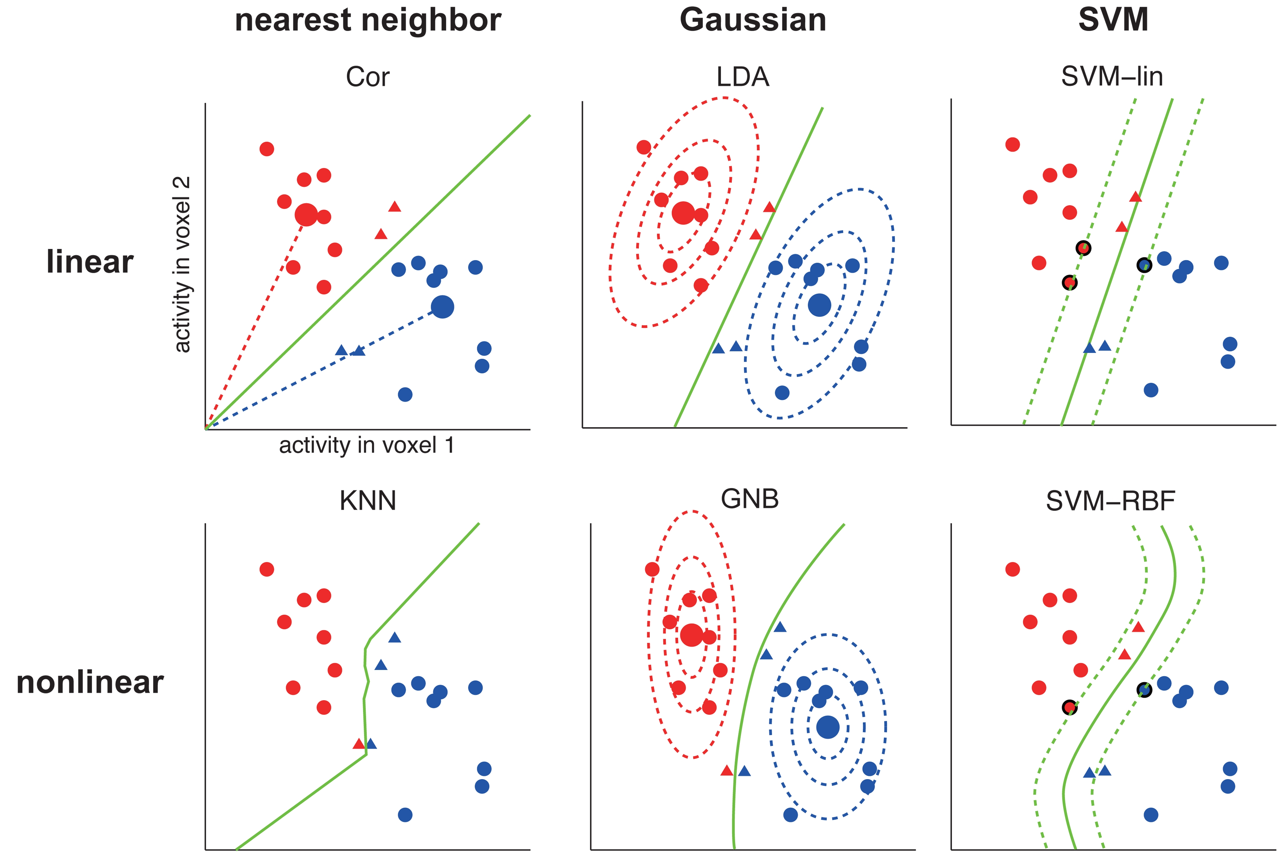
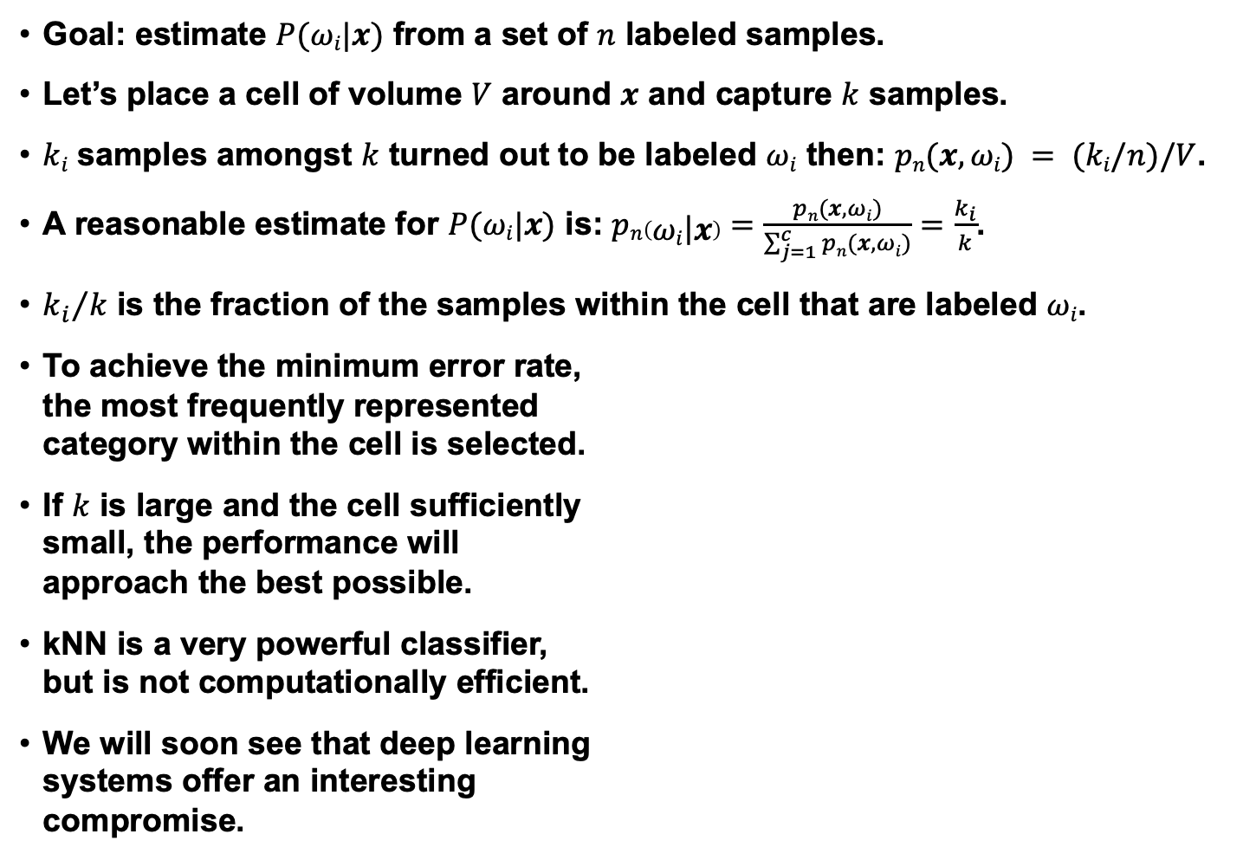
Application: Estimation of A Posteriori Probabilities
  Goal: estimate $P(ωi|x)$ from a set of $n$ labeled samples.
      Let’s place a cell of volume $V$ around $x$ and capture $k$ samples.
      $ki$ samples amongst $k$ turned out to be labeled $ωi$ then: $pn(x, ωi) = (ki/n)/V$.
      A reasonable estimate for $P(ωi|x)$ is: $pn\left(\left.ωi\right|x\right)=\frac{pn(x, ωi)}{\sum_{j=1}^{c}{pn(x, ωi)}}=\frac{k_{i}}{k}$.
      ${k_{i}}/k$ is the fraction of the samples within the cell that are labeled $ωi$.
      To achieve the minimum error rate,
      the most frequently represented
      category within the cell is selected.
      If $k$ is large and the cell sufficiently
      small, the performance will
      approach the best possible.
      kNN is a very powerful classifier,
      but is not computationally efficient.
      We will soon see that deep learning
      systems offer an interesting
      compromise.

Slide 11
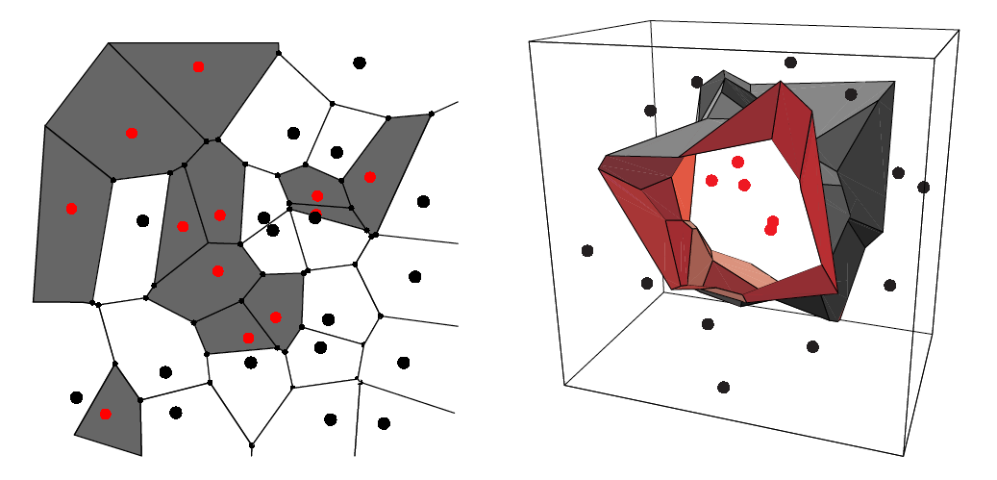
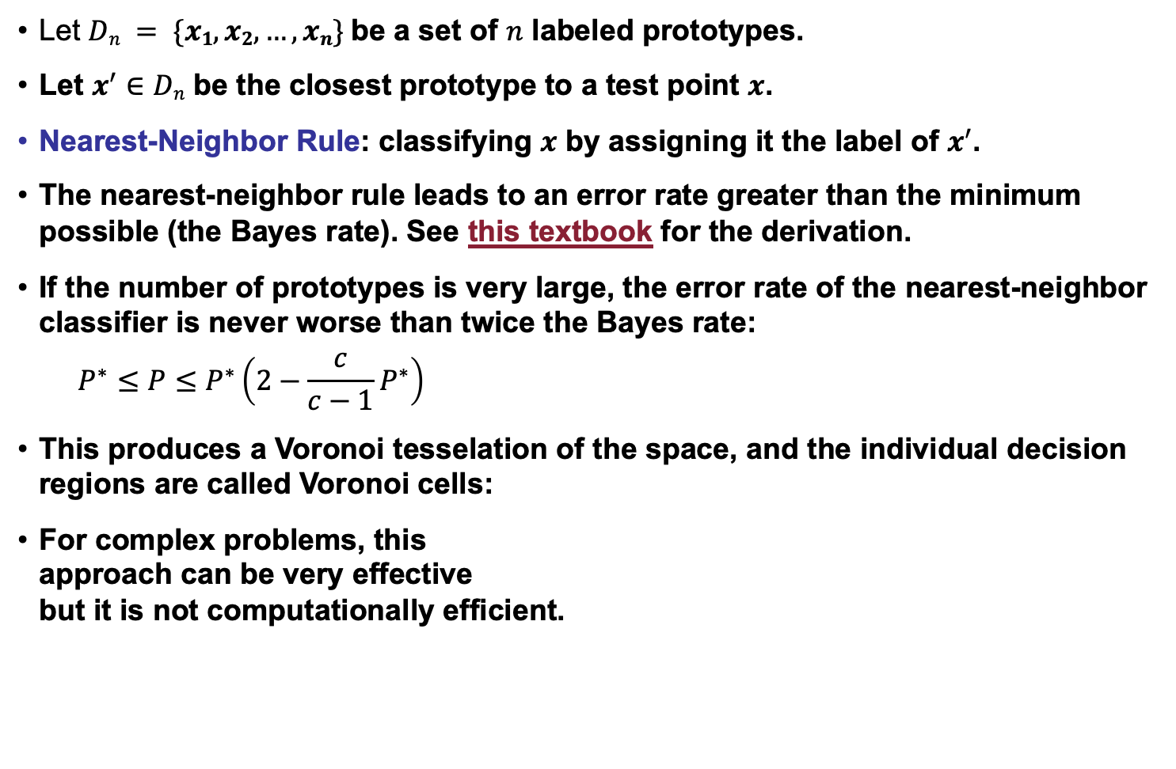
The Nearest-Neighbor Rule
  Let $Dn = \{x1, x2, …, xn\}$be a set of $n$ labeled prototypes.
  Let $x^{′}∈Dn$ be the closest prototype to a test point $x$.
  Nearest-Neighbor Rule: classifying $x$ by assigning it the label of $x^{′}$.
  The nearest-neighbor rule leads to an error rate greater than the minimum possible (the Bayes rate). See this textbook for the derivation.
  If the number of prototypes is very large, the error rate of the nearest-neighbor classifier is never worse than twice the Bayes rate:
  $$P^{∗}≤P≤P^{∗}\left(2−\frac{c}{c−1}P^{∗}\right)$$
This produces a Voronoi tesselation of the space, and the individual decision regions are called Voronoi cells:
For complex problems, this
approach can be very effective
but it is not computationally efficient.

Slide 12
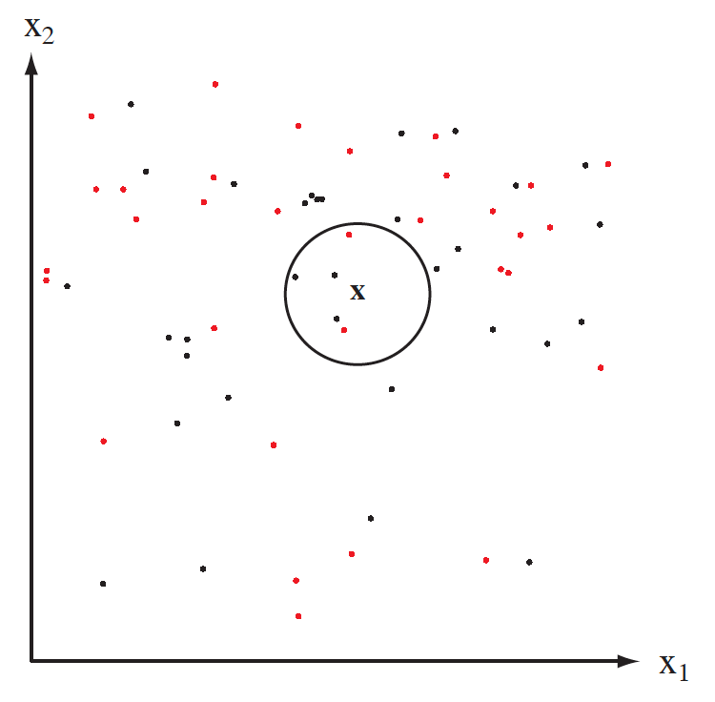
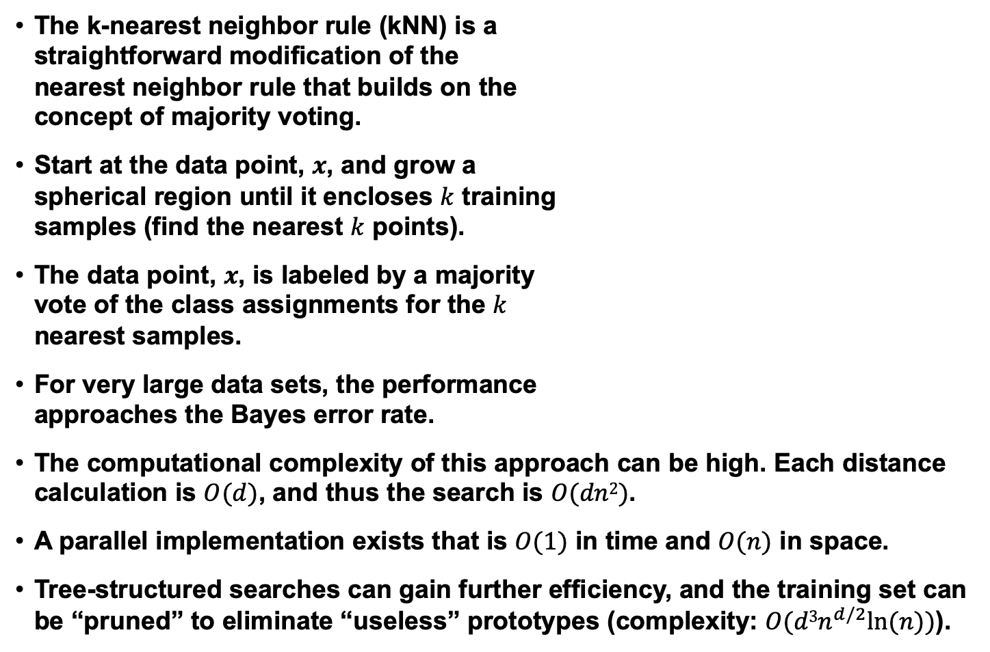
The K-Nearest-Neighbor Rule
The k-nearest neighbor rule (kNN) is a
straightforward modification of the
nearest neighbor rule that builds on the
concept of majority voting.
Start at the data point, $x$, and grow a
spherical region until it encloses $k$ training
samples (find the nearest $k$ points).
The data point, $x$, is labeled by a majority
vote of the class assignments for the $k$
nearest samples.
For very large data sets, the performance
approaches the Bayes error rate.
  The computational complexity of this approach can be high. Each distance calculation is $O(d)$, and thus the search is $O(dn2)$.
  A parallel implementation exists that is $O(1)$ in time and $O(n)$ in space.
  Tree-structured searches can gain further efficiency, and the training set can be “pruned” to eliminate “useless” prototypes (complexity: $O(d3n^{d/2}ln⁡(n))$).

Slide 13
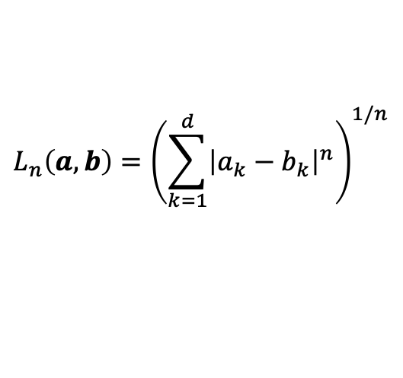
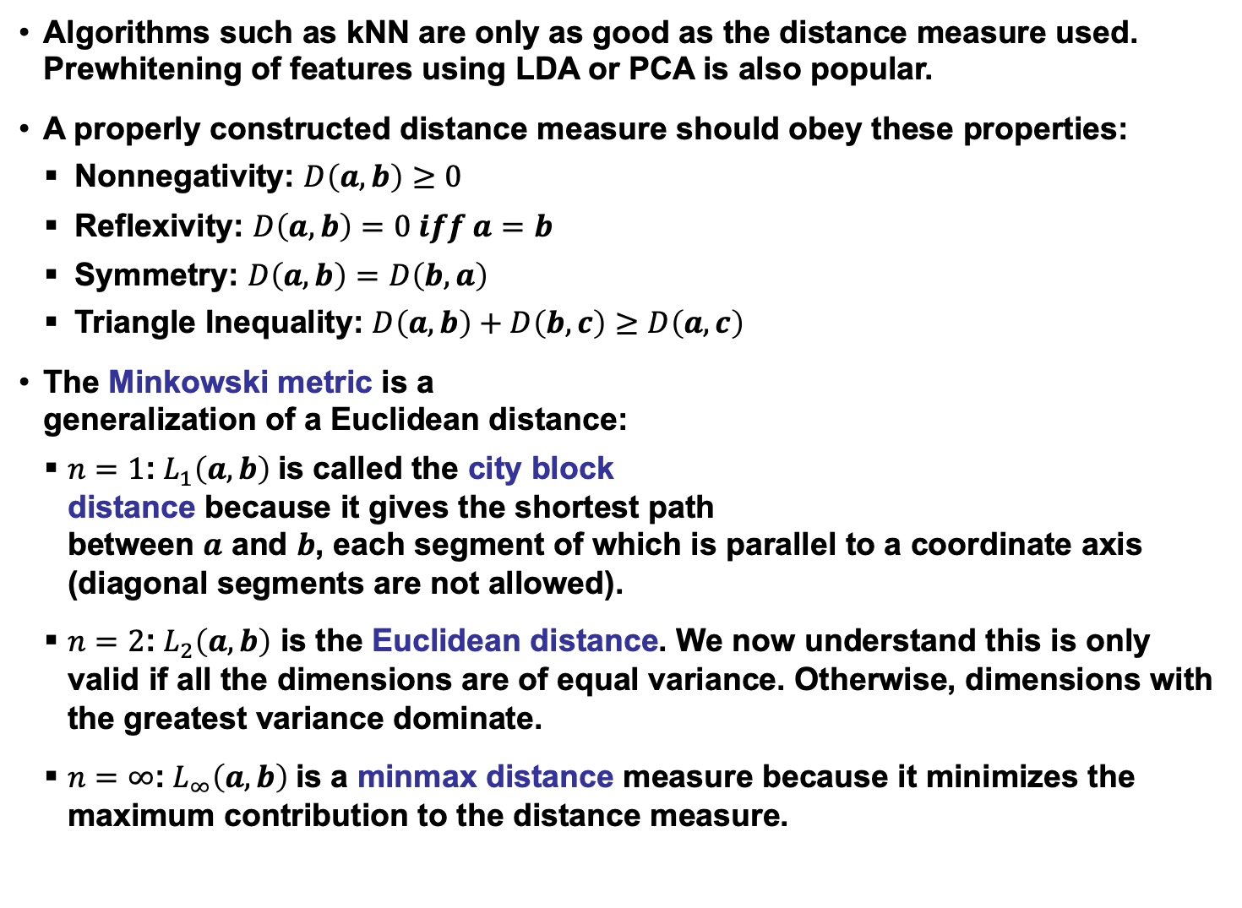
Properties of Metrics
Algorithms such as kNN are only as good as the distance measure used. Prewhitening of features using LDA or PCA is also popular.
A properly constructed distance measure should obey these properties:
Nonnegativity: $D\left(a,b\right)≥0$
Reflexivity: $D\left(a,b\right)=0 iff a=b$
Symmetry: $D\left(a,b\right)=D\left(b,a\right)$
Triangle Inequality: $D\left(a,b\right)+D\left(b,c\right)≥D\left(a,c\right)$
The Minkowski metric is a
generalization of a Euclidean distance:
$n=1$:$L_{1}\left(a,b\right)$is called the city block
distance because it gives the shortest path
between $a$ and $b$, each segment of which is parallel to a coordinate axis (diagonal segments are not allowed).
$n=2$:$L_{2}\left(a,b\right)$ is the Euclidean distance. We now understand this is only valid if all the dimensions are of equal variance. Otherwise, dimensions with the greatest variance dominate.
$n=∞$:$L_{∞}\left(a,b\right)$is a minmax distance measure because it minimizes the maximum contribution to the distance measure.
$$L_{n}\left(a,b\right)={\left(\sum_{k=1}^{d}{{\left|a_{k}−b_{k}\right|}^{n}}\right)}^{1/n}$$

Slide 14
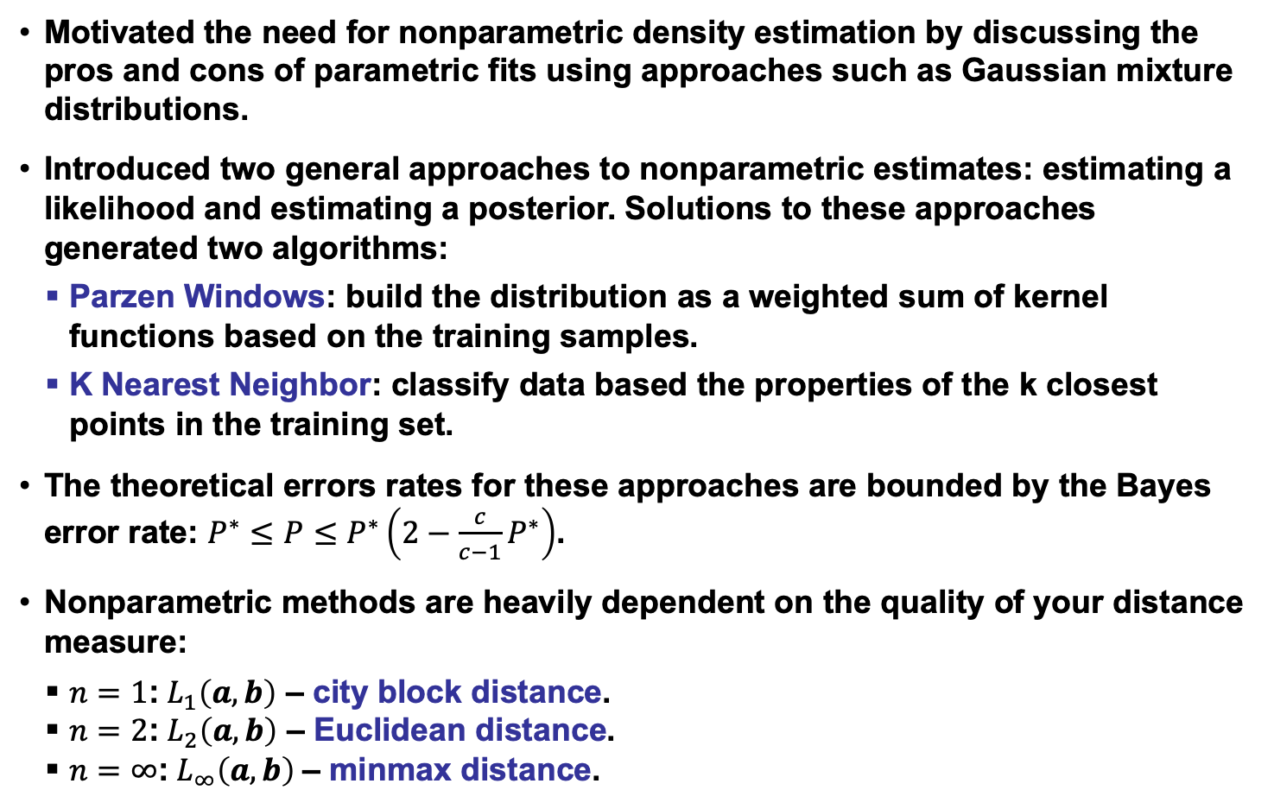
Summary
Motivated the need for nonparametric density estimation by discussing the pros and cons of parametric fits using approaches such as Gaussian mixture distributions.
Introduced two general approaches to nonparametric estimates: estimating a likelihood and estimating a posterior. Solutions to these approaches generated two algorithms:
Parzen Windows: build the distribution as a weighted sum of kernel functions based on the training samples.
K Nearest Neighbor: classify data based the properties of the k closest points in the training set.
The theoretical errors rates for these approaches are bounded by the Bayes error rate: $P^{∗}≤P≤P^{∗}\left(2−\frac{c}{c−1}P^{∗}\right)$.
Nonparametric methods are heavily dependent on the quality of your distance measure:
$n=1$:$L_{1}\left(a,b\right)$ – city block distance.
$n=2$:$L_{2}\left(a,b\right)$ – Euclidean distance.
$n=∞$:$L_{∞}\left(a,b\right)$– minmax distance.

