Slide 1
Lecture 02: Bayes Rule
Objectives:
Probability Decision Theory
Prior Probabilities
Likelihood Functions
Posterior Probabilities
Bayes Decision Rule
Likelihood Ratios
Resources:
Textbook (Sections 9.1 – 9.2)
DHS: Chapter 2

Slide 2
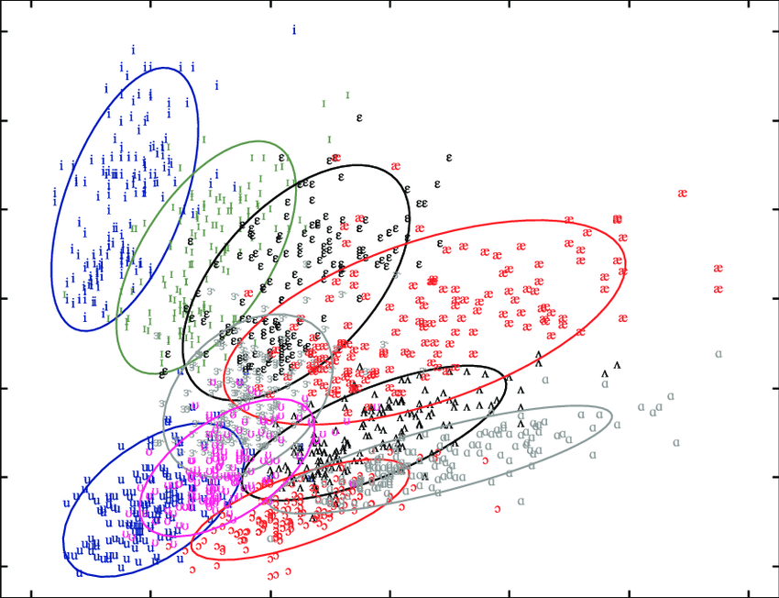
Can We Exploit Correlation of Features?
Treat features as a N-tuple (e.g., two-dimensional vector)
Create a scatter plot
Draw lines (regression) or other surfaces to separate classes

Slide 3
Bayesian Decision Theory
Bayesian Decision Theory is a fundamental statistical approach to the problem of pattern classification.
It allows us to quantify the tradeoffs between various classification decisions using probability and the costs that accompany these decisions.
We assume all relevant probability distributions are known.
Later, as part of the machine learning process, we will learn how to estimate these from data.
Can we exploit prior knowledge using Bayesian Decision Theory?
Important questions to ask:
Is each class equally probable? (uniform priors)
Can measurements be correlated with the label associated with each data point? (likelihood)
Can we combine these to make a better decision? (posterior)
What is the cost of an error? (risk, optimization)

Slide 4
Prior Probabilities
State of nature or the “class label” is prior information
Model the class label as a random variable, $ω$:
$ω=ω_{1}$: the event that a sample belongs to class 1
$P\left(ω_{1}\right)=$probability of class 1
$P\left(ω_{2}\right)$ = probability of class 2
$P\left(ω_{1}\right)+P\left(ω_{2}\right)$ = 1
Exclusivity: $ω_{1}$ and $ω_{2}$ share no basic events
Exhaustivity: the union of all outcomes is the sample space (either $ω_{1}$ or $ω_{2}$ must occur)
If all incorrect classifications have an equal cost:
Choose$ω_{1}$ if $P\left(ω_{1}\right)$> $P\left(ω_{2}\right)$; otherwise, choose $ω_{2}.$

Slide 5
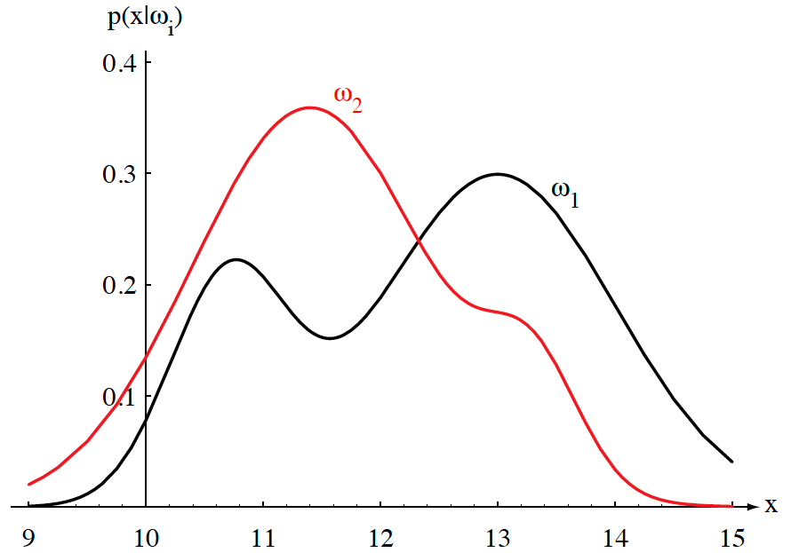
Class-Conditional Probabilities (Likelihoods)
A decision rule with only prior information always produces the same result and ignores measurements.
If $P\left(ω_{1}\right)$>> $P\left(ω_{2}\right)$, we will be correct most of the time.
Probability of error: $P\left(E\right)=min\left(P\left(ω_{1}\right),P\left(ω_{2}\right)\right).$
Given a feature, $x$, which is a continuous random variable, $p(x|ω1)$ is a class-conditional probability density function, or likelihood.
$p(x|ω1)$and $p(x|ω2)$describe the chance a data element belongs to a specific class.
We often refer to these as likelihoods because they represent the likelihood of a value $x$ given that it came from class $ω1$ (or $ω2$).

Slide 6
Probability Functions
A probability density function is denoted in lowercase and represents a function of a continuous variable.
$px(x|ω)$, often abbreviated as $p(x)$, denotes a probability density function for the random variable $X$. Note that $px(x|ω)$ and $py(y|ω)$ can be two different functions.
$P(x|ω)$ denotes a probability mass function, and must obey the following constraints:
$$P\left(x\right)≥0$$
$$\sum_{x∈X}{P\left(x\right)=1}$$
Probability mass functions are typically used for discrete random variables (which are summed) while densities describe continuous random variables (latter must be integrated).
In this course, we mix both discrete variables (related to the number of classes) and continuous variables (the probability of a feature vector).

Slide 7
Bayes Formula
Suppose we know both $P(ωj)$and $p(x|ωj)$, and we can measure $x$. How does this influence our decision?
The joint probability of finding a pattern that is in category $ωj$ and that this pattern has a feature value of $x$ is:
$$p\left(ω_{j},x\right)=P\left(ω_{j} | x\right)p\left(x\right)=p\left(x | ω_{j}\right)P\left(ω_{j}\right)$$
Rearranging terms, we arrive at Bayes Rule, also known as Bayes Formula:
$$P\left(ω_{j} | x\right)=\frac{p\left(x | ω_{j}\right)P\left(ω_{j}\right)}{p\left(x\right)}$$
The denominator term, which is known as the evidence, combines the two numerator terms (for the case of two categories):
$$p\left(x\right)=\sum_{j=1}^{2}{p\left(x | ω_{j}\right)P\left(ω_{j}\right)}$$
This is the probability that a particular value of x can occur. It is difficult to calculate because it is the sum across all possible conditions.

Slide 8
Posterior Probabilities
Bayes Rule:
$$P\left(ω_{j} | x\right)=\frac{p\left(x | ω_{j}\right)P\left(ω_{j}\right)}{p\left(x\right)}$$
can be expressed in words as:
$$posterior=\frac{likelihood × prior}{evidence}$$
By measuring $x$, we can convert the prior probability, $P(ωj)$, into a posterior probability, $P(ωj|x)$.
Evidence can be viewed as a scale factor and is often ignored in optimization applications (e.g., speech recognition).
Bayes Rule allows us to train a system by collecting data in what is called a supervised mode (e.g., collect a sea bass sample and measure its length, speak a specific set of words and measure the feature vectors).

Slide 9
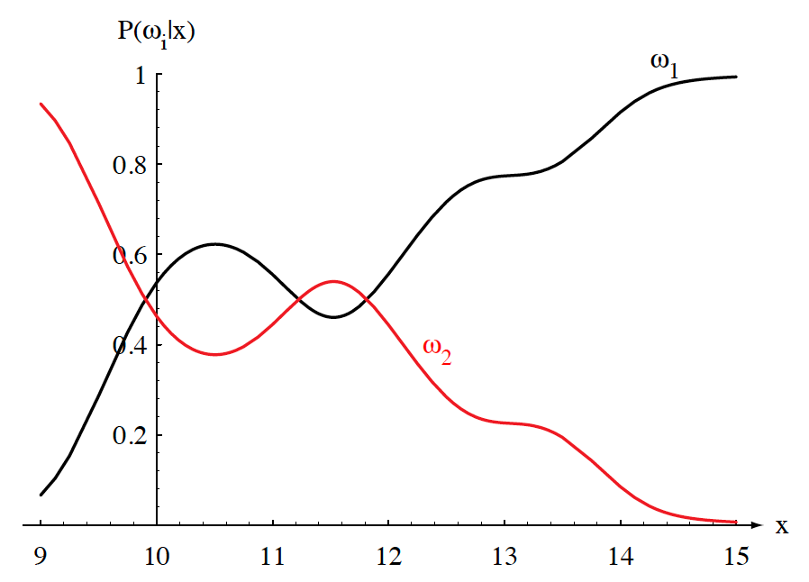
Posteriors Sum To 1.0
Two-class problem $(P(ω1) = 2/3, P(ω2) = 1/3)$:
For every value of $x$, the posteriors sum to $1$.
At $x = 14$, the probability $x$ is in category $ω1$ is $0.92$.
The probability $x$ is in $ω2$ is 0.08.
Likelihoods and posteriors are related via Bayes Rule.

Slide 10
Evidence
The evidence, $p(x)$, is a scale factor that assures probabilities sum to 1:
$$P\left(ω1|x\right)+P\left(ω2|x\right)=1$$
Using Bayes Rule:
$$P\left(error,x\right)=\left\{\begin{matrix}P\left(ω1 | x\right) if we decide ω2 \\ P\left(ω2 | x\right) if we decide ω1\end{matrix}\right.$$
$P\left(error\right)=\int_{−∞}^{∞}{P\left(error,x\right) dx}=$ $\int_{−∞}^{∞}{P\left(error\left|x\right.\right)p\left(x\right) dx}$
Goal: Minimize $P\left(error\left|x\right.\right)$ for every $x$
Decide $ω1$ if $P\left(ω1 | x\right)>$ $P\left(ω2 | x\right)$; otherwise decide $ω2$
$$P\left(error\right)=min\left[P\left(ω1 | x\right),P(ω2|x)\right]$$
$P\left(ω_{1} | x\right)={p\left(x|ω_{1}\right)P\left(ω_{1}\right)}/{p\left(x\right)}$ and $P\left(ω_{2} | x\right)={p\left(x|ω_{2}\right)P\left(ω_{2}\right)}/{p\left(x\right)}$
$P\left(error\right)=min\left[\frac{p\left(x|ω_{1}\right)P\left(ω_{1}\right)}{p\left(x\right)},\frac{p\left(x|ω_{2}\right)P\left(ω_{2}\right)}{p\left(x\right)}\right]$
We can eliminate the scale factor (which appears in both terms):
$$x∈ω1 iff p\left(x|ω1\right)P\left(ω1\right)>p\left(x|ω2\right)P\left(ω2\right)$$
Special cases:
$p\left(x|ω1\right)$= $p\left(x|ω2\right)$: $x$ gives us no useful information.
$P\left(ω1\right)=P\left(ω2\right)$: priors give no useful information.

Slide 11
Posterior Probabilities
Bayes Rule:
$$P\left(ω_{j} | x\right)=\frac{p\left(x | ω_{j}\right)P\left(ω_{j}\right)}{p\left(x\right)}$$
can be expressed in words as:
$$posterior=\frac{likelihood × prior}{evidence}$$
By measuring x, we can convert the prior probability, P(ω_{j}), into a posterior probability, P(ω_{j}|x).
Evidence can be viewed as a scale factor and is often ignored in optimization applications (e.g., speech recognition).
Bayes Rule allows us to train a system by collecting data in what is called a supervised mode (e.g., collect a sea bass sample and measure its length, speak a specific set of words and measure the feature vectors).

Slide 12
Generalization of the Two-Class Problem
Generalization of the preceding ideas:
Use of more than one feature
Use more than two classes (e.g., N-way classification)
Allowing actions other than a decision to decide on the label (e.g., rejection: refusing to take an action when alternatives are close or confidence is low)
Introduce a loss of function which is more general than the probability of error (e.g., errors are not equally costly)
Let us replace the scalar x by the vector, $x$, in a $d$-dimensional Euclidean space, $Rd$, called the feature space.

Slide 13
Loss Function
Let $\{ω1, ω2,…, ωc\}$be the set of $c$ categories
Let $\{α1,α2,…,αa\}$ be the set of $a$ possible actions
Let $λ(αi|ωj)$be the loss incurred for taking action $αi$ when the state of nature is $ωj$.
The posterior, $P\left(ωj | x\right)$, can be computed from Bayes formula:
$$P\left(ωj | x\right)=\frac{p\left(x | ωj\right)P\left(ωj\right)}{p\left(x\right)}$$
where the evidence is:
$$p\left(x\right)=\sum_{j=1}^{c}{p\left(x | ωj\right)P\left(ωj\right)}$$
The expected loss from taking action $α_{i}$ is:
$$R\left(αi | x\right)=\sum_{j=1}^{c}{λ\left(αi | x\right)P\left(ωj | x\right) .}$$

Slide 14
Bayes Risk
An expected loss is called a risk.
$R(ωi|x)$ is called the conditional risk.
A general decision rule is a function $α(x)$ that tells us which action to take for every possible observation.
The overall risk is given by:
$$R=\int{R\left(α\left(x\right) | x\right)p\left(x\right)dx}$$
If we choose $α(x)$ so that $R(αi(x))$is as small as possible for every $x$, the overall risk will be minimized.
Compute the conditional risk for every $ω$ and select the action that minimizes $R(ωi|x)$. This is denoted $R^{∗}$, and is referred to as the Bayes risk.
The Bayes risk is the best performance that can be achieved (for the given data set or problem definition).

Slide 15
Two-Category Classification
Let $α1$ correspond to $ω1$, $α2$ to $ω2$, and $λij= λ(αi|ωj)$.
The conditional risk is given by:
$$R(α1|x) = λ11P(ω1|x) + λ12P(ω2|x)$$
$$R(α2|x) = λ21P(ω1|x) + λ22P(ω2|x)$$
Our decision rule is:
$choose:$ $ω1 if: R(α1|x) < R(α2|x)$; $otherwise:$ $decide$ $ω2$
This results in the equivalent rule:
$choose:$ $ω1 if: (λ21− λ11) P(x|ω1) > (λ12− λ22) P(x|ω2)$;
$otherwise:$ $decide$ $ω2$
If the loss incurred for making an error is greater than that incurred for being correct, the factors $(λ21− λ11)$ and $(λ12− λ22)$ are positive, and the ratio of these factors simply scales the posteriors.

Slide 16
Likelihood
By employing Bayes formula, we can replace the posteriors:
$$(λ21− λ11) P(x|ω1) > (λ12− λ22) P(x|ω2)$$
by the prior probabilities and conditional densities:
$choose:$ $ω1 if:(λ21− λ11) p(x|ω1) P(ω1) > (λ12− λ22) p(x|ω2) P(ω2);$ $otherwise:$ $decide$ $ω2$
If $λ21− λ11$is positive, our rule becomes:
$$choose ω1 if:\frac{p(x|ω1)}{p(x|ω2)}>\frac{λ12− λ22}{λ21− λ11}\frac{P(ω2)}{P(ω1)}$$
If the loss factors are identical, and the prior probabilities are equal, this reduces to a standard likelihood ratio:
$$choose ω1 if: \frac{p(x|ω1)}{p(x|ω2)}>1$$

Slide 17
Minimum Error Rate
Consider a symmetrical or zero-one loss function:
$$λ\left(α_{i} | ω_{j}\right)= \left\{\begin{matrix}0, i=j \\ 1, i≠j\end{matrix} i,j=1, 2, 3, …, c\right.$$
The conditional risk is:
$$\begin{matrix}R\left(αi | x\right)=\sum_{j=1}^{c}{R(αi|ωj)P\left(ωj | x\right)} \\ =\sum_{j≠i}^{c}{P\left(ωj | x\right)} \\ =1−P\left(ωi | x\right)\end{matrix}$$
The conditional risk is the average probability of error.
To minimize error, maximize $P(ωi|x)$ — also known as maximum a posteriori decoding (MAP).

Slide 18
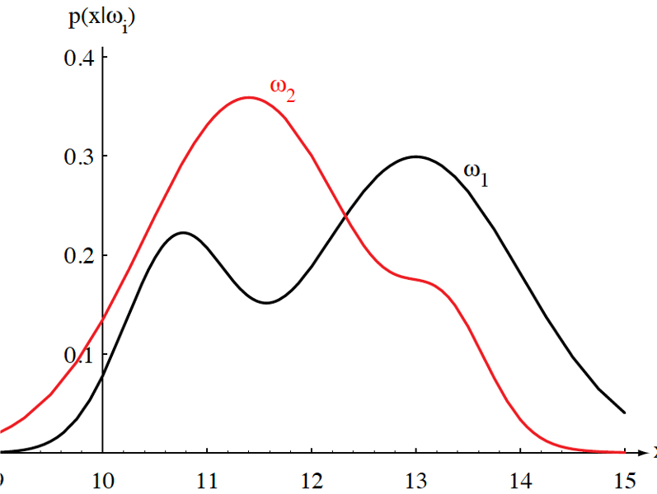
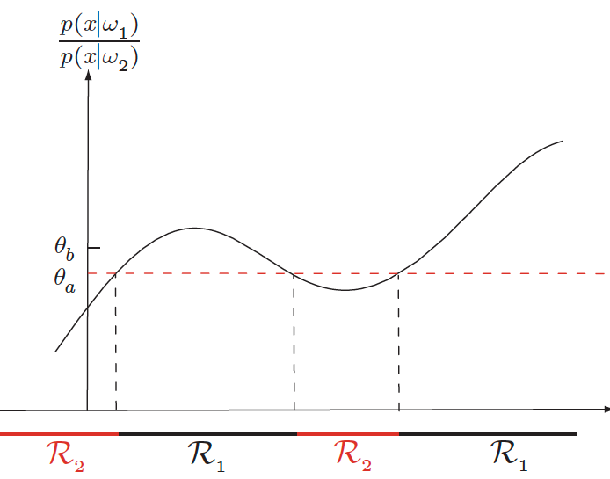
Likelihood Ratio
Minimum error rate classification:
$$choose ωi if: P(ωi| x) > P(ωj| x) for all j≠i$$

Slide 19
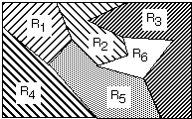
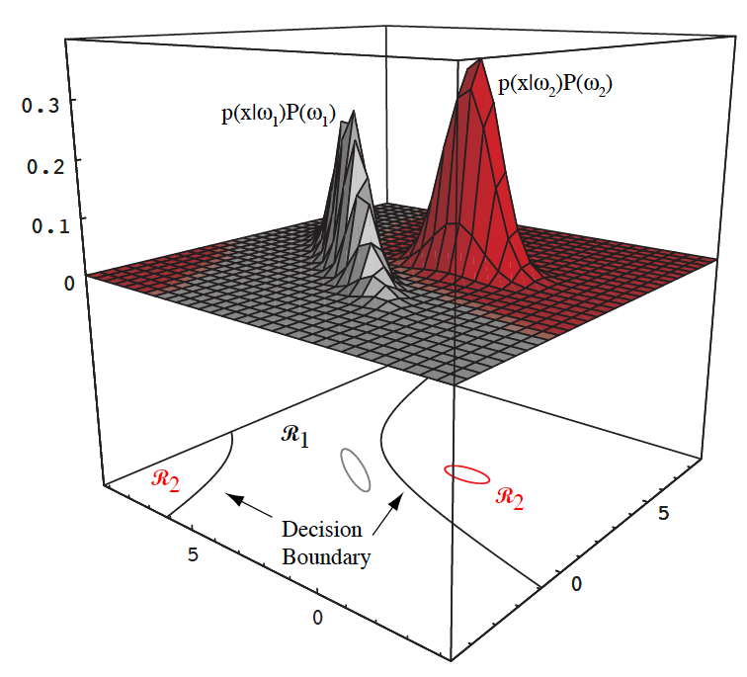
Decision Surfaces
We can visualize our decision rule several ways:

Slide 20
Summary
Probability Decision Theory: allows us to quantify the tradeoffs between various classification decisions using probability and the costs that accompany these decisions.
Prior Probabilities: reflect our knowledge of the problem, which comes from “subject matter expertise.”
Likelihoods: A model that assesses the probability a specific feature vector could have occurred from a specific class.
Posterior Probabilities: the probability a class occurred given a specific feature vector (converts a measurement to a probability that it came from a specific class).
Bayes Rule: factors a posterior into a combination of a likelihood, prior and the evidence. Is this the only appropriate engineering model?
Bayes Decision Rule: choose the class that has the highest posterior.

Slide 21
Summary
Bayes Decision Rule: what is its relationship to minimum error?
Decision Criteria: Several viable choices for decision rules.
Decision Surfaces: The shape of the decision surface is influenced by the number of categories and the statistics of the data.
Bayes Risk: what is its relation to performance?
Generalized Risk: what are some alternate formulations for decision criteria based on risk? What are some applications where these formulations would be appropriate?
Minimum Error Rate: How do we determine the minimum achievable error rate?
Likelihood Ratio: a simple decision rule or method for evaluating a classifier over a range of operating conditions. Convenient for two-class problems.

Slide 22
Minimax Criterion
Design our classifier to minimize the worst overall risk (avoid catastrophic failures)
Factor overall risk into contributions for each region:
$$R =\int_{R_{1}}{\left[λ_{11}P\left(ω_{1}\right)p\left(x | ω_{1}\right)+λ_{12}P\left(ω_{2}\right)p\left(x | ω_{2}\right)\right]ⅆx}$$ $+\int_{R_{2}}{\left[λ_{21}P\left(ω_{1}\right)p\left(x | ω_{1}\right)+λ_{22}P\left(ω_{2}\right)p\left(x | ω_{2}\right)\right]ⅆx}$
Using a simplified notation (Van Trees, 1968):
$P_{1}=$ $P\left(ω_{1}\right)$; $P_{2}=$ $P\left(ω_{2}\right)$;
$I_{11}=$ $\int_{R_{1}}{p\left(x | ω_{1}\right)ⅆx}$; $I_{12}=$ $\int_{R_{1}}{p\left(x | ω_{2}\right)ⅆx}$;
$I_{21}=$ $\int_{R_{2}}{p\left(x | ω_{1}\right)ⅆx}$; $I_{22}=$ $\int_{R_{2}}{p\left(x | ω_{2}\right)ⅆx}$;

Slide 23
Minimax Criterion
We can rewrite the risk:
$$R=P_{1}λ_{11}I_{11}+P_{2}λ_{12}I_{12}+P_{1}λ_{21}I_{21}+P_{2}λ_{22}I_{22}$$
Note that $I11=1−I21$ and $I22=1−I12$:
$$R=P_{1}λ_{11}\left(1−I_{21}\right)+P_{2}λ_{12}I_{12}+P_{1}λ_{21}I_{21}+P_{2}λ_{22}\left(1−I_{21}\right)$$
We make this substitution because we want the risk in terms of error probabilities and priors.
Multiply out, add and subtract $P1λ21$, and rearrange:
$$R=P_{1}λ_{21}+P_{1}λ_{11}−P_{1}λ_{12}I_{21}−P_{1}λ_{21}+P_{1}λ_{21}I_{21}+P_{2}λ_{22}−P_{2}λ_{22}I_{12}$$
$=P_{1}λ_{21}+P_{2}λ_{22}+P_{2}\left(λ_{12}−λ_{22}\right)I_{12}+$ $\left[{−P}_{1}λ_{11}I_{21}−P_{1}λ_{21}+P_{1}λ_{21}I_{21}+P_{1}λ_{11}\right]$
$=P_{1}λ_{21}+P_{2}λ_{22}+P_{2}\left(λ_{12}−λ_{22}\right)I_{12}−$ $P_{1}\left(λ_{21}−λ_{11}\right)\left(1−I_{21}\right)$
But $P1 =1− P2$:
$R=$ $λ_{21}\left(1−P_{2}\right)+P_{2}λ_{22}+P_{2}\left(λ_{12}−λ_{22}\right)I_{12}−\left(1−P_{2}\right)\left(λ_{21}−λ_{11}\right)\left(1−I_{21}\right)$
$=$ $λ_{21}−λ_{21}P_{2}+P_{2}λ_{22}+P_{2}\left(λ_{12}−λ_{22}\right)I_{12}−\left(1−P_{2}\right)\left(λ_{21}−λ_{11}\right)\left(1−I_{21}\right)$
$=$ $λ_{21}+\left(λ_{11}−λ_{12}\right)\left(1−I_{21}\right)+P_{2}\left[\left(λ_{22}−λ_{21}\right)+{\left(λ_{12}−λ_{22}\right)I}_{12}−\left(λ_{11}−λ_{21}\right) I_{12}\right]$

Slide 24
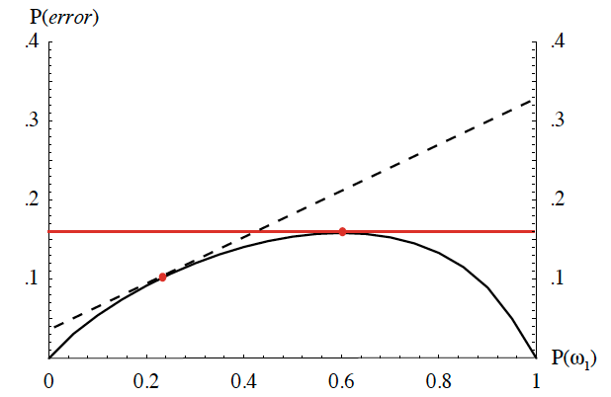
Minimax Criterion (Cont.)
Continuing:
$R=$ $λ_{21}+λ_{11}−λ_{21}−λ_{11}I_{21}+λ_{21}I_{21}+$
$P_{2}\left[\left(λ_{22}−λ_{21}\right)+\left(λ_{12}−λ_{22}\right)I_{12}−\left(λ_{11}−λ_{21}\right)I_{12}\right]$
$=$ $λ_{11}\left(1−I_{21}\right)+λ_{21}I_{21}$ ${+ P}_{2}\left[\left(λ_{22}−λ_{21}\right)+\left(λ_{12}−λ_{22}\right)I_{12}−\left(λ_{11}−λ_{21}\right)I_{12}\right]$
Note that the risk is linear in $P2$:$R= A{+ P}_{2}\left[B\right]$
If we can find a boundary such that the second term, $B$, is zero, then the minimax risk becomes:
$R=$ $λ_{21}+λ_{11}−λ_{21}−λ_{11}I_{21}+λ_{21}I_{21}+$
$P_{2}\left[\left(λ_{22}−λ_{21}\right)+\left(λ_{12}−λ_{22}\right)I_{12}−\left(λ_{11}−λ_{21}\right)I_{12}\right]$
$=$ $λ_{11}\left(1−I_{21}\right)+λ_{21}I_{21}=$ $λ_{11}+$ $\left(λ_{21}−λ_{11}\right)I_{21}$
For each value of the prior, there is an associated Bayes error rate.
Minimax: find the maximum Bayes error for the prior $P1$, and then use the corresponding decision region.

Slide 25
Neyman-Pearson Criterion
Guarantee the total risk is less than some fixed constant (or cost).
Minimize the risk subject to the constraint:
$$\int{R\left(α_{i} | x\right)ⅆx< constant}$$
(e.g., must not misclassify more than 1% of salmon as sea bass).
Typically must adjust boundaries numerically.
For some distributions (e.g., Gaussian), analytical solutions do exist.

Slide 26
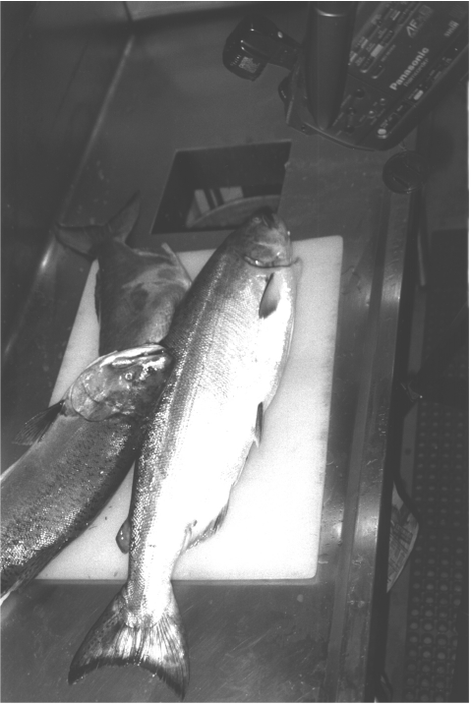
Image Processing Example: Sorting Fish
Sorting Fish: we seek to sort incoming fish according to their species using an optical sensing system (e.g., sea bass or salmon?)
Problem Analysis:
We will set up one or more cameras, collect some sample images to use for system development.
How much data do we need to collect to develop a high performance system?
We decide to extract features automatically from the images.
With a little bit of thought, we decide to consider features such as length, lightness, width, number and shape of fins, position of mouth, etc.
But how do we decide what is the best combination of features?
Sensing
Segmentation
Feature Extraction

Slide 27
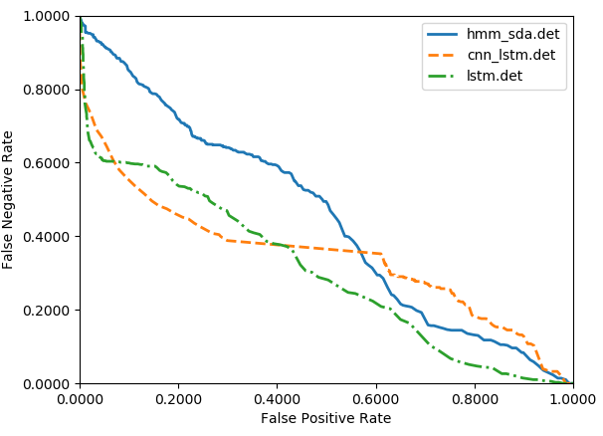
Example: Which System is Better?

