Slide 1
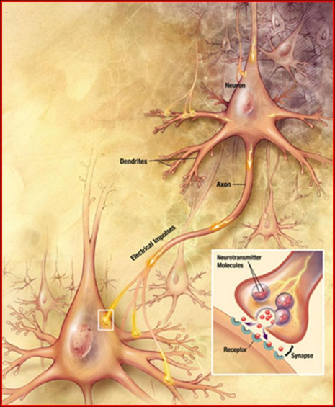
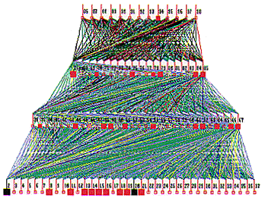
Lecture 25: Vanishing Gradients and Regularization
Objectives: Backpropagation Stopping Criteria Overfitting Regularization
Resources: Textbook (Sections 3.3, 5.3) DHS: Chapter 6 AM: Neural Network Tutorial NSFC: Introduction to NNs GH: Short Courses

Slide 2
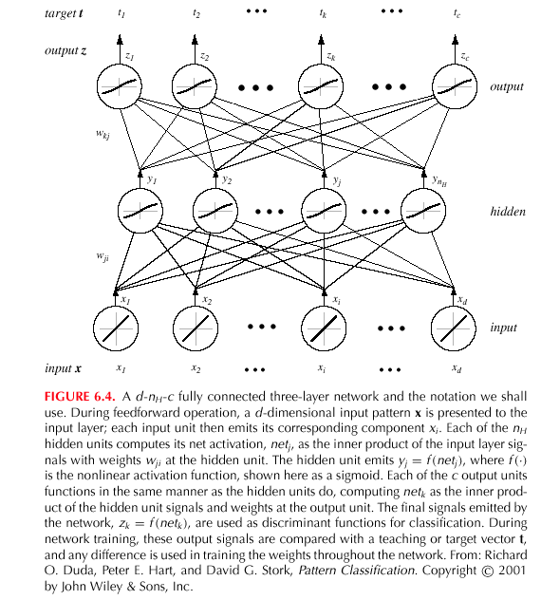
Backpropagation (Cont.)
Notes:
XOR: x_1, x_2, and we want to transform to x_1^2, x_2^2, x_1 x_2
It can also be viewed as feature extraction from the feature vector x, but now we extract more feature than the number of features in x.

Slide 3
General Feedforward Operation
For $c$ output units:
$$g_{k}\left(x\right)≝z_{k}=f\left(\sum_{j=1}^{n_{H}}{w_{kj}}f\left(\sum_{i=1}^{d}{w_{ji}x_{i}}\right)+w_{k0}\right) k=1,…,c$$
Hidden units enable us to express more complicated nonlinear functions and thus extend the classification.
The activation function does not have to be a sign function, it is often required to be continuous and differentiable.
We can allow the activation in the output layer to be different from the activation function in the hidden layer or have different activation for each individual unit.
We assume for now that all activation functions to be identical.
Can every decision be implemented by a three-layer network?
Yes (A. Kolmogorov): “Any continuous function from input to output can be implemented in a three-layer net, given sufficient number of hidden units $nH$, proper nonlinearities, weights, and properly chosen functions $δ_{j}$ and $β_{ij}$.”
$$\begin{matrix}g\left(x\right)=\sum_{j=1}^{2n+1}{δ_{j}\left(\sum{β_{ij}\left(x_{i}\right)}\right)} & ∀x∈I^{n}\left(I=\left[0,1\right];n≥2\right)\end{matrix}$$
for properly chosen functions δ_{j} and β_{ij}
Notes:
XOR: x_1, x_2, and we want to transform to x_1^2, x_2^2, x_1 x_2
It can also be viewed as feature extraction from the feature vector x, but now we extract more feature than the number of features in x.

Slide 4
Network Learning (Cont.)
Since $netk=wkty$: $\frac{∂{net}_{k}}{∂w_{kj}}=y_{j}.$
Therefore, the weight update (or learning rule) for the hidden-to-output weights is: $Δwkj=ηδkyj=η(tk – zk) f’(netk)yj$.
The error on the input-to-hidden units is: $\frac{∂J}{∂w_{ji}}=\frac{∂J}{∂y_{j}}∙\frac{∂y_{j}}{∂{net}_{j}}∙\frac{∂{net}_{j}}{∂w_{ji}}$
The first term is given by:
We define the sensitivity for a hidden unit:
which demonstrates that “the sensitivity at a hidden unit is simply the sum of the individual sensitivities at the output units weighted by the hidden-to-output weights $wkj$; all multipled by $f’(netk)$.”
The learning rule for the input-to-hidden weights is:

Slide 5
Stochastic Back Propagation
Starting with a pseudo-random weight configuration, the stochastic backpropagation algorithm can be written as:
Begin
initialize n_{H}; w, criterion θ, η, m ⬅ 0
do m ⬅ m + 1
x^{m} ⬅ randomly chosen pattern
w_{ji} ⬅ w_{ji} + ηδ_{j}x_{i}; w_{kj} ⬅ w_{kj} + ηδ_{k}y_{j}
until ||∇J(w)|| < θ
return w
End

Slide 6
Stopping Criterion
One example of a stopping algorithm is to terminate the algorithm when the change in the criterion function J(w) is smaller than some preset value θ.
There are other stopping criteria that lead to better performance than this one. Most gradient descent approaches can be applied.
So far, we have considered the error on a single pattern, but we want to consider an error defined over the entirety of patterns in the training set.
The total training error is the sum over the errors of n individual patterns:
A weight update may reduce the error on the single pattern being presented but can increase the error on the full training set.
However, given a large number of such individual updates, the total error decreases.

Slide 7
Learning Curves
Before training starts, the error on the training set is high; through the learning process, the error becomes smaller.
The error per pattern depends on the amount of training data and the expressive power (such as the number of weights) in the network.
The average error on an independent test set is always higher than on the training set, and it can decrease as well as increase.
A validation set is used in order to decide when to stop training; we do not want to overfit the network and decrease the power of the classifier generalization.

Slide 8
Gradient descent
pick a starting point (w)
repeat until loss doesn’t decrease in all dimensions:
pick a dimension
move a small amount in that dimension towards decreasing loss (using the derivative)
What is this doing?

Slide 9
Perceptron learning algorithm!
repeat until convergence (or for some # of iterations):
for each training example (f₁, f₂, …, f_{m}, label):
if prediction * label ≤ 0: // they don’t agree
for each w_{j}:
w_{j} = w_{j} + f_{j}*label
b = b + label
or
where

Slide 10
The constant
learning rate
label
prediction
When is this large/small?

Slide 11
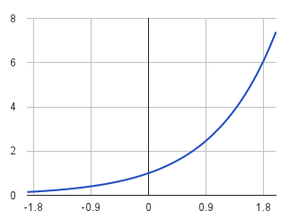
The constant
label
prediction
If they’re the same sign, as the predicted gets larger there update gets smaller
If they’re different, the more different they are, the bigger the update

Slide 12
One concern
loss
What is this calculated on?
Is this what we want to optimize?
w

Slide 13
Perceptron learning algorithm!
repeat until convergence (or for some # of iterations):
for each training example (f₁, f₂, …, f_{m}, label):
if prediction * label ≤ 0: // they don’t agree
for each w_{j}:
w_{j} = w_{j} + f_{j}*label
b = b + label
Note: for gradient descent, we always update
or
where

Slide 14
One concern
loss
We’re calculating this on the training set
We still need to be careful about overfitting!
The min w,b on the training set is generally NOT the min for the test set
w
How did we deal with this for the perceptron algorithm?

Slide 15
Overfitting revisited: regularization
A regularizer is an additional criteria to the loss function to make sure that we don’t overfit
It’s called a regularizer since it tries to keep the parameters more normal/regular
It is a bias on the model forces the learning to prefer certain types of weights over others

Slide 16
Regularizers
Should we allow all possible weights?
Any preferences?
What makes for a “simpler” model for a linear model?

Slide 17
Regularizers
Generally, we don’t want huge weights
If weights are large, a small change in a feature can result in a large change in the prediction
Also gives too much weight to any one feature
Might also prefer weights of 0 for features that aren’t useful
How do we encourage small weights? or penalize large weights?

Slide 18
Regularizers
How do we encourage small weights? or penalize large weights?

Slide 19
Common regularizers
sum of the weights
sum of the squared weights
What’s the difference between these?

Slide 20
Summary
Reviewed backpropagation and gradient descent.
Discussed the vanishing gradient problem.
Discussed overfitting.
Introduced the concept of regularization.
Introduced common approaches to regularization.

Slide 21
Regularization
David Kauchak CS 451 – Fall 2013

Slide 22
Model-based machine learning
pick a model
pick a criteria to optimize (aka objective function)
develop a learning algorithm
Find w and b that minimize the 0/1 loss

Slide 23
Model-based machine learning
pick a model
pick a criteria to optimize (aka objective function)
develop a learning algorithm
use a convex surrogate loss function
Find w and b that minimize the surrogate loss

Slide 24
Finding the minimum
You’re blindfolded, but you can see out of the bottom of the blindfold to the ground right by your feet. I drop you off somewhere and tell you that you’re in a convex shaped valley and escape is at the bottom/minimum. How do you get out?

Slide 25
Gradient descent
pick a starting point (w)
repeat until loss doesn’t decrease in all dimensions:
pick a dimension
move a small amount in that dimension towards decreasing loss (using the derivative)

Slide 26
Some maths

Slide 27
Gradient descent
pick a starting point (w)
repeat until loss doesn’t decrease in all dimensions:
pick a dimension
move a small amount in that dimension towards decreasing loss (using the derivative)
What is this doing?

Slide 28
Perceptron learning algorithm!
repeat until convergence (or for some # of iterations):
for each training example (f₁, f₂, …, f_{m}, label):
if prediction * label ≤ 0: // they don’t agree
for each w_{j}:
w_{j} = w_{j} + f_{j}*label
b = b + label
or
where

Slide 29
The constant
learning rate
label
prediction
When is this large/small?

Slide 30
The constant
label
prediction
If they’re the same sign, as the predicted gets larger there update gets smaller
If they’re different, the more different they are, the bigger the update

Slide 31
One concern
loss
What is this calculated on?
Is this what we want to optimize?
w

Slide 32
Perceptron learning algorithm!
repeat until convergence (or for some # of iterations):
for each training example (f₁, f₂, …, f_{m}, label):
if prediction * label ≤ 0: // they don’t agree
for each w_{j}:
w_{j} = w_{j} + f_{j}*label
b = b + label
Note: for gradient descent, we always update
or
where

Slide 33
One concern
loss
We’re calculating this on the training set
We still need to be careful about overfitting!
The min w,b on the training set is generally NOT the min for the test set
w
How did we deal with this for the perceptron algorithm?

Slide 34
Overfitting revisited: regularization
A regularizer is an additional criteria to the loss function to make sure that we don’t overfit
It’s called a regularizer since it tries to keep the parameters more normal/regular
It is a bias on the model forces the learning to prefer certain types of weights over others

Slide 35
Regularizers
Should we allow all possible weights?
Any preferences?
What makes for a “simpler” model for a linear model?

Slide 36
Regularizers
Generally, we don’t want huge weights
If weights are large, a small change in a feature can result in a large change in the prediction
Also gives too much weight to any one feature
Might also prefer weights of 0 for features that aren’t useful
How do we encourage small weights? or penalize large weights?

Slide 37
Regularizers
How do we encourage small weights? or penalize large weights?

Slide 38
Common regularizers
sum of the weights
sum of the squared weights
What’s the difference between these?

Slide 39
Common regularizers
sum of the weights
sum of the squared weights
Squared weights penalizes large values more
Sum of weights will penalize small values more

Slide 40
p-norm
sum of the weights (1-norm)
sum of the squared weights (2-norm)
p-norm
Smaller values of p (p < 2) encourage sparser vectors
Larger values of p discourage large weights more

Slide 41
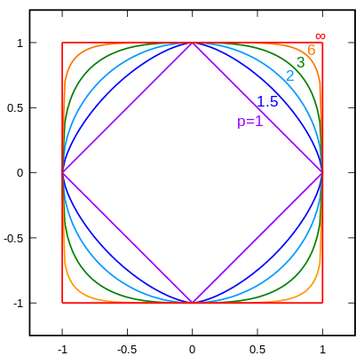
p-norms visualized
lines indicate penalty = 1
w₁
w₂
p | w₂
1 | 0.5
1.5 | 0.75
2 | 0.87
3 | 0.95
∞ | 1
For example, if w₁ = 0.5

Slide 42
p-norms visualized
all p-norms penalize larger weights
p < 2 tends to create sparse (i.e. lots of 0 weights)
p > 2 tends to like similar weights
Notes:
- The 1 norm penalizes non-zero weights, e.g

Slide 43
Model-based machine learning
pick a model
pick a criteria to optimize (aka objective function)
develop a learning algorithm
Find w and b that minimize

Slide 44
Minimizing with a regularizer
We know how to solve convex minimization problems using gradient descent:
If we can ensure that the loss + regularizer is convex then we could still use gradient descent:
make convex

Slide 45
Convexity revisited
One definition: The line segment between any two points on the function is above the function
Mathematically, f is convex if for all x₁, x₂:
the value of the function at some point between x₁ and x₂
the value at some point on the line segment between x₁ and x₂
Notes:
Put another way, the right hand side says, take the value of the function at x1, take the value of the function at x2 and then “linearly” average them based on t. This represents a line segment between f(x1) and f(x2)

Slide 46
Adding convex functions
Claim: If f and g are convex functions then so is the function z=f+g
Prove:
Mathematically, f is convex if for all x₁, x₂:

Slide 47
Adding convex functions
By definition of the sum of two functions:
Then, given that:
We know:
So:

Slide 48
Minimizing with a regularizer
We know how to solve convex minimization problems using gradient descent:
If we can ensure that the loss + regularizer is convex then we could still use gradient descent:
convex as long as both loss and regularizer are convex

Slide 49
p-norms are convex
p-norms are convex for p >= 1

Slide 50
Model-based machine learning
pick a model
pick a criteria to optimize (aka objective function)
develop a learning algorithm
Find w and b that minimize

Slide 51
Our optimization criterion
Loss function: penalizes examples where the prediction is different than the label
Regularizer: penalizes large weights
Key: this function is convex allowing us to use gradient descent

Slide 52
Gradient descent
pick a starting point (w)
repeat until loss doesn’t decrease in all dimensions:
pick a dimension
move a small amount in that dimension towards decreasing loss (using the derivative)

Slide 53
Some more math
…
(some math happens)

Slide 54
Gradient descent
pick a starting point (w)
repeat until loss doesn’t decrease in all dimensions:
pick a dimension
move a small amount in that dimension towards decreasing loss (using the derivative)

Slide 55
The update
learning rate
direction to update
regularization
constant: how far from wrong
What effect does the regularizer have?

Slide 56
The update
learning rate
direction to update
regularization
constant: how far from wrong
If w_{j} is positive, reduces w_{j}
If w_{j} is negative, increases w_{j}
moves w_{j} towards 0

Slide 57
L1 regularization

Slide 58
L1 regularization
learning rate
direction to update
regularization
constant: how far from wrong
What effect does the regularizer have?

Slide 59
L1 regularization
learning rate
direction to update
regularization
constant: how far from wrong
If w_{j} is positive, reduces by a constant
If w_{j} is negative, increases by a constant
moves w_{j} towards 0
regardless of magnitude

Slide 60
Regularization with p-norms
L1:
L2:
Lp:
How do higher order norms affect the weights?
Notes:
if they’re magnitude > 1, reduce them drastically
if they’re magnitude < 1, much slower reductions for higher p

Slide 61
Regularizers summarized
L1 is popular because it tends to result in sparse solutions (i.e. lots of zero weights)
However, it is not differentiable, so it only works for gradient descent solvers
L2 is also popular because for some loss functions, it can be solved directly (no gradient descent required, though often iterative solvers still)
Lp is less popular since they don’t tend to shrink the weights enough

Slide 62
The other loss functions
Without regularization, the generic update is:
where
exponential
hinge loss
squared error

Slide 63
Many tools support these different combinations
Look at scikit learning package:
http://scikit-learn.org/stable/modules/sgd.html

Slide 64
Common names
(Ordinary) Least squares: squared loss
Ridge regression: squared loss with L2 regularization
Lasso regression: squared loss with L1 regularization
Elastic regression: squared loss with L1 AND L2 regularization
Logistic regression: logistic loss

