Slide 1
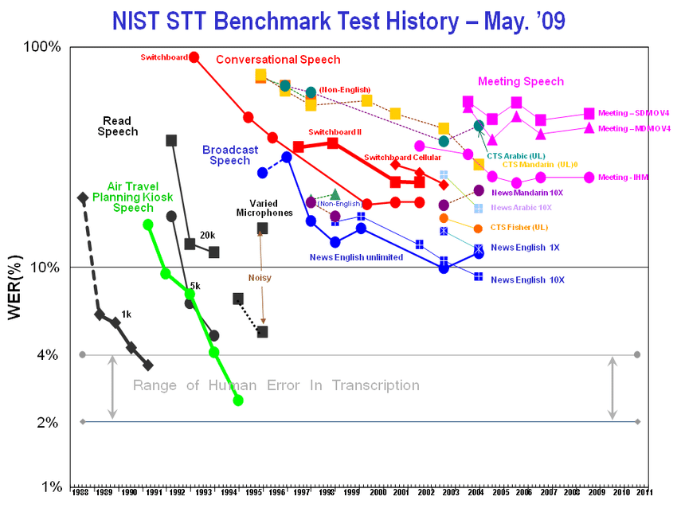
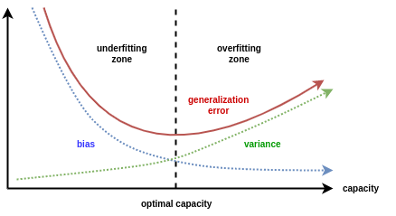
Lecture 18: Experimental Design – Evaluation
Objectives:
Generalization
Confusion Matrices and Other Metrics
Database Design
Scoring of Sequential Decoding Systems
Resources:
Textbook (Sections 11.1 – 11.6)
Wiki: Confusion Matrix Wiki: Receiver Operating Characteristic
RogerGrosse: Generalization
NIST: Scoring Tools
ISIP: Scoring Metrics

Slide 2
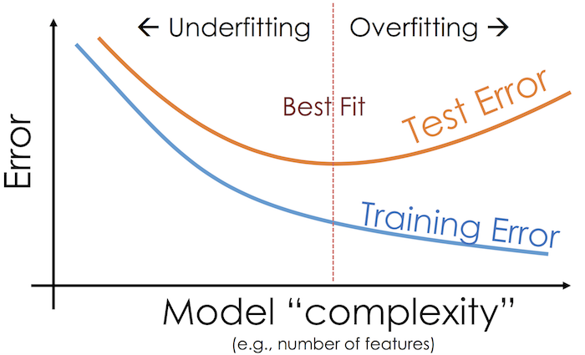
Generalization

Slide 3
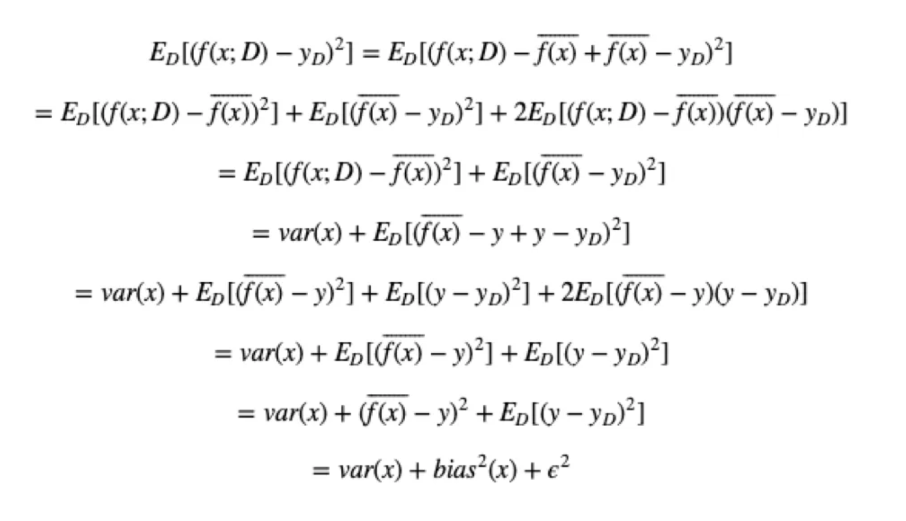
The Bias and Variance Tradeoff

Slide 4
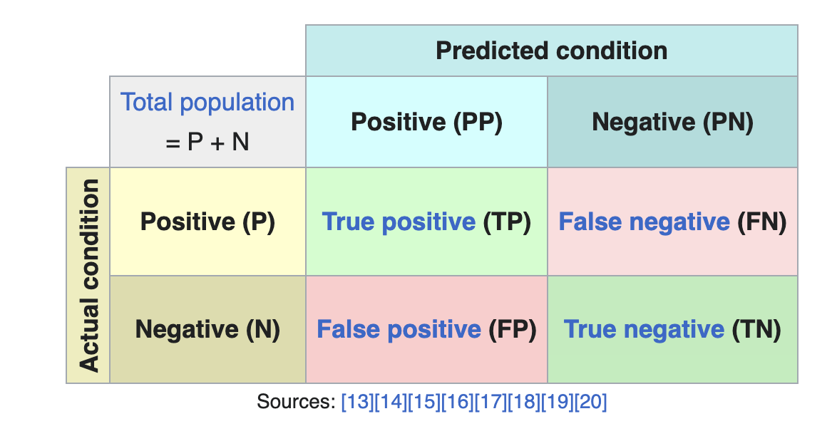
Confusion Matrices

Slide 5
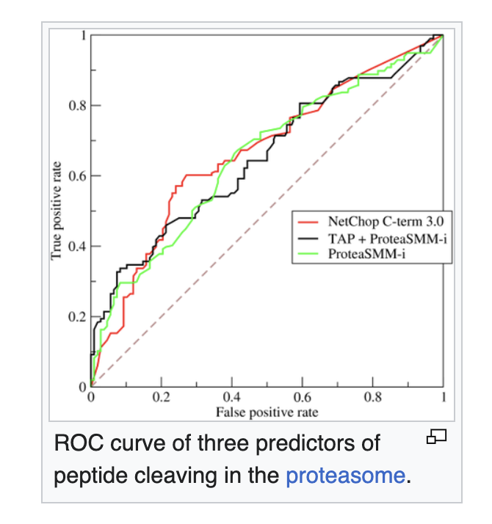
Receiver Operating Characteristics

Slide 6
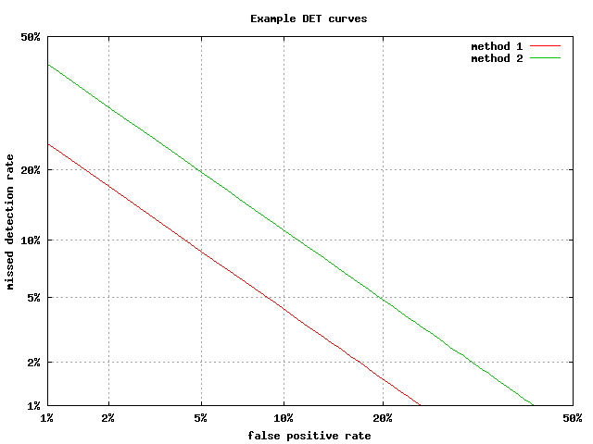
Detection Error Tradeoff (DET) Curves

Slide 7
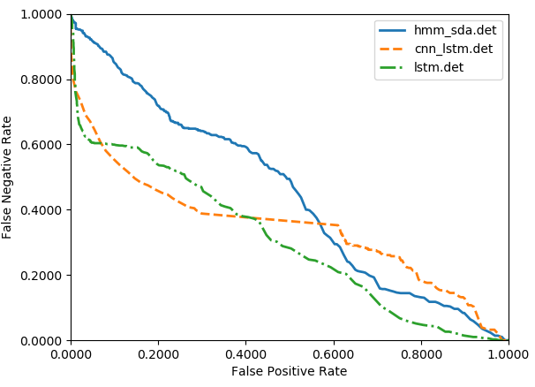
Example: Which System is Better?

Slide 8
Summary
Generalization: s…

Slide 9
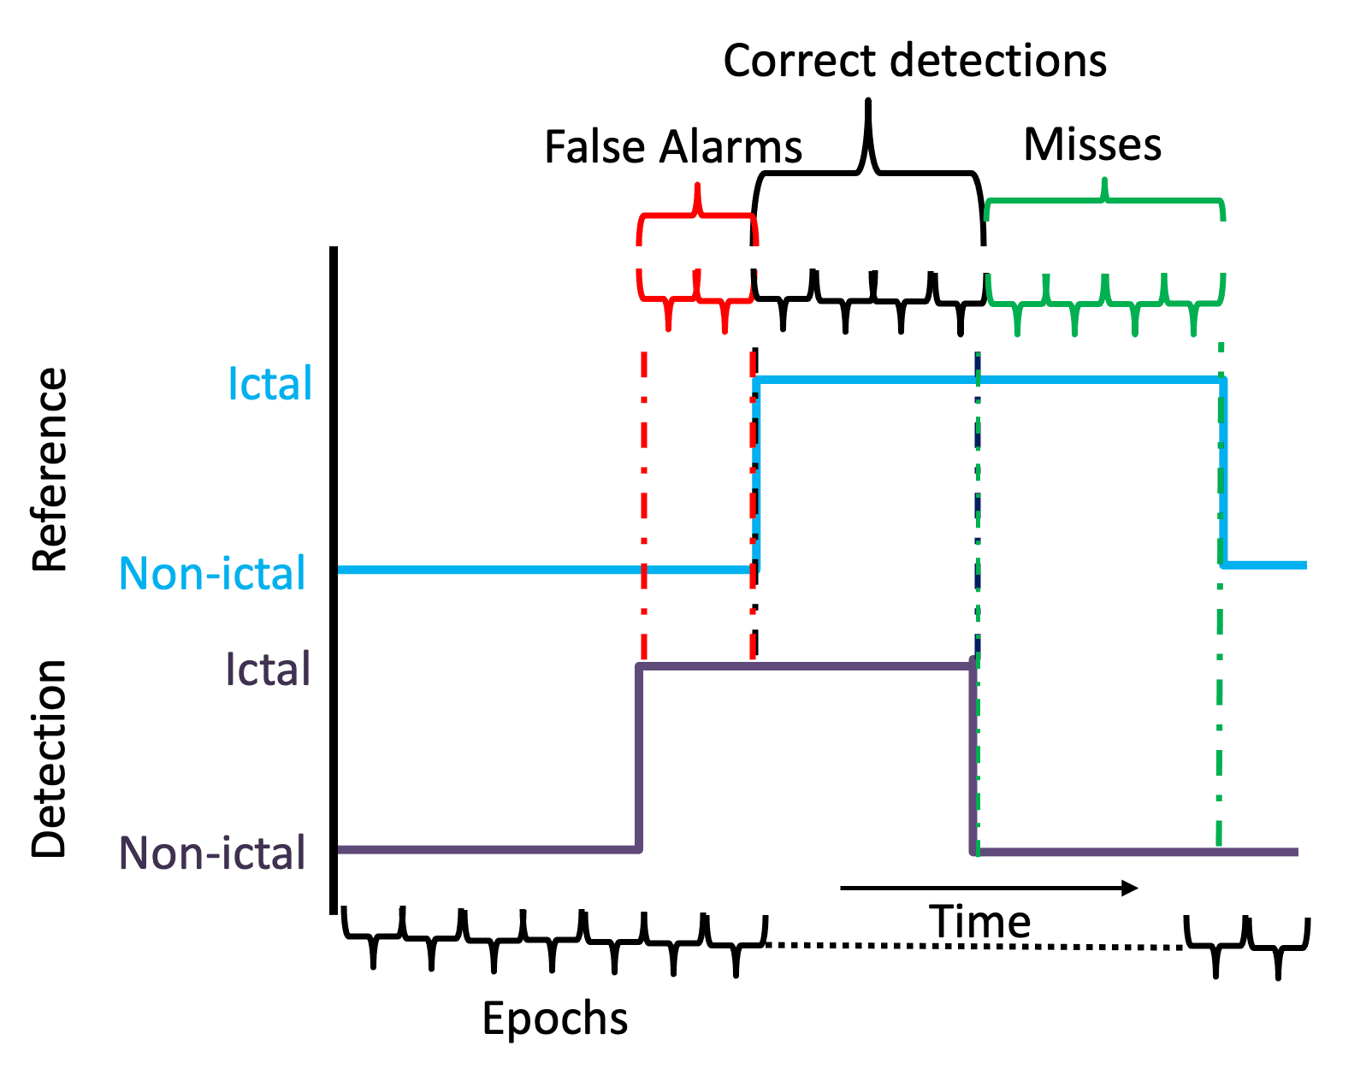
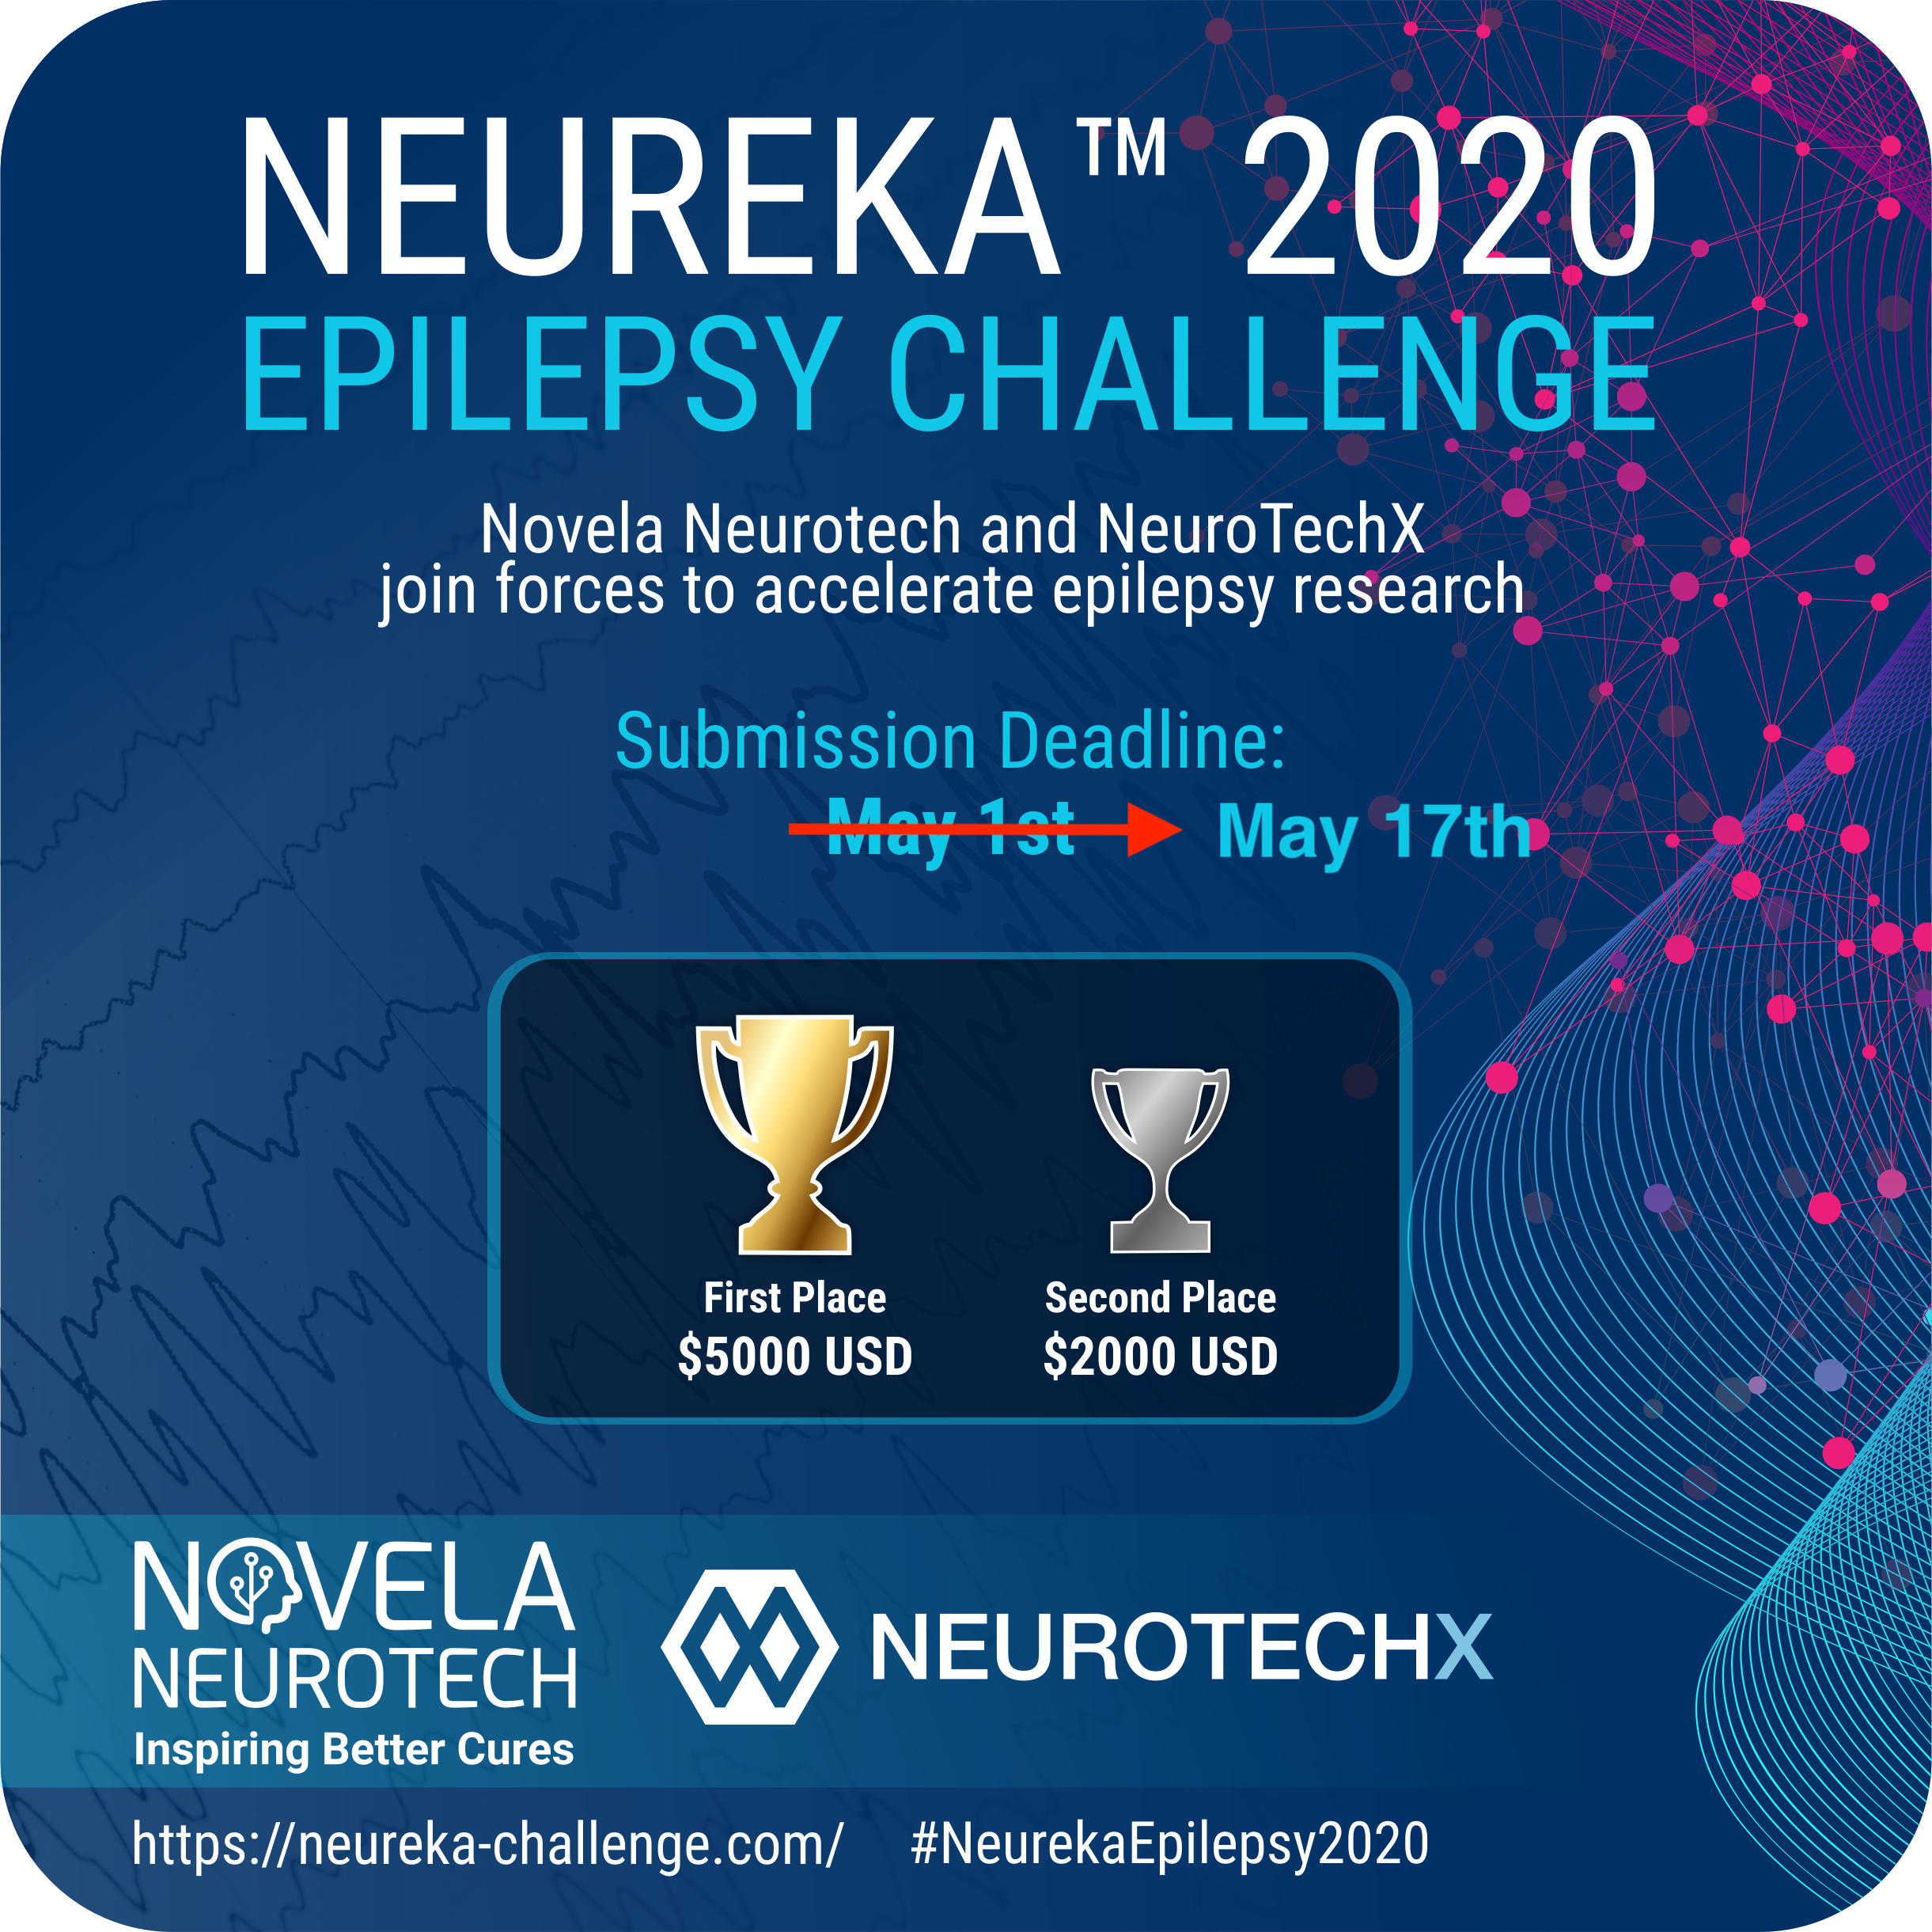
Validation of Temporal Scoring Metrics for Automatic Seizure Detection
V. Shah I. Obeid J. Picone
G. Ekladious R. Iskander
Y. Roy

Slide 10
Abstract
Standardized databases and evaluation metrics accelerate research and technology development by enabling direct comparisons of research results.
The bioengineering community lacks standard evaluation metrics for scoring of sequential decoding algorithms.
The Neureka 2020 Epilepsy Challenge was created to bring a community-wide focus on automated seizure detection and establish meaningful baselines.
In this presentation, we analyze the results of 4 research groups that provided sufficiently detailed results using four evaluation metrics:
Dynamic Programming Alignment (DPAL)
Epoch Sampling (EPCH)
Any-Overlap Method (OVLP)
Time Aligned Event Scoring (TAES)
We validate the use of the TAES metric because it evaluates partial overlaps and penalizes errors based on a reference event’s duration.
We also demonstrate that scoring a system using multiple metrics gives insight into the system’s behavior that can be used to improve an algorithm and optimally tune it for a specific evaluation metric.

Slide 11
The Neureka™ 2020 Epilepsy Challenge
Based on the Temple University Hospital Seizure Detection Corpus (TUSZ) v1.5.2, which includes a blind evaluation set.
The results were scored using v3.3.3 of our open source evaluation software.
Time Aligned Event Scoring (TAES) was used as a basis for ranking the submissions.
In order to stimulate interest in the use of low cost commercial sensors, penalties were further imposed based on the number of channels.
To emphasize the importance of a low false alarm rate, a single integrated metric was used that penalized false alarms and the number of channels:
$$P=Sens−2.5∗\left(FA\right)−7.5∗\left(NC/19\right)$$
where Sens, FA and NC are sensitivity, false alarms per 24 hours and the number of channels respectively.
This metric was designed with an expectation that Sens would be in the range of 40%, FAs in the range of 10, and so that NC would be a tiebreaker.
Description | Train | Dev
Patients | 592 | 50
Sessions | 1,185 | 238
Files | 4,599 | 1,013
No. Events | 2,377 | 673
Event Dur. (sec.) | 169,794 | 58,445
Total Dur (sec.) | 2,710,483 | 613,232

Slide 12
Open Source Scoring Software
The scoring metrics used for evaluating a system should reflect the performance requirements of an application (e.g., word error rate in speech recognition is highly correlated with the usability of a voice interface).
Clinicians are overwhelmingly emphatic that false alarm rate is the most important criterion for user acceptance.
Clinicians argue that performance goals for seizure detection are 75% sensitivity and 1 false alarm per 24 hours for a system to be usable.
We have introduced open source sequential decoding software that integrates five metrics for measuring similarity and produces a wide variety of popular statistics for evaluating system performance:
https://www.isip.piconepress.com/publications/unpublished/book_sections/2021/springer/metrics/
This software has been used internally for many years and one external evaluation conducted by IBM Research.
The Python implementation of the scoring software can be found at:
https://www.isip.piconepress.com/projects/tuh_eeg/downloads/nedc_eval_eeg
Using the Neureka Challenge data, we have analyzed several of the leading systems and validate the accuracy of our Time-Aligned Event Scoring (TAES) metric, showing it correlates with other measure including DET curves.

Slide 13
Fundamental Scores and Derived Measures
There are 4 fundamental quantities that must be calculated to derive most performance measures:
True Positive (TP)
False Positive (FP)
False Negative (FN)
True Negative (TN)
From these we calculate traditional measures such as:
Sensitivity = TP / (TP + FN) Accuracy = (TP+TN)/(TP+FN+TN+FP)
Specificity = TN / (TN + FP) Precision = TP/(TP + FN)
There are many ways to compute quantities such as TP and FP. In our scoring software, we introduce four ways to measure errors.

Slide 14
Evaluation Metrics – Dynamic Programming Align. (DPAL)
Popularized in the speech recognition community when time alignments were not available. Computed error rates correlate well with time-aligned results.
Minimizes an edit distance (the Levenshtein distance) to map the hypotheses onto the reference:
Three types of errors are recorded: substitution, deletion and insertion.
A dynamic programming algorithm is used to find the optimal alignment. Weights can be applied to different error classes (we use equal weights).
A fast, simple algorithm with few tunable parameters that can be easily applied to system output.
Alignments do not necessarily reflect the errors that actually occurred, though the aggregated results display the correct trends.

Slide 15
Evaluation Metrics – Epoch-based Sampling (EPCH)
Uses a metric that treats the reference and hypothesis as signals sampled at a fixed frame rate (an epoch):
The epoch duration used for scoring EEG events is 1.0 second.
Fixed-size epochs avoid the problem of disambiguating overlap between reference and hypothesis events (a ‘many to many’ mapping).
Tends to bias scores by weighting longer events more heavily and tends to produce a higher value of specificity.
Since seizure events can be very long, this is a concern.
Also, since each epoch is scored independently, false alarms are very high because each event can generate more than one false alarm.

Slide 16
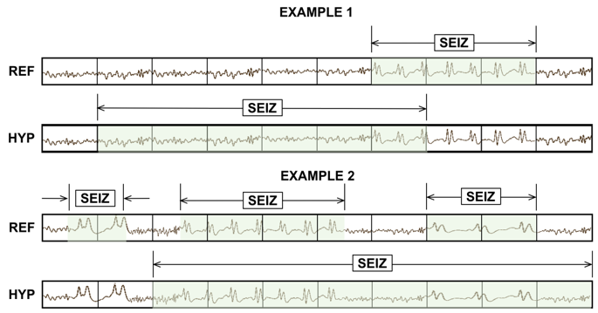
Evaluation Metrics – Any-Overlap (OVLP)
If a hypothesis event overlaps within the proximity of the reference event, it is considered a hit.
No penalty when multiple reference events overlap with a single large hypothesis event.
Misses and false alarms are counted when no overlap between hypothesis and reference is found.
Short and long events are weighed equally.
A very permissive metric that scores a match as correct even though the accuracy of the time alignment might be very poor.
Widely used in the neuroengineering community because it tends to produce a high sensitivity. Used in FDA submissions which has created an overly optimistic view of the accuracy of state of the art systems.

Slide 17
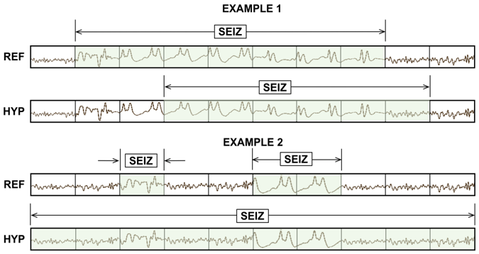
Evaluation Metrics – Time-aligned Event Scoring (TAES)
Similar to EPCH, TAES scores events based on their time-alignments.
A seizure can vary in duration from a few seconds to hours depending on its type and severity. TAES attempts to balance errors on short duration events with errors on long duration events.
The amount of overlap is tabulated for each error.
Each event is weighed equally by normalizing the score to a range of [0.0,1.0].
Multiple hypotheses that map to the same reference event are accumulated into a single score.
Multiple reference events that map to the same hypothesis event add FP errors for all but the first event.

Slide 18
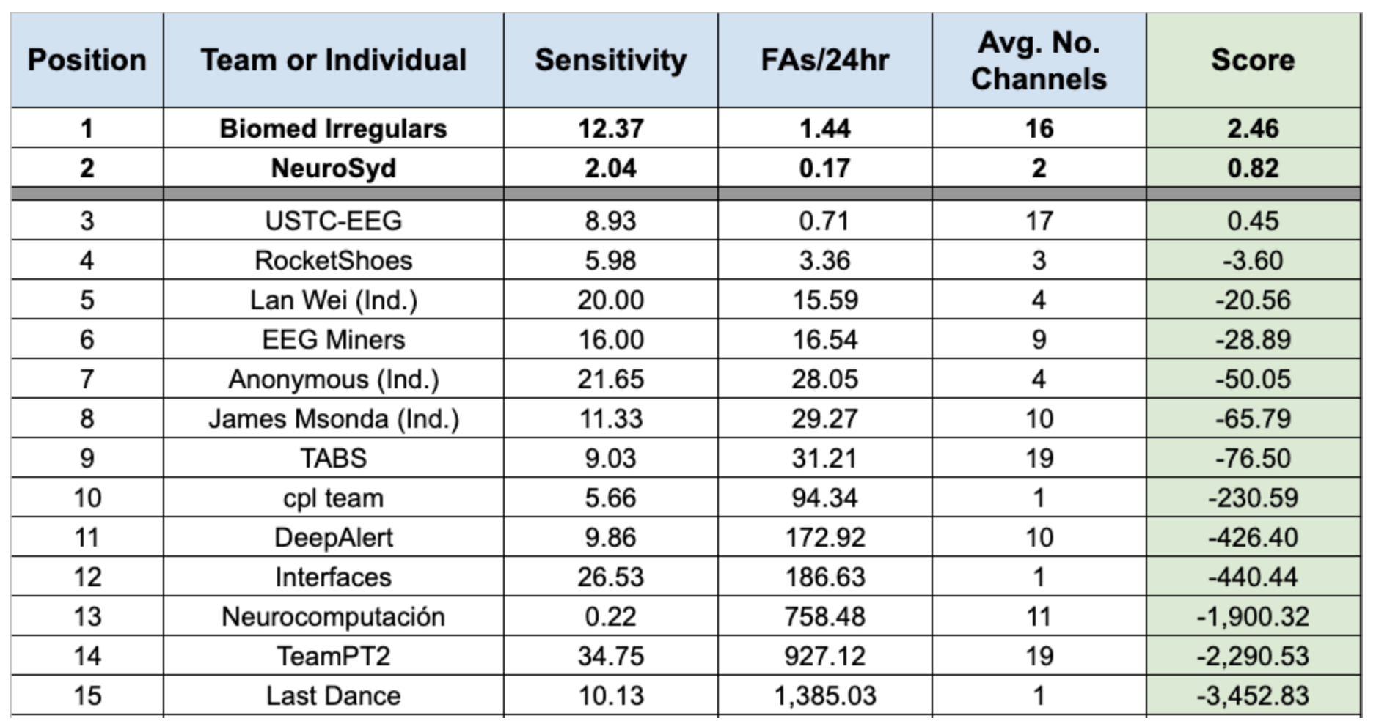
System Performance – Neureka Leaderboard
Submissions were scored using the TAES metric and a weighted measure that combines sensitivity, false alarms and the number of channels:
$$P=Sens−2.5∗\left(FA\right)−7.5∗\left(NC/19\right)$$
sia
pnc98
1zk
yff

Slide 19
Analysis of Several Selected Neureka Contributions (dev)
All sites were invited to submit detailed results. Only four external sites participated: Lan Wei (1zk), NeuroSyd (pnc98), EEG miners (yff) and Biomed Irregulars (sia).
We also included an internally developed system (nedc).
Some sites could not produce detailed hypothesis files necessary for analysis ☹
Comparisons using multiple evaluation metrics gives greater insight into a system’s behavior.
nedc and 1zk are balanced and have the highest sensitivities but higher FA rates.
pnc98 was biased to have a low FA rate. It is conservative in how it assigns an onset.
System |  | nedc | 1zk | pnc98 | yff
D P A L | Sens | 37.23 | 27.64 | 6.98 | 20.51
 | Spec | 96.88 | 85.27 | 98.33 | 91.98
 | FAs | 5.63 | 29.16 | 2.54 | 14.09
E P C H | Sens | 36.28 | 13.78 | 1.56 | 31.18
 | Spec | 97.30 | 97.89 | 99.99 | 94.06
 | FAs | 2,101 | 1,647 | 8 | 4,644
O V L P | Sens | 40.29 | 23.92 | 6.39 | 26.15
 | Spec | 97.56 | 90.29 | 99.65 | 94.19
 | FAs | 5.77 | 25.36 | 0.85 | 14.23
T A E S | Sens | 32.60 | 14.36 | 2.04 | 14.03
 | Spec | 90.72 | 83.53 | 99.42 | 87.44
 | FAs | 17.03 | 31.32 | 0.87 | 21.42

Slide 20
Analysis of Several Selected Neureka Contributions (dev)
1zk performs well on isolated events because FA rates for all metrics are comparable. The difference between OVLP and TAES sensitivities suggest that while parts of an event are identified correctly, the alignments are off.
pnc98 is conservative in detecting boundaries and only correctly identifies the center region of an event.
yff detects regions which extend beyond the boundaries of an event. This is inferred by comparing OVLP FA rates with TAES and EPCH FA rates.
nedc tends to generate a single long hypothesis that maps to multiple reference events, which can be seen by difference in FA rates for OVLP and TAES.
Overall performance was better on the eval set than the dev sets which suggests the eval set is relatively easier.
System |  | nedc | 1zk | pnc98 | yff
D P A L | Sens | 37.23 | 27.64 | 6.98 | 20.51
 | Spec | 96.88 | 85.27 | 98.33 | 91.98
 | FAs | 5.63 | 29.16 | 2.54 | 14.09
E P C H | Sens | 36.28 | 13.78 | 1.56 | 31.18
 | Spec | 97.30 | 97.89 | 99.99 | 94.06
 | FAs | 2,101 | 1,647 | 8 | 4,644
O V L P | Sens | 40.29 | 23.92 | 6.39 | 26.15
 | Spec | 97.56 | 90.29 | 99.65 | 94.19
 | FAs | 5.77 | 25.36 | 0.85 | 14.23
T A E S | Sens | 32.60 | 14.36 | 2.04 | 14.03
 | Spec | 90.72 | 83.53 | 99.42 | 87.44
 | FAs | 17.03 | 31.32 | 0.87 | 21.42

Slide 21
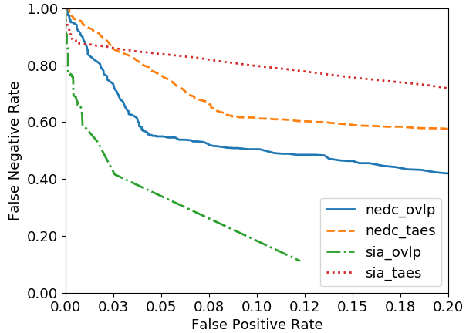
DET Analysis: nedc vs. sia (eval)
Many sites could not provide data suitable for DET curve analysis because their systems did not output a ‘confidence’:
sia has a low FA rate at the expense of sensitivity.
nedc has a higher sensitivity and a higher FA rate.
In cases like this, performance must be compared using a DET curve:
Scores |  | sia | nedc
A T W V | Sens | 22.70 | 41.08
 | Spec | 99.02 | 93.20
 | FAs | 1.61 | 13.36
D P A L | Sens | 23.45 | 42.96
 | Spec | 99.47 | 94.39
 | FAs | 0.96 | 11.77
E P C H | Sens | 12.84 | 51.58
 | Spec | 99.97 | 98.38
 | FAs | 25 | 1,301
O V L P | Sens | 23.26 | 42.96
 | Spec | 99.74 | 95.54
 | FAs | 0.64 | 11.45
T A E S | Sens | 11.37 | 35.55
 | Spec | 99.46 | 91.80
 | FAs | 0.99 | 17.23

Slide 22
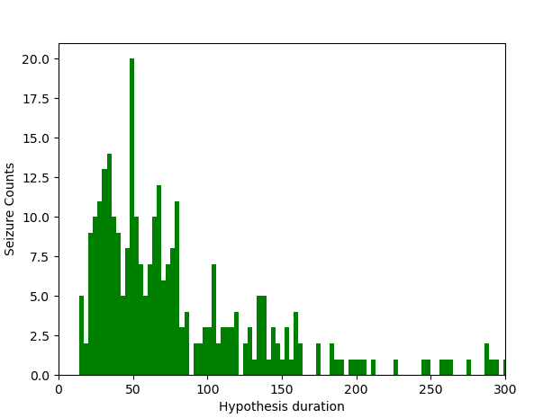
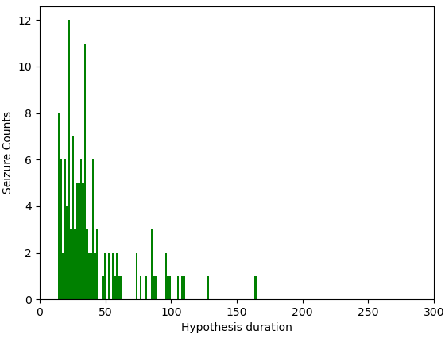
Statistical Analysis: nedc vs. sia
Hypothesis event durations for nedc and sia are significantly different.
A distribution of event durations for both systems are shown to the right.
The sia system detects seizures which are mostly in the range of 15-40 seconds in duration.
The nedc system detects seizures for durations as low as 4 seconds.
The sia system is very careful with overdetection and performs well with mid-duration seizure events.
The nedc system provides more balanced performance across metrics whereas the sia system performs better where time-alignment and partial overlaps are important.
System: nedc
System: sia

Slide 23
Statistical Analysis
Pairwise Pearson’s correlation coefficient was calculated for all four metrics for all 16 submissions.
OVLP and DPAL are highly correlated.
DPAL and EPCH show very low correlation in terms of both sensitivity and specificity.
EPCH and TAES show higher correlation in terms of sensitivity but EPCH fails to correlate well with the other metrics.
TAES combines salient features of the other metrics and provides a more accurate view of overall performance.
 | DPAL | EPCH | OVLP | TAES
DPAL | 1.00 | 0.4029 (p=0.121) | 0.9535 (p<0.001) | 0.5746 (p=0.019)
EPCH | — | 1.00 | 0.6141 (p=0.011) | 0.9144 (p<0.001)
OVLP | — | — | 1.00 | 0.7641 (p<0.001)
TAES | — | — | — | 1.00
 | DPAL | EPCH | OVLP | TAES
DPAL | 1.00 | 0.6676 (p=0.004) | 0.9985 (p<0.001) | 0.9980 (p<0.001)
EPCH | — | 1.00 | 0.6777 (p=0.003) | 0.6948 (p=0.002)
OVLP | — | — | 1.00 | 0.9971 (p<0.001)
TAES | — | — | — | 1.00

Slide 24
Summary
Seizure events can vary significantly in duration. Each event should be weighed equally regardless of its duration to avoid bias.
Traditional metrics, such as OVLP, are too lenient when it comes to assessing the time alignment of a hypothesis.
TAES, by scoring partial overlaps and weighing seizure events equally, was designed to evaluate systems where time-alignments are crucial and ‘many-to-many’ mappings between reference and hypothesis events are required.
Analyzing systems using multiple scoring metrics can provide insight into a system’s behavior without the need for extensive manual error analysis.
Standardization of scoring software in the research community is an important step towards accelerating progress and establishing statistically significant advances.
Many modern machine learning algorithms, when properly evaluated, are marginally different on difficult tasks such as seizure prediction. Real world challenges such as artifacts and event segmentation dominate system performance.
Neureka™ 2020 Epilepsy Challenge demonstrated that the TAES metric is a viable alternative to traditional scoring metrics.

Slide 25
Acknowledgments
The Neureka 2020 Epilepsy Challenge was made by possible by a generous grant from Novela Neurotech (https://www.novelaneuro.com).
The research reported in this publication by the Neural Engineering Data Consortium was most recently supported by the National Science Foundation Partnership for Innovation award number IIP-1827565 and the Pennsylvania Commonwealth Universal Research Enhancement Program (PA CURE). Any opinions, findings, and conclusions or recommendations expressed in this material are those of the author(s) and do not necessarily reflect the official views of any of these organizations.

Slide 26
References
The Neureka Challenge:
Y. Roy, R. Iskander, and J. Picone, “The Neureka® 2020 Epilepsy Challenge,” NeuroTechX, 2020. [Online]. Available: https://neureka-challenge.com/. [Accessed: 01-Jul-2020].
V. Shah et al., “The Temple University Hospital Seizure Detection Corpus,” Front. Neuroinform., vol. 12, pp. 1–6, 2018.
I. Obeid and J. Picone, “Machine Learning Approaches to Automatic Interpretation of EEGs,” in Biomedical Signal Processing in Big Data, 1st ed., E. Sejdik and T. Falk, Eds. Boca Raton, Florida, USA: CRC Press, 2017 (in press).
V. Shah, M. Golmohammadi, I. Obeid, and J. Picone, “Objective Evaluation Metrics for Automatic Classification of EEG Events,” in Signal Processing in Medicine and Biology: Emerging Trends in Research and Applications, 1st ed., I. Obeid, I. Selesnick, and J. Picone, Eds. New York City, New York, USA: Springer, 2021, pp. 1–26.
V. Shah and J. Picone, “NEDC Eval EEG: A Comprehensive Scoring Package for Sequential Decoding of Multichannel Signals,” The TUH EEG Project Web Site, 2019. [Online]. Available: https://www.isip.piconepress.com/projects/tuh_eeg/downloads/nedc_eval_eeg/. [Accessed: 01-Jul-2020].
Participants:
nedc: M. Golmohammadi, V. Shah, I. Obeid, and J. Picone, “Deep Learning Approaches for Automatic Seizure Detection from Scalp Electroencephalograms,” in Signal Processing in Medicine and Biology: Emerging Trends in Research and Applications, 1st ed., I. Obeid, I. Selesnick, and J. Picone, Eds. New York, New York, USA: Springer, 2020, pp. 233–274.
lwei: L. Wei and C. Mooney, “An Automatic Seizure Detection Method for Clinical EEG data,” in Proceedings of the IEEE Signal Processing in Medicine and Biology Symposium (SPMB), 2020.
pnc98: Y. Yang, N. D. Truong, C. Maher, A. Nikpour, and O. Kavehei, “Two-Channel Epileptic Seizure Detection with Blended Multi-Time Segments Electroencephalography (EEG) Spectrogram,” in Proceedings of the IEEE Signal Processing in Medicine and Biology Symposium (SPMB), 2020.
yff: T. Anand, M. G. Kumar, M. Sur, R. Aghoram, and H. Murphy, “Seizure Detection Using Time Delay Neural Networks and LSTM,” in Proceedings of the IEEE Signal Processing in Medicine and Biology Symposium (SPMB), 2020.
sia: C. Chatzichristos et al., “Epileptic Seizure Detection in EEG via Fusion of Multi-View Attention-Gated U-net Deep Neural Networks,” in Proceedings of the IEEE Signal Processing in Medicine and Biology Symposium (SPMB), 2020.

