Slide 1

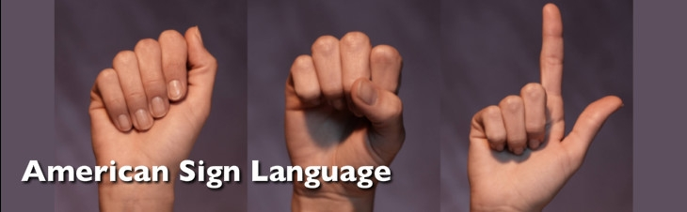
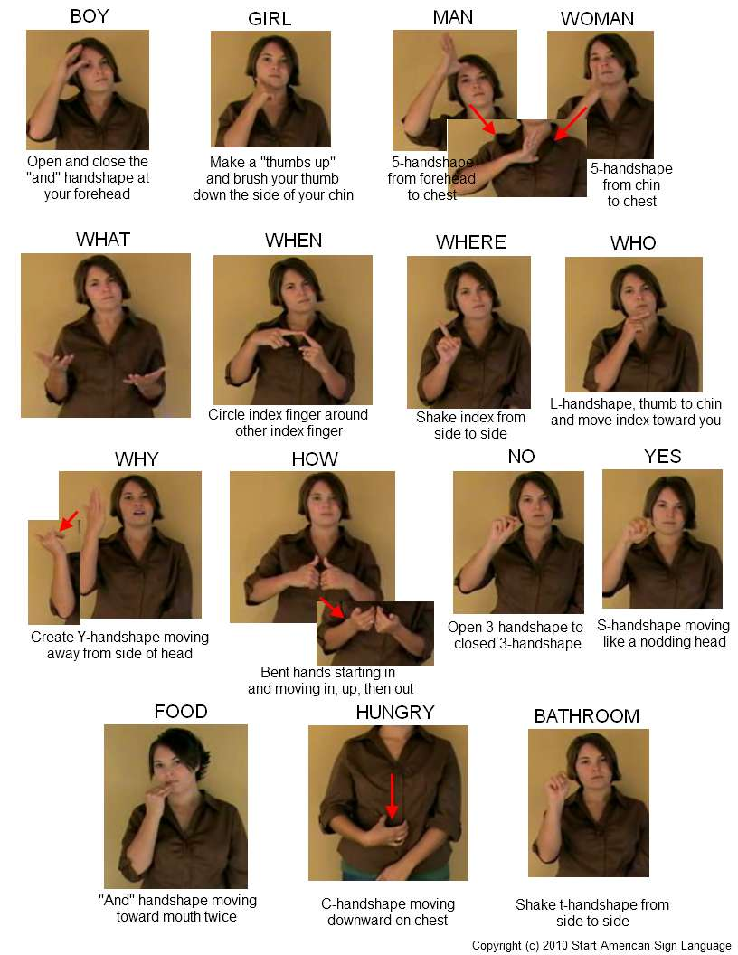
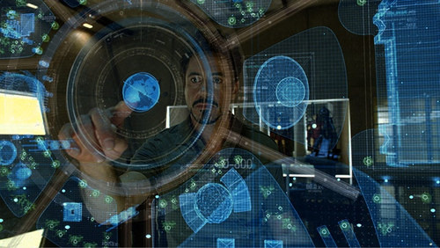

Hand Gesture Recognition Using Hidden Markov Models
Shuang Lu, Amir Harati and Joseph Picone
Institute for Signal and Information Processing
Temple University
Philadelphia, Pennsylvania, USA

Slide 2
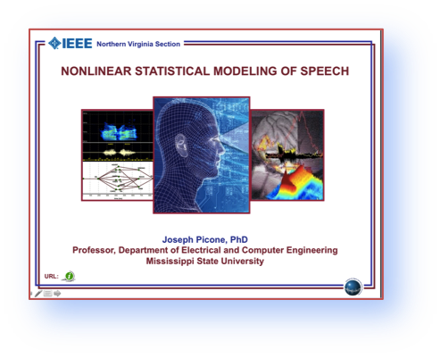
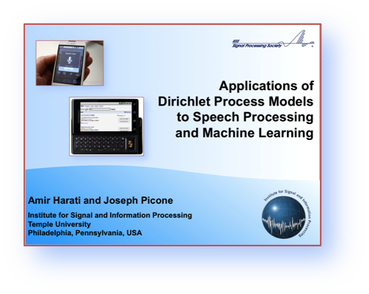
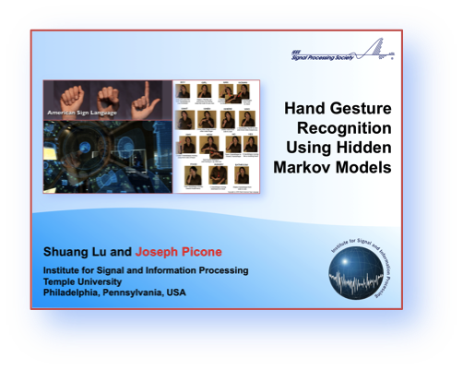
Abstract
Advanced gaming interfaces have generated renewed interest in hand gesture recognition as an ideal interface for human computer interaction. In this talk, we will discuss a specific application of gesture recognition - fingerspelling in American Sign Language. Signer-independent (SI) fingerspelling alphabet recognition is a very challenging task due to a number of factors including the large number of similar gestures, hand orientation and cluttered background. We propose a novel framework that uses a two-level hidden Markov model (HMM) that can recognize each gesture as a sequence of sub-units and performs integrated segmentation and recognition. We present results on signer-dependent (SD) and signer-independent (SI) tasks for the ASL Fingerspelling Dataset: error rates of 2.0% and 46.8% respectively.
Nonlinear Stats
March 25, 2009
The Sequel
May 9, 2012
Part III – Image
May 29, 2013

Slide 3
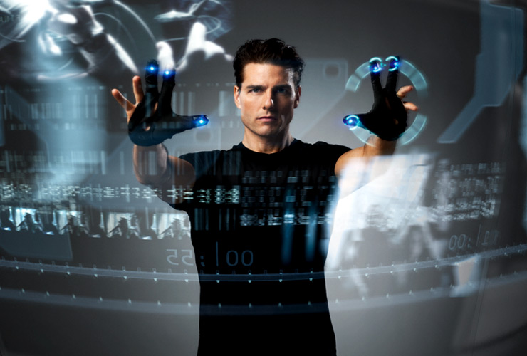
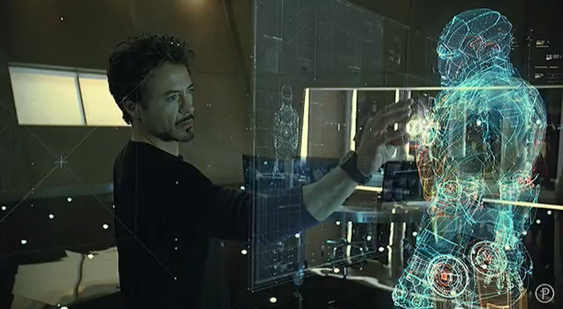
Gesture Recognition… In The Movies…
Emphasized the use of wireless data gloves to better localize hand positions.
Manipulated data on a 2D screen.
Relatively simple inventory of gestures focused on window manipulations.
Integrated gestures and speech recognition to provide a very natural dialog.
Introduced 3D visualization and object manipulation.
Virtual reality-style CAD.

Slide 4
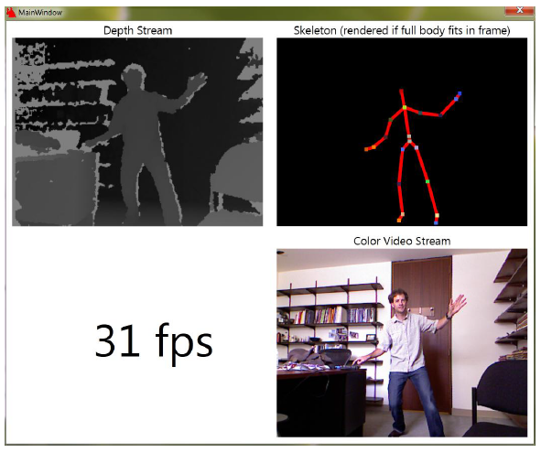
Gesture Recognition: Improved Sensors
Microsoft Kinect
  Motion sensing input device for Xbox
  (and Windows in 2014)
  8-bit RGB camera
  11-bit infrared depth sensor
  (infrared laser projector and CMOS sensor)
  Multi-array microphone
  Frame rate of 9 to 30 Hz
  Resolution from 640x480 to 1280x1024
RGB Camera
3D Depth Sensors
Motorized Tilt
Microphone Array
Depth images are useful for separating the image from the background
Wireframe modeling and other on-board signal processing provides high quality image tracking

Slide 5
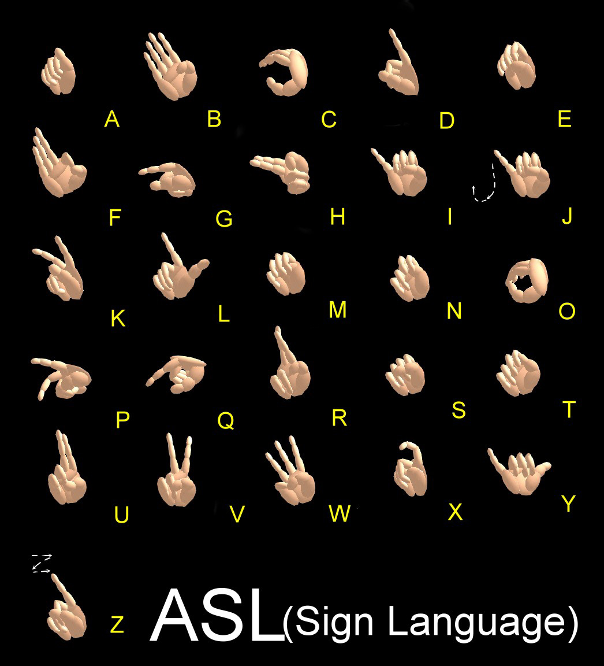
Gesture Recognition: American Sign Language (ASL)
Primary mode of communication for over 500,000 people in North America alone.
Approximately 6,000 words with unique signs.
Additional words are spelled using fingerspelling of alphabet signs.
In a typical communication, 10% to 15% of the words are signed by fingerspelling of alphabet signs.
Similar to written English, the one-handed Latin alphabet in ASL consists of 26 hand gestures.
The objective of our work is to classify 24 ASL alphabet signs from a static 2D image (we exclude “J” and “Z” because they are dynamic hand gestures).

Slide 6


Gesture Recognition: ASL still a challenging problem
Similar shapes
(e.g., “r” vs. “u”)
Separation of hand from background
Hand and background are similar in color
Hand and arm are similar in color
Background occurs within a hand shape
Left-handed vs. right-handed
Rotation, magnification, perspective, lighting, complex backgrounds, skin color, …
Signer independent (SI) vs.
signer dependent (SD)

Slide 7
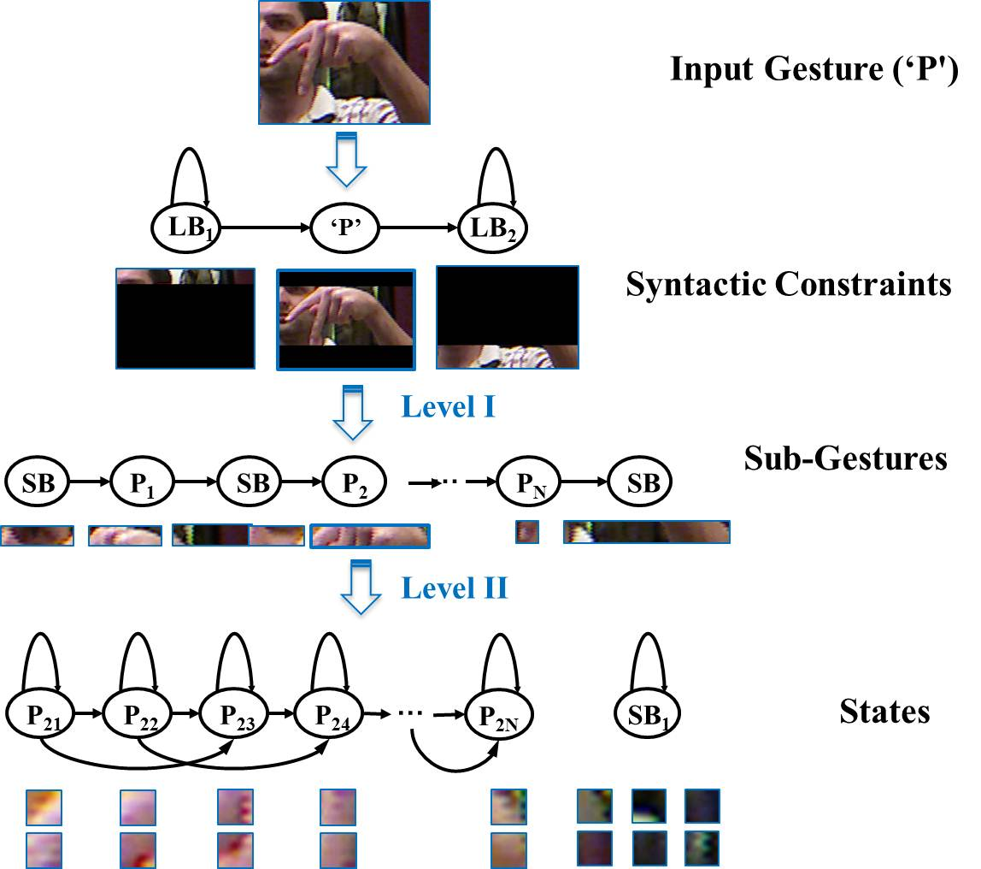
Architecture: Two-Level Hidden Markov Model

Slide 8
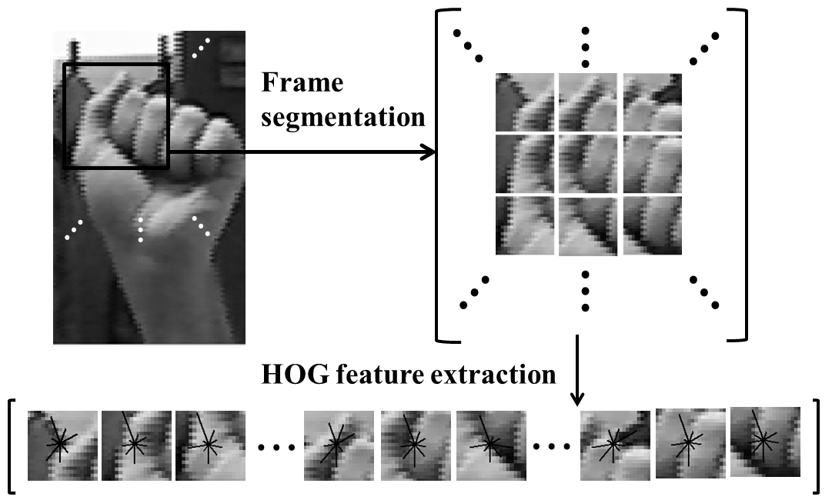
Architecture: Histogram of Oriented Gradient (HOG)
Gradient intensity and orientation:
In every window, separate A(x, y) (from 0 to 2π) into 9 regions; sum all G(x, y) within the same region.
Normalize features inside each block:
Benefits:
Illumination invariance due to the normalization of the gradient of the intensity values within a window.
Emphasizes edges by the use of an intensity gradient calculation.
Less sensitive to background details because the features use a distribution rather than a spatially-organized signal.

Slide 9
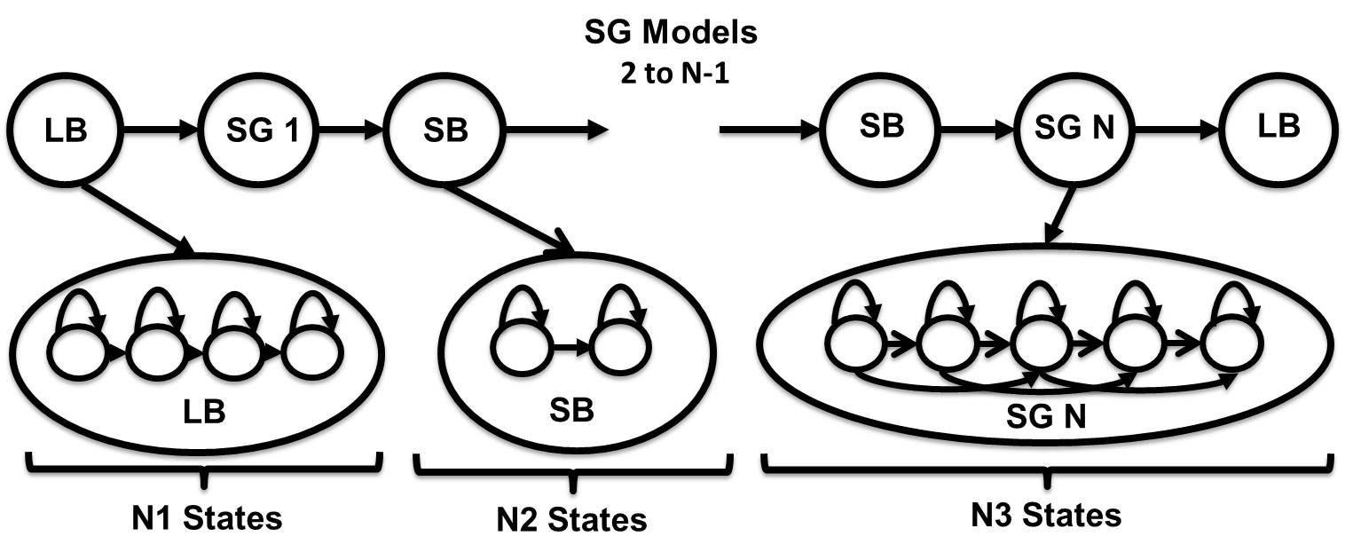

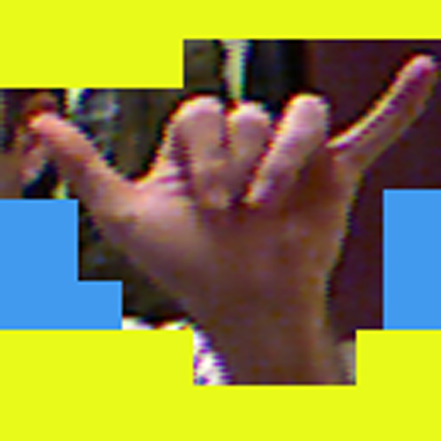
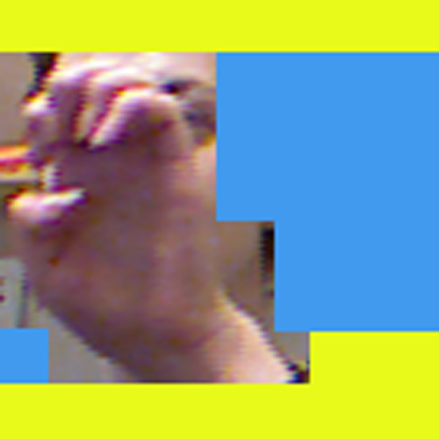
Architecture: Two-Levels of Hidden Markov Models

Slide 10
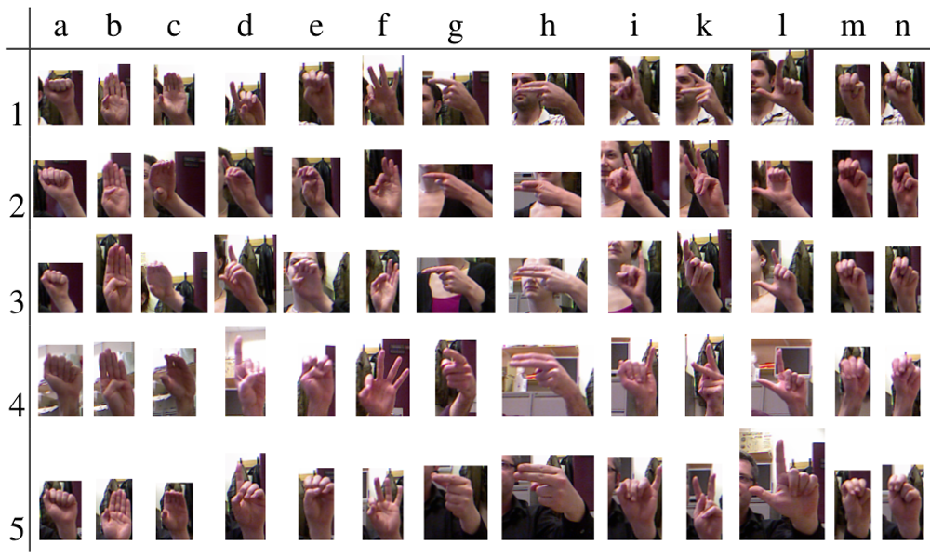
Experiments: ASL Fingerspelling Corpus
24 static gestures (excluding letters ”J” and ”Z”)
5 subsets from 4 subjects
More than 500 images per sign per subject
A total of 60,000 images
Similar gestures
Different image sizes
Face occlusion
Changes in illumination
Variations in signers
Sign rotation

Slide 11
Experiments: Parameter Tuning
Performance as a function of the frame/window size
Performance as a function of the number of mixture components
Frame (N) | Window (M) | % Overlap | Error (%)
5 | 20 | 75% | 7.1%
5 | 30 | 83% | 4.4%
10 | 20 | 50% | 5.1%
10 | 30 | 67% | 5.0%
10 | 60 | 83% | 8.0%
No. Mixtures | Error Rate (%)
1 | 9.9
2 | 6.8
4 | 4.4
8 | 2.9
16 | 2.0
System Parameter | Value
Frame Size (pixels) | 5
Window Size (pixels) | 30
No. HOG Bins | 9
No. Sub-gesture Segments | 11
No. States Per Sub-gesture Model | 21
No. States Long Background (LB) | 11
No. States Short Background (SB) | 1
No. Gaussian Mixtures (SG models) | 16
No. Gaussian Mixtures (LB/SB models) | 32
An overview of the optimal system parameters
Parameters were sequentially optimized and then jointly varied to test for optimality
Optimal settings are a function of the amount of data and magnification of the image

Slide 12
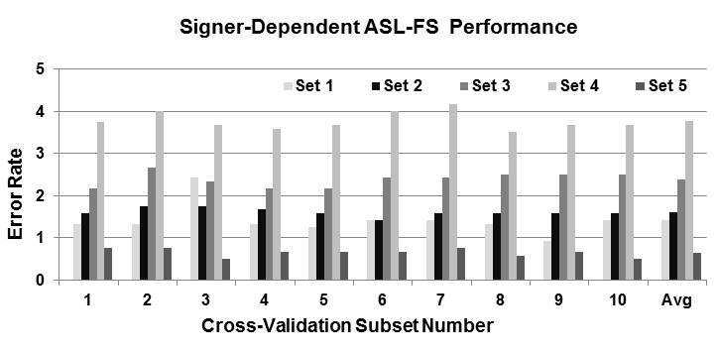
Experiments: SD vs. SI Recognition
Performance is relatively constant as a function of the cross-validation set
Greater variation as a function of the subject
System | SD | Shared | SI
Pugeault (Color Only) | N/A | 27.0% | 65.0%
Pugeault (Color + Depth) | N/A | 25.0% | 53.0%
HMM (Color Only) | 2.0% | 7.8% | 46.8%
SD performance is significantly better than SI performance.
“Shared” is a closed-subject test where 50% of the data is used for training and the other 50% is used for testing.
HMM performance doesn’t improve dramatically with depth.

Slide 13
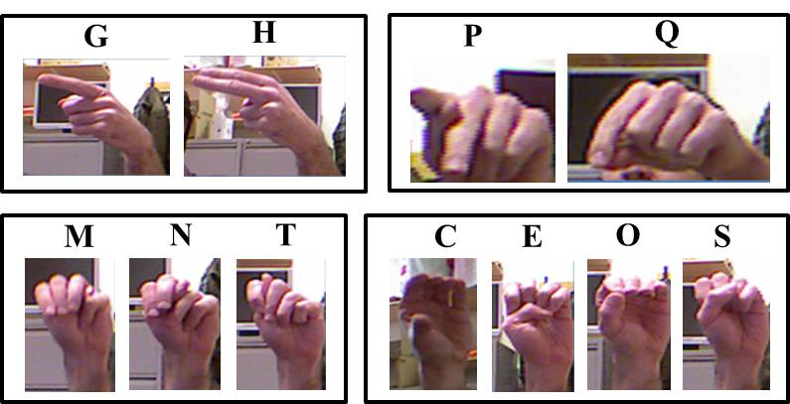
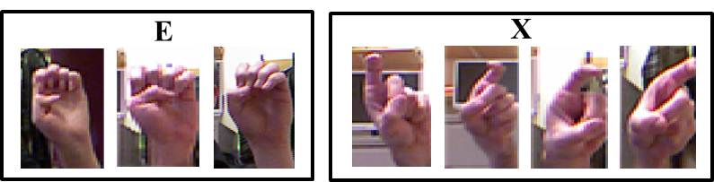
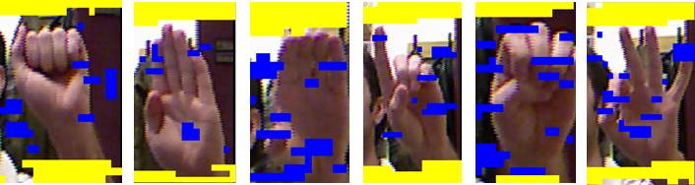
Experiments: Error Analysis
Gestures with a high confusion error rate.
Images with significant variations in background and hand rotation.
“SB” model is not reliably detecting background.
Solution: transcribed data?

Slide 14
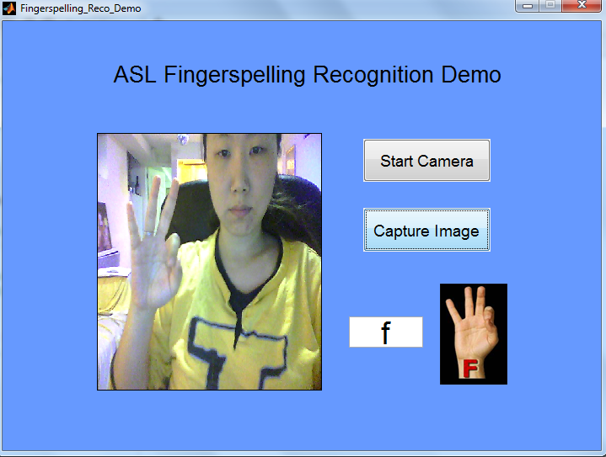
Analysis: ASL Fingerspelling Corpus
Region of interest
Recognition result

Slide 15
Summary and Future Directions
A two-level HMM‑based ASL fingerspelling alphabet recognition system that trains gesture and background noise models automatically:
Five essential parameters were tuned by cross-validation.
Our best system configuration achieved a 2.0% error rate on an SD task, and a 46.8% error rate on an SI task.
Currently developing new architectures that perform improved segmentation. Both supervised and unsupervised methods will be employed.
We expect performance to be significantly better on the SI task.
All scripts, models, and data related to these experiments are available from our project web site:
http://www.isip.piconepress.com/projects/asl_fs.

Slide 16
Brief Bibliography of Related Research
[1] Lu, S., & Picone, J. (2013). Fingerspelling Gesture Recognition Using Two Level Hidden Markov Model. Proceedings of the International Conference on Image Processing, Computer Vision, and Pattern Recognition. Las Vegas, USA. (Download).
[2] Pugeault, N. & Bowden, R. (2011). Spelling It Out: Real-time ASL Fingerspelling Recognition. Proceedings of the IEEE International Conference on Computer Vision Workshops (pp. 1114–1119). (available at http://info.ee.surrey.ac.uk/Personal/N.Pugeault/index.php?section=FingerSpellingDataset).
[3] Vieriu, R., Goras, B. & Goras, L. (2011). On HMM Static Hand Gesture Recognition. Proceedings of International Symposium on Signals, Circuits and Systems (pp. 1–4). Iasi, Romania.
[4] Kaaniche, M. & Bremond, F. (2009). Tracking HOG Descriptors for Gesture Recognition. Proceedings of the Sixth IEEE International Conference on Advanced Video and Signal Based Surveillance (pp. 140–145). Genova, Italy.
[5] Wachs, J. P., Kölsch, M., Stern, H., & Edan, Y. (2011). Vision-based Hand-gesture Applications. Communications of the ACM, 54(2), 60–71.

