Slide 1
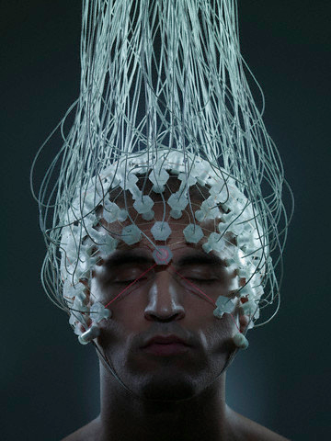
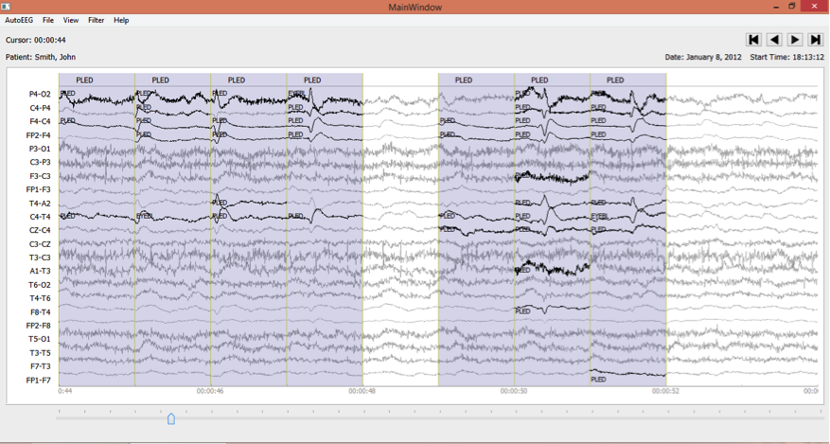
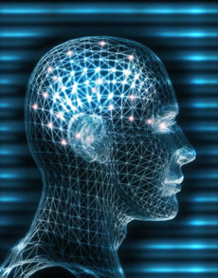

Deep Architectures For
Spatio-Temporal Sequence Recognition
With Applications in Automated Seizure Detection
A Dissertation Proposal by:
Meysam Golmohammadi
Neural Engineering Data Consortium
College of Engineering
Temple University
Philadelphia, Pennsylvania, USA

Slide 2
Abstract
  Scalp electroencephalograms (EEGs) are used in a broad range of health care institutions to monitor and record electrical activity in the brain using electrodes placed on the scalp. EEGs are essential in diagnosis of clinical conditions such as epilepsy.
  EEG records are manually interpreted by board certified physicians. Manual interpretation of EEGs is time-consuming and expensive. Automatic analysis of clinical EEGs is a very difficult machine learning problem due to the low fidelity of EEGs.
  Deep learning-based systems have generated significant improvements in performance for sequence recognitions tasks for temporal signals such as speech and for image analysis that exploit spatial correlations.
  The primary goal of our proposed research is to develop deep learning-based architectures that capture spatial and temporal correlations in an EEG signal. We specifically apply these architectures to the problem of automated seizure detection for adult EEGs.
  We will also analyze performance to gain additional insight into what aspects of the signal are being modeled adequately and where the models fail. A major outcome of this work will be a better understanding of the limitations of deep learning approaches for seizure detection.

Slide 3
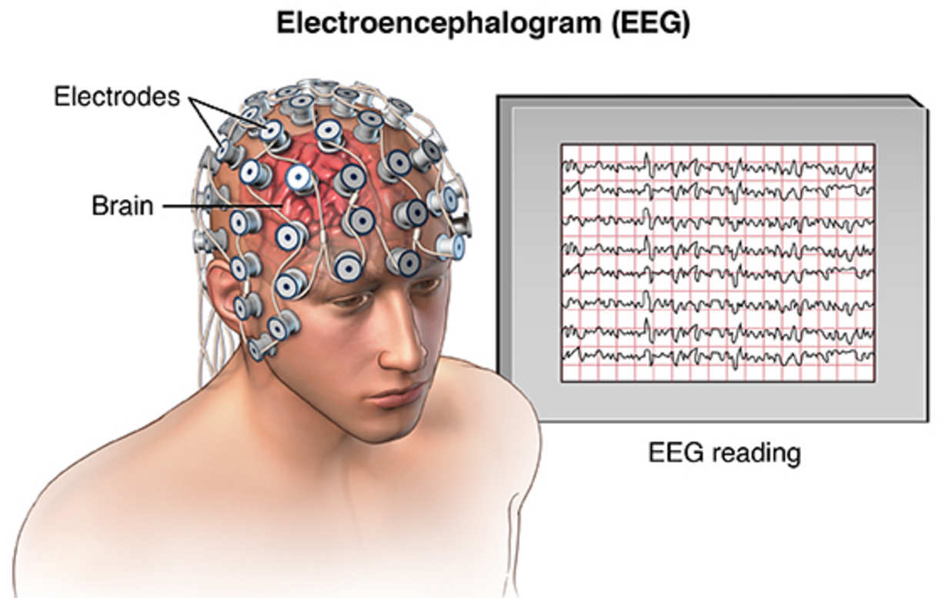
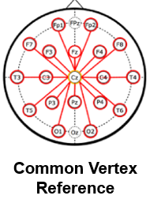
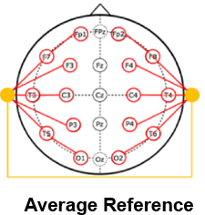
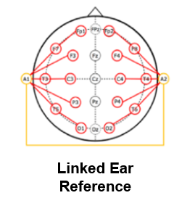
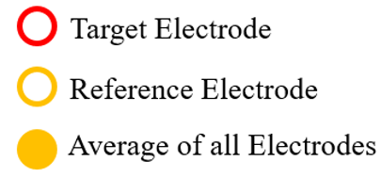
Electroencephalography (EEG)
Electroencephalography (EEG) refers to the recording of electrical activity along the scalp.
It is used to treat conditions such as sleep disorders and epilepsy.
Because an EEG is noninvasive and relatively inexpensive, it is still used despite the emergence of technologies such as Magnetic Resonance Imaging (MRI).
EEG records are manually interpreted by board certified physicians.
High performance automated analysis of EEGs can reduce time to diagnosis and enhance real-time applications by identifying sections of the signal that need further review.

Slide 4
Manual Interpretation of EEGs
Manual interpretation of an EEG is performed by a board-certified neurologist. It takes several years to receive this certification.
Inter-rater agreement is low: the interpretation of an EEG depends somewhat on the training and subjective judgement of the examiner.
Increasing the inter-rater agreement for EEG interpretation is one of the advantages of an automated technique.
Patient Preparation
EEG Recording
EEG ranging from 22 minutes to several days is recorded
EEG is Interpreted
Certified physicians interpret EEG
Patients are prepared for the test
EEG Report is Produced
Report of findings (e.g. abnormality) is prepared

Slide 5
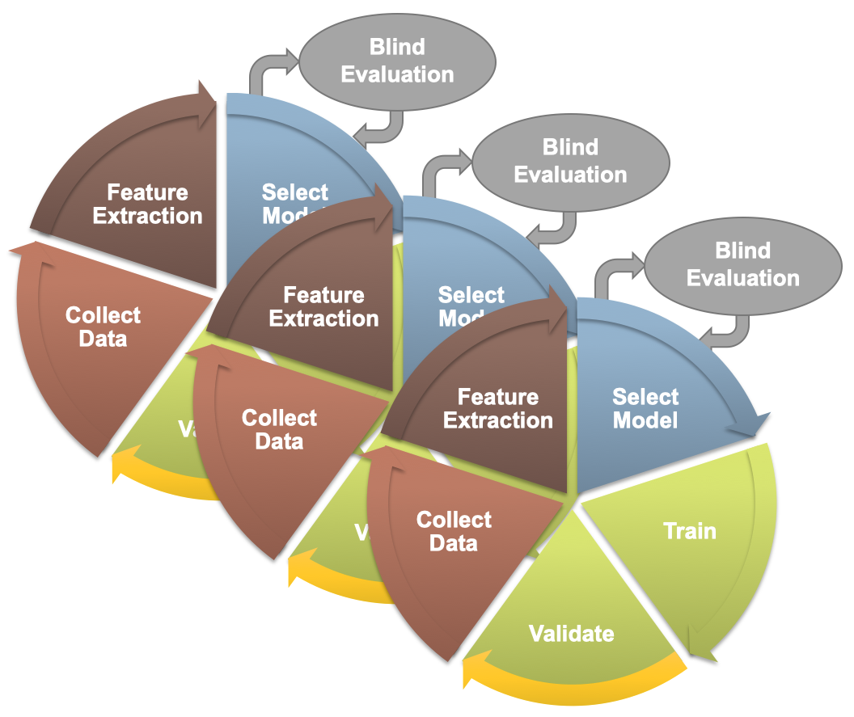
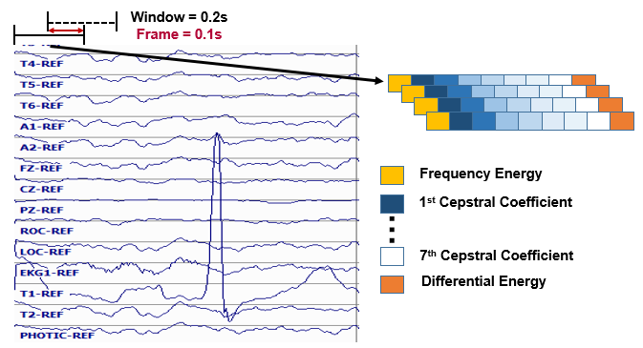
Baseline Approaches: Hidden Markov Models
  The design cycle for machine learning typically involves an iterative process where everything from data to the evaluation paradigm are tweaked to improve the overall performance and generalization of the system.
  Data is usually sorted into training, development test set and evaluation. Evaluations on the development set is used to guide system development.
  The first step in our machine learning systems consists of converting each channel of the EEG signal to features.
  Common EEG feature extraction methods include temporal, spatial and spectral analysis. In our systems, we use linear frequency cepstral coefficients (LFCCs).

Slide 6
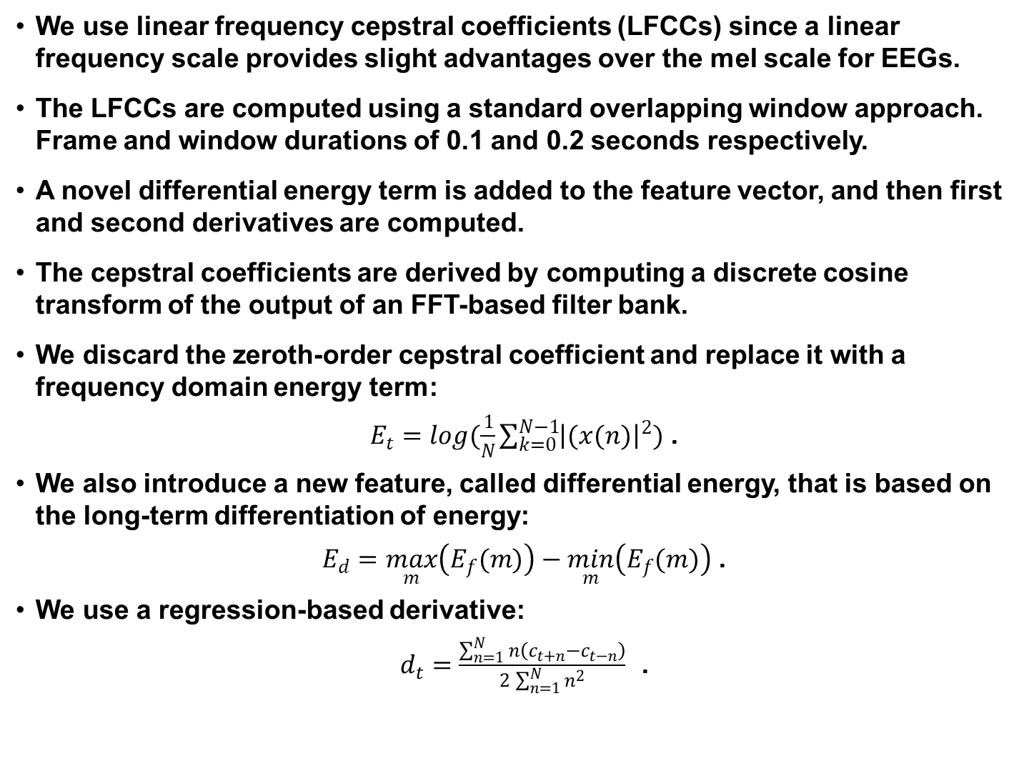
Linear Frequency Cepstral Coefficients (LFCCs)
  We use linear frequency cepstral coefficients (LFCCs) since a linear frequency scale provides slight advantages over the mel scale for EEGs.
  The LFCCs are computed using a standard overlapping window approach. Frame and window durations of 0.1 and 0.2 seconds respectively.
  A novel differential energy term is added to the feature vector, and then first and second derivatives are computed.
  The cepstral coefficients are derived by computing a discrete cosine transform of the output of an FFT-based filter bank.
  We discard the zeroth-order cepstral coefficient and replace it with a frequency domain energy term:
$E_{t}=\log{(\frac{1}{N}\sum_{k=0}^{N−1}{{\left|(x(n)\right|}^{2}})}$ .
  We also introduce a new feature, called differential energy, that is based on the long-term differentiation of energy:
$E_{d}=\max_{m}\left(E_{f}(m)\right)−\min_{m}\left(E_{f}(m)\right)$ .
  We use a regression-based derivative:
$d_{t}=\frac{\sum_{n=1}^{N}{n\left(c_{t+n}−c_{t−n}\right)}}{2\sum_{n=1}^{N}{n^{2}}}$ .

Slide 7
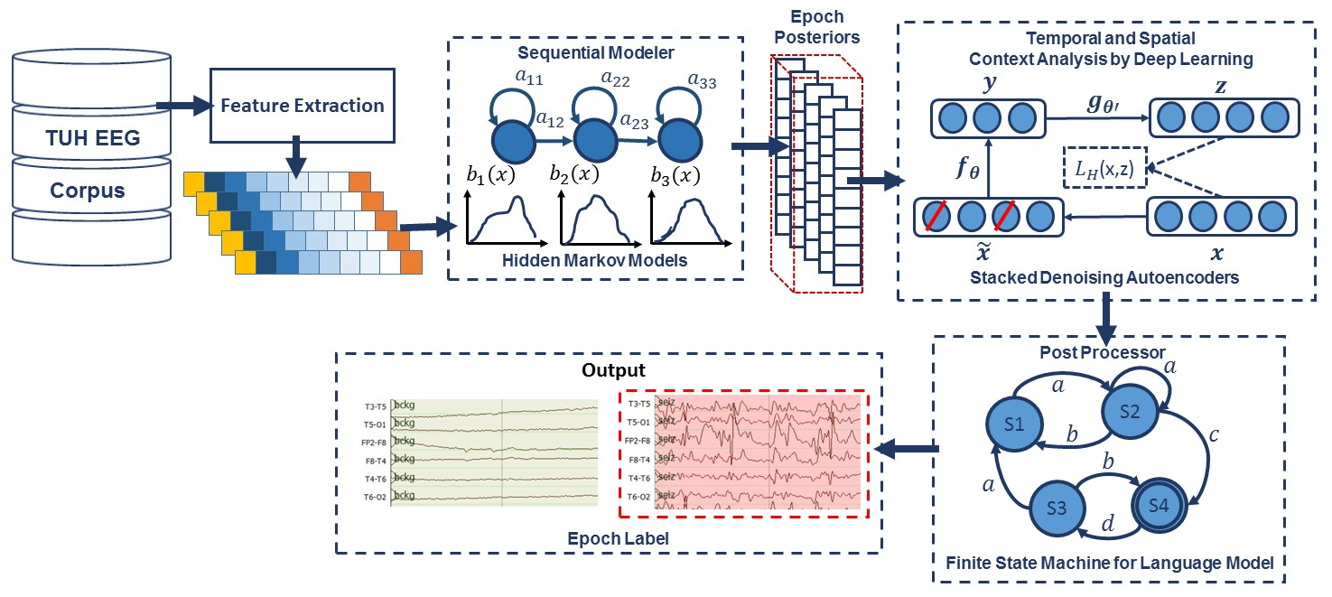
Automatic Analysis of EEGs: Six-Way Classification
  Our baseline system integrates hidden Markov models (HMMs) for sequential decoding of EEG events with deep learning-based postprocessing that incorporates temporal and spatial context:
  Classifies three patterns of clinical interest: (1) SPSW: spike and/or sharp waves, (2) GPED: generalized periodic epileptiform discharges, and (3) PLED: periodic lateralized epileptiform discharges.
  Also classifies three patterns used to model background activity: (1) EYEM: eye movement, (2) ARTF: artifacts, and (3) BCKG: background.

Slide 8
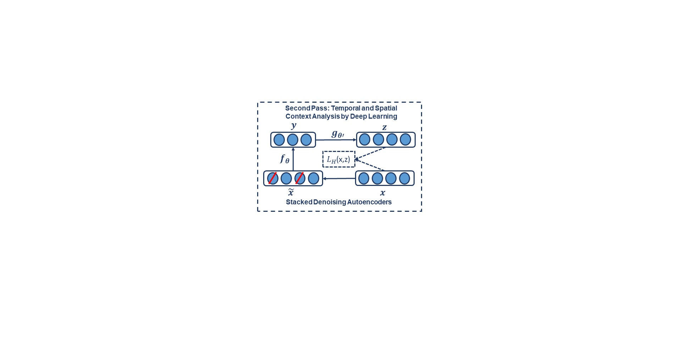
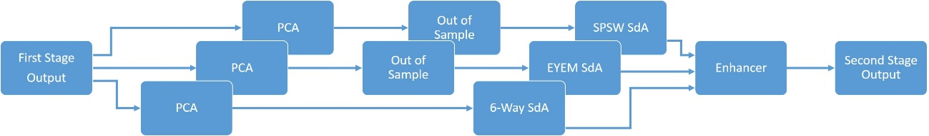
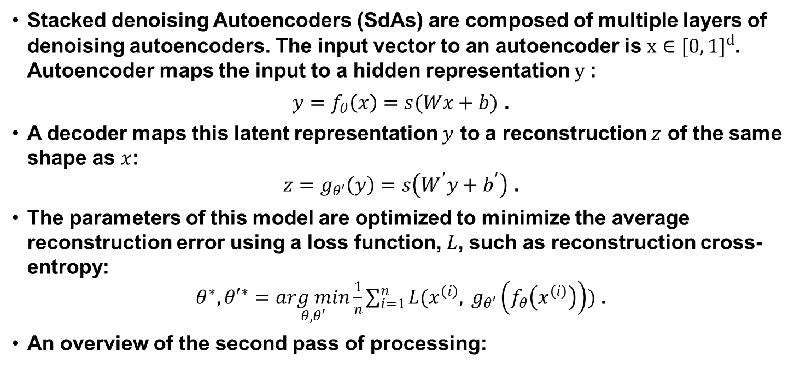
Temporal and Spatial Context Analysis With Deep Learning
  Stacked denoising Autoencoders (SdAs) are composed of multiple layers of denoising autoencoders. The input vector to an autoencoder is $x∈{[0, 1]}^{d}$. Autoencoder maps the input to a hidden representation$y$:
  $y=f_{θ}\left(x\right)=s(Wx+b)$ .
  A decoder maps this latent representation $y$ to a reconstruction $z$ of the same shape as $x$:
  $z=g_{θ′}\left(y\right)=s\left(W^{′}y+b^{′}\right)$ .
  The parameters of this model are optimized to minimize the average reconstruction error using a loss function, $L$, such as reconstruction cross-entropy:
  $θ^{∗},{θ′}^{∗}=\underset{θ,θ′}{arg min}{\frac{1}{n}\sum_{i=1}^{n}{L(x^{\left(i\right)}, }}g_{θ′}\left(f_{θ}\left(x^{\left(i\right)}\right)\right))$ .
  An overview of the second pass of processing:

Slide 9
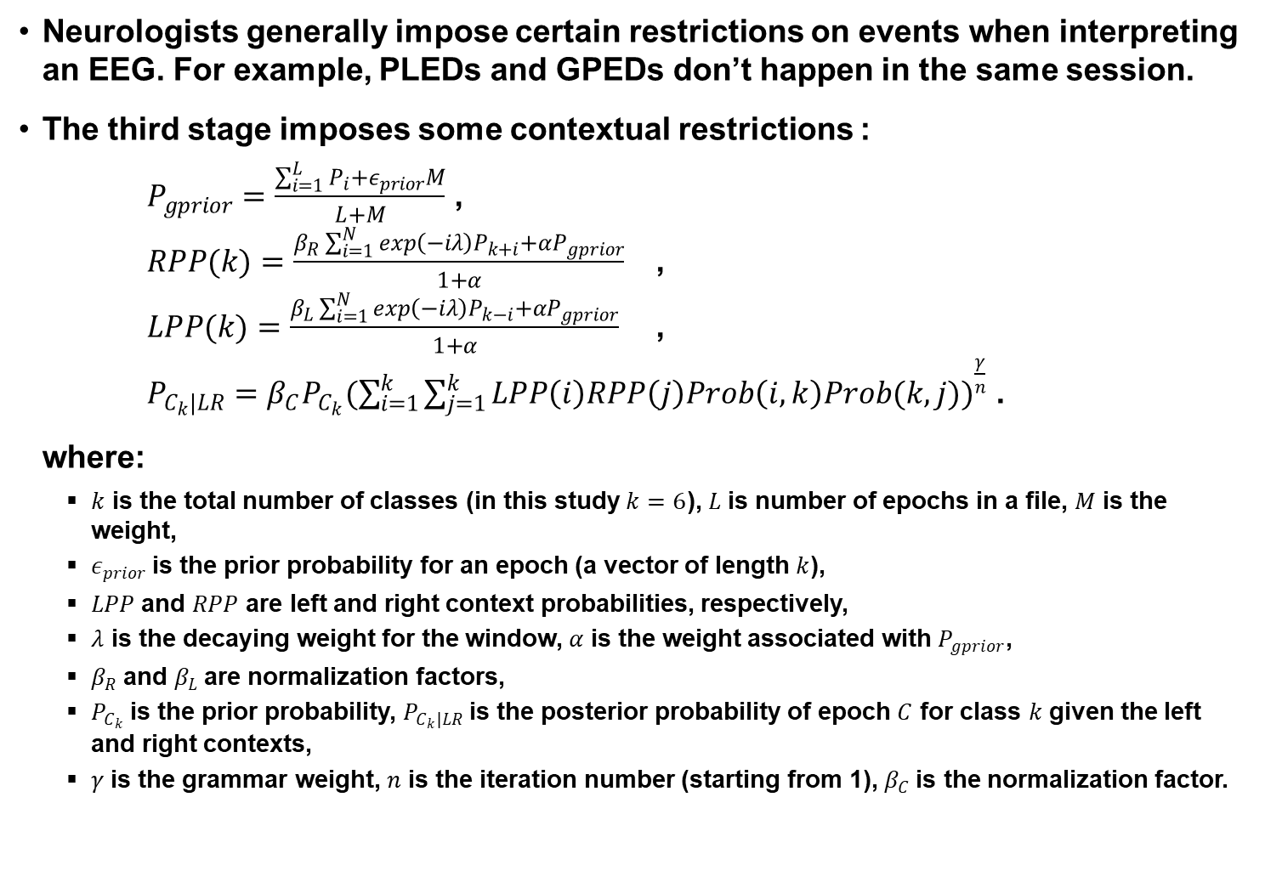
Statistical Language Modeling
Neurologists generally impose certain restrictions on events when interpreting an EEG. For example, PLEDs and GPEDs don’t happen in the same session.
The third stage imposes some contextual restrictions :
    $P_{gprior}=\frac{\sum_{i=1}^{L}{P_{i}+ε_{prior}M}}{L+M}$ ,
    $RPP(k)=\frac{β_{R}\sum_{i=1}^{N}{\exp\left(−iλ\right)P_{k+i}+αP_{gprior}}}{1+α}$ ,
    $LPP(k)=\frac{β_{L}\sum_{i=1}^{N}{\exp\left(−iλ\right)P_{k−i}+αP_{gprior}}}{1+α}$ ,
    $P_{C_{k}|LR}=β_{C}P_{C_{k}}{(\sum_{i=1}^{k}{\sum_{j=1}^{k}{LPP\left(i\right)RPP\left(j\right)Prob\left(i,k\right)Prob(k,j))}}}^{\frac{γ}{n}}$ .
  where:
  $k$ is the total number of classes (in this study$k=6$), $L$is number of epochs in a file, $M$ is the weight,
  $ε_{prior}$is the prior probability for an epoch (a vector of length $k$),
  $LPP$and $RPP$ are left and right context probabilities, respectively,
  $λ$ is the decaying weight for the window, $α$ is the weight associated with $P_{gprior}$,
  $β_{R}$and $β_{L}$are normalization factors,
  $P_{C_{k}}$is the prior probability, $P_{C_{k}|LR}$is the posterior probability of epoch $C$ for class $k$given the left and right contexts,
  $γ$is the grammar weight, $n$ is the iteration number (starting from 1), $β_{C}$is the normalization factor.

Slide 10
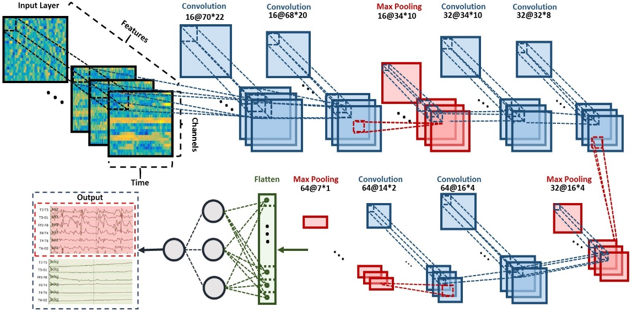
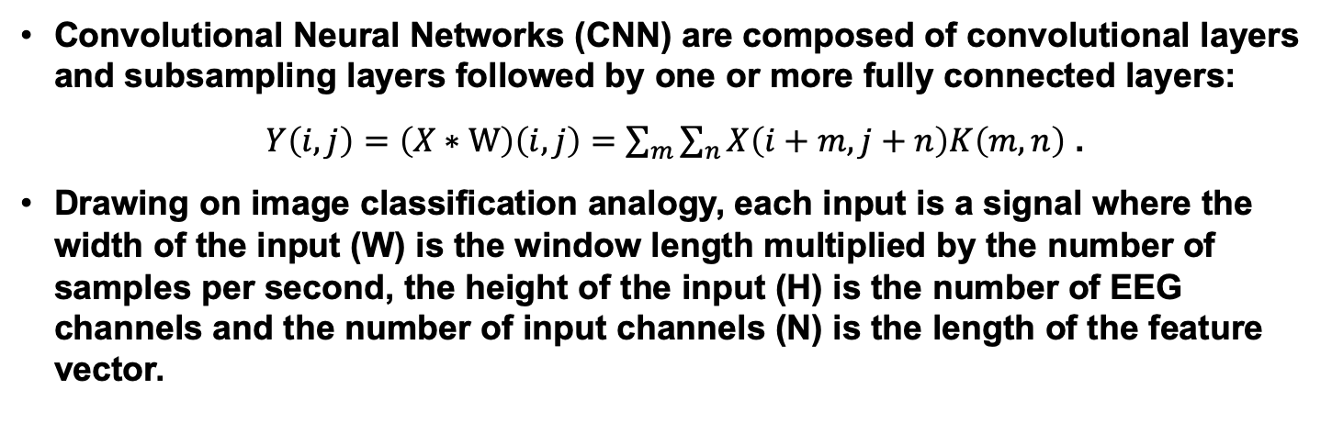
Automatic Seizure Detection Using CNN/MLP
  Convolutional Neural Networks (CNN) are composed of convolutional layers and subsampling layers followed by one or more fully connected layers:
$Y\left(i,j\right)=\left(X∗W\right)\left(i,j\right)=\sum_{m}{\sum_{n}{X\left(i+m,j+n\right)K\left(m,n\right)}}$ .
  Drawing on image classification analogy, each input is a signal where the width of the input (W) is the window length multiplied by the number of samples per second, the height of the input (H) is the number of EEG channels and the number of input channels (N) is the length of the feature vector.
  A window duration of 7 secs is used.
  The first convolutional layer filters the input of size of 70 × 22 × 26 using 16 kernels of size 3 × 3 with a stride of 1.
  The input feature vectors have a dimension of 26, while there are 22 EEG channels.

Slide 11
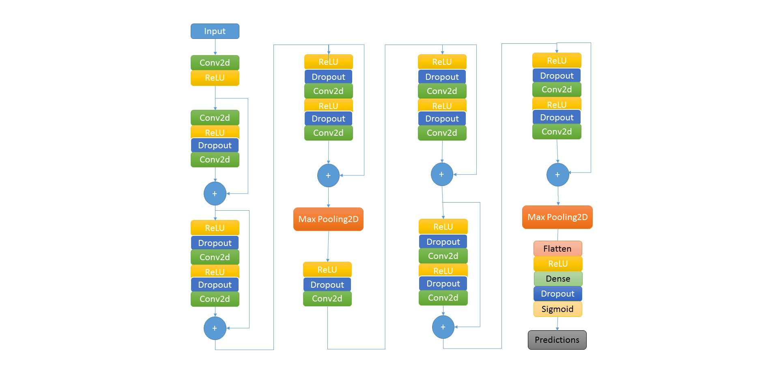
Augmenting CNNs with Deep Residual Learning
  A deep residual learning framework, ResNet, is shown that consists of 14 layers of convolution followed by a fully connected layer and a sigmoid as the last layer.
  The deep residual learning structure mitigates two important problems: vanishing/exploding gradients and saturation of accuracy when the number of layers is increased.
The network consists of 6 residual blocks with two 2D convolutional layers per block, a fully connected layer and a single dense neuron as the last layer.
The first 7 layers have 32 filters while the last layers have 64 filters. We increment the number of filters from 32 to 64, since the initial layers represent generic features, while the deeper layers represent more detailed features.

Slide 12
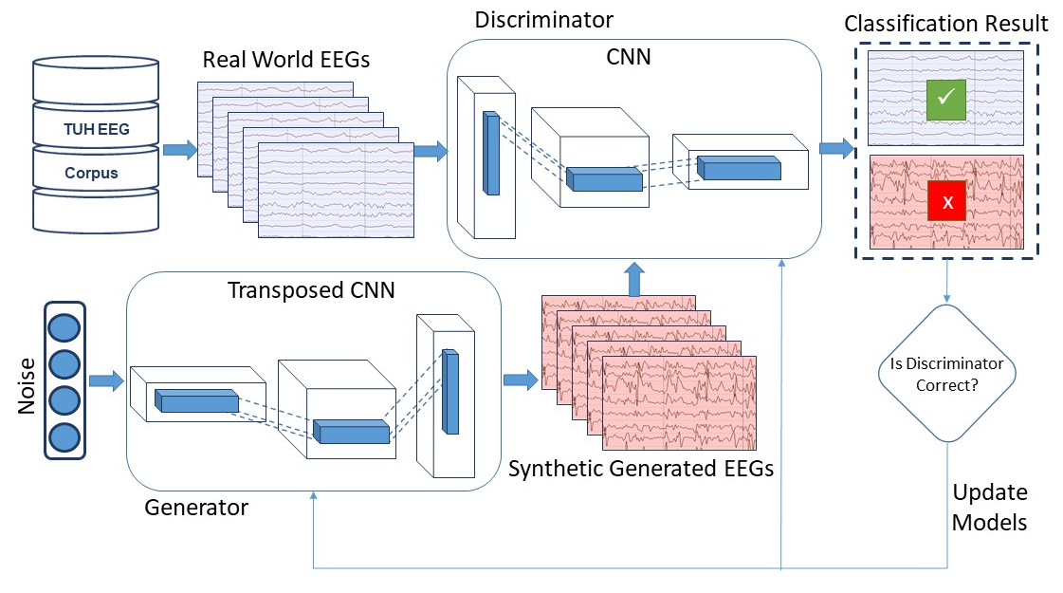
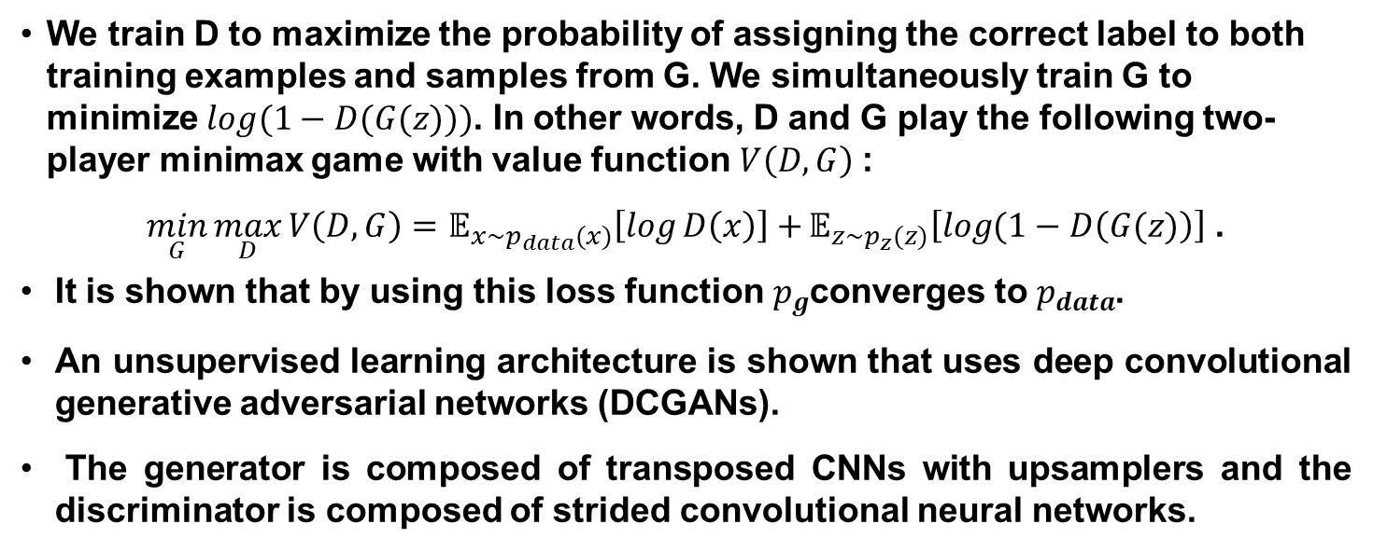
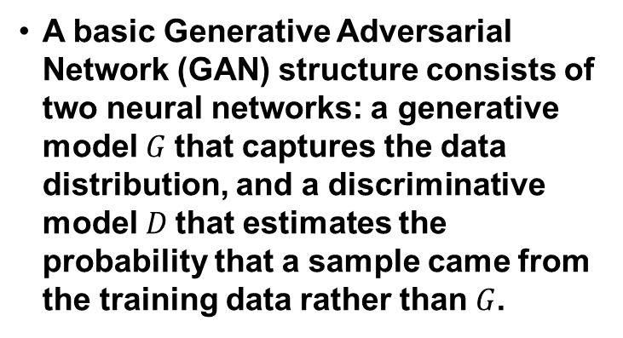
Generative Adversarial Networks
A basic Generative Adversarial Network (GAN) structure consists of two neural networks: a generative model$G$ that captures the data distribution, and a discriminative model $D$that estimates the probability that a sample came from the training data rather than$G$.
We train D to maximize the probability of assigning the correct label to both training examples and samples from G. We simultaneously train G to minimize $log(1−D(G(z)))$. In other words, D and G play the following two-player minimax game with value function $V\left(D,G\right)$:
  $\min_{G}{\max_{D}{V\left(D,G\right)=𝔼_{x\sim p_{data}(x)}\left[\log{D\left(x\right)}\right]+}}𝔼_{z\sim p_{z}(z)}\left[\log{(1−D\left(G(z)\right)}\right]$ .
  It is shown that by using this loss function $p_{g}$converges to $p_{data}$.
  An unsupervised learning architecture is shown that uses deep convolutional generative adversarial networks (DCGANs).
  The generator is composed of transposed CNNs with upsamplers and the discriminator is composed of strided convolutional neural networks.

Slide 13
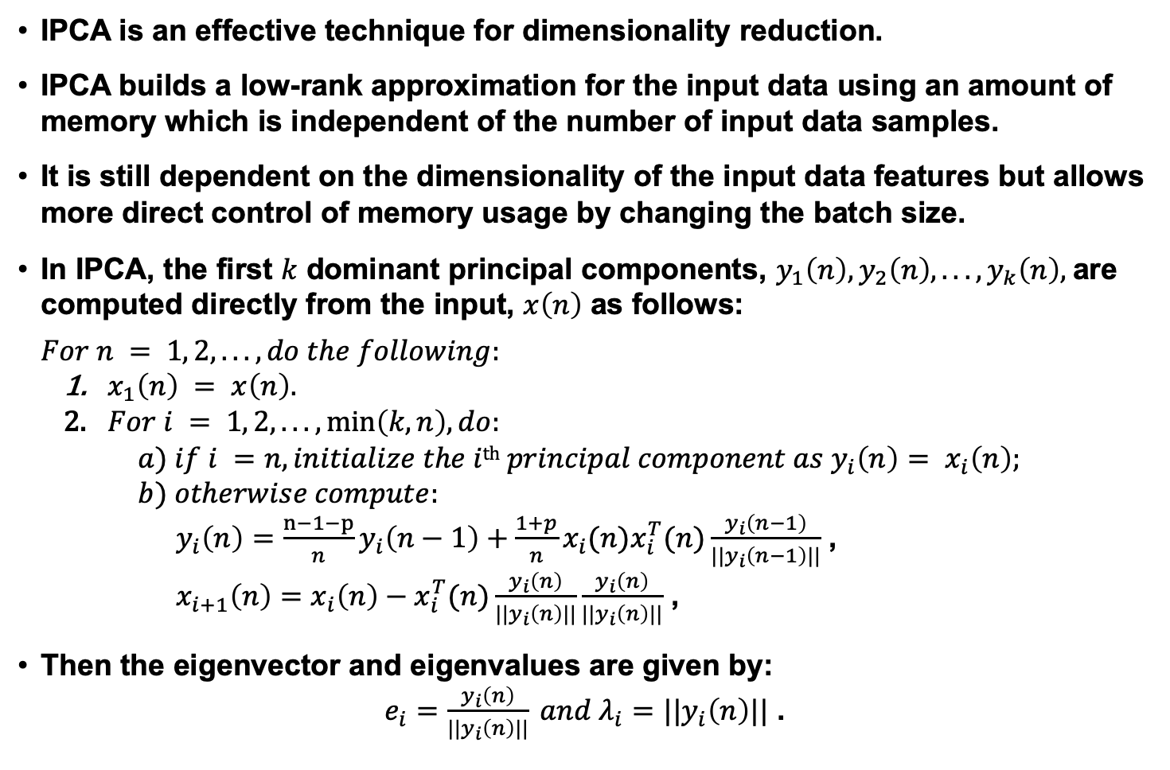
Incremental Principal Components Analysis (IPCA)
  IPCA is an effective technique for dimensionality reduction.
  IPCA builds a low-rank approximation for the input data using an amount of memory which is independent of the number of input data samples.
  It is still dependent on the dimensionality of the input data features but allows more direct control of memory usage by changing the batch size.
  In IPCA, the first $k$ dominant principal components, $y_{1}\left(n\right), y_{2}\left(n\right), ...,y_{k}\left(n\right),$are computed directly from the input, $x\left(n\right)$ as follows:
  $$For n = 1, 2, . . ., do the following:$$
    $x_{1}\left(n\right) = x\left(n\right).$
    $For i = 1, 2, . . . , min\left(k, n\right), do:$
      $$a) if i =n, initialize the ith principal component as y_{i}\left(n\right)= x_{i}\left(n\right);$$
      $$b) otherwise compute:$$
        $y_{i}\left(n\right)=\frac{n−1−p}{n}y_{i}\left(n−1\right)+\frac{1+p}{n}x_{i}(n)x_{i}^{T}(n)\frac{y_{i}\left(n−1\right)}{||y_{i}\left(n−1\right)||}$ ,
        $x_{i+1}\left(n\right)=x_{i}\left(n\right)−x_{i}^{T}(n)\frac{y_{i}\left(n\right)}{||y_{i}\left(n\right)||}\frac{y_{i}\left(n\right)}{||y_{i}\left(n\right)||}$ ,
Then the eigenvector and eigenvalues are given by:
$e_{i}=\frac{y_{i}\left(n\right)}{||y_{i}\left(n\right)||} and λ_{i}=||y_{i}\left(n\right)||$ .
Notes:
It is often more memory efficient than PCA. IPCA has constant memory complexity proportional to the batch size, and it enables use of large datasets without a need to load the entire file or dataset into memory.

Slide 14
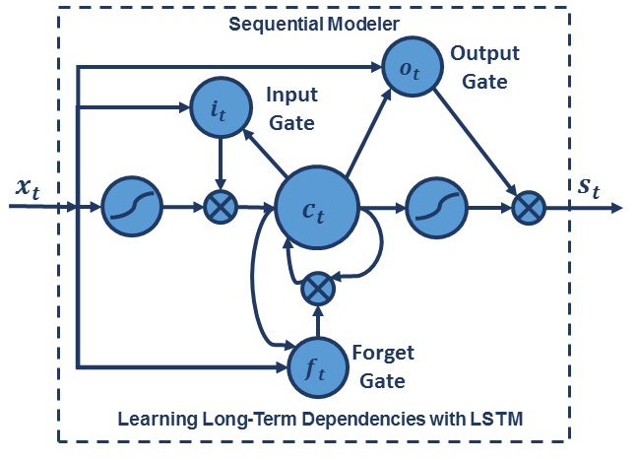
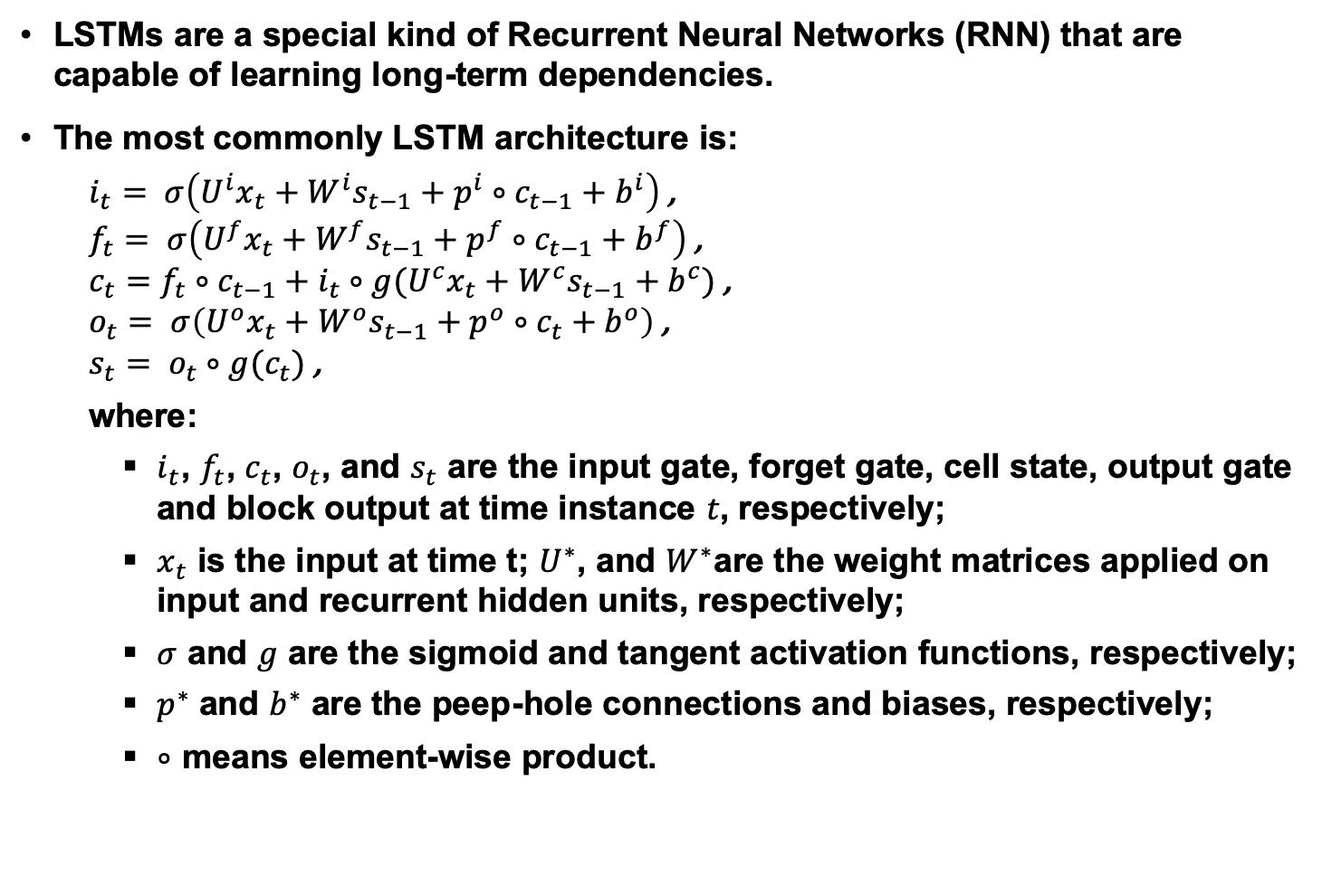
Long Short-Term Memory Networks (LSTMs)
  LSTMs are a special kind of Recurrent Neural Networks (RNN) that are capable of learning long-term dependencies.
  The most commonly LSTM architecture is:
    $i_{t}= σ\left({U^{i}x}_{t}+W^{i}s_{t−1}+p^{i}∘c_{t−1}+b^{i}\right)$ ,
    $f_{t}= σ\left({U^{f}x}_{t}+W^{f}s_{t−1}+p^{f}∘c_{t−1}+b^{f}\right)$ ,
    $c_{t}=f_{t}∘c_{t−1}+i_{t}∘g({U^{c}x}_{t}+W^{c}s_{t−1}+b^{c})$ ,
    $o_{t}= σ\left({U^{o}x}_{t}+W^{o}s_{t−1}+p^{o}∘c_{t}+b^{o}\right)$ ,
    $s_{t}= o_{t}∘g(c_{t})$ ,
  where:
    $i_{t}$, $f_{t}$, $c_{t}$, $o_{t}$, and $s_{t}$ are the input gate, forget gate, cell state, output gate and block output at time instance $t$, respectively;
    $x_{t}$ is the input at time t; $U^{∗}$, and $W^{∗}$are the weight matrices applied on input and recurrent hidden units, respectively;
    $σ$ and $g$ are the sigmoid and tangent activation functions, respectively;
    $p^{∗}$ and $b^{∗}$ are the peep-hole connections and biases, respectively;
    $∘$ means element-wise product.
Notes:
It is often more memory efficient than PCA. IPCA has constant memory complexity proportional to the batch size, and it enables use of large datasets without a need to load the entire file or dataset into memory.

Slide 15
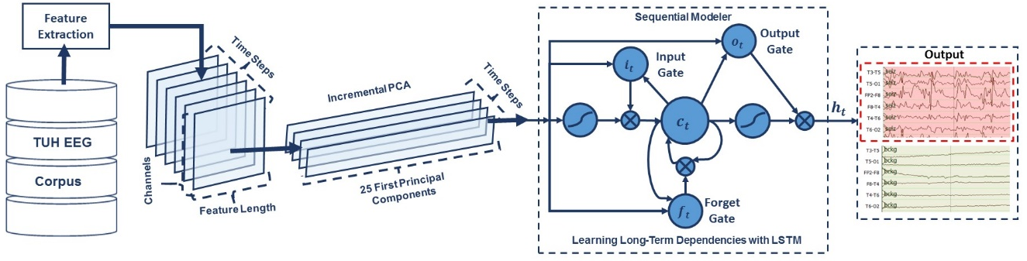
Integration of IPCA with LSTMs
An architecture that integrates IPCA for spatial context analysis and LSTM for learning long-term temporal dependencies:
Our experiments have shown that 7 seconds of temporal context performs well. The corresponding dimension of the vector input to IPCA is 22 channels × 26 features × 7 seconds × 10 frames/second, or a total of 4,004 elements.
A batch size of 50 is used in IPCA and the dimension of its output is 25 elements per frame at 10 frames/second.
In order to learn long-term dependencies, one LSTM with a hidden layer size of 128 and batch size of 128 is used along with Adam optimization and a cross-entropy loss function.

Slide 16
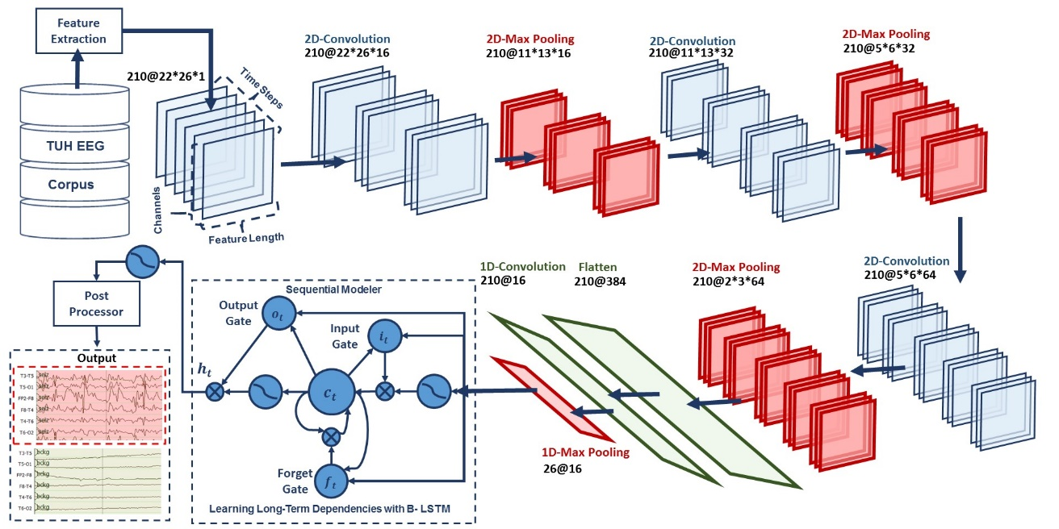
End-to-End Sequence Labeling Using Deep Architectures
  A deep recurrent convolutional architecture for two-dimensional decoding of EEG signals that integrates 2D CNNs, 1-D CNNs and LSTM networks:
  In our optimized system, where features are available 10 times per second, a window duration of 21 seconds is used.
  The first 2D convolutional layer filters 210 frames (T = 21 × 10) of EEGs distributed in time with a size of 26 × 22 × 1 (W = 26, H = 22, N = 1) using 16 kernels of size 3 × 3 with a stride of 1.
  The first 2D max pooling layer takes as input a vector which is 260 frames distributed in time with a size of 26 × 22 × 16 and applies a pooling size of 2 × 2. This process is repeated twice.

Slide 17
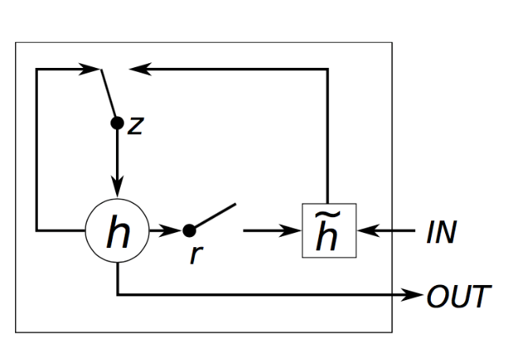
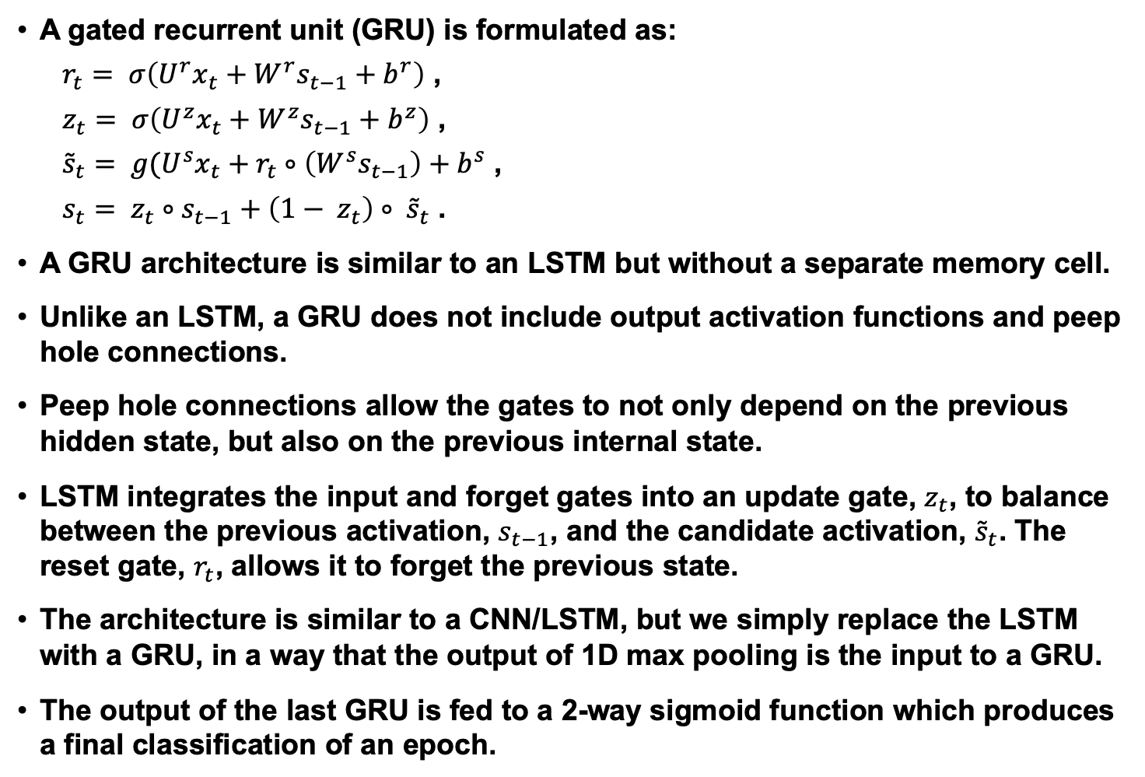
End-to-End Sequence Labeling with CNN/GRU
A gated recurrent unit (GRU) is formulated as:
$r_{t}= σ\left({U^{r}x}_{t}+W^{r}s_{t−1}+b^{r}\right)$ ,
$z_{t}= σ\left({U^{z}x}_{t}+W^{z}s_{t−1}+b^{z}\right)$ ,
${\tilde{s}}_{t}= g({U^{s}x}_{t}+r_{t}∘\left(W^{s}s_{t−1}\right)+b^{s}$ ,
$s_{t}= z_{t}∘s_{t−1}+\left(1− z_{t}\right)∘ {\tilde{s}}_{t}$ .
A GRU architecture is similar to an LSTM but without a separate memory cell.
Unlike an LSTM, a GRU does not include output activation functions and peep hole connections.
Peep hole connections allow the gates to not only depend on the previous hidden state, but also on the previous internal state.
LSTM integrates the input and forget gates into an update gate, $z_{t}$, to balance between the previous activation, $s_{t−1}$, and the candidate activation, ${\tilde{s}}_{t}$. The reset gate, $r_{t}$, allows it to forget the previous state.
The architecture is similar to a CNN/LSTM, but we simply replace the LSTM with a GRU, in a way that the output of 1D max pooling is the input to a GRU.
The output of the last GRU is fed to a 2-way sigmoid function which produces a final classification of an epoch.

Slide 18

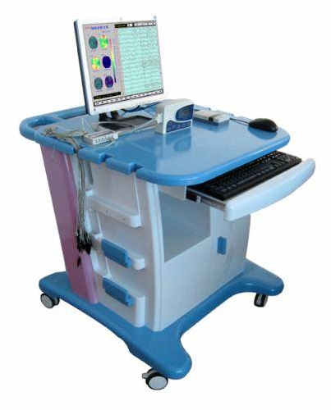
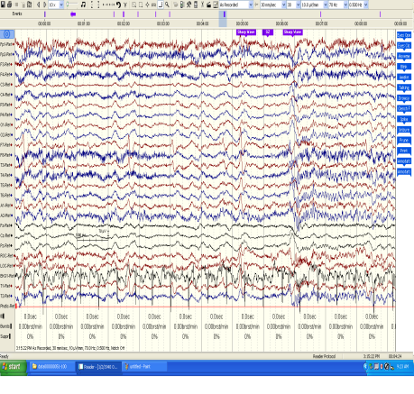
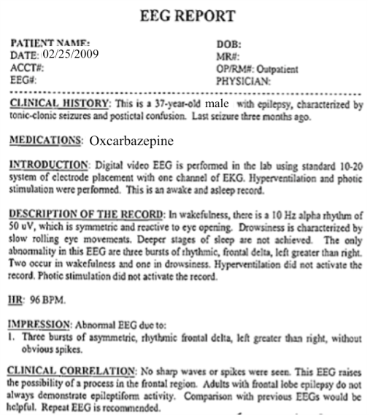
The Temple University Hospital EEG Corpus
Synopsis: The world’s largest publicly available EEG corpus consisting of 30,000+ EEGs collected
from 22,000+ patients, collected over 17 years. Includes physician’s diagnoses and patient medical
histories. Signal data distributed in an EDF format.
Impact:
  Sufficient data to support application of state-of-the-art machine learning algorithms
  Patient medical histories, particularly drug treatments, supports statistical analysis of correlations between signals and treatments
  Historical archive also supports investigation of EEG changes over time for a given patient
  Enables the development of real-time monitoring
Database Overview:
  30,000+ EEGs collected at Temple University Hospital from 2002 to 2019 (an ongoing process)
  Recordings vary from 24 to 36 channels of signal data sampled at 250 Hz
  Patients range in age from 18 to 90 with an average of 1.75 EEGs per patient
  Data includes a test report generated by a technician, an impedance report and a physician’s report; data from 2009 forward inlcudes ICD-9 codes
  A total of 1.8 TBytes of data
  Personal information
  has been redacted
  Clinical history and medication history are included
  Physician notes are captured in three fields: description, impression and correlation fields.

Slide 19
6-Way Event Classification
Pass | Event | ARTF | BCKG | EYEM | GPED | PLED | SPSW
First | ARTF | 41.24 | 45.19 | 2.18 | 3.81 | 2.77 | 4.81
 | BCKG | 7.02 | 71.93 | 2.59 | 7.37 | 2.28 | 8.81
 | EYEM | 2.13 | 0.61 | 82.37 | 2.13 | 8.51 | 4.26
 | GPED | 7.46 | 4.85 | 2.39 | 53.32 | 20.42 | 11.55
 | PLED | 0.70 | 1.85 | 4.70 | 17.62 | 54.80 | 20.32
 | SPSW | 4.41 | 8.29 | 9.17 | 33.33 | 4.59 | 40.21
Second | ARTF | 27.49 | 61.73 | 7.28 | 0.00 | 1.08 | 2.43
 | BCKG | 7.00 | 82.03 | 5.79 | 0.97 | 0.36 | 3.86
 | EYEM | 4.21 | 16.84 | 77.89 | 0.00 | 0.00 | 1.05
 | GPED | 0.60 | 14.69 | 0.00 | 59.96 | 10.26 | 14.49
 | PLED | 1.40 | 22.65 | 0.80 | 13.83 | 52.30 | 9.02
 | SPSW | 7.69 | 35.90 | 2.56 | 28.21 | 0.00 | 25.64
Third | ARTF | 14.04 | 72.98 | 10.18 | 0.00 | 0.00 | 2.81
 | BCKG | 3.42 | 81.40 | 8.93 | 0.30 | 0.00 | 5.95
 | EYEM | 2.30 | 17.24 | 79.31 | 0.00 | 0.00 | 1.15
 | GPED | 0.30 | 3.65 | 0.00 | 65.05 | 13.37 | 17.63
 | PLED | 0.00 | 10.76 | 0.49 | 9.78 | 65.28 | 13.69
 | SPSW | 10.00 | 33.33 | 13.33 | 10.00 | 0.00 | 33.33
  First Pass: HMM-based sequential modeling.
  Second Pass: temporal and spatial context analysis using SdA.
  Third Pass: statistical language modeling.
  The overall performance is promising with more than 90% sensitivity while maintaining a specificity above 95%.
  The first pass classification results for all these tables are measured by counting each epoch for each channel as an independent event.
  We refer to this as forced-choice event-based scoring because every epoch for every channel is assigned a score based on its class label.

Slide 20
Automatic Seizure Detection on TUSZ
  The accuracy reported here is much
  lower than what is often published in the
  literature on other seizure detection tasks:
    The neuroscience community has favored a
    more permissive method of scoring that tends
    to produce much higher sensitivities and lower
    false alarm (FA) rates.
    TUSZ is a much more difficult task than any
    previously released open source corpus.
    The evaluation set was designed to be
    representative of common clinical issues and
    includes many challenging examples of seizures.
  Adding a deep learning structure for
  temporal and spatial analysis of EEGs can
  decrease the FA rate dramatically.
  By comparing the results of HMM/SdA with HMM/LSTM, we find that a simple one-layer LSTM performs better than 3 layers of SdA due to LSTM’s ability to explicitly model long-term dependencies.
System | Sensitivity | Specificity | FA/24 Hrs.
HMM | 30.32% | 80.07% | 244
HMM/SdA | 35.35% | 73.35% | 77
HMM/LSTM | 30.05% | 80.53% | 60
IPCA/LSTM | 32.97% | 77.57% | 73
CNN/MLP | 39.09% | 76.84% | 77
CNN/GRU | 30.83% | 91.49% | 21
ResNet | 30.50% | 94.24% | 13
CNN/LSTM | 30.83% | 97.10% | 6

Slide 21
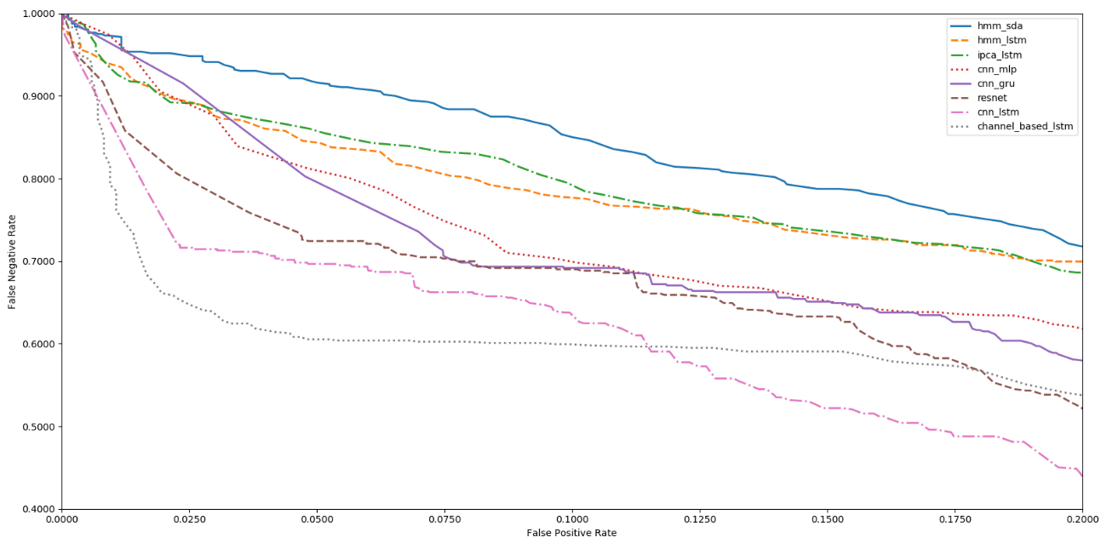
Performance at Low False Alarm Rates
  The best overall system shown is CNN/LSTM. CNN/LSTM is a doubly deep recurrent convolutional structure that models both spatial relationships (e.g., cross-channel dependencies) and temporal dynamics (e.g., spikes).
  CNN/LSTM does a much better job rejecting artifacts that are easily confused with spikes because these appear on only a few channels, and hence can be filtered based on correlations between channels.

Slide 22
Performance at Low False Alarm Rates
  The depth of the convolutional network is important since the top convolutional layers tend to learn generic features while the deeper layers learn dataset specific features.
  Performance degrades if a single convolutional layer is removed. For example, removing any of the middle convolutional layers results in a loss of about 4% in the sensitivity.

Slide 23
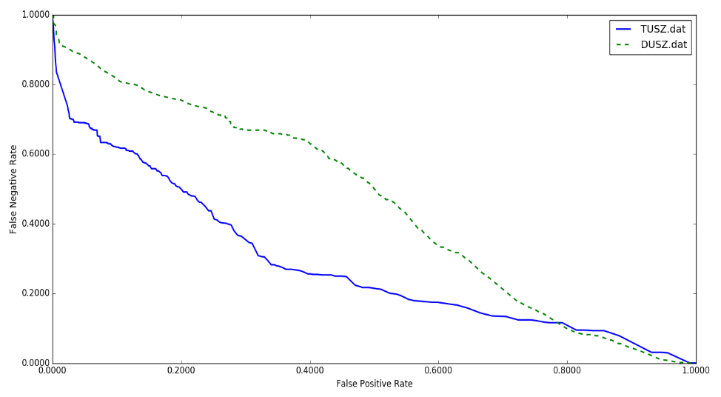
Evaluating Robustness
  We have evaluated robustness by conducting an open-set evaluation of the best system, CNN/LSTM, on a completely different corpus: the Duke University Seizure Detection Corpus (DUSZ).
  The CNN/LSTM system was not exposed to DUSZ data during training. Parameter optimizations were performed only on TUSZ data.
  DUSZ was collected at a different hospital, Duke University, using a Nihon Kohden hardware system (TUSZ was collected using several generations of Natus Incorporated equipment).
System | Data | Sensitivity | Specificity | FA/24 Hrs.
CNN/LSTM | TUSZ | 30.83% | 97.10% | 6
CNN/LSTM | DUSZ | 33.71% | 70.72% | 40
  At high FA rates, performance between the two systems is comparable.
  At low FA rates, false positives on TUSZ are lower than on DUSZ.
  This suggests there is room for additional optimization on DUSZ.

Slide 24
Exploring Optimization and Activation Functions
Comparison of Optimization Algorithms
  The choice of optimization method had a considerable impact on performance.
  The best performance is achieved with Adam.
  The choice of activation function had a
  smaller impact on sensitivity but a big
  impact on the FA rate.
System | Sensitivity | Specificity | FA/24 Hrs.
SGD | 23.12% | 72.24% | 44
RMSprop | 25.17% | 83.39% | 23
Adagrad | 26.42% | 80.42% | 31
Adadelta | 26.11% | 79.14% | 33
Adam | 30.83% | 97.10% | 6
Adamax | 29.25% | 89.64% | 18
Nadam | 30.27% | 92.17% | 14
SGD | 23.12% | 72.24% | 44
  Exponential Linear Unit (ELU) delivers
  a small but measurable increase in
  sensitivity, and more importantly, a
  significant reduction in FAs.
  The ELU activation function is very similar
  to ReLU except for negative inputs.
  ReLUs and ELUs accelerate learning by
  decreasing the gap between the normal
  gradient and the unit natural gradient.
  But unlike ReLUs, ELUs have a clear saturation plateau in their negative region, allowing them to learn a more robust and stable representation.
Comparison of Activation Functions
System | Sensitivity | Specificity | FA/24 Hrs.
Linear | 26.46% | 88.48% | 25
Tanh | 26.53% | 89.17% | 21
Sigmoid | 28.63% | 90.08% | 19
Softsign | 30.05% | 90.51% | 18
ReLU | 30.51% | 94.74% | 11
ELU | 30.83% | 97.10% | 6

Slide 25
Exploring Initialization and Regularization
Comparison of Initialization Algorithms
  Optimizing the initialization strategy for the parameters is part of the difficulty in training.
  For example, initialization of tensor values to zero or one completely stalled the convergence process.
  Best performance is achieved using orthogonal initialization.
System | Sensitivity | Specificity | FA/24 Hrs.
Orthogonal | 30.8% | 96.9% | 7
Lecun Uniform | 30.3% | 96.5% | 8
Glorot Uniform | 31.0% | 94.2% | 13
Glorot Normal | 29.5% | 92.4% | 18
Variance Scaling | 31.8% | 92.1% | 19
Lecun Normal | 31.8% | 92.1% | 19
He Normal | 31.3% | 91.1% | 22
Random Uniform | 30.2% | 90.0% | 25
Truncated Normal | 31.6% | 87.8% | 31
He Uniform | 29.2% | 85.1% | 40
Comparison of Regularization Algorithms
  Overfitting is a serious problem and impacts generalization.
  While L1/L2 regularization has the best overall performance, in the region where FA rates are low dropout has better performance.
System | Sensitivity | Specificity | FA/24 Hrs.
L1/L2 | 30.8% | 97.1% | 6
Dropout | 30.8% | 96.9% | 7
Gaussian | 30.8% | 95.8% | 9
L2 | 30.2% | 95.6% | 10
L1 | 30.0% | 43.7% | 276
Notes:
Best performance is achieved using orthogonal initialization. This method is a simple yet effective way of combatting exploding and vanishing gradients. In orthogonal initialization, the weight matrix is chosen as a random orthogonal matrix, i.e., a square matrix W for which W^T W=I. Typically, the orthogonal matrix is obtained from the QR decomposition of a matrix of random numbers drawn from a normal distribution. Orthogonal matrices preserve the norm of a vector ‎and their eigenvalues have an absolute value of one. This means that no matter how many times we perform repeated matrix multiplication, the resulting matrix doesn't explode or vanish. Also, in orthogonal matrices, columns and rows are all orthonormal to one another, which helps the weights to learn different input features. For example, if we apply orthogonal initialization on a CNN architecture, in each layer, each channel has a weight
vector that is orthogonal to the weight vectors of the other channels.

Slide 26
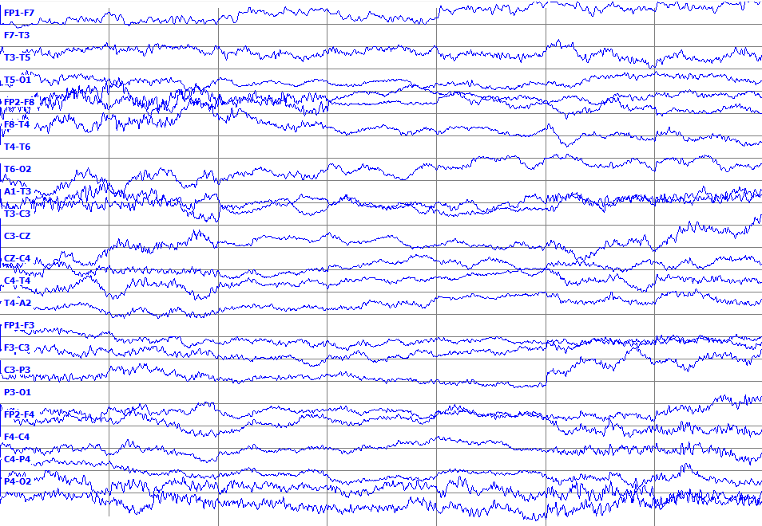
Synthetic EEG Waveforms Generated Using DCGAN
  An EEG 7 sec in duration
  generated by DCGAN.
  We apply a 25 Hz low pass filter
  on the output of DCGAN, since
  most of the cerebral signals
  observed in scalp EEGs fall in
  the range of 1–20 Hz.
  Unfortunately, in a simple pilot
  experiment in which we
  randomly mixed actual EEGs
  with synthetic EEGs, expert
  annotators could easily detect
  synthetic EEGs.
  Seizures in the synthetic EEGs were sharper and more closely resembled a slowing event. Slowing incorrectly detected as a seizure is a primary error modality.
  Our annotators also noted that the synthetic EEGs did exhibit focality. An example of focality: the inverse of activity observed on the CZ-C4 channel would be observed on the C4-T4 channel.

Slide 27
Open Questions To Be Addressed
  What do deep learning architectures learn from EEG datasets?
  Even though these deep learning architectures perform better than our previous HMM-based systems, we do not have much insight into the internal behavior of these complex models, such as how do they achieve such good performance.
  The main goal in our future work is to gain insight into the behavior of these structures using visualization tools.
  What is the benefit of training on “crops”?
  Currently, our training strategy for a system like CNN/LSTM is to train on the entire seizure event and to use a comparable amount of background data. In an alternative training strategy, we can train a system on multiple crops of the data.
  For example for a seizure segment, we can have three crops of the segment: first 70% , last 70% and middle 70% of seizure segment. In this way we can increase the amount of training data.
  Using multiple crops is promising since it increases the amount of training examples by generating time-shifted variants of the original data.
  What is the benefit of training on different EEG datasets?
  We have presented results on seizure detection for two datasets: DUSZ and TUSZ. We have acquired another EEG dataset from Emory University which we refer to as EUSZ.
  We will investigate how performance varies when we have mismatched conditions
  (e.g., train on TUSZ, evaluate on EUSZ).
  We will compare the results of CNN/LSTM on EUSZ when trained on TUSZ vs. when trained on DUSZ. By comparing the results of these experiments, we can demonstrate the benefits of training on TUSZ in comparison with other dataset like DUSZ.

Slide 28
Research Plan
  Dec 16 – Dec 31:
  Revise written document and presentation based on committee feedback.
  Dec 20 – Jan 1:
  Train CNN/LSTM on new version of TUSZ and report results on TUSZ and DUSZ.
  Prepare cropped TUSZ training dataset.
  Jan 1 – Jan 15:
  In consultation with our EEG experts, we will develop hypotheses predicting which band power features (or other features) are discriminative for the seizure detection task.
  Train CNN/LSTM on TUSZ and evaluate on EUSZ dataset.
  Jan 15 – Feb 15:
  Data preparation, necessary for visualization experiments, for the seizure detection task, based on identified discriminative features.
  Train CNN/LSTM on DUSZ and evaluate on EUSZ and TUSZ.
  Run experiments on cropped TUSZ experiments.
  Feb 1 – Feb 28:
  Design a visualization algorithm for the seizure detection task based on
  class discriminative features.
  Train CNN/LSTM on EUSZ and evaluate on DUSZ and TUSZ.
  Diagnose and debug problems related to the cropped TUSZ experiments.

Slide 29
Research Plan (Cont.)
  Feb 15 – Mar 15:
  Diagnose and debug problems related to the visualization experiments.
  Complete the comparison of training on TUSZ vs. DUSZ and EUSZ.
  Complete the experiments using the cropped dataset.
  Mar 15 – Apr 15:
  Analyze different trials using the results of the visualization experiments.
  Document the results of training on TUSZ vs. DUSZ and EUSZ.
  Document the results of training on cropped dataset.
  April 1 – April 30:
  Update the dissertation.
  Complete the final chapter on analysis of results.
  April 15 – May 15:
  Finalize the draft of the dissertation.
  Prepare dissertation presentation.
  Submit a journal paper on the new findings.
  May 15 – June 15:
  Dissertation defense.
  Revise the dissertation.
  Submission to thesis examiner.

Slide 30
Publications (1st Author)
Grants (Funded):
Golmohammadi, M., Obeid, I., & Picone, J. (2017). STTR Phase I: Real- time Automatic Analysis of Electroencephalograms in an Intensive Care Environment Using Deep Learning. Industrial Innovation and Partnerships (IIP) - STTR Phase I, National Science Foundation, Award No. IIP-1622765, $224K,
July 1, 2016 – June 30, 2017.
Grants (Submitted):
Golmohammadi, M., Obeid, I., & Picone, J. (2017). STTR Phase II:Real- time Automatic Analysis of Electroencephalograms in an Intensive Care Environment Using Deep Learning. Industrial Innovation and Partnerships (IIP) – STTR Phase II, National Science Foundation, $750K, August 30, 2017.
Book Chapters:
Golmohammadi, M., Shah, V., Obeid, I., & Picone, J. (2020). Deep Learning Approaches for Automatic Analysis of EEGs. In I. Obeid & J. Picone (Eds.), Machine Learning Applications in Medicine and Biology (Tentative) (1st ed., p. 45). New York City, New York, USA: Springer-Verlag. https://www.isip.piconepress.com/publications/unpublished/books/2019/springer/deep_learning/.
Journal Publications:
Golmohammadi, M., Harati Nejad Torbati, A., Lopez, S., Obeid, I., & Picone, J. (2019). Automatic Analysis of EEGs Using Big Data and Hybrid Deep Learning Architectures. Frontiers in Human Neuroscience, 13(76), 1–30. https://doi.org/10.3389/fnhum.2019.00076.
Refereed Conference Publications:
Golmohammadi, M., Ziyabari, S., Shah, V., Obeid, I., & Picone, J. (2018). Deep Architectures for Spatio-Temporal Modeling: Automated Seizure Detection in Scalp EEGs. Proceedings of the IEEE International Conference on Machine Learning and Applications (ICMLA) (pp. 1–6). Orlando, FL, USA. http://dx.doi.org/10.1109/ICMLA.2018.00118.
Golmohammadi, M., Ziyabari, S., Shah, V., Obeid, I., & Picone, J. (2017). Gated Recurrent Networks for Seizure Detection. I. Obeid & J. Picone (Eds.), Proceedings of the IEEE Signal Processing in Medicine and Biology Symposium (pp. 1–5). Philadelphia, Pennsylvania, USA: IEEE. https://doi.org/10.1109/SPMB.2017.8257020.

Slide 31
Publications (1st Author)
Conference Abstracts:
Golmohammadi, M., Obeid, I., & Picone, J. (2018). Deep Residual Learning for Automatic Seizure Detection. 26th Conference on Intelligent Systems for Molecular Biology, p. 1. https://www.isip.piconepress.com/publications/conference_presentations/2018/ismb/resnet/.
Golmohammadi, M., Shah, V., Lopez, S., Ziyabari, S., Yang, S., Camaratta, J., … Picone, J. (2017). The TUH EEG Seizure Corpus. American Clinical Neurophysiology Society (ACNS) Annual Meeting, p. 1. https://www.isip.piconepress.com/publications/conference_presentations/2017/acns/tuh_eeg_seizures/.
Golmohammadi, M., Ziyabari, S., Lopez, S., Krome, E., Thiess, M., Yang, S., … Picone, J. (2016). EEG Event Detection Using Deep Learning. Big Data to Knowledge All Hands Grantee Meeting, p. 1. https://www.isip.piconepress.com/publications/conference_presentations/2016/nih_bd2k/autoeeg/.
Golmohammadi, M., Lopez, S., Obeid, I., & Picone, J. (2015). EEG Event Detection on the TUH EEG Corpus. Big Data to Knowledge All Hands Grantee Meeting, p. 1. http://www.isip.piconepress.com/publications/conference_presentations/2015/nih_bd2k/autoeeg/.

Slide 32
Publications (Co-Author)
Journal Publications:
Shah, V., von Weltin, E., Lopez, S., McHugh, J. R., Veloso, L., Golmohammadi, M., … Picone, J. (2018). The Temple University Hospital Seizure Detection Corpus. Frontiers in Neuroinformatics, 12, 83. https://doi.org/10.3389/fninf.2018.00083.
Refereed Conference Publications:
Jungreis, D., Capp, N., Golmohammadi, M., & Picone, J. (2019). Predicting Endogenous Bank Health from FDIC Statistics on Depository Institutions Using Deep Learning. In K. Arai, R. Bhatia, & S. Kappor (Eds.), Proceedings of Computing Conference (pp. 1–9). https://doi.org/10.1007/978-3-030-22871-2_38.
Shah, V., Golmohammadi, M., Ziyabari, S., von Weltin, E., Obeid, I., & Picone, J. (2017). Optimizing Channel Selection for Seizure Detection. In I. Obeid & J. Picone (Eds.), Proceedings of the IEEE Signal Processing in Medicine and Biology Symposium (pp. 1–5). Philadelphia, Pennsylvania, USA: IEEE. https://doi.org/10.1109/SPMB.2017.8257019.
von Weltin, E., Ahsan, T., Shah, V., Jamshed, D., Golmohammadi, M., Obeid, I., & Picone, J. (2017). Electroencephalographic Slowing: A Primary Source of Error in Automatic Seizure Detection. In I. Obeid & J. Picone (Eds.), Proceedings of the IEEE Signal Processing in Medicine and Biology Symposium (pp. 1–5). https://doi.org/10.1109/SPMB.2017.8257018.
Lopez, S., Golmohammadi, M., Obeid, I., & Picone, J. (2016). An analysis of two common reference points for EEGs. In I. Obeid & J. Picone (Eds.), Proceedings of the IEEE Signal Processing in Medicine and Biology Symposium (pp. 1–4). https://doi.org/10.1109/SPMB.2016.7846854
Harati, A., Golmohammadi, M., Lopez, S., Obeid, I., & Picone, J. (2015). Improved EEG Event Classification Using Differential Energy. I. Obeid & J. Picone (Eds.), Proceedings of the IEEE Signal Processing in Medicine and Biology Symposium (pp. 1–4). Philadelphia, Pennsylvania, USA. https://doi.org/10.1109/SPMB.2015.7405421.
Conference Abstracts (Cont.):
Harati Nejad Torbati, A. H., Golmohammadi, M., Jacobson, M., Lopez, S., Obeid, I., Picone, J., & Tobochnik, S. (2016). Automatic Interpretation of EEGs for Clinical Decision Support. In American Clinical Neurophysiology Society (ACNS) Annual Meeting (p. 1). Orlando, Florida, USA. https://www.acns.org/UserFiles/file/AM16PosterAbstracts.pdf.
Yang, S., López, S., Golmohammadi, M., Obeid, I., & Picone, J. (2016). Semi-automated annotation of signal events in clinical EEG data. In I. Obeid & J. Picone (Eds.), Proceedings of the IEEE Signal Processing in Medicine and Biology Symposium (SPMB) (pp. 1–5). https://doi.org/10.1109/SPMB.2016.7846855.

