Slide 1
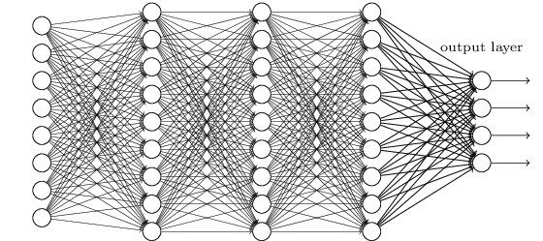
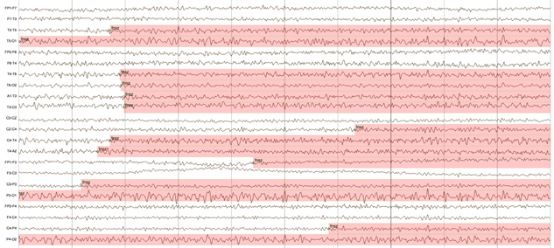

Enabling
Deep Learning Approaches
for Automatic Interpretation of EEGs
J. Picone, Vinit Shah and Iyad Obeid
Neural Engineering Data Consortium
Temple University

Slide 2
Abstract
Electronic medical records (EMRs) collected at every hospital in the country collectively contain a staggering wealth of biomedical knowledge. EMRs can include unstructured text, temporally constrained measurements (e.g., vital signs), multichannel signal data (e.g., EEGs), and image data (e.g., MRIs). This information could be transformative if properly harnessed.
We are focused on the automatic interpretation of clinical EEGs collected since 2002 at Temple University Hospital (30,000+ sessions/16,000+ patients). The corpus contains EEG signal data, reports, and automatically-generated annotations of key features (e.g. abnormal) and events (e.g., seizure).
Automated processing of EEGs is a challenging machine learning problem because the multichannel signal often has an extremely low signal to noise ratio. Events of interest such as seizures are easily confused with signal artifacts (e.g., eye movements) or benign variants (e.g., slowing).
We have developed a cohort retrieval system that allows clinicians to retrieve relevant EMRs using standard queries (e.g. “Young patients with focal cerebral dysfunction who were treated with Topamax”). The system integrates temporal and spatial context for signal and text data.
Applications of this system include clinical support, education and training. The data and tools are available from the NEDC web site (www.nedcdata.org).

Slide 3
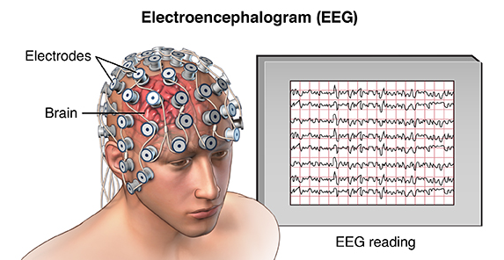
What is an EEG ?
Electroencephalography (EEG) is a popular tool used to diagnose brain related illnesses.
Scalp Electroencephalogram (EEG) monitoring is a non-invasive and convenient method to assess electrical activity from brain.
Interpretation of EEGs is challenging, and its accurate annotation requires extensive training.
Diagnosis is performed considering the factors such as patient’s video recordings, medical history, age, environmental & physiological changes, etc.

Slide 4
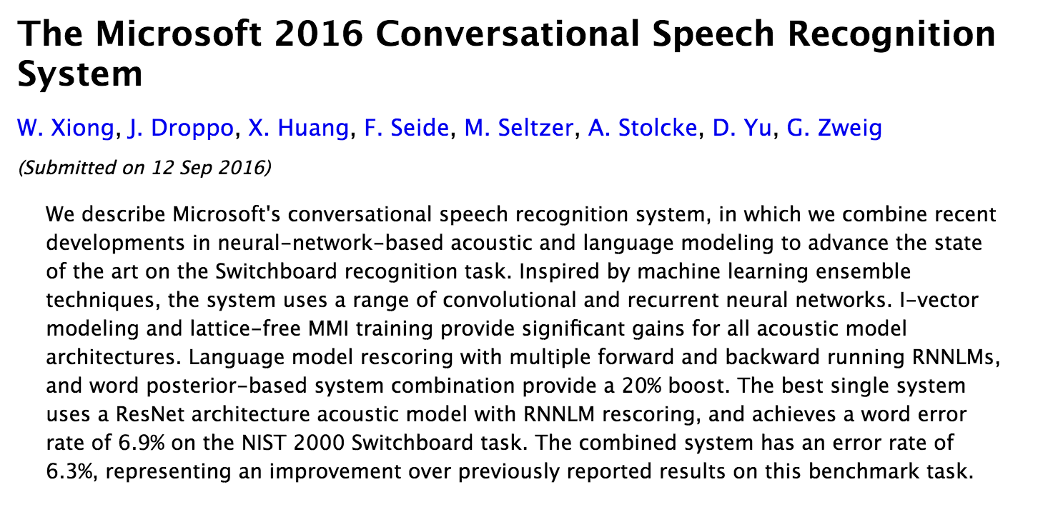
Why Is Big Data So Important?
  Deep learning systems have contributed to reductions in error rates in speech recognition from 80% in the 1990’s to 6.9% in 2016.
  Progress in the last 5 years alone has been significant.
Markov
Model
Deep Learning
  Deep learning systems require large amounts of data:
Corpus | Training Speech | SGMM WER | DNN WER
BABEL Pashto | 10 hours | 69.2% | 67.6%
BABEL Pashto | 80 hours | 50.2% | 42.3%
Fisher English | 2000 hours | 15.4% | 10.3%

Slide 5


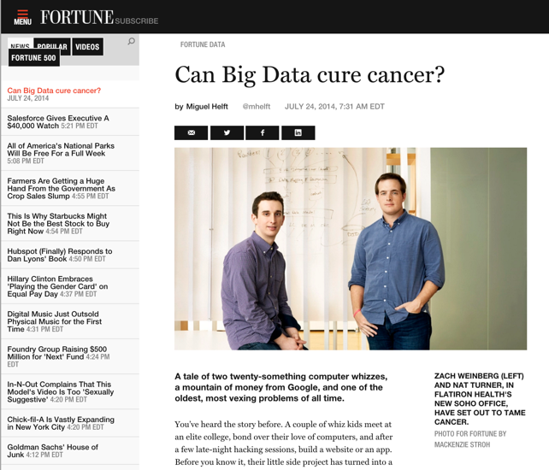
Big Data is Everywhere
Bob Mercer, IBM Speech Research (1985):
“There is no data like more data.”
Dan Ariely, Duke University (2013):
“Big Data is like teenage sex: everyone talks about it,
nobody really knows how to do it,
everyone thinks everyone else is doing it,
so everyone claims they are doing it.”
Douglas Merrill, Zestfinance.com (2013):
“Given enough data, everything is statistically significant.”

Slide 6
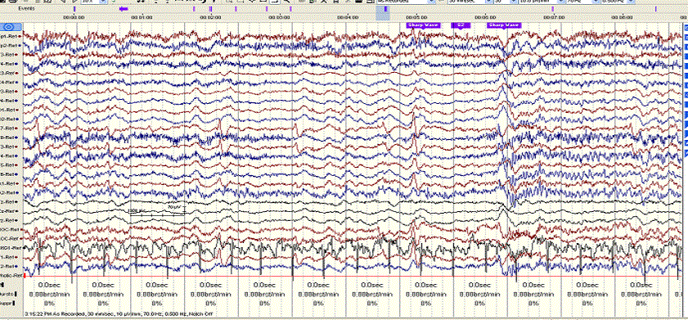
Where Does This Data Come From?
  In commercially viable applications, there are significant economic motivations to develop large data resources.
  In many bioengineering applications, the commercial opportunities are not as significant, so the development of data resources is lagging.
  However, the healthcare industry is awash in vast amounts of unstructured data:
  The TUH EEG Corpus: over 30,000 EEGs from over 16,000 patients in the last 14 years collected in a clinical setting at an urban public hospital.
  At least 4 Petabytes of data including raw EEGs and video.
  At least 1M pathology slides are read and interpreted daily across the U.S.
  Little of this data is being captured for research purposes due to IRB and HIPAA concerns.

Slide 7
Why Big Data Is Critical
  Medicine by its nature deals with statistical outliers and rare events. Rare diseases are often hard to diagnose yet are critical to effective healthcare:
  Example: Temple Hospital’s Department of Neurology conducts about 3,000 EEGs per year, and less than 1% of these patients are diagnosed with posterior reversible encephalopathy syndrome (PRES).
  It is difficult to build powerful analytics with such small sample sizes.
  Every patient seems to be unique in some way:
  “CLINICAL HISTORY: This is a 50-year-old male with previous surgery for a left frontal glioma now with accelerating complex partial seizures.
  MEDICATIONS: Dilantin, Ativan, and others.”
  “CLINICAL HISTORY: A 69-year-old male with known ascending arch aneurysm, recent worsening after GI bleed.”
  MEDICATIONS: Etomidate, midazolam fentanyl, vecuronium, protamine, gabapentin, scopolamine patch, others.”
  Clinicians see a small percentage of the total population throughout their career, and must stay current through continuing education.

Slide 8

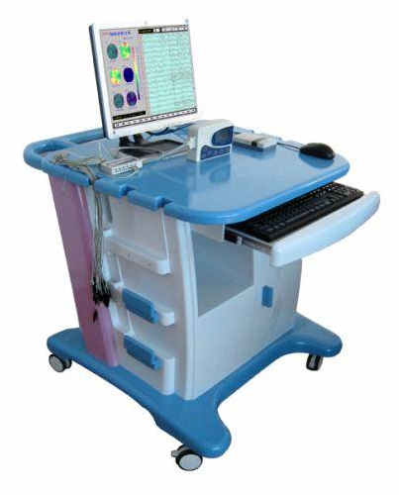
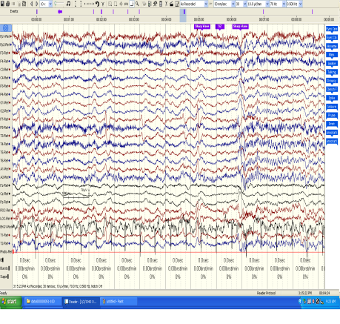
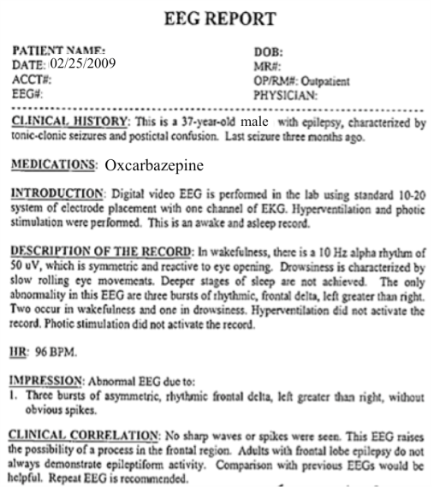
The Temple University Hospital EEG Corpus
Synopsis: The world’s largest publicly available EEG corpus consisting of 30,000+ EEGs collected
from 16,000+ patients, collected over 16 years. Includes EEG signal data, physician’s diagnoses
and patient medical histories. A total of 1.4 Tbytes of data.
Impact:
  Sufficient data to support application of state of the art machine learning algorithms
  Patient medical histories, particularly drug treatments, supports statistical analysis of correlations between signals and treatments
  Historical archive also supports investigation of EEG changes over time for a given patient
  Over 1,300 customers have subscribed to the corpus
Database Overview:
  28,000+ EEGs collected at Temple University Hospital from 2002 to 2018 (an ongoing process)
  Recordings vary from 24 to 36 channels of signal data sampled at 250 Hz
  Patients range in age from 18 to 90+ with an average of 1.6 EEGs per patient
  72% of the patients have one session; 16% have two sessions; 12% have three or more sessions
  Data includes a test report generated by a technician, an impedance report and a physician’s report
  Personal information
  has been redacted
  Clinical history and medication history are included
  Physician notes are captured in three fields: description, impression and correlation fields.

Slide 9
Cohort Retrieval
Queries can be submitted that search signals and reports.
A simple query building interface is supported.
Search results are displayed in a way that link signals and reports.
Users can easily review and select the top-ranked results.
The user interface is being co-developed with feedback from expert neurologists.

Slide 10
Case Study: Manual Interpretation of EEGs
  EEGs are used to diagnose a variety of brain-related illnesses including seizures and epilepsy.
  EEG data is recorded for a period of time ranging from 20 minutes (short-term, outpatient) to several days (long-term, inpatient).
  Approximately 93% of short-term EEGs are inconclusive. It is very difficult to replicate the conditions under which a patient seizes.
  Manual interpretation of an EEG is performed by a board-certified neurologist. It takes several years to receive this certification.
Patient Preparation
EEG Recording
EEG ranging from 22 minutes to several days is recorded
EEG is Interpreted
Certified physicians interpret EEG
Patients are prepared for the test
EEG Report is Produced
Report of findings (e.g. abnormality) is prepared

Slide 11
The Classic Machine Learning Paradigm
Key issues:
  Is the data representative of the problem?
  Do the features capture meaningful differences between patterns?
  How do we find the best model?
  How do we estimate the parameters of the model?
  How do we evaluate performance?
Collect Data
Evaluate Classifier
Select Features
Train Classifier
Choose Model
Other considerations:
The answers are often application specific and data dependent.
Customers/users don’t often completely understand their requirements.
Data collection is often an on-going process that drives the technology.

Slide 12
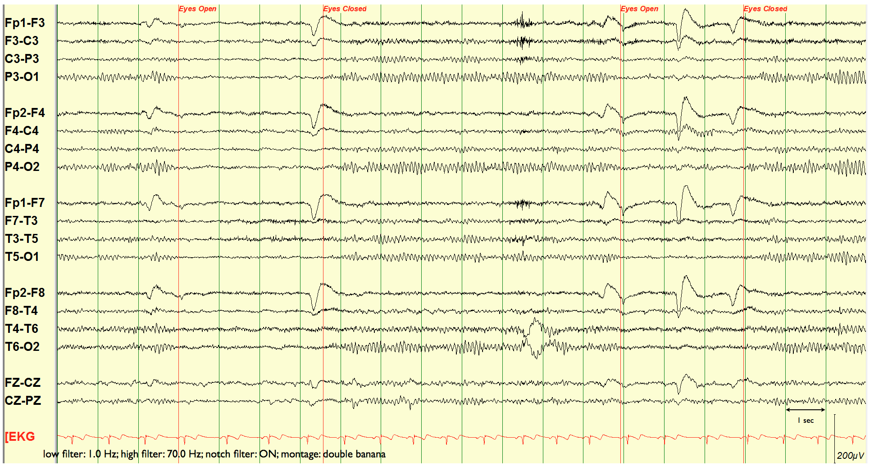
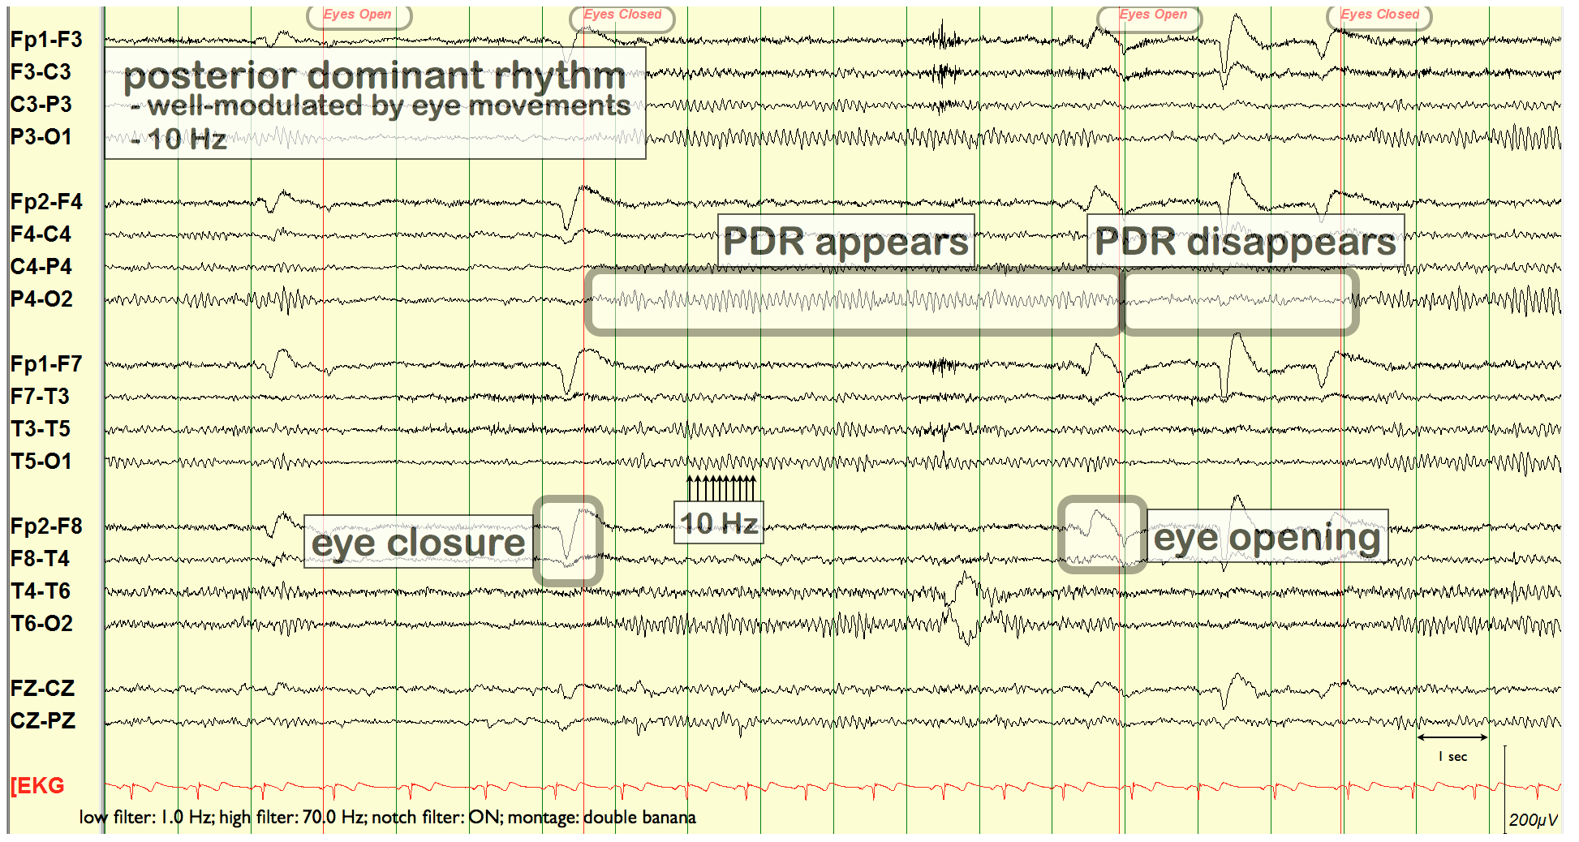
EEG Signals Are Challenging To Interpret
  Neurologists visually inspect waveforms looking for epileptiform discharges (e.g., spikes) that are an indication of abnormalities.
  Though there is general agreement on a diagnosis, interrater agreement on annotation of local events is low.

Slide 13
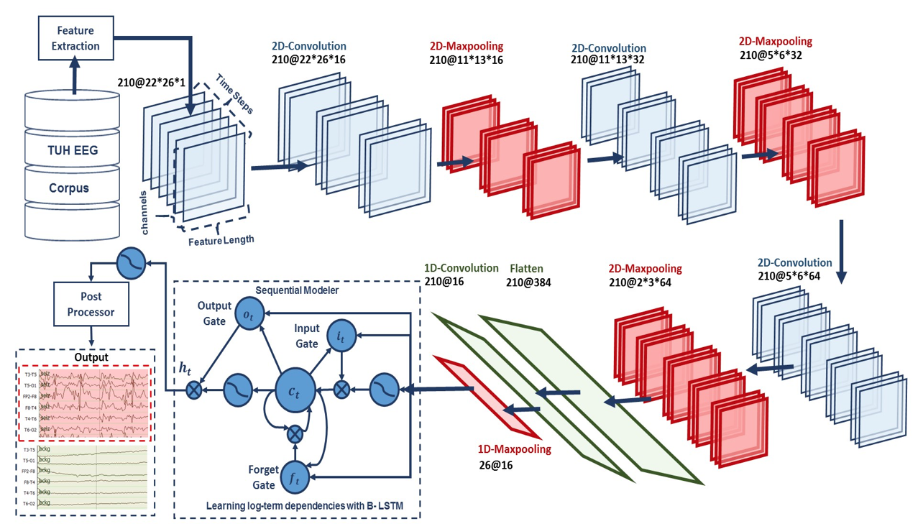
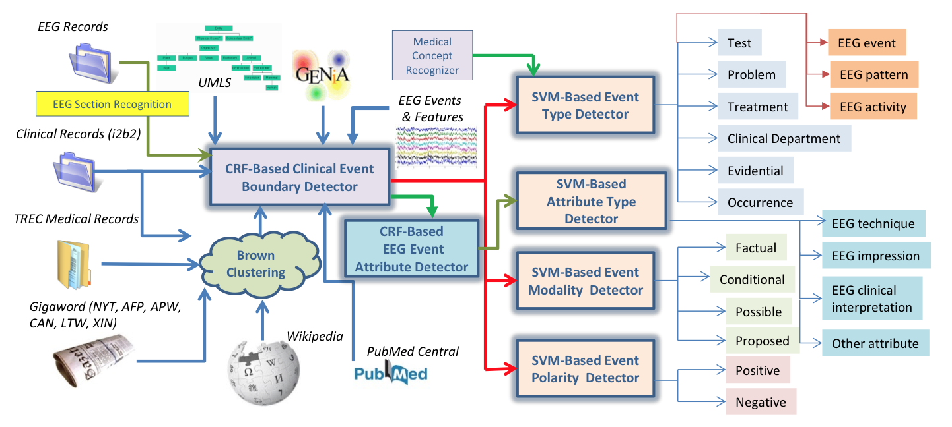
Overview: Two Main Components
AutoEEG: hyper-real-time automated identification and localization of EEG signal events
Identification of the temporal and spatial location of EEG signal events such as spikes.
Two levels of deep learning are used (CNN followed by LSTM), followed by a postprocessor that uses a statistical language model.
MERCuRY: Multi-modal EncephalogRam patient Cohort discoverY
Automated identification of EEG activities, EEG events and patterns as well as their attributes in EEG reports.
Identification of medical concepts that describe the clinical picture and therapy of the patients.

Slide 14
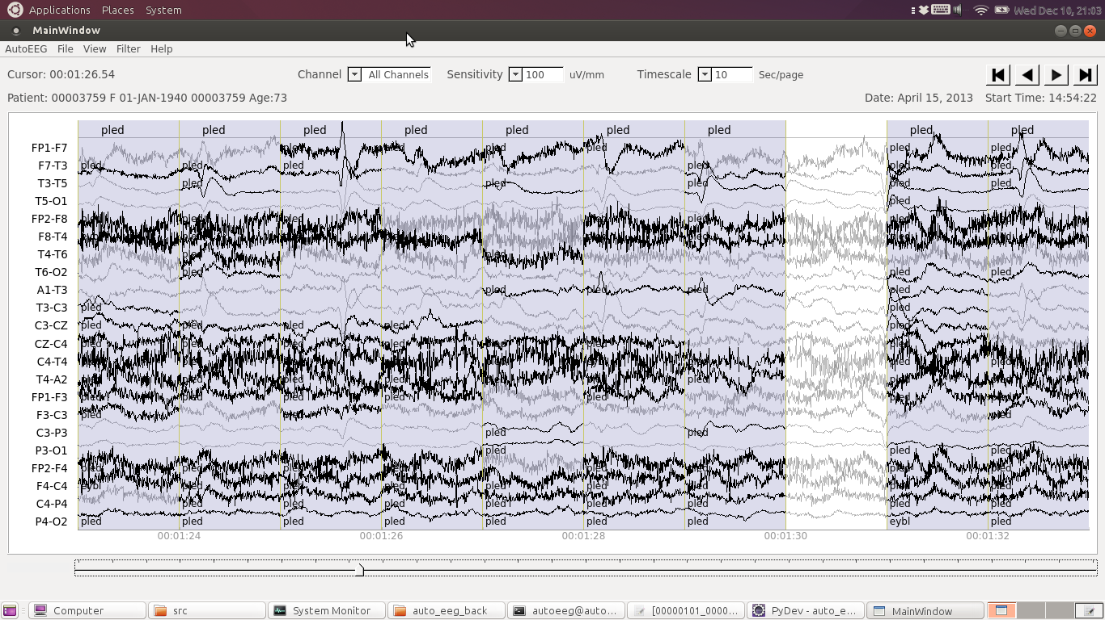
EEG Signal Event Detection
High performance event detection using a multi-pass deep learning approach.
Events are localized in time (e.g., start time and duration) and space (e.g., EEG channels map to location on the scalp).
Physiological data is searchable by labels and types of events.
The user interface emulates existing clinical tools.
Customizable visualizations supported include waveforms, spectrograms and energy.
Spectrograms are increasingly being used to verify the onset of a seizure.

Slide 15
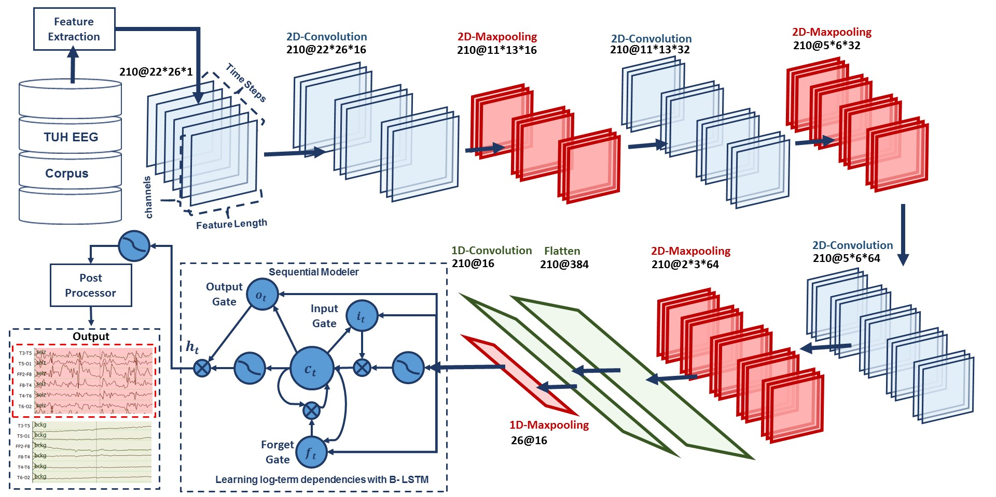
AutoEEG: Automatic Interpretation of EEGs
  AutoEEG is a hybrid system that uses three levels of processing to achieve high performance event detection on clinical data:
  Pass 1 (P1): 2D Convolutional Neural Network (CNN)
  Pass 2 (P2): Bidirectional Long Short Term Memory Network (B-LTSM)
  Pass 3 (P3): A statistical language model is used to model event sequences

Slide 16
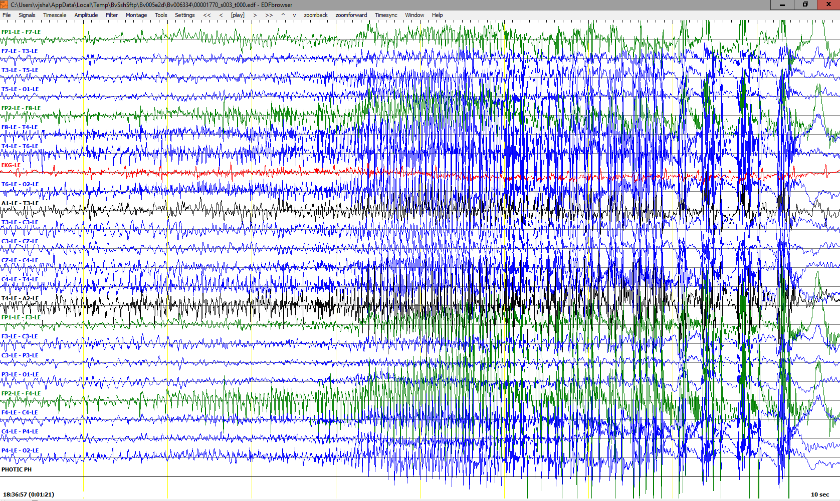
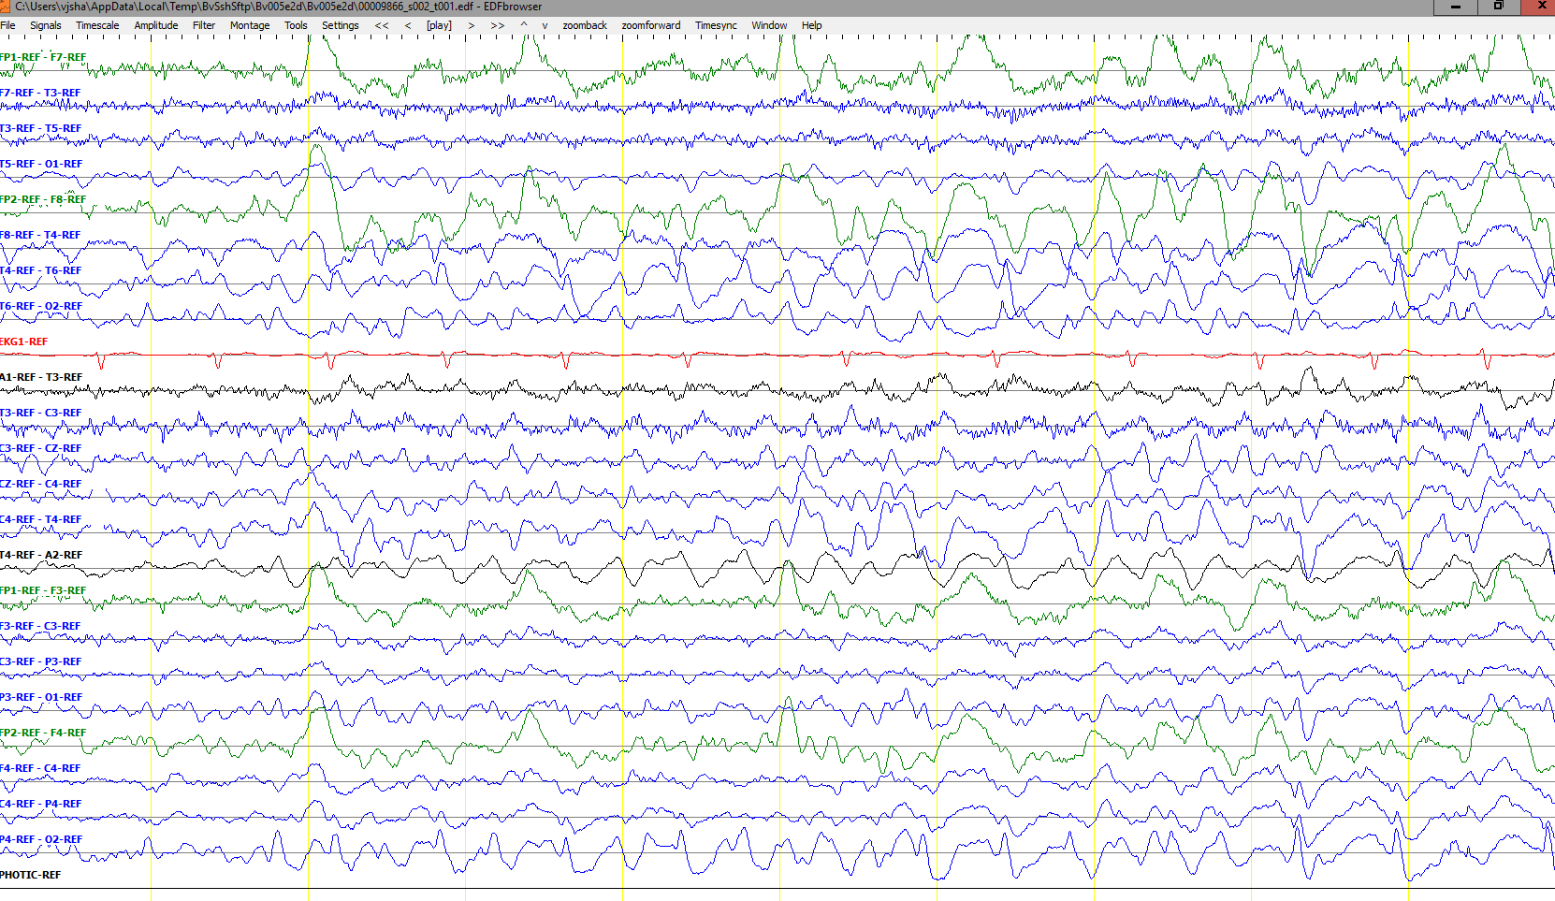
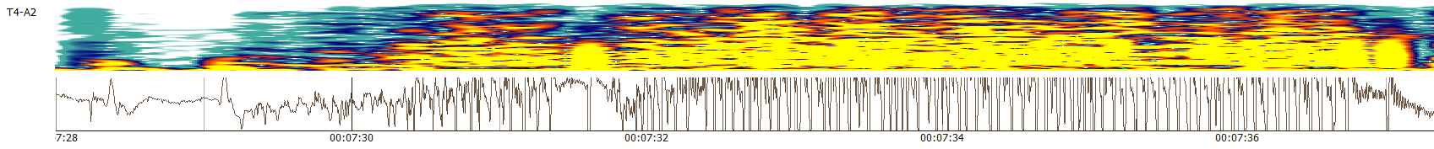
Seizure Morphologies
Electrographic seizures can be detected either by observing epileptiform activities or by observing artifacts related to specific types of seizures.
There are multiple types of seizures (i.e. tonic-clonic/grand mal, absence/petit mal, complex-partial)
Interpretation of focal seizures require temporal as well as sufficient level of spatial information.
Typically interpreters look for epileptiform activity such as spike and wave discharges and its evolution over time.
Easy seizures show clear evolution in signal’s frequency and amplitude.

Slide 17
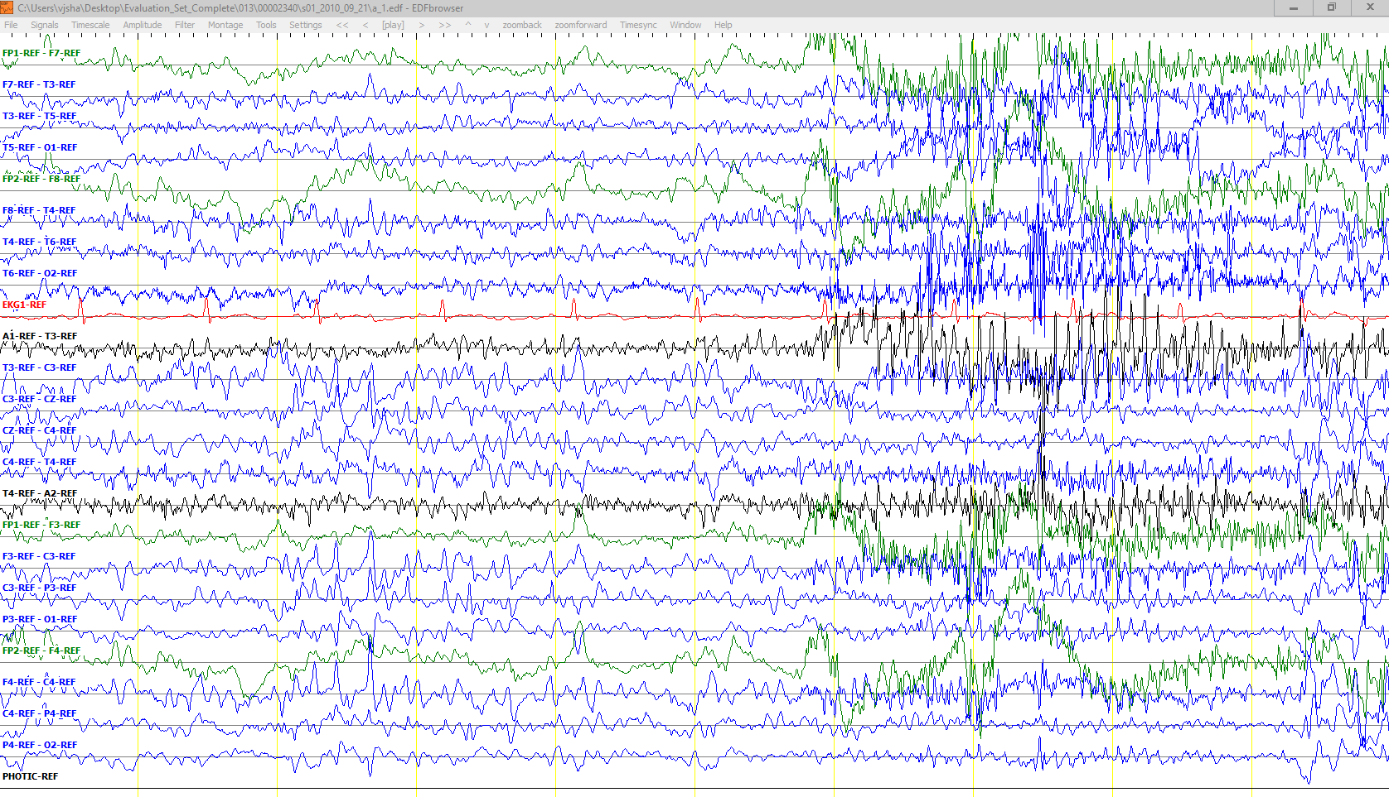
Inconclusive Segments
Some EEG records are very challenging and show wide spread epileptiform features along with artifacts (i.e. Shivers). Obscured patterns as such could also make interpretation inconclusive.
There are specific rules implemented by American Clinical Neurophysiology Society (ACNS) for diagnosis of patients with epilepsy.
Accurate onset and offset detection of an ictal is, in many cases, subjective which encourages us to use Any-Overlap method for scoring.
Shivers
Epileptiform
Activity

Slide 18
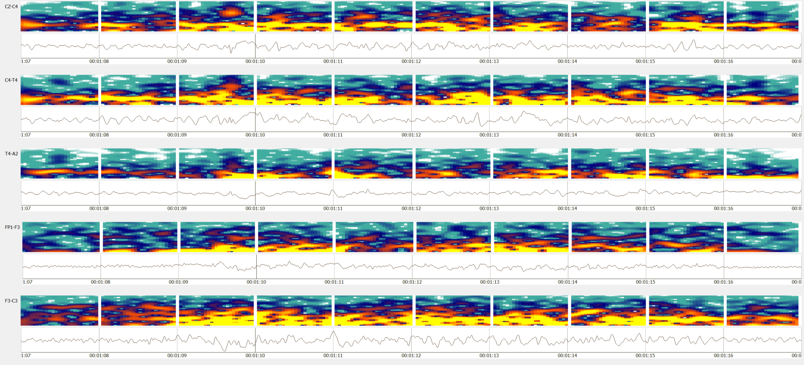
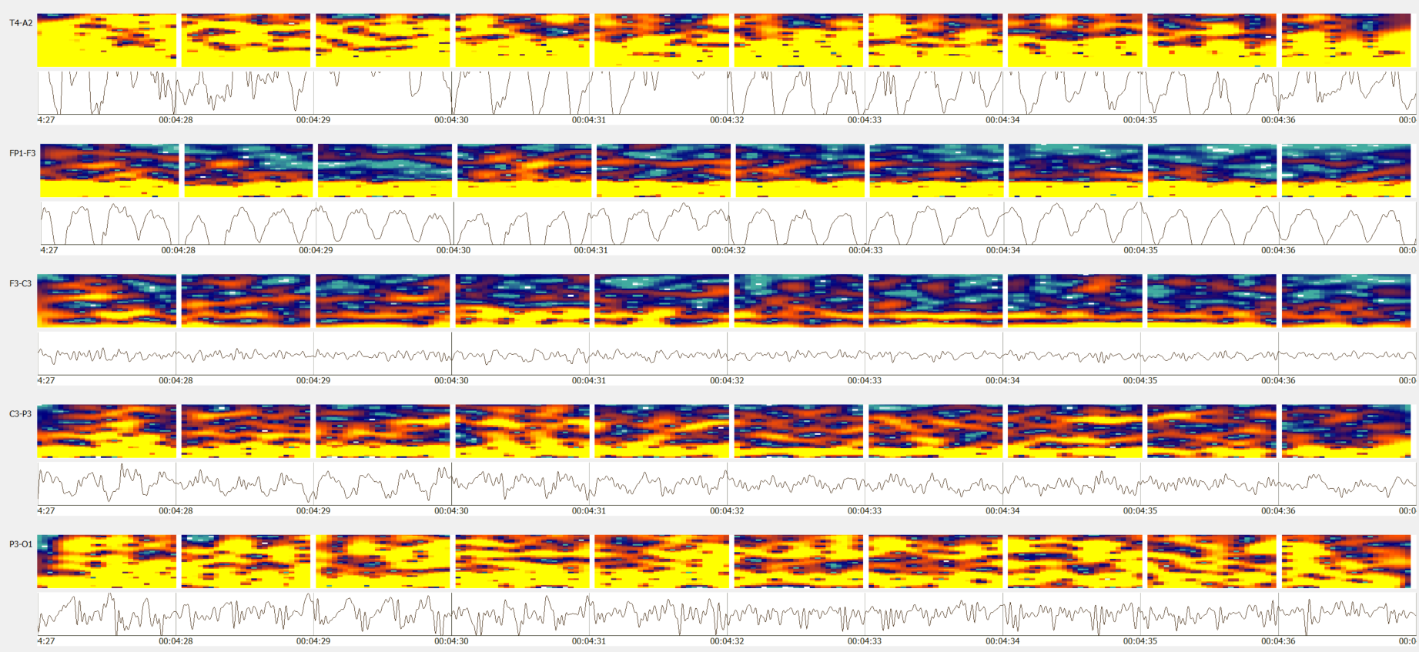
Spectral Properties of an Ictal Seizure
Seizures usually occur within the range of 2.5 to 25 Hz.
Seizure duration can rand from 3 seconds to days.
Generalized seizures are easy to spot due
to their high energy
in specific
frequency bands.
Waxing-waning patterns (e.g., bursts) can be mistakenly identified as ictal.

Slide 19
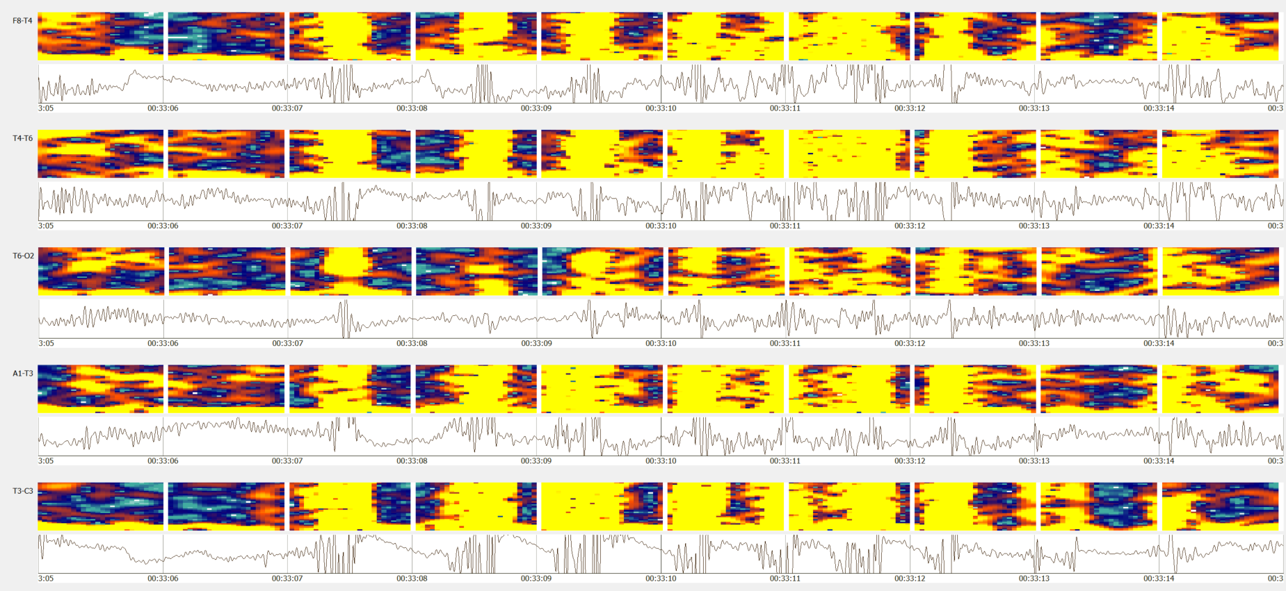
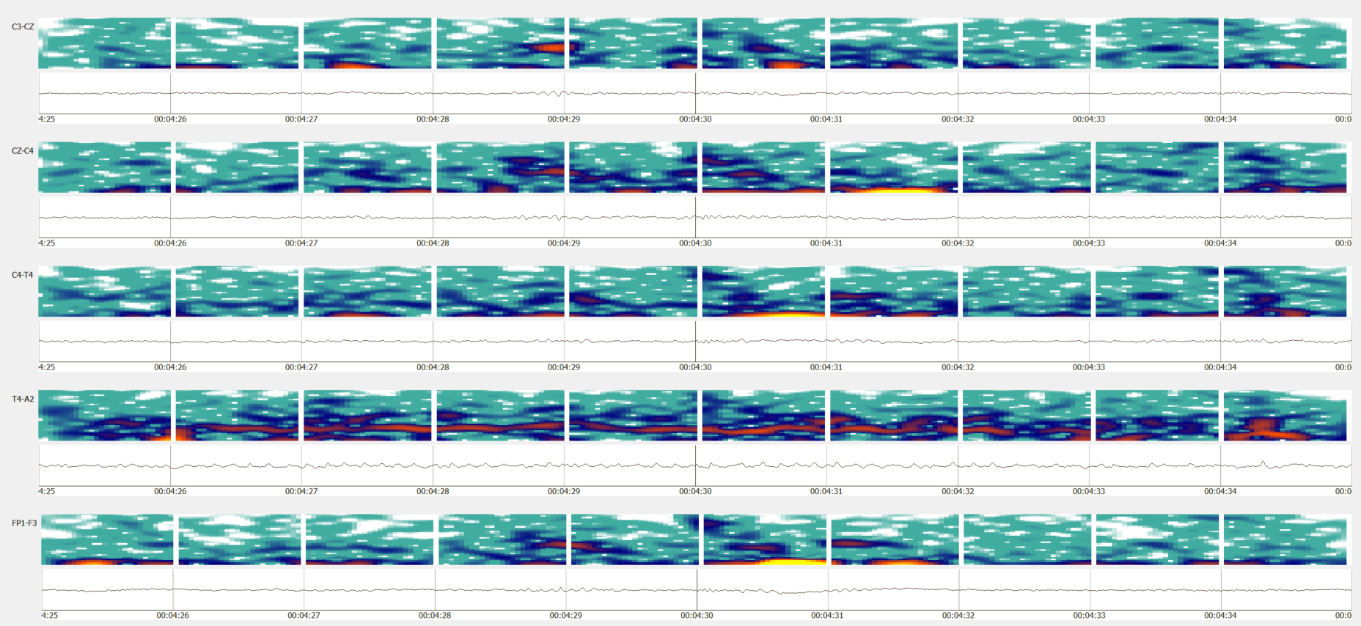
Artifacts and Medications Pose Challenges
Artifacts such as chewing resemble features of tonic-clonic and complex-partial seizures.
This is usually disambiguated from the context/history of the record.
Medication makes it more difficult.
Subtle seizures such as extremely focal, low energy seizures are widespread in ICU patients due to medication.

Slide 20
Experimental Setup
Electroencephalography (EEG) is a popular tool used to diagnose brain related illnesses.
The 10-20 system is a universally accepted method for the placement of electrodes for any EEG test or experiment.
Six separate channel configurations were selected to optimize the spatial information specific to the application of seizure detection:
The TUH EEG Seizure Corpus (TUSZ - v1.1.1) was used in this study:
A TCP montage was applied prior to generating features, and standard linear frequency cepstral coefficient (LFCC) features were used.
Seizure Corpus | Version 1.1.1
Dataset | Training set |  | Evaluation set
 | w/seiz | Total | w/seiz | Total
Patients | 71 | 196 | 38 | 50
Sessions | 102 | 456 | 89 | 230
Epochs (sec.) | 51,140 (5.51%) | 928,962 (100.00%) | 53,930 (8.96%) | 601,649 (100.00%)

Slide 21
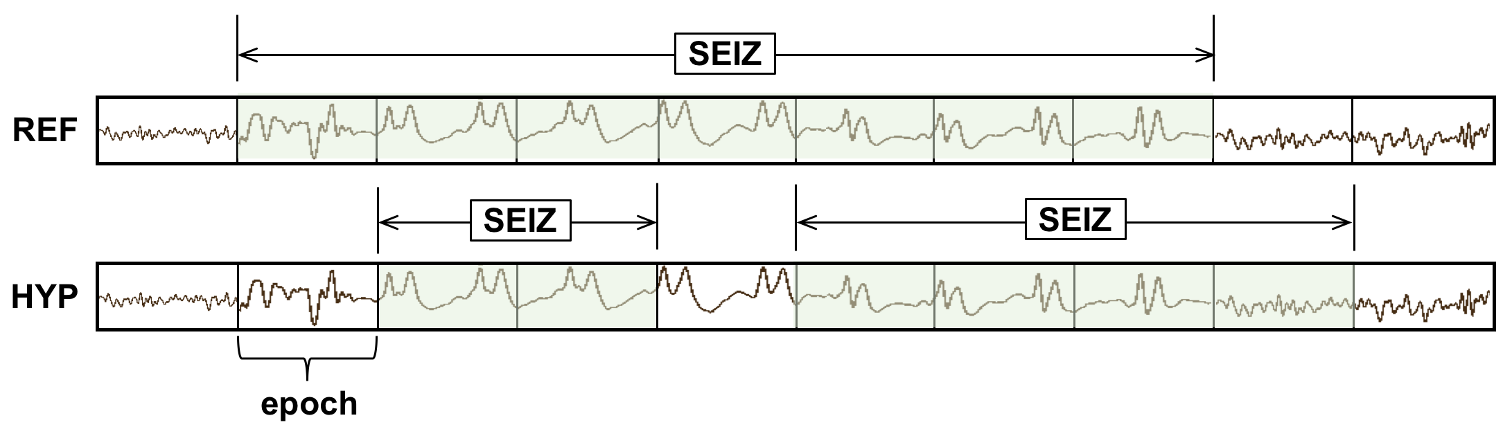
Evaluation Metrics
Any Overlap method (OVLP):
  Any overlap method is a permissive method which looks for the detection of an event within a proximity of the reference.
  This metric tend to produce
  higher sensitivities
  since only isolated
  events are considered
  as false alarms.
  Multiple overlapping events
  detected in bursts are also counted as detection.
Performance measures are calculated in terms of Sensitivity and Specificity (or false alarms per 24 hours):
  Sensitivity = ( True Positives / (True Positives + False Negatives) )
  Specificity = (True Negatives / (True Negatives + False Positives) )
  False Alarm rate = Rate of ( ( # Target False Positives / Total duration ) × (60 × 60 × 24) )

Slide 22
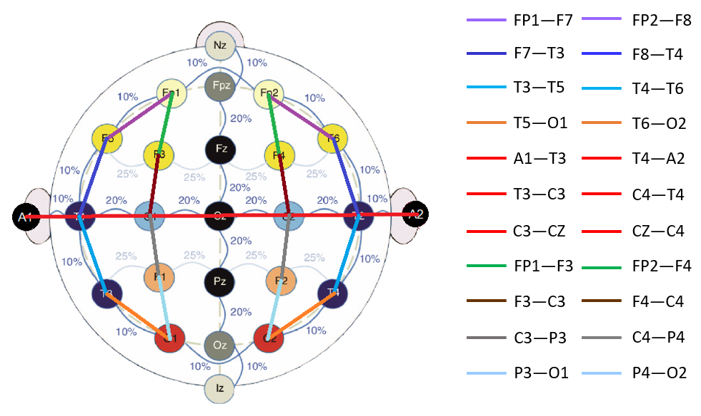
Temporal Central Parasagittal (TCP) Montage
A TCP montage is a type of longitudinal and transverse bipolar montage.
Differential channels, such as FP1-F7 (longitudinal) and C3-CZ (transverse), help in removing static noise and improving spatial information.
Transverse
Longitudinal

Slide 23
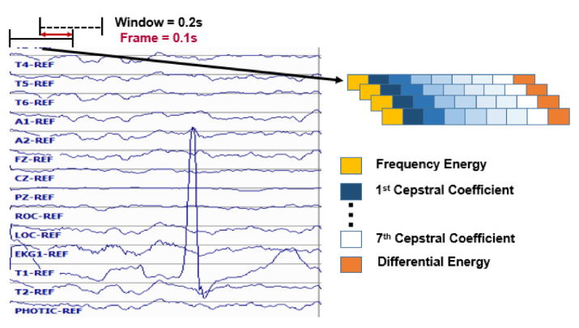
Feature Extraction
 | Version 1.2.1
 | Training set |  | Evaluation set
 | w/seiz | Total | w/seiz | Total
Patients | 119 | 265 | 38 | 50
Sessions | 182 | 583 | 98 | 239
Epochs (sec.) | 76,517 (6.4%) | 1,196,381 (100.0%) | 55,765 (9.0%) | 618,096 (100.0%)
TUH EEG Seizure Corpus (v1.2.1) was used:
  The database consists of clinical data with many types of seizures and lots of artifacts.
  World’s largest open source repository of EEG data.
Standard frequency domain features are used:
  10 frames per second
  0.2 second analysis window
  9 base features including energy, differential energy, and 7 cepstral coefficients.
  1st and 2nd derivatives are used for most features.
  Total dimension: 26.

Slide 24
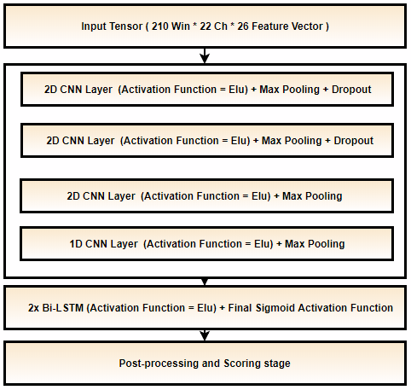
Baseline System: CNN-LSTM
Three baseline systems:
  CNN-LSTM system
  Channel based LSTM networks
  A Kaldi multipass system with
  P-norm and MLP networks.
CNN-LSTM Architecture:
  Each sample is a 21 sec. long window for all 22 channels.
  Trained with constant learning rate with a kernel size of (3, 3).
  Heuristic postprocessing approaches are applied which include a threshold for output probabilities and seizure events of a certain duration.
  An Adam optimizer is used.
CNN-LSTM Model

Slide 25
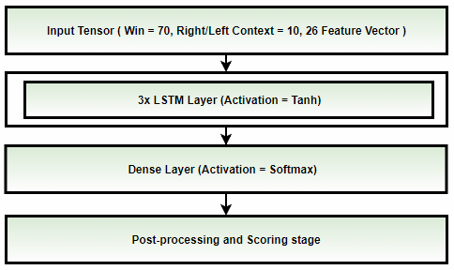
Baseline System: LSTM
Channel based LSTM Architecture:
  Each sample is a 7 sec. long
  window with right/left context
  (splice width) of 11 frames
  (1.1 sec.).
  Each channel is processed
  individually so that the model
  only learns spike/sharp and wave
  discharges.
  Trained with annealing learning
  rate after CV loss is stagnated
  for 3 consecutive epochs.
  SGD optimizer with nestrov
  momentum is used.
  A small CNN-LSTM-MLP model is used for postprocessing followed by heuristic postprocessing.
LSTM Model

Slide 26
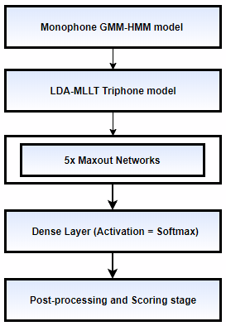
Baseline System: Kaldi
Kaldi baseline systems:
  Kaldi multipass systems with P-norm (Dan’s DNN (nnet2) implementation)
  Kaldi multipass systems with MLP networks (TF implementation).
Kaldi P-norm fast:
  Fixed Affined Component / LDA is applied to decorrelate splice window of 11 (Left/Right context of 5).
  Training is performed for 20 epochs with annealing learning rate with last 5 epochs with constant minimum lr.
  P-norm Input dim = 2000 & Output dim = 400.
  Preconditioned SGD is used which is a matrix valued learning rate.
Kaldi DNN (TF):
  Tensorflow’s MLP network with 3 hidden layers
  is implemented.
  Priors, decision tree and alignments from Kaldi’s LDA-MLLT systems are used for acoustic modeling.

Slide 27
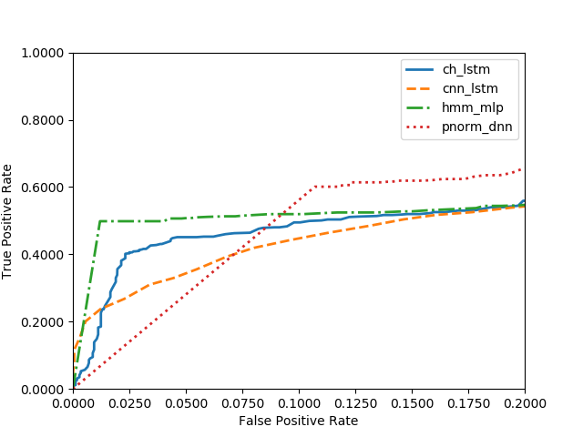
Performance
Kaldi models use word boundary information during event classification.
Kaldi’s best performance is only ~50% sensitivity @ 2.58 FAs/24 hours (with word boundaries).
Channel-based LSTM network outperforms other models with no word boundary information.
DNN Model | Sensitivity (%) | FA/24 Hours
CNN-LSTM | 30.8% | 6.7
LSTM | 40.3% | 5.8
Kaldi P-Norm | 60.1% | 25.7
Kaldi MLP | 49.8% | 2.6
ROC curve for the target/seizure class.
The region of interest is when the FA is low (< 10 FAs/24 hours).

Slide 28
Summary
Big data resources such as the TUH EEG Corpus are enabling the application of state of the art machine learning algorithms.
The ability to search both EEG signal and text data from a unified framework can be useful in clinical, educational and training applications.
Cohort retrieval allows practitioners to retrieve patients with similar medical histories, morphologies, etc. from large resources such as TUH EEG.
The ability to automatically index data with high accuracy greatly reduces the cost to bring up some applications.
Future work:
  Expand TUH EEG at the rate of about 3,000 sessions/yr.
  Manually annotate seizure data with a goal of tripling the size of TUH EEG Seizure (TUSZ) by 2020.
  Automatically annotate the entire corpus for normal/abnormal, seizures, three types of relevant signal events (PLEDs, GPEDS, spikes), and three types of background events (eye movements, artifacts and general background). We are also annotating artifacts by subtype.
  We continue to develop improved seizure detection technology based on new deep learning approaches. There is still a large gap between state of the art performance and clinical acceptance.

Slide 29
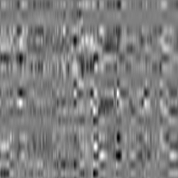
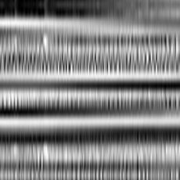
Low Latency Real-Time Seizure Detection Using Transfer Deep Learning
V. Khalkhali, N. Shawki, V. Shah,
M. Golmohammadi, I. Obeid, and J. Picone
Neural Engineering Data Consortium
Temple University

Slide 30
Abstract
Scalp electroencephalogram (EEG) signals have a low signal-to-noise ratio.
Temporal and spatial information must be exploited to achieve accurate detection of seizure events.
Most popular approaches to seizure detection using deep learning do not jointly model this information or require multiple passes over the signal, which makes the systems inherently non-causal.
We exploit spatiotemporal information by converting the multichannel signal to a grayscale image and using transfer learning to achieve high performance.
The proposed system is trained end-to-end with only very simple pre- and post-processing operations which are computationally lightweight and have low latency, making them conducive to clinical applications that require real-time processing.
We have achieved a performance of 42.05% sensitivity with 5.78 false alarms per 24 hours on the development dataset of v1.5.2 of the Temple University Hospital Seizure Detection Corpus.
On a single core CPU operating at 1.7 GHz, the system runs faster than real-time (0.58 xRT), uses 16 Gbytes of memory, and has a latency of 300 msec.
Notes:
We propose a system for seizure detection in a real-time manner.
Low SNR EEG signal’s interpretation needs spatiotemporal processing.
We propose a system based on deep learning methods to find the seizure patterns in the EEG signals. It is very lightweight with respect to pre and post processing and can be run in real-time.
We reached good results with very low latency on the famous Temple University Seizure dataset.

Slide 31
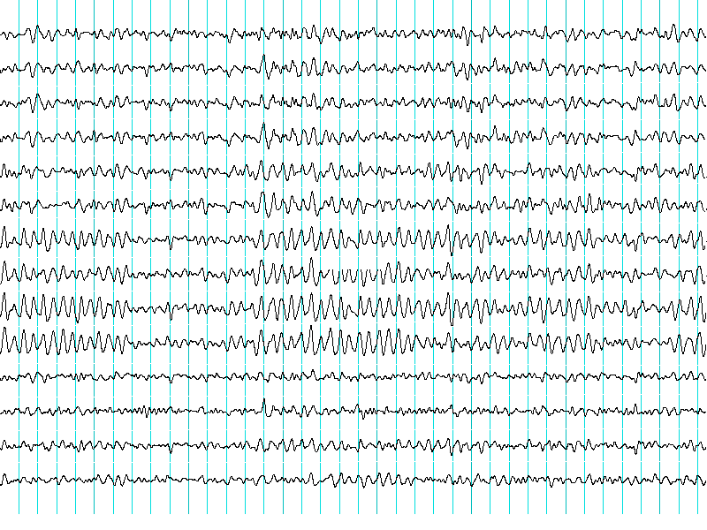

Introduction: Visual Interpretation of an EEG
Manual Interpretation
Human Vision
Train to Visually Interpret EEG
Expert Interpreter of EEG
Normal | Seizure | Normal
Seizure | Seizure | Seizure
Normal | Normal | Normal
? | ➔ | Normal
? | ➔ | Seizure
? | ➔ | Normal
Automatic Interpretation
ImageNet
Pretrained
Network
EEG Adaptation Training
Machine Interpretation
Notes:
Neurologists are capable of manually interpreting EEGs with accuracies that can exceed machine performance. Image processing approaches, such as those disclosed in ImageNet competitions, attempts to emulate the way humans interpret visual data in an application independent manner.
Manual interpretation of an EEG signal requires detection of very subtle pattens. Accurate classification of these patterns requires a deep learning system with many parameters, which in turn, requires large amounts of manually annotated training data. When the number of model parameters greatly exceeds the number of patterns available for training, overfitting becomes a huge concern. Dropout, batch normalization and other regularization methods attempt to mitigate this, but a better approach is to add relevant data from other sources.
In this way, we can leverage vast amount of training image data available from other applications, such as object recognition and autonomous vehicle navigation.
We attempt to leverage these pretrained models from the ImageNet competition and adapt them to seizure detection.

Slide 32
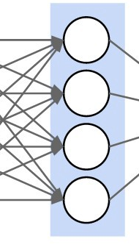
Transfer Learning: Leveraging Pretrained Networks
ResNet18
Input
(D₁, D₂)
Input
(3, 64)
Input
Conv2D@D1xD2
kernel: 7x7
stride: 2x2
padding: 3x3
MaxPool2D@D₁xD₂
kernel: 3x3
stride: 2x2
padding: 1x1
dilation: 1x1
BatchNorm@D₂
Layer 1
ReLU
Basic Block
(64, 64)
Basic Block
(64, 64)
Basic Block
(D₁, D₂)
Layer 2
Basic Block
(64, 128)
Downsample
(64, 128)
Basic Block
(128, 128)
Conv2D@D₁xD₂
k: 3x3
s: 1x1
p: 1x1
Conv2D@D₂xD₂
k: 3x3
s: 1x1
p: 1x1
BatchNorm@D₂
BatchNorm@D₂
ReLU
Basic Block
(128, 256)
Basic Block
(256, 256)
Layer 3
Downsample
(128, 256)
Downsample
(D₁, D₂)
Output
(D₁, D₂)
Basic Block
(256, 512)
Basic Block
(512, 512)
Layer 4
Downsample
(256, 512)
Conv2D@D₁xD₂
k: 1x1
s: 2x2
p: 1x1
Average Pooling
Linear@D₁ to D₂
BatchNorm@D₂
Output
(512, 2)
Output
Notes:
One of the well-known and efficient networks that has achieved good performance is ResNet18. It is a type of deep residual network that overcame the limitations of training very deep networks by introducing identity shortcut connections between the layers.
The ResNet18 model consists of four module blocks as shown in the left figure.
The input block contains a two-dimensional CNN followed by batch normalization and max pooling. The output block consists of an average pooling operation that improves generalization and a linear layer that performs classification.
The numbers in the right figure refers to the dimensions of the input and output planes (channels), respectively.
The four hidden layers are similar in design.
The network is loaded with pretrained parameters from ImageNet. During training, we optimize parameters using a cross-entropy loss function with predefined prior probabilities (weights).

Slide 33
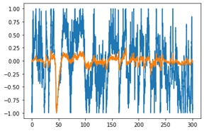
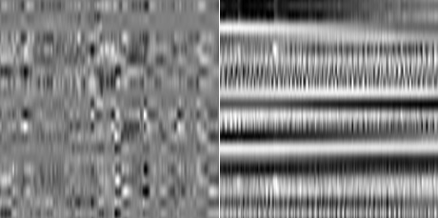

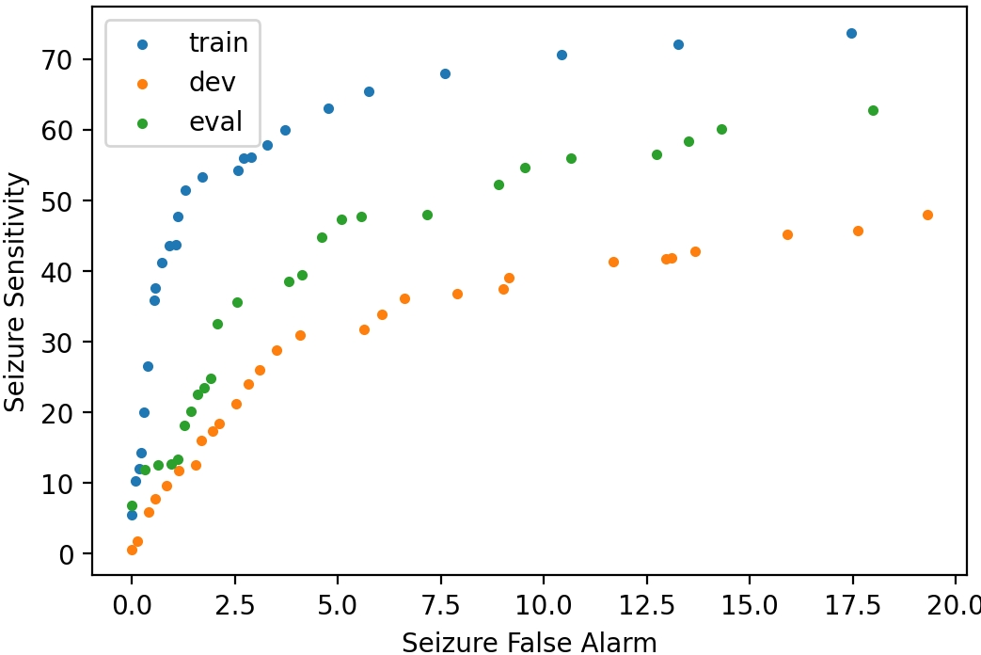
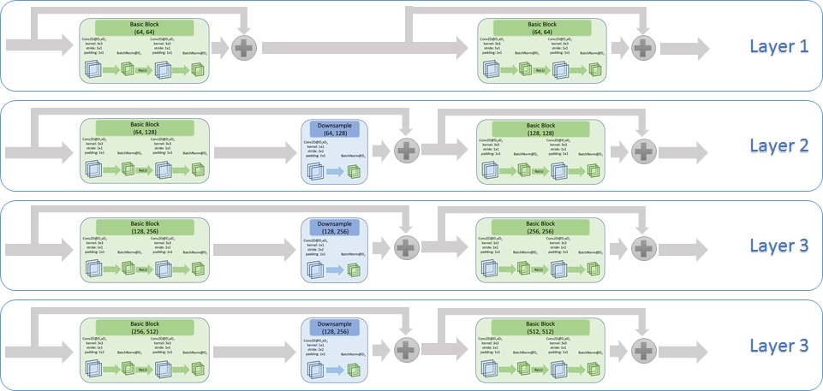
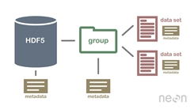
Processing Pipeline: An Overview
Local Normalization
Conversion to Image
Decimation to 50Hz
Postprocessing
ResNet18
Conversion to HDF5
Notes:
Our proposed system passes EEG signals through six major operations to train and find the optimum working points.

Slide 34
Processing Pipeline: Decimation
Local Normalization
Conversion to Image
Decimation to 50Hz
Postprocessing
ResNet18
Conversion to HDF5
Notes:
We found that higher frequencies than 25Hz does not have obvious impact on seizure detection but filtering the input signal can largely reduce the storage, processing needs, and noise power.

Slide 35

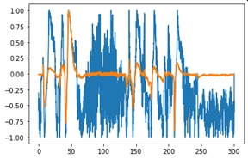

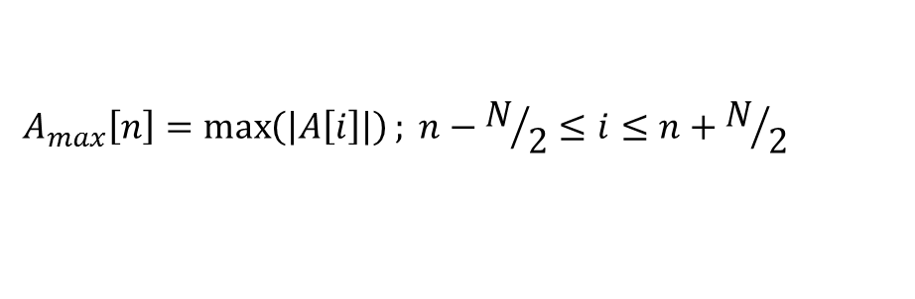

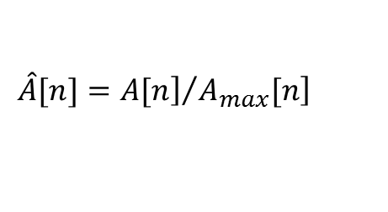

Processing Pipeline: Local Normalization
$$A_{max}\left[n\right]=\max\left(\left|A\left[i\right]\right|\right); n−N/2≤i≤n+N/2$$
Local Normalization
Conversion to Image
Decimation to 50Hz
$$\hat{A}[n]={\left.A[n\right]}/{\left.A_{max}[n\right]}$$
$$A:Amplitude$$
$$n:index of the sample$$
$$N:number of samples in a window centered around current sample$$
$$\hat{A}\left[n\right]:Locally Scaled Image$$
Postprocessing
ResNet18
Conversion to HDF5
Notes:
Scaling or normalization of the resulting signals is a very important step. Channel dependent or global normalization does not work well for this data.
Moving average filters, which are also popular, can significantly diminish spike behavior. Outlier removal is another popular method for artifact removal, but in practice this approach also tends to remove many seizure events.
We chose to implement a local scaling approach, which we refer to as max local scaling, in which all samples in a window are scaled between $\left[−1, +1\right].$
where $A$ is amplitude, $n$ is the current sample and $N$ is the number of samples in a window centered around the current sample. $\hat{A}[n]$ is the locally scaled sample.
In our work, we found that implementing local scaling with a 6‑second center-aligned window gives good results.

Slide 36
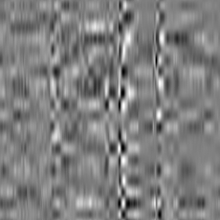
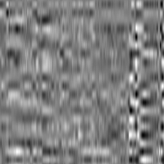
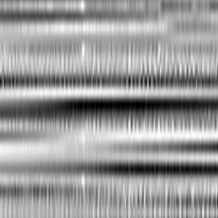
Processing Pipeline: Conversion to an Image
Background Windows
Local Normalization
Conversion to Image
Decimation to 50Hz
Seizure Windows
Postprocessing
ResNet18
Conversion to HDF5
Notes:
The next step for data preparation is converting all samples into grayscaled images.
Through experimentation, we found using $256$ samples for every window for every channel is efficient. But, since it is necessary to use a square shaped image as an input to the ResNet system, and the height of the windows is equal to the number of montages, then rescaling these images is necessary. Therefore, the windows are resized from $20×256$ to $256×256$ with cubic interpolation.

Slide 37
Processing Pipeline: Conversion to HDF5
Local Normalization
Conversion to Image
Decimation to 50Hz
The Hierarchical Data Format version 5 (HDF5), is an open-source file format that supports large, complex, heterogeneous data with fast read and write capabilities.
Postprocessing
ResNet18
Conversion to HDF5
Notes:
All necessary operations on neural networks (training, development and evaluation) can be done on images produced on the last step, but it run slow. To improve the speed of processes, especially training, the HDF5 format were used. All 2D images attached vertically and three (train, dev, eval) large HDF5 were made. Every dataset contains two subset which are called bckg and seiz. The total size of HDF5 file for train set is 32GB, dev set is 7GB and eval set is 6.5GB.
Since accessing HDF5 is much faster than images, the training process will be run much faster.
Also, the samples in HDF5 files are arranged sequentially, random sampling (without replacement) removes the need for a windowing process with predefined overlaps.

Slide 38
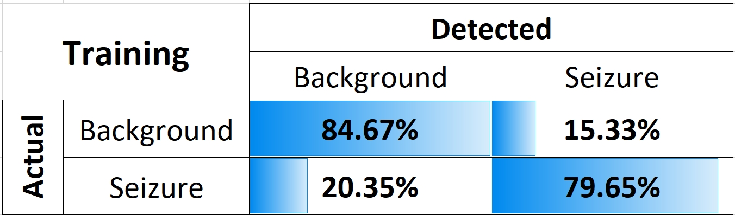
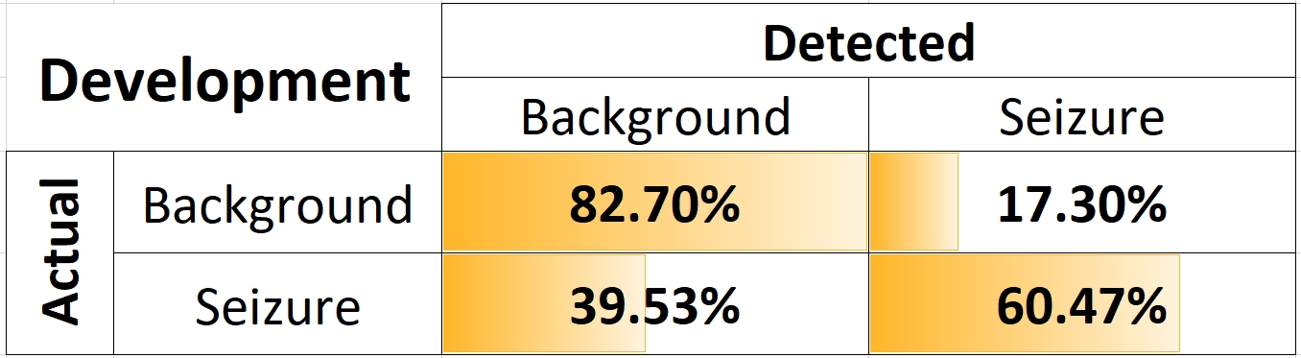







Processing Pipeline: Retraining ResNet18
$$ω_{b}=\frac{N_{seiz}}{N}, ω_{s}=\frac{N_{bckg}}{N} ,$$
Local Normalization
Conversion to Image
Decimation to 50Hz
$$N:Total number of samples$$
$$N_{seiz}:Number of seizure samples$$
$$N_{seiz}:Number of background samples$$
$$loss_{weighted}=ω_{b}∗loss\left(x_{i}, b\right)+ω_{s}∗loss\left(x_{i},s\right),$$
$$x_{i}:i^{th} input sample$$
$$b:background index$$
$$s:seizure index$$
$$loss\left(x, y\right):cross entropy or mse$$
Postprocessing
ResNet18
Conversion to HDF5
Notes:
Seizures occur about 7% of the time in the TUSZ Corpus. Since the distribution of classes is highly unbalanced, we must adjust the weights of the loss function. Hence, to better balance the number of seizure and background patterns, we randomly selected one-fifth of the background patterns. It was observed that using all the background samples did not improve the results. In practice, we have used about 30,000 samples for seizure events and 100,000 samples for background events.
To further adjust for the unbalanced number of samples in the two classes, we include prior probabilities in the loss function computation.
By observing the confusion matrix, the low false positive and high true positive of the ResNet18 on both train and development set show that the system has done his best to distinguish seizure samples between very complex shapes of backgrounds.
But the false positive ratio is still too high to be accepted in clinical applications.

Slide 39
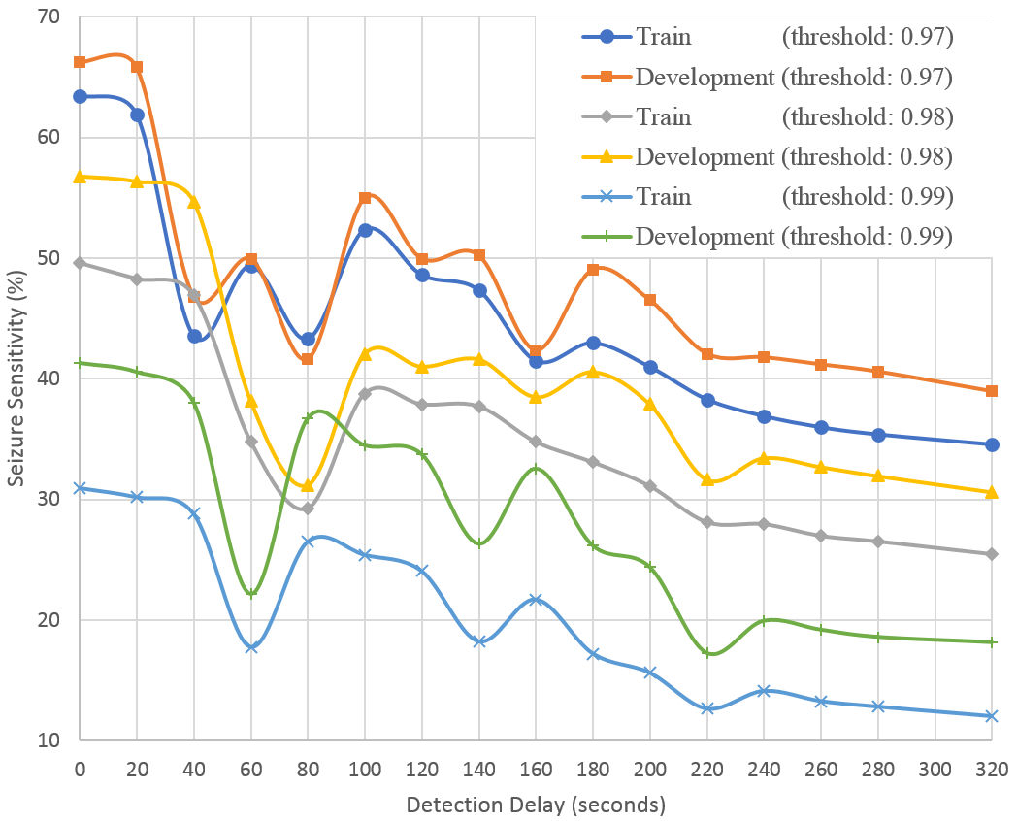
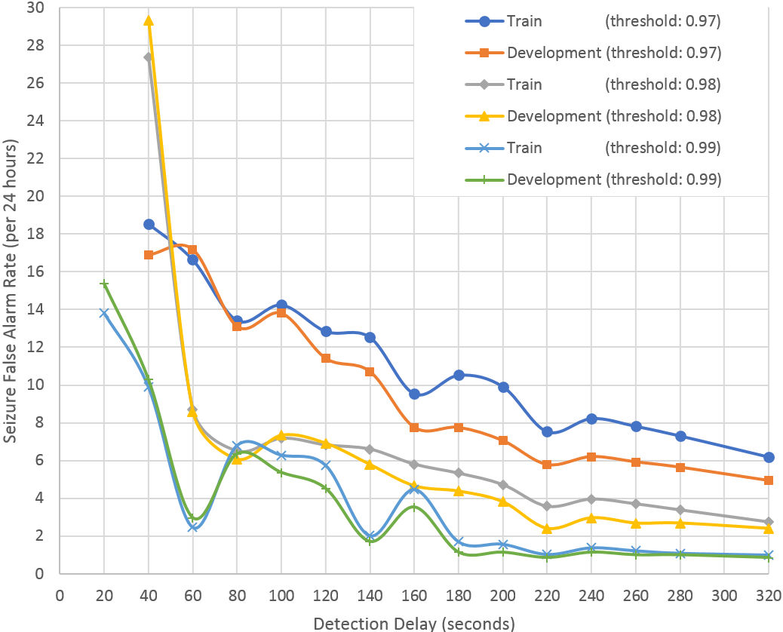

Processing Pipeline: Postprocessing
Seizure confidence threshold, Sth
Minimum acceptable background duration, Bdmin
Minimum acceptable seizure duration, SDmin
Local Normalization
Conversion to Image
Decimation to 50Hz
$$Detection Delay={BD}_{min}+{SD}_{min}$$
Sensitivity
False Alarm
Postprocessing
ResNet18
Conversion to HDF5
Notes:
The raw classification performance of ResNet18 is poor and needs additional postprocessing. Our postprocessor is based on three parameters:
Seizure confidence threshold
Minimum acceptable background duration
Minimum acceptable seizure duration
The first parameter reduces noisy decisions by increasing the seizure confidence threshold. The second and third parameters act similar to dilation and erosion in morphological image processing.
Once the threshold is applied, then all background windows between two seizure events with a duration less than (BDmin) will be classified as seizures. Similarly, all seizure events with a duration less than SDmin will be classified as background.
Detection delay is defined as the summation of minimum acceptable duration of background and seizure events.
Postprocessing has a significant impact on both the misclassification errors and the false alarm rate. Left figure shows the sensitivity as a function of the detection latency. Right shows the false alarm rate as a function of the detection latency.
The false alarm rate is significantly reduced by increasing the detection delay. There is also a moderate reduction in sensitivity.

Slide 40
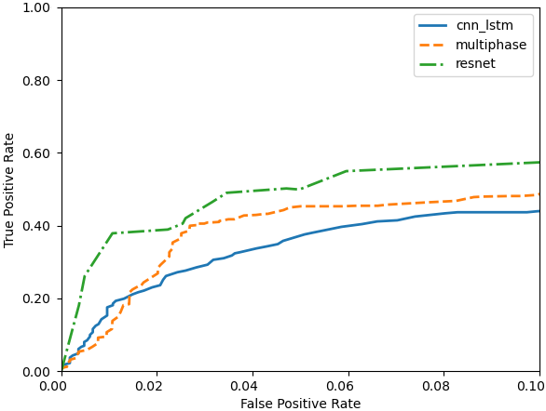

Results: Performance Comparison Using Overlap Scoring
Three systems were evaluated:
  cnn_lstm: a hybrid CNN/LSTM system
  mphase: a multipass system
  resnet: transfer learning
System | Sensitivity | FA Rate (/24H)
cnn_lstm | 43.69% | 20.85
mphase | 40.12% | 6.62
resnet | 42.05% | 5.78
Development Data
Evaluation Data
  ResNet outperforms both of these systems when the FA rate is low.
Notes:
In the left figure, we compare the performance of the proposed system to two other previously published systems: a hybrid CNN/LSTM system (cnn_lstm) developed by Golmohammadi and a multiphase system (mphase) developed by Shah.
This comparison was performed on the development data set (dev) using the overlap (OVLP) scoring metric. Note that we focus on performance for the range $[0,0.1]$ where false alarms are very low. This is the operating region of most interest for this application.
In the right figure, a similar analysis is shown for the blind evaluation set (eval). It is important to note that no tuning was performed based on the evaluation set results.
The seizure sensitivity and false alarm rate of the new system, which are 42.05% and 5.78/24h, respectively, are better than our previous best results (40.12% and 6.62/24h for the multiphase system). However, it is important to note that the resnet system is much simpler, has much less latency, and runs faster than real-time on relatively modest computing resources. This makes it ideal for critical care applications.

Slide 41
Results: Analysis of the False Positive Rate
Comparison with two top systems in the NeurekaTM 2020 Epilepsy Challenge.
ResNet still lags the two best performing systems (sia and pnc98).
The ResNet system runs faster than real time with a latency of 300 ms. The competition systems are non-real-time with infinite latency.
Development Data
Evaluation Data
Metric |  | cnn lstm | multi phase | resnet | sia | pnc98
D P A L | Sens | 45.17 | 36.70 | 20.36 | 23.45 | 6.98
 | Spec | 88.63 | 96.25 | 96.72 | 99.47 | 98.33
 | FPs | 23.25 | 6.76 | 5.50 | 0.97 | 2.54
E P C H | Sens | 37.67 | 36.34 | 49.83 | 12.84 | 1.56
 | Spec | 96.56 | 97.16 | 92.64 | 99.97 | 99.99
 | FPs | 2686.97 | 2221.29 | 5753.08 | 25.85 | 8.45
O V L P | Sens | 43.69 | 40.12 | 42.06 | 23.26 | 6.39
 | Spec | 91.71 | 97.19 | 97.40 | 99.74 | 99.65
 | FPs | 20.85 | 6.62 | 5.78 | 0.64 | 0.85
T A E S | Sens | 35.83 | 32.27 | 15.34 | 11.38 | 2.04
 | Spec | 83.91 | 90.18 | 88.81 | 99.46 | 99.42
 | FPs | 32.55 | 18.07 | 19.42 | 0.99 | 0.87
 | WGT | -53.05 | -21.21 | -40.71 | 2.59 | 0.83
Metric |  | cnn lstm | multi phase | resnet | sia | pnc98
D P A L | Sens | 54.79 | 45.01 | 14.29 | 24.07 | 8.61
 | Spec | 90.41 | 94.47 | 98.03 | 99.31 | 99.44
 | FPs | 21.79 | 11.61 | 3.50 | 1.27 | 0.95
E P C H | Sens | 38.15 | 52.04 | 42.82 | 1.27 | 5.09
 | Spec | 98.40 | 98.27 | 95.88 | 99.95 | 100.00
 | FPs | 1282.04 | 1391.52 | 3314.04 | 43.23 | 2.07
O V L P | Sens | 51.47 | 44.62 | 37.18 | 23.88 | 8.41
 | Spec | 92.63 | 95.48 | 98.33 | 99.61 | 99.93
 | FPs | 19.25 | 11.45 | 3.82 | 0.96 | 0.16
T A E S | Sens | 39.46 | 37.80 | 10.97 | 12.37 | 2.04
 | Spec | 87.49 | 91.29 | 93.51 | 99.22 | 99.90
 | FPs | 28.21 | 18.39 | 11.82 | 1.44 | 0.17
 | WGT | -38.57 | -16.58 | -26.08 | 2.46 | 0.82
Notes:
In the above tables, we compare the results of the proposed system to several leading systems including two of the top systems that participated in the NeurekaTM 2020 Epilepsy Challenge. These tables include the raw scores for sensitivity, specificity, and the false alarm rate for four scoring metrics. The last metric, time-aligned event scoring (TAES), also shows the final weighted score (WGT) using the weighting function adopted for the competition.
From these results, we see that the performance of the resnet system still lags the two best performing systems from the competition, sia and pnc98. However, the resnet system was designed to be real-time and low latency, while the best performing systems in the competition were non-real time with infinite latency and focused more on minimizing the weighted error metric.

Slide 42
Conclusions
Real-Time System
Sensitivity
Delay
False Alarm
Transfer deep learning is used to improve
spatiotemporal modeling and accelerate
convergence during training.
Through the optimization of three critical
parameters:
Sensitivity
False Alarm Rate
Detection Latency
real-time performance comparable to offline systems,
can be achieved on v1.5.2 of the TUH EEG Seizure Detection Corpus
without sacrificing performance:
Sensitivity: 42.05%
False Alarm Rate: 5.78 false alarms per 24 hours
While the number of samples in our database is relatively large, we do observe overfitting tendencies on the training dataset.
Though cross-validation was used, we plan to explore other pretrained ImageNet networks to avoid overfitting and improve generalization.
Notes:
Designing high sensitivity, low false alarm, and low delay seizure detection systems from noninvasive electroencephalogram scalp measurements is challenging. We have shown that with some trade-offs between three critical parameters – sensitivity, false alarm rate, and detection delay – real-time performance can be achieved without sacrificing performance.
Transfer deep learning is the core of the proposed system and helps our approach in two important ways: spatiotemporal interpretation of EEG signals and neural network convergence. The multiresolution convolutional layers in ResNet18 can effectively encode spatial and temporal relationships. Data augmentation in transfer learning makes the training fast and more importantly, it improves the convergence of a large neural network significantly. While the number of samples in our database is relatively large, we do observe overfitting tendencies on the training dataset. Though cross-validation was used, we plan to explore other pretrained ImageNet networks to assess their impact on overfitting and maintain generality.

Slide 43


Acknowledgments
This material is based upon work supported by the National Science Foundation under Grant No. IIP‑1827565. Any opinions, findings, and conclusions or recommendations expressed in this material are those of the author(s) and do not necessarily reflect the views of the National Science Foundation.
The TUH EEG Corpus effort was initially funded by (1) the Defense Advanced Research Projects Agency (DARPA) MTO under the auspices of Dr. Doug Weber through the Contract No. D13AP00065, (2) Temple University’s College of Engineering and (3) Temple University’s Office of the Senior Vice-Provost for Research. A number of funding agencies including the National Science Foundation and the National Institutes of Health have since contributed to its development.
NEDC’s data and resources are freely available at:
https://www.isip.piconepress.com/projects/tuh_eeg/html/downloads.shtml

Slide 44
Brief Bibliography
Y. Roy, R. Iskander, and J. Picone, “The NeurekaTM 2020 Epilepsy Challenge,” NeuroTechX, 2020. [Online]. Available: https://neureka-challenge.com/. [Accessed: 16-Apr-2020].
V. Shah, I. Obeid, J. Picone, G. Ekladious, R. Iskander, and Y. Roy, “Validation of Temporal Scoring Metrics for Automatic Seizure Detection,” in Proceedings of the IEEE Signal Processing in Medicine and Biology Symposium (SPMB), 2020, pp. 1‑5. https://ieeexplore.ieee.org/abstract/document/9353631.
M. Golmohammadi, Deep Architectures for Spatio-Temporal Sequence Recognition With Applications in Automatic Seizure Detection, Temple University, 2021. https://www.isip.piconepress.com/publications/ phd_dissertations/2021/seizure_detection/.
V. Shah et al., “The Temple University Hospital Seizure Detection Corpus,” Front. Neuroinform., vol. 12, pp. 1‑6, 2018.
﻿http://journal.frontiersin.org/researchtopic/1563/pdf.
C. Gómez, P. Arbeláez, M. Navarrete, C. Alvarado-Rojas, M. Le Van Quyen, and M. Valderrama, “Automatic seizure detection based on imaged-EEG signals through fully convolutional networks,” Sci. Rep., vol. 10, no. 1, p. 21833, 2020. ﻿https://doi. org/10.1038/s41598-020-78784-3.

Slide 45

Cancer Detection using Image Inpainting
Presented By:
Nabila Shawki
Neural Engineering Data Consortium,
Temple University

Slide 46
Introduction
Self-supervised learning (SSL) is a branch of unsupervised learning where we train a model with an intermediate task using automatically generated labels from data or predict a part of the data.
One can utilize the unannotated data to train a model and achieve better performance with a small amount of annotated data using the pretrained model.
In recent years, computer vision tasks have employed SSL successfully in various tasks such as detection, classification, and segmentation tasks.
Biomedical images such as whole slide images (WSIs) containing cancer samples are expensive and tedious to annotate.
Not all pretext task can be employed on WSIs such as, rotation detection.
We use a context encoder for image inpainting with a U-Net that has an Inception-ResNet-v2 encoder to reconstruct a part of an image.
Compared to ImageNet, the context encoder performs better by both freezing and fine tuning model. In both cases, the context encoder outperforms ImageNet pretrained model on cancer sensitivity.

Slide 47

Methodology
Pretext training
  Collect random patches from WSIs (in this case, we used patches collected from the partially annotated slides in TUH DPATH v1.1.1).
  Train a context encoder on the patches by hiding a part of them.
Downstream Task
  Collect patches from the latest TUH DPATH (v1.2.0).
  Add a classifier layer to the encoder model.
  Train on the labeled patches by both freezing layers and finetuning.
Datasets
  TUH DPATH v1.1.1 and v1.2.0.
  Lung and colon cancer patch dataset from Kaggle.
  ACDC-LungHP.

Slide 48
Preprocessing
For TUH_DPATH, the patches for both the pretext and downstream tasks are extracted by creating a mask based on the partial annotation. Then we traverse across the image, collect patches of 512 x 512 pixels, and label them if more than 50% of the image belongs to any certain label.
For the classes with low patch count (null, infl), we augmented with Augmentor python library.
The Kaggle dataset contains patch images which can be used directly to train the models.
The slides in ACDC-LungHP only contain lung cancer annotation. Also, most contain multiple samples per slide.

Slide 49
The Context Encoder
A context encoder is a generative adversarial network proposed by Pathak et al. which is one of the earliest work in self-supervised learning.
They used a modified AlexNet as their generator backend and the discriminator is a simple ConvNet.
In this experiment, we replaced the generator with a U-Net with an Inception-ResNet-v2 model. We used segmentation_model.pytorch library to build the model. The discriminator remained the same as the original model.
The loss criterion involves a reconstruction loss and adversarial loss.
  Adversarial loss -> mean squared error
  Reconstruction loss -> L1Loss
  Joint loss -> 0.001 * adversarial loss + 0.999 * reconstruction loss
Both the generator and the discriminator were trained with Adam optimizer.
Notes:
https://arxiv.org/abs/1604.07379
https://github.com/chsasank/segmentation_models.pytorch

Slide 50
The Context Encoder
For training, the patches were fed by creating square masks at random places while, for validation, the masks were always created at the center. The mask is a white square block that hides certain portion of the image.
The input patch size -> 128 x 128, mask size -> 64 x 64.
The generator is fed the image and the decoder only reconstructs the hidden portion (64 x 64).
Using the reconstruction loss, we compare the generated and actual masked part.
The discriminator is then fed the actual 64x 64 part and the corresponding generated part.

Slide 51
Downstream Task
The downstream task is the cancer patch classification.
From the pretrained model, we collect the generator (U-Net with Inception-ResNet-v2) and attach a classification head.
The number of classes varies according the database.
We train the U-Net using cross entropy loss and an Adam optimizer.
For fine tuning, we trained the whole model and for only feature extraction, we only train the classification head.
An approach that will be tested next is to train the first few layers for the downstream task while rest of the encoder is frozen. Since the model does not see a portion of the image during pretraining, it might be affecting the performance of the model during feature extraction.

Slide 52
ImageNet Pretrained Model
The segmentation_model.pytorch provides the weights for models trained on ImageNet. We downloaded the weights for the Inception-ResNet-v2 U-net.
This model also was trained by both freezing and fine tuning the layers.
The patches were preprocessed the same way as the context encoder.

Slide 53
Results (TUH DPATH v1.2.0)

Slide 54
Results (Colon and Lung Datasets)

Slide 55


ACDC-LungHP Status

Slide 56
Future Experiment Sets
ACDC-LungHP
Vahid’s patches on v1.2.0
Train the first few layers as the pretrained model only saw partial images.
Test the model with DeepLab backend.

