Slide 1
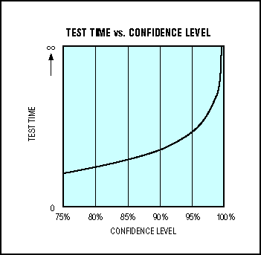
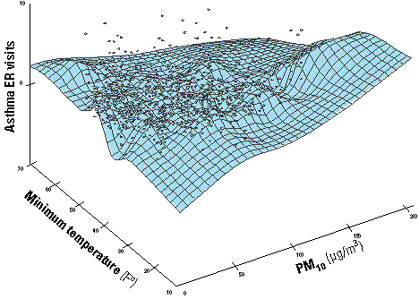
Lecture 30: Confidence Measures
Objectives:
Applications Confidence Measures Word Posteriors
Resources:
F.W.: Word Posteriors
H.J.: Confidence Measures Review
M.B.: Beyond Switchboard
L.D.: Calibration of Confidence
J.M.: Fuzzy Integrals
J.H.: Local Confidence Measures

Slide 2
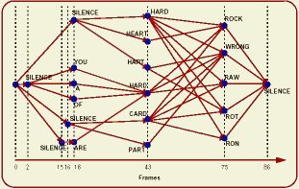
Confidence Measures
In many pattern recognition systems in which an overall judgment about an event is composed of a series (or product) of individual judgments, it is desirable to know how sure we are about this individual judgments.
For example, in a speech recognition system, we output sentences, but would like to spot words that are likely to be in error.
The overall likelihood of the sentence given the words is a product of the individual word probabilities.
Hence, we would like to use “word” or event posteriors as the confidence measure.
There are a number of practical issues associated with this. Perhaps the most significant one is the need to know all possible word hypotheses for all time.
This can be approximated using a “word graph”:
There are assorted practical issues associated with this approach, including the “depth” of the word graph, time registration, and “acoustic” (e.g., HMM) vs. “grammar” (e.g., language model) weights.

Slide 3
Confidence Measures Using Word Posteriors
There are many approximations to the exact computation of a word posteriors:

Slide 4
Approximations For Posteriors In Confidence Measures
More practical and successful approximations are:
Other techniques to approximate the posterior have been tried (neural networks, support vector machines, etc.) and have not been as successful.

Slide 5
Summary
Discussed the need for confidence measures in pattern recognition systems.
Introduced the concept of an event, or word, posterior and discussed how this can be estimated in practical applications such as a speech recognition.

