Slide 1
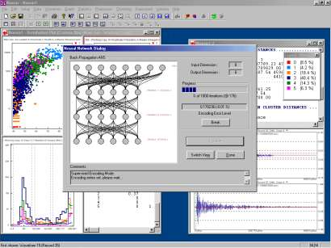
Lecture 01: Course Overview
Objectives:
Terminology
Generalization and Risk
Machine Understanding
Feature Confusability
The Design Cycle
Feature Selection
The Bayesian Approach
First Principles
Resources:
Syllabus
DHS: Chapter 1
DJM: Information Theory

Slide 2
Terminology
Pattern Recognition: “the act of taking raw data and taking an action based on the category of the pattern.”
Common Applications: speech and image recognition, machine translation, fingerprint identification (biometrics) and just about everything else including financial modeling, autonomous vehicles and even drug discovery.
Related Terminology:
  Machine Learning: “It gives computers the ability to learn without being explicitly programmed.” (Arthur Samuel, 1959)
  The ability of a machine to improve its performance based on previous results.
  Machine Understanding: acting on the intentions of the user
  generating the data.
  Big Data: “Big data is like teenage sex: everyone talks about it, nobody really knows how to do it, everyone thinks everyone else is doing it, so everyone claims they are doing it.” (Dan Ariely, 2013)
Related Fields: artificial intelligence, signal processing and discipline-specific research (e.g., speech understanding, natural language processing).

Slide 3
Generalization And Risk
How much trust can we place in
isolated data points?
What is the optimal decision surface?
Suppose you now receive two more data points?
The optimal decision surface is still a line, so this
new data is consistent with our current beliefs.
Next, you receive two more data points. What is the
optimal decision surface?
The optimal decision surface changes abruptly with
these two new data points. Is this a good thing?
In this course, we will study techniques that can easily drive the error rate to zero on the training data – referred to as overtraining. Is this the best classifier for previously unseen data?
We will see that the collection of data that accurately characterizes the problem, is critical:
“There is no data like more data.”
Some applications, particularly bioengineering, only have limited data. Some events, such as natural disasters (e.g. tsunamis), do not have more than a few data points.
For such applications, we must use model-based approaches (e.g. differential equations).
Can we integrate prior knowledge about the likelihood of each class, application constraints (e.g., N-gram frequencies, the grammar of a language or the physics of the real world) to make better decisions when faced with limited amounts of data?

Slide 4



Recognition or Understanding?
Which of these images are most scenic?
Half of the battle in building a machine learning system is understanding the requirements and developing data (e.g., annotated data) to support those requirements. We often iterate several times to get things ‘right’.
How can we develop a system to automatically determine scenic beauty? (Hint: feature combination)
Solutions to such problems require good feature extraction, good decision theory and good user interface engineering (e.g., Alexa).

Slide 5
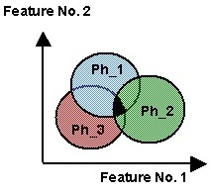
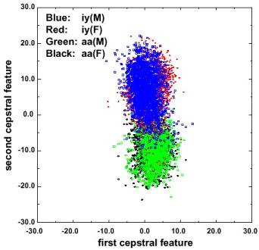
Traditional Model-Based Features Are Confusable
Regions of overlap represent the classification error
Error rates can be computed with knowledge of the joint probability distributions (see probability of error in transmission).
Context is used to reduce overlap.
In real problems, features are confusable and represent actual variation in the data.
The traditional role of the signal processing engineer has been to develop better features (e.g., “invariants”).

Slide 6
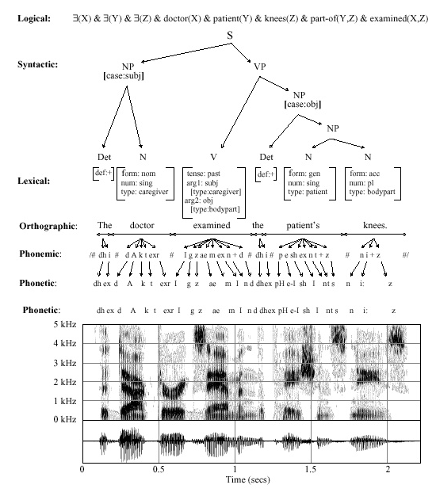
Classical Pattern Recognition: Problem Decomposition
Decision
Post-Processing
End-to-End Deep Learning
Classification
Feature Extraction
Segmentation
Sensing
Input

Slide 7
Classical Pattern Recognition: The Design Cycle
Start
Collect Data
Key issues:
  “There is no data like more data.”
  Perceptually-meaningful features?
  How do we find the best model?
  How do we estimate parameters?
  How do we evaluate performance?
Goal of the course:
  Introduce you to mathematically rigorous ways to train and evaluate models.
Choose Features
Choose Model
Train Classifier
Evaluate Classifier
End

Slide 8
Common Mistakes Made By Novices
I got 100% accuracy on...
  Almost any algorithm works some of the time, but few real-world problems have ever been completely solved.
  Training on the evaluation data is forbidden.
  Once you use evaluation data, you should discard it.
My algorithm is better because...
  Statistical significance and experimental design play a big role in determining the validity of a result.
  There is always some probability a random choice of an algorithm will produce a better result.
Hence, in this course, we will also learn how to evaluate algorithms and quite a bit about experimental design.

Slide 9
Summary
Pattern recognition vs. machine learning vs. machine understanding
We will focus more on decision theory and less on feature extraction.
This course emphasizes statistical and data-driven methods for optimizing system design and parameter values.
Two fundamental rules of machine learning:
Rule #1: There is no data like more data.
Rule #2: Are your results statistically significant?
Other important principles?

