Slide 1
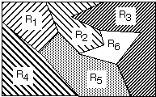
Lecture 07: Threshold Decoding
• Objectives:
Decision Surfaces Multivariate Gaussian Distributions Discriminant Functions Gaussian Classifiers Eigenvectors Revisited
• Resources:
DHS: Chapter 2 (Part 4) K.F.: Intro to PR X. Z.: PR Course A.N. : Gaussian Discriminants

Slide 2
Decision Surfaces
We can visualize our decision rule several ways:
$$choose ωi if: g_{i}\left(x\right)>g_{j}\left(x\right) for all j≠i$$

Slide 3
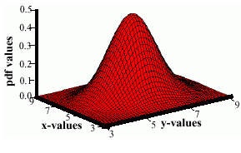
Multivariate Normal Distributions
A multivariate distribution is defined as:
$$p\left(x\right)=\frac{1}{\left({2π}^{d/2}\right){\left|Σ\right|}^{1/2}}exp\left(−\frac{1}{2}{\left(x−μ\right)}^{t}Σ^{−1}\left(x−μ\right)\right)$$
where $μ$ represents the mean (vector) and $Σ$ represents the covariance (matrix).
Note the exponent term is really a dot product or weighted Euclidean distance.
We will later refer to this as the Mahalanobis distance metric.
The covariance is always symmetric and positive semidefinite.
How does the shape vary as a function of the covariance?

Slide 4
Discriminant Functions
Recall our discriminant function for minimum error rate classification:
For a multivariate normal distribution:
Consider the case: Σ_{i} = σ²I
(statistical independence, equal variance, class-independent variance)

Slide 5
Threshold Decoding
This has a simple geometric interpretation:
The decision region when the priors are equal and the support regions are spherical is simply halfway between the means (Euclidean distance).

Slide 6
General Case for Gaussian Classifiers

Slide 7
Identity Covariance
Case: Σ_{i} = σ²I
This can be rewritten as:

Slide 8
Equal Covariances
Case: Σ_{i} = Σ

Slide 9
Arbitrary Covariances

Slide 10
Typical Examples of 2D Classifiers

Slide 11
Summary
Decision Surfaces: a partition of the feature space into regions associated with particular classes.
Multivariate Gaussian Distributions: completely specified by a mean vector and a covariance matrix.
Discriminant Functions: functions we use to classify data.
Gaussian Classifiers: data represented by multivariate Gaussian distributions can be classified using a simple scalar threshold.
Principal Components Analysis: eigenvectors reveal a great deal about the correlation structure of the data.

