Slide 1
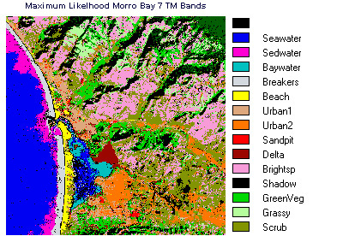
Lecture 02: Probability Decision Theory
Objectives:
Probability Decision Theory Probability Functions Prior Probabilities Class-Conditional Probabilities Posterior Probabilities Bayes Rule
Resources:
DHS: Chapter 2 (Part 1) R.G.O. : Intro to PR

Slide 2
Probability Decision Theory
Bayesian Decision Theory is a fundamental statistical approach to the problem of pattern classification.
It allows us to quantify the tradeoffs between various classification decisions using probability and the costs that accompany these decisions.
We assume all relevant probability distributions are known.
Later, as part of the machine learning process, we will learn how to estimate these from data.
Can we exploit prior knowledge using Bayesian Decision Theory?
For example, in our fish classification problem:
Are the sequence of fish predictable? (statistics)
Is each class equally probable? (uniform priors)
What is the cost of an error? (risk, optimization)

Slide 3
Image Processing Example: Sorting Fish
Sorting Fish: incoming fish are sorted according to species using optical sensing (sea bass or salmon?)
Problem Analysis:
Set up a camera and take some sample images to extract features
Consider features such as length, lightness, width, number and shape of fins, position of mouth, etc.
Sensing
Segmentation
Feature Extraction

Slide 4
Prior Probabilities
State of nature is prior information
Model as a random variable, ω:
ω = ω₁: the event that the next fish is a sea bass
category 1: sea bass; category 2: salmon
P(ω₁) = probability of category 1
P(ω₂) = probability of category 2
P(ω₁) + P(ω₂) = 1
Exclusivity: ω₁ and ω₂ share no basic events
Exhaustivity: the union of all outcomes is the sample space (either ω₁ or ω₂ must occur)
If all incorrect classifications have an equal cost:
Decide ω₁ if P(ω₁) > P(ω₂); otherwise, decide ω₂

Slide 5
Class-Conditional Probabilities
A decision rule with only prior information always produces the same result and ignores measurements.
If P(ω₁) >> P(ω₂), we will be correct most of the time.
Probability of error: P(E) = min(P(ω₁),P(ω₂)).
Given a feature, x (lightness), which is a continuous random variable, p(x|ω₁) is a class-conditional probability density function.
p(x|ω₁) and p(x|ω₂) describe the difference in lightness between populations of sea and salmon.
We often refer to these as likelihoods because they represent the likelihood of a value x given that it came from class ω₁ (or ω₂).

Slide 6
Probability Functions
A probability density function is denoted in lowercase and represents a function of a continuous variable.
p_{x}(x|ω), often abbreviated as p(x), denotes a probability density function for the random variable X. Note that p_{x}(x|ω) and p_{y}(y|ω) can be two different functions.
P(x|ω) denotes a probability mass function, and must obey the following constraints:
$$P\left(x\right)≥0$$
$$\sum_{x∈X}{P\left(x\right)=1}$$
Probability mass functions are typically used for discrete random variables (which are summed) while densities describe continuous random variables (latter must be integrated).
In this course, we mix both discrete variables (related to the number of classes) and continuous variables (the probability of a feature vector).

Slide 7
Bayes Formula
Suppose we know both P(ω_{j}) and p(x|ω_{j}), and we can measure x. How does this influence our decision?
The joint probability of finding a pattern that is in category ω_{j} and that this pattern has a feature value of x is:
$$p\left(ω_{j},x\right)=P\left(ω_{j} | x\right)p\left(x\right)=p\left(x | ω_{j}\right)P\left(ω_{j}\right)$$
Rearranging terms, we arrive at Bayes Rule, also known as Bayes Formula:
$$P\left(ω_{j} | x\right)=\frac{p\left(x | ω_{j}\right)P\left(ω_{j}\right)}{p\left(x\right)}$$
The denominator term, which is known as the evidence, combines the two numerator terms (for the case of two categories):
$$p\left(x\right)=\sum_{j=1}^{2}{p\left(x | ω_{j}\right)P\left(ω_{j}\right)}$$
This is the probability that a particular value of x can occur. It is difficult to calculate because it is the sum across all possible conditions.

Slide 8
Posterior Probabilities
Bayes Rule:
$$P\left(ω_{j} | x\right)=\frac{p\left(x | ω_{j}\right)P\left(ω_{j}\right)}{p\left(x\right)}$$
can be expressed in words as:
$$posterior=\frac{likelihood × prior}{evidence}$$
By measuring x, we can convert the prior probability, P(ω_{j}), into a posterior probability, P(ω_{j}|x).
Evidence can be viewed as a scale factor and is often ignored in optimization applications (e.g., speech recognition).
Bayes Rule allows us to train a system by collecting data in what is called a supervised mode (e.g., collect a sea bass sample and measure its length, speak a specific set of words and measure the feature vectors).

Slide 9
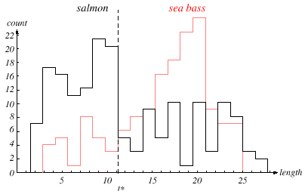
Length As A Discriminator
Conclusion: Length is a poor discriminator

Slide 10
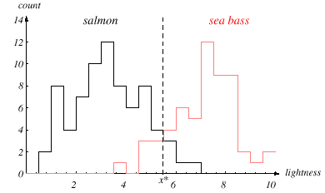
Add Another Feature
Lightness is a better feature than length because it reduces the misclassification error.
Can we combine features in such a way that we improve performance? (Hint: correlation)

Slide 11
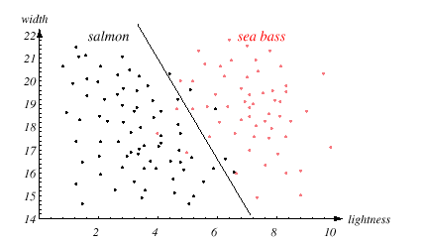
Width And Lightness
Treat features as a N-tuple (two-dimensional vector)
Create a scatter plot
Draw a line (regression) separating the two classes

Slide 12
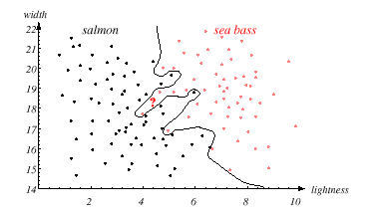
Decision Theory
Can we do better than a linear classifier?
What is wrong with this decision surface? (Hint: generalization)

Slide 13
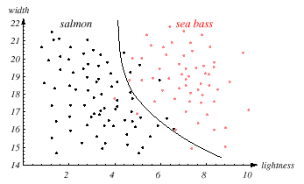
Generalization and Risk Revisited
Why might a smoother decision surface be a better choice? (Hint: Occam’s Razor).
This course investigates how to find such “optimal” decision surfaces and how to provide system designers with the tools to make intelligent trade-offs.

Slide 14
Posteriors Sum To 1.0
Two-class fish sorting problem (P(ω₁) = 2/3, P(ω₂) = 1/3):
For every value of x, the posteriors sum to 1.0.
At x=14, the probability x is in category ω₁ is 0.92.
The probability x is in ω₂ is 0.08.
Likelihoods and posteriors are related via Bayes Rule.

Slide 15
Summary
Probability Decision Theory: allows us to quantify the tradeoffs between various classification decisions using probability and the costs that accompany these decisions.
Prior Probabilities: reflect our knowledge of the problem, which comes from “subject matter expertise.”
Likelihoods: A model that assesses the probability a specific feature vector could have occurred from a specific class.
Posterior Probabilities: the probability a class occurred given a specific feature vector (converts a measurement to a probability that it came from a specific class).
Bayes Rule: factors a posterior into a combination of a likelihood, prior and the evidence. Is this the only appropriate engineering model?

