Slide 1
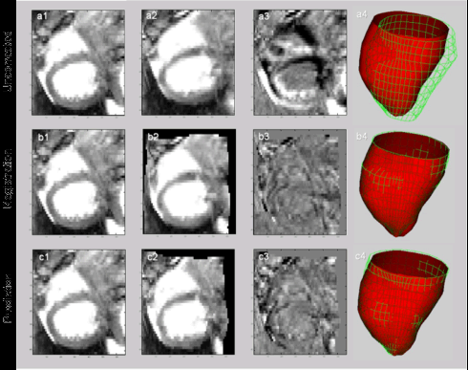
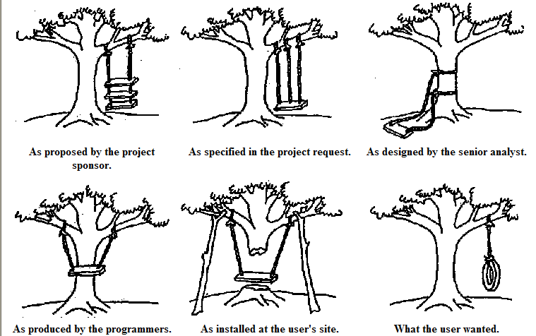
LECTURE 27: FOUNDATIONS OF MACHINE LEARNING
Objectives:
Bias and Variance
Jackknife
Bootstrap
Resources:
WIKI: Occam's Razor
CSCG: MDL On the Web
MS: No Free Lunch
TGD: Bias and Variance
CD: Jackknife Error Estimates
KT: Bootstrap Sampling Tutorial

Slide 2
No Free Lunch Theorem
A natural measure of generalization is the expected value of the error given D:
where δ() denotes the Kronecker delta function (value of 1 if the two arguments match, a value of zero otherwise).
The expected off-training set classification error when the true function F(x) and the probability for the kth candidate learning algorithm is P_{k}(h(x)|D) is:
No Free Lunch Theorem: For any two learning algorithms P₁(h|D) and P₂(h|D), the following are true independent of the sampling distribution P(x) and the number of training points:
Uniformly averaged over all target functions, F, E₁(E|F,n) – E₂(E|F,n) = 0.
For any fixed training set D, uniformly averaged over F,
E₁(E|F,n) – E₂(E|F,n) = 0.
Uniformly averaged over all priors P(F), E₁(E|F,n) – E₂(E|F,n) = 0.
For any fixed training set D, uniformly averaged over P(F),
E₁(E|F,n) – E₂(E|F,n) = 0.

Slide 3
Bias and Variance
Two ways to measure the match of alignment of the learning algorithm to the classification problem involve the bias and variance.
Bias measures the accuracy in terms of the distance from the true value of a parameter – high bias implies a poor match.
Variance measures the precision of a match in terms of the squared distance from the true value – high variance implies a weak match.
For mean-square error, bias and variance are related.
Consider these in the context of modeling data using regression analysis. Suppose there is an unknown function F(x) which we seek to estimate based on n samples in a set D drawn from F(x).
The regression function will be denoted g(x;D). The mean square error of this estimate is (see lecture 5, slide 12):
The first term is the bias and the second term is the variance.
This is known as the bias-variance tradeoff since more flexible classifiers tend to have lower bias but higher variance.

Slide 4
Bias and Variance For Classification
Consider our two-category classification problem:
Consider a discriminant function:
Where ε is a zero-mean random variable with a binomial distribution with variance:
The target function can be expressed as .
Our goal is to minimize .
Assuming equal priors, the classification error rate can be shown to be:
where y_{B} is the Bayes discriminant (1/2 in the case of equal priors).
The key point here is that the classification error is linearly proportional to
, which can be considered a boundary error in that it represents the incorrect estimation of the optimal (Bayes) boundary.

Slide 5
Bias and Variance For Classification (Cont.)
If we assume p(g(x;D)) is a Gaussian distribution, we can compute this error by integrating the tails of the distribution (see the derivation of P(E) in Chapter 2). We can show:
The key point here is that the first term in the argument is the boundary bias and the second term is the variance.
Hence, we see that the bias and variance are related in a nonlinear manner.
For classification the relationship is multiplicative. Typically, variance dominates bias and hence classifiers are designed to minimize variance.
See Fig. 9.5 in the textbook for an example of how bias and variance interact for a two-category problem.

Slide 6
Resampling For Estimating Statistics
How can we estimate the bias and variance from real data?
Suppose we have a set D of n data points, x_{i} for i=1,…,n.
The estimates of the mean/sample variance are:
Suppose we wanted to estimate other statistics, such as the median or mode. There is no straightforward way to measure the error.
Jackknife and Bootstrap techniques are two of the most popular resampling techniques to estimate such statistics.
Use the “leave-one-out” method:
This is just the sample average if the ith point is deleted.
The jackknife estimate of the mean is defined as:
The variance of this estimate is:
The benefit of this expression is that it can be applied to any statistic.

Slide 7
Jackknife Bias and Variance Estimates
We can write a general estimate for the bias as:
The jackknife method can be used to estimate this bias. The procedure is to delete points x_{i} one at a time from D and then compute: .
The jackknife estimate is:
We can rearrange terms:
This is an unbiased estimate of the bias.
Recall the traditional variance:
The jackknife estimate of the variance is:
This same strategy can be applied to estimation of other statistics.

Slide 8
Bootstrap
A bootstrap data set is one created by randomly selecting n points from the training set D, with replacement.
In bootstrap estimation, this selection process is repeated B times to yield B bootstrap data sets, which are treated as independent sets.
The bootstrap estimate of a statistic, , is denoted and is merely the mean of the B estimates on the individual bootstrap data sets:
The bootstrap estimate of the bias is:
The bootstrap estimate of the variance is:
The bootstrap estimate of the variance of the mean can be shown to approach the traditional variance of the mean as .
The larger the number of bootstrap samples, the better the estimate.

Slide 9
Summary
Discussed bias and variance using regression as an example.
Introduced a class of methods based on resampling to estimate statistics.
Introduced the Jackknife and Bootstrap methods.
Next: Introduce similar techniques for classifier design.

