Slide 1
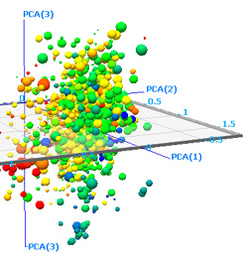
LECTURE 15: DISCRIMINANT ANALYSIS
• Objectives: Mean-Square Error Objective Function Projection Operator Whitening Transformation Principal Components Analysis Fisher Linear Discriminant Analysis Multiple Discriminant Analysis Examples
Resources:
D.H.S.: Chapter 3 (Part 2) JL: Layman’s Explanation QT: PCA Introduction JP: Speech Processing KF: Fukunaga, Pattern Recognition

Slide 2
Component Analysis
Component analysis is a technique that combines features to reduce the dimension of the feature space.
It can also be the basis for a classification algorithm.
Features of this approach include:
Statistical decorrelation of the data.
Linear combinations are simple to compute and tractable.
Project a high dimensional space onto a lower dimensional space.
Gain insight into the relative importance of each feature.
Three classical approaches for finding the optimal transformation:
Principal Components Analysis (PCA): projection that best represents the data in a least-square sense.
Multiple Discriminant Analysis (MDA): projection that best separates the data in a least-squares sense.
Independent Component Analysis (IDA): projection that minimizes the mutual information of the components.

Slide 3
Principal Component Analysis
Consider representing a set of n d-dimensional samples x₁,…,x_{n} by a single vector, x₀.
Define a squared-error criterion:
The solution to this problem is given by:
The sample mean is a zero-dimensional representation of the data set.
Consider a one-dimensional solution:
In other words, the best one-dimensional projection of the data (in the least mean-squared error sense) is the projection of the data onto a line through the sample mean in the direction of the eigenvector of the scatter matrix having the largest eigenvalue (hence the name Principal Component).
For the Gaussian case, the eigenvectors are the principal axes of the hyperellipsoidally shaped support region!

Slide 4
Alternate View: Coordinate Transformations
Why is it convenient to convert an arbitrary distribution into a spherical one? (Hint: Euclidean distance)
Consider the transformation: A_{w}= Φ Λ^{-1/2}
where Φ is the matrix whose columns are the orthonormal eigenvectors of Σ and Λ is a diagonal matrix of eigenvalues (Σ= Φ Λ Φ^{t}). Note that Φ is unitary.
What is the covariance of y=A_{w}x?
E[yy^{t}] = (A_{w}x)(A_{w}x)^{t} =(Φ Λ^{-1/2}x) (Φ Λ^{-1/2}x)^{t}
= Φ Λ^{-1/2}x x^{t} Λ^{-1/2} Φ^{t} = Φ Λ^{-1/2} Σ Λ^{-1/2} Φ^{t}
= Φ Λ^{-1/2} Φ Λ Φ^{t} Λ^{-1/2} Φ^{t}
= (Φ Φ^{t}) (Λ^{-1/2} Λ Λ^{-1/2} )(ΦΦ^{t})
= I
Why is this significant?

Slide 5
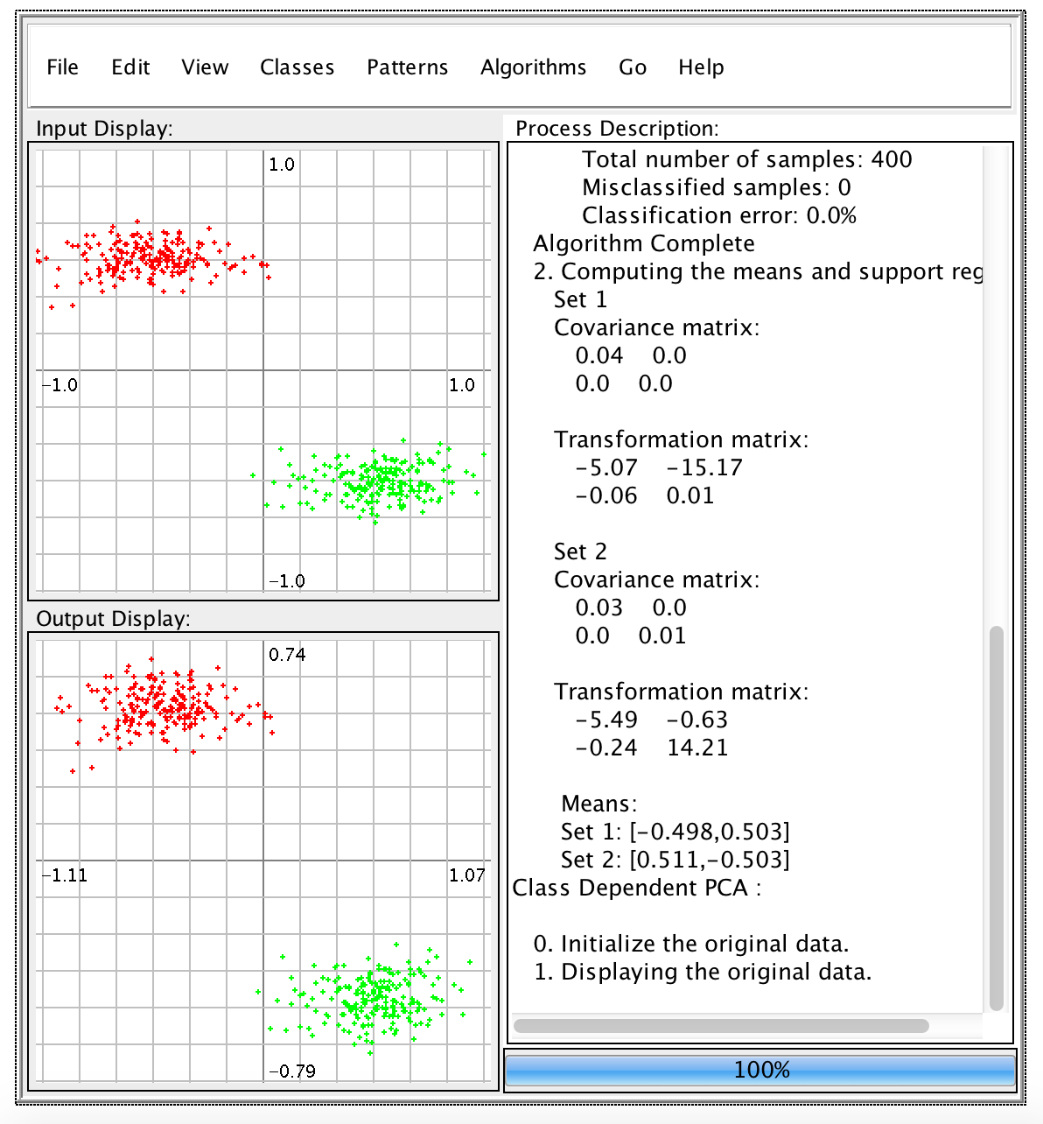
Examples of Maximum Likelihood Classification
For the Gaussian case, the eigenvectors are the principal axes of the hyperellipsoidally shaped support region!
Let’s work some examples (class-independent and class-dependent PCA).
In class-independent PCA, a global covariance matrix is computed:
In this case, the covariance will be an ellipsoid.
The first principal component will be the major axis of this ellipsoid.
The second principal component will be the minor axis.
In class-dependent PCA, which requires labeled training data, transformations are computed independently for each class.
The ML decision surface is a line (or a parabola in this case).

Slide 6
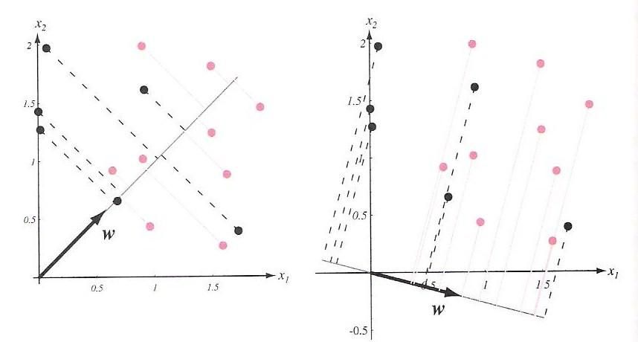
Discriminant Analysis
Discriminant analysis seeks directions that are efficient for discrimination.
Consider the problem of projecting data from d dimensions onto a line with the hope that we can optimize the orientation of the line to minimize error.
Consider a set of n d-dimensional samples x₁,…,x_{n} in the subset D1 labeled ω₁ and n₂ in the subset D₂ labeled ω₂.
Define a linear combination of x:
and a corresponding set of n samples y₁, …, y_{n} divided into Y₁ and Y₂.
Our challenge is to find w that maximizes separation.
This can be done by considering the ratio of the between-class scatter to the within-class scatter.

Slide 7
Separation of the Means and Scatter
Define a sample mean for class i:
The sample mean for the projected points are:
The sample mean for the projected points is just the projection of the mean (which is expected since this is a linear transformation).
It follows that the distance between the projected means is:
Define a scatter for the projected samples:
An estimate of the variance of the pooled data is:
and is called the within-class scatter.

Slide 8
Fisher Linear Discriminant and Scatter
The Fisher linear discriminant maximizes the criteria:
Define a scatter for class I, S_{i} :
The total scatter, S_{w}, is:
We can write the scatter for the projected samples as:
Therefore, the sum of the scatters can be written as:

Slide 9
Separation of the Projected Means
The separation of the projected means obeys:
Where the between class scatter, S_{B}, is given by:
S_{w} is the within-class scatter and is proportional to the covariance of the pooled data.
S_{B} , the between-class scatter, is symmetric and positive definite, but because it is the outer product of two vectors, its rank is at most one.
This implies that for any w, S_{B}w is in the direction of m₁-m₂.
The criterion function, J(w), can be written as:

Slide 10
Linear Discriminant Analysis
This ratio is well-known as the generalized Rayleigh quotient and has the well-known property that the vector, w, that maximizes J(), must satisfy:
The solution is:
This is Fisher’s linear discriminant, also known as the canonical variate.
This solution maps the d-dimensional problem to a one-dimensional problem (in this case).
From Chapter 2, when the conditional densities, p(x|ω_{i}), are multivariate normal with equal covariances, the optimal decision boundary is given by:
where , and w₀ is related to the prior probabilities.
The computational complexity is dominated by the calculation of the within-class scatter and its inverse, an O(d²n) calculation. But this is done offline!
Let’s work some examples (class-independent PCA and LDA).

Slide 11
Multiple Discriminant Analysis
For the c-class problem in a d-dimensional space, the natural generalization involves c-1 discriminant functions.
The within-class scatter is defined as:
Define a total mean vector, m:
and a total scatter matrix, S_{T}, by:
The total scatter is related to the within-class scatter (derivation omitted):
We have c-1 discriminant functions of the form:

Slide 12
Multiple Discriminant Analysis (Cont.)
The criterion function is:
The solution to maximizing J(W) is once again found via an eigenvalue decomposition:
Because S_{B} is the sum of c rank one or less matrices, and because only c-1 of these are independent, S_{B} is of rank c-1 or less.
An excellent presentation on applications of LDA can be found at PCA Fails!

Slide 13
Summary
Principal Component Analysis (PCA): represents the data by minimizing the squared error (representing data in directions of greatest variance).
PCA is commonly applied in a class-dependent manner where a whitening transformation is computed for each class, and the distance from the mean of that class is measured using this class-specific transformation.
PCA gives insight into the important dimensions of your problem by examining the direction of the eigenvectors.
Linear DIscriminant Analysis (LDA): attempts to project the data onto a line that represents the direction of maximum discrimination.
LDA can be generalized to a multi-class problem through the use of multiple discriminant functions (c classes require c-1 discriminant functions).

