Slide 1
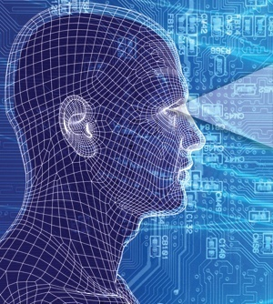
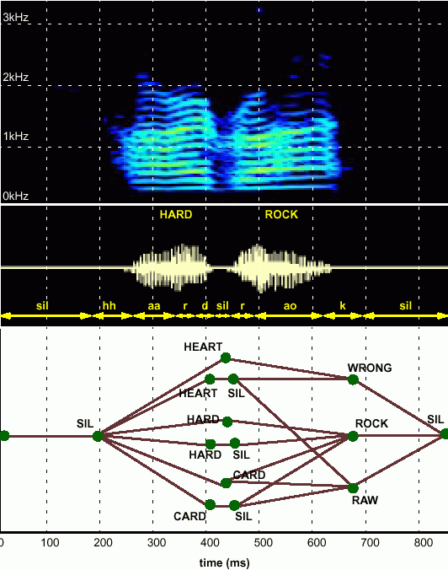
HUMAN LANGUAGE TECHNOLOGY:
From Bits to Blogs
Joseph Picone, PhD
Professor and Chair
Department of Electrical and Computer Engineering
Temple University
URL:

Slide 2
Fundamental Challenges: Generalization and Risk
What makes the development of human language technology so difficult?
“In any natural history of the human species, language would stand out as the preeminent trait.”
“For you and I belong to a species with a remarkable trait: we can shape events in each other’s brains with exquisite precision.”
S. Pinker, The Language Instinct: How the Mind Creates Language, 1994
Some fundamental challenges:
Diversity of data, much of which defies simple mathematical descriptions or physical constraints (e.g., Internet data).
Too many unique problems to be solved (e.g., 6,000 language, billions of speakers, thousands of linguistic phenomena).
Generalization and risk are fundamental challenges (e.g., how much can we rely on sparse data sets to build high performance systems).
Underlying technology is applicable to many application domains:
Fatigue/stress detection, acoustic signatures (defense, homeland security);
EEG/EKG and many other biological signals (biomedical engineering);
Open source data mining, real-time event detection (national security).

Slide 3
Abstract
What makes machine understanding of human language so difficult?
“In any natural history of the human species, language would stand out as the preeminent trait.”
“For you and I belong to a species with a remarkable trait: we can shape events in each other’s brains with exquisite precision.”
S. Pinker, The Language Instinct: How the Mind Creates Language, 1994
In this presentation, we will:
Discuss the complexity of the language problem in terms of three key engineering approaches: statistics, signal processing and machine learning.
Introduce the basic ways in which we process language by computer.
Discuss some important applications that continue to drive the field (commercial and defense/homeland security).

Slide 4
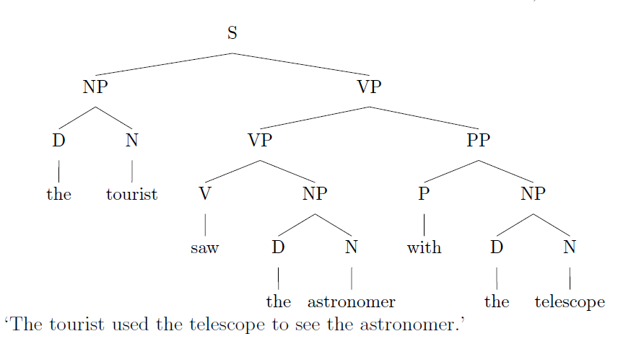
Language Defies Conventional Mathematical Descriptions
According to the Oxford English Dictionary, the 500 words used most in the English language each have an average of 23 different meanings. The word “round,” for instance, has 70 distinctly different meanings.
(J. Gray, http://www.gray-area.org/Research/Ambig/#SILLY )
Are you smarter than a 5th grader?
“The tourist saw the astronomer on the hill with a telescope.”
Hundreds of linguistic phenomena we must take into account to understand written language.
Each can not always be perfectly identified (e.g., Microsoft Word)
95% x 95% x … = a small number
D. Radev, Ambiguity of Language
Is SMS messaging even a language? “y do tngrs luv 2 txt msg?”

Slide 5
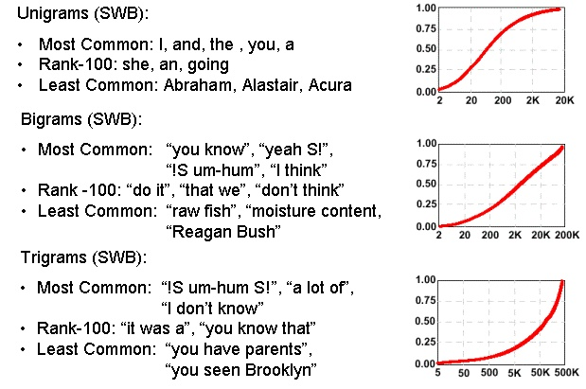
Communication Depends on Statistical Outliers
A small percentage of words constitute a large percentage of word tokens used in conversational speech:
Conventional statistical approaches are based on average behavior (means) and deviations from this average behavior (variance).
Consider the sentence:
“Show me all the web pages about Franklin Telephone in Oktoc County.”
Key words such as “Franklin” and “Oktoc” play a significant role in the meaning of the sentence.
What are the prior probabilities of these words?
Consequence: the prior probability of just about any meaningful sentence is close to zero. Why?

Slide 6
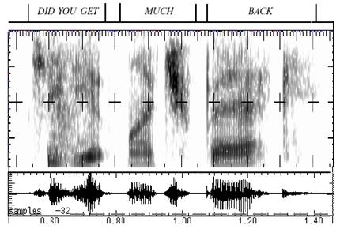
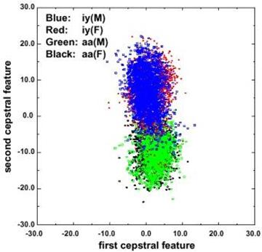
Fundamental Challenges in Spontaneous Speech
Common phrases experience significant reduction (e.g., “Did you get” becomes “jyuge”).
Approximately 12% of phonemes and 1% of syllables are deleted.
Robustness to missing data is a critical element of any system.
Linguistic phenomena such as coarticulation produce significant overlap in the feature space.
Decreasing classification error rate requires increasing the amount of linguistic context.
Modern systems condition acoustic probabilities using units ranging from phones to multiword phrases.

Slide 7
Human Performance is Impressive
Human performance exceeds machine performance by a factor ranging from 4x to 10x depending on the task.
On some tasks, such as credit card number recognition, machine performance exceeds humans due to human memory retrieval capacity.
The nature of the noise is as important as the SNR (e.g., cellular phones).
A primary failure mode for humans is inattention.
A second major failure mode is the lack of familiarity with the domain (i.e., business terms and corporation names).
Word Error Rate
20%
Wall Street Journal (Additive Noise)
15%
Machines
10%
5%
Human Listeners (Committee)
0%
10 dB
16 dB
22 dB
Quiet
Speech-To-Noise Ratio

Slide 8

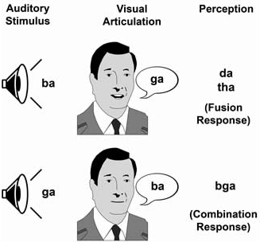
Human Performance is Robust
Cocktail Party Effect: the ability to focus one’s listening attention on a single talker among a mixture of conversations and noises.
McGurk Effect: visual cues of a cause a shift in perception of a sound, demonstrating multimodal speech perception.
Sound localization is enabled by our binaural hearing, but also involves cognition.
Suggests that audiovisual integration mechanisms in speech take place rather early in the perceptual process.

Slide 9
Human Language Technology (HLT)
Audio Processing:
Speech Coding/Compression (mpeg)
Text to Speech Synthesis (voice response systems)
Pattern Recognition / Machine Learning:
Language Identification (defense)
Speaker Identification (biometrics for security)
Speech Recognition (automated operator services)
Natural Language Processing (NLP):
Entity/Content Extraction (ask.com, cuil.com)
Summarization and Gisting (CNN, defense)
Machine Translation (Google search)
Integrated Technologies:
Real-time Speech to Speech Translation (videoconferencing)
Multimodal Speech Recognition (automotive)
Human Computer Interfaces (tablet computing)
All technologies share a common technology base: machine learning.

Slide 10
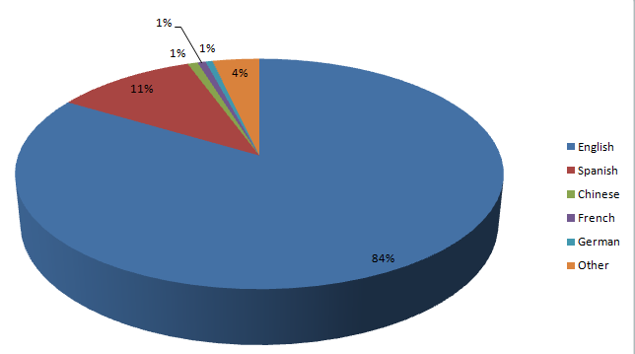
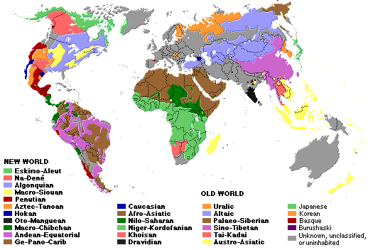
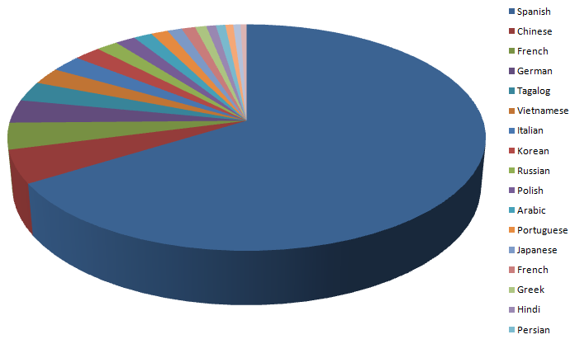
The World’s Languages
There are over 6,000 known languages in the world.
The dominance of English is being challenged by growth in Asian and Arabic languages.
Common languages are used to facilitate communication; native languages are often used for covert communications.
U.S. 2000 Census
Non-English Languages

Slide 11
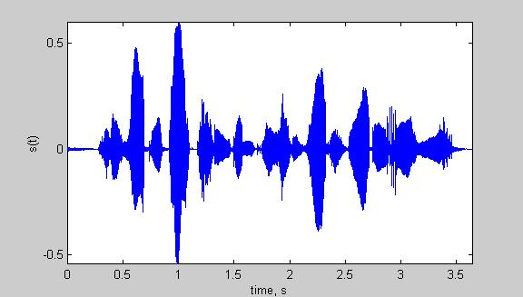
Speech Recognition Architectures
Core components of modern speech recognition systems:
Transduction: conversion of an electrical or acoustic signal to a digital signal;
Feature Extraction: conversion of samples to vectors containing the salient information;
Acoustic Model: statistical representation of basic sound patterns (e.g., hidden Markov models);
Language Model: statistical model of common words or phrases (e.g., N-grams);
Search: finding the best hypothesis for the data using an optimization procedure.
Input
Speech
Acoustic
Front-end
Acoustic Models
P(A/W)
Language Model
P(W)
Search
Recognized Utterance

Slide 12
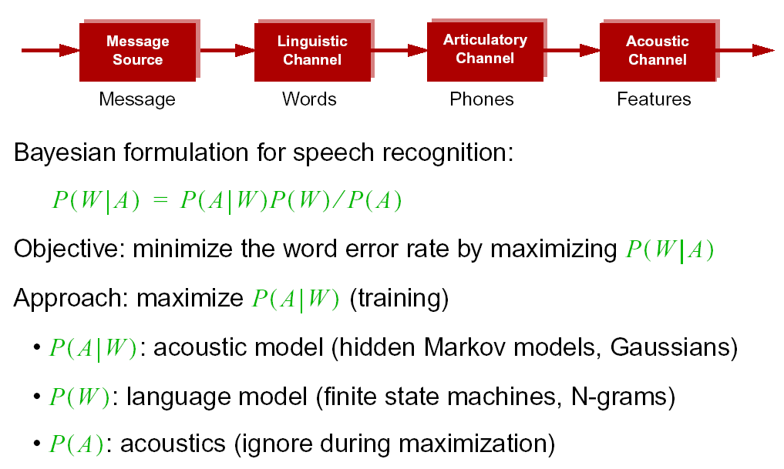
Statistical Approach: Noisy Communication Channel Model

Slide 13
Brief Bibliography of Related Research
S. Pinker, The Language Instinct: How the Mind Creates Language, William Morrow and Company, New York, New York, USA, 1994.
F. Juang and L.R. Rabiner, “Automatic Speech Recognition - A Brief History of the Technology,” Elsevier Encyclopedia of Language and Linguistics, 2nd Edition, 2005.
M. Benzeghiba, et al., “Automatic Speech Recognition and Speech Variability, A Review,” Speech Communication, vol. 49, no. 10-11, pp. 763–786, October 2007.
B.J. Kroger, et al., “Towards a Neurocomputational Model of Speech Production and Perception,” Speech Communication, vol. 51, no. 9, pp. 793-809, September 2009.
B. Lee, “The Biological Foundations of Language”, available at http://www.duke.edu/~pk10/language/neuro.htm (a review paper).
M. Gladwell, Blink: The Power of Thinking Without Thinking, Little, Brown and Company, New York, New York, USA, 2005.

