Slide 1
LECTURE 33: Alternative OPTIMIZERS
Objectives:
Convolutional Neural Networks Stochastic Gradient Descent Adaptive Moment Estimation Generative Adversarial Networks The Neural Network Zoo
Resources: Learning Architectures for AI Contrastive Divergence RBMs

Slide 2
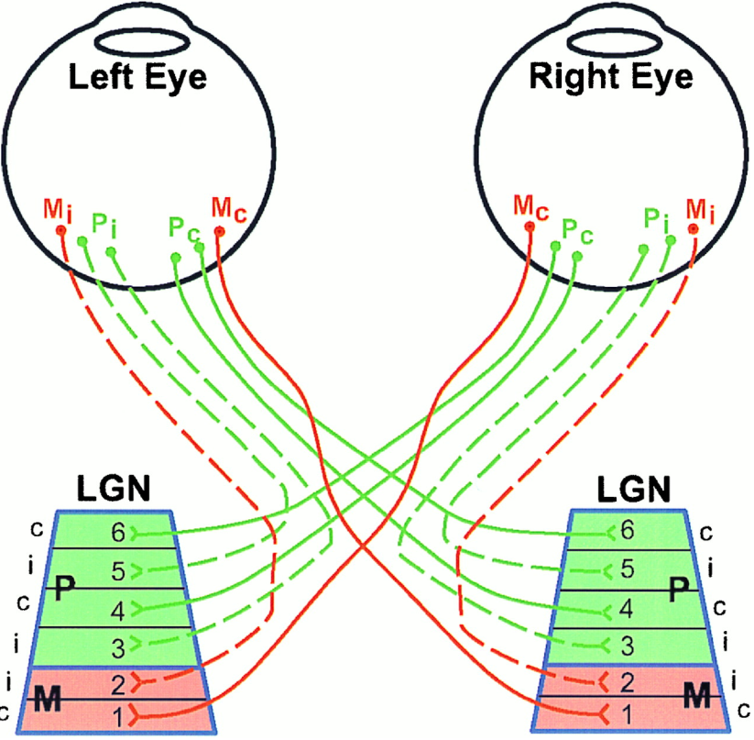
The Visual System: Inspiration for CNNs
The visual system contains a complex arrangement of cells
Each cell is responsible for only a sub-region of the visual field, or receptive field
The arrangement of these sub-regions is such, that the entire visual field is covered
Convolutional Neural Networks (CNNs) were proposed to emulate the animal visual cortex, which exploits the spatially local correlations present in natural images.
Before reaching the primary visual cortex, fibers on the optic nerve make a synapse in the lateral geniculate nucleus (LGN), cells from the fovea (in eye) project to layers composed parvocellular layers. These take care of the fine details that necessary to determine what an object is. Ganglion cells from the peripheral retina project to the Magnocellular (M) layers, which help determine where an object is.

Slide 3
CNNs Connectivity
To exploit the spatially local correlations, the neurons in a layer receive inputs only from a subset of units in the previous layer (spatially contiguous visual field).
The units (neurons) are unresponsive to changes outside of their receptive fields
Higher layers, become more global
Receptive Field = 3
These units have a receptive field of 3, therefore, they are only connected to 3 contiguous units in the previous layer

Slide 4
CNNs Convolutional Layer
The convolutional layer is comprised of several “filters” that search for different patterns in the entire input
A feature map can be generated with the information from the learned filters as follows:
$$h_{ij}^{k}=tahn{\left({(W}^{k}⋆x\right)}_{ij}+b_{k})$$
Where $h^{k}$ represents the $k^{th}$ feature map in a hidden layer.
Note that the weight and bias parameters are shared within the same filter
Gradient descent is commonly used for the training of CNNs, but the gradient of the shared weights is given by the sum of the shared parameters
Parameter sharing allows the search of the same pattern in the entire visual field
Each hidden layer is formed of several feature maps
Filter 2

Slide 5
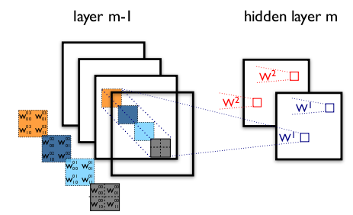
CNNs Convolutional Layer
The figure contains two different CNN layers. Layer $m−1$ contains four feature maps, while layer $m$ contains 2 ($h^{0}$ and $h^{1}$).
The blue and red squares in $m$ are computed from pixels of layer $m−1$ that fall within their 2x2 receptive field (squares in $m−1$).
$W_{ij}^{kl}$ then denotes the weight connecting each pixel of the $k^{th}$feature map at layer $m$ with the pixel at coordinates $(i,j)$ of the $l^{th}$ feature map at layer $m−1$.
It is important to know that the frame length of the filter for image recognition, called stride, is usually set to 1 or 2.
To control the spatial size of the output, zero-padding around the borders is commonly performed

Slide 6
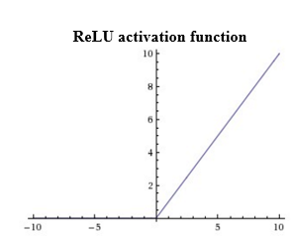
CNNs ReLU Layer
An activation layer is added after one or more convolutional layers.
Typically, for the image recognition tasks, a Rectified Linear Unit activation function (ReLU) is used.
This function is given by
$$f\left(x\right)=max(0,x)$$
Using this activation function increases the non-linear properties of the decision function without affecting the receptive fields of the convolutional layer.
$$x=0$$

Slide 7
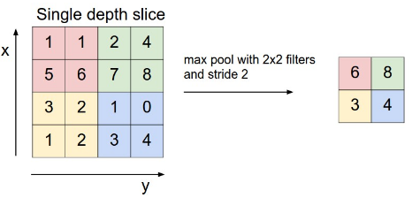
CNNs Pooling Layer
Another typical layer in a CNN is a pooling layer
Pooling layers reduce the resolution through a local maximum, which also reduces the amount of computations and parameters in the network
The pooling layer needs two hyperparameters:
$F:$ Spatial extent (size)
$S:$ Stride (frame length)
Common parameters used in literature are
$$F=2×2$$
$$S=2$$
The most common pooling operation is maxPooling, which partitions the input into a set of non-overlapping section and, for each sub-region outputs the max value.
Pooling helps to make the representation become approximately invariant to small translations in the input.

Slide 8
CNNs Fully Connected Layer
If classification is being performed, a fully-connected layer is added
This layer corresponds to a traditional Multilinear Perceptron (MLP)
As the name indicates it, the neurons in the fully connected layer have full connections to all activations in the previous layers
Adding this layer allows the classification of the input described by the feature maps extracted by the previous layers
This layer works in the same way as an MLP and activation functions used commonly include the sigmoid function and the tahn function

Slide 9
CNN: All Together
Summarizing the layers shown so far, a CNN is depicted:
ReLu Layer
Convolutional Layer
Pooling Layer
Fully Connected Layer

Slide 10
DRNN Training
Use stochastic gradient decent for optimization:
$θ\left(j+1\right)=θ\left(j\right)−η_{0}\left(1−\frac{j}{T}\right)\frac{∇_{θ}\left(j\right)}{\left\|∇_{θ}\left(j\right)\right\|}$
$θ\left(j\right):$the set of all trainable parameters after j updates
$∇_{θ}\left(j\right)$: the gradient of a cost function with respect to this parameter set, as computed on a randomly sampled part of the training set.
T: the number of batches
$η_{0}$: the learning rate is set at an initial value which decreases linearly with each subsequent parameter update.
Incremental layer-wise method: train the full network with BPTT and linearly reduce the learning rate to zero before a new layer is added. After adding a new layer the previous output weights will be discarded, and new output weights are initialized connecting from the new top layer.
For DRNN-AO, we test the influence of each layer by setting it to zero, assuring that model is efficiently trained.
Notes:
http://www.iro.umontreal.ca/~bengioy/papers/ftml.pdf

Slide 11
Gradient Descent Algorithms For Optimization
Notes:
http://www.iro.umontreal.ca/~bengioy/papers/ftml.pdf

Slide 12
Gradient Descent Algorithms For Optimization
SGD: Stochastic Gradient Descent http://ufldl.stanford.edu/tutorial/supervised/OptimizationStochasticGradientDescent/
RMSprop: Root Mean Square Propagation http://www.cs.toronto.edu/~tijmen/csc321/slides/lecture_slides_lec6.pdf)
Adagrad: Adaptive Gradient Algorithm http://jmlr.org/papers/v12/duchi11a.html
Adadelta: an extension of Adagrad that seeks to reduce its aggressive, monotonically decreasing learning rate https://arxiv.org/abs/1212.5701
Adam: Adaptive Moment Estimation – keeps separate learning rates for each weight as well as an exponentially decaying average of previous gradients. http://arxiv.org/abs/1412.6980v8
Adamax: A variant of Adam that scales the gradient inversely proportionally to the ℓ₂ norm of the past gradients https://arxiv.org/abs/1412.6980v8
Nadam: Nesterov-accelerated Adaptive Moment Estimation http://cs229.stanford.edu/proj2015/054_report.pdf
Notes:
http://www.iro.umontreal.ca/~bengioy/papers/ftml.pdf

Slide 13
Why different optimization algorithms?
The main difference is actually how they treat the learning rate.
Stochastic Gradient Descent:
Theta (weights) is getting changed according to the gradient of the loss with respect to theta.
alpha is the learning rate.
If alpha is very small, convergence will be very slow. On the other hand, large alpha will lead to divergence.
Notes:
http://www.iro.umontreal.ca/~bengioy/papers/ftml.pdf

Slide 14
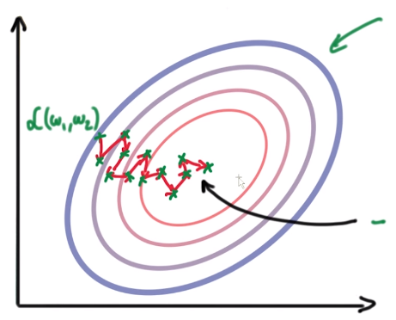
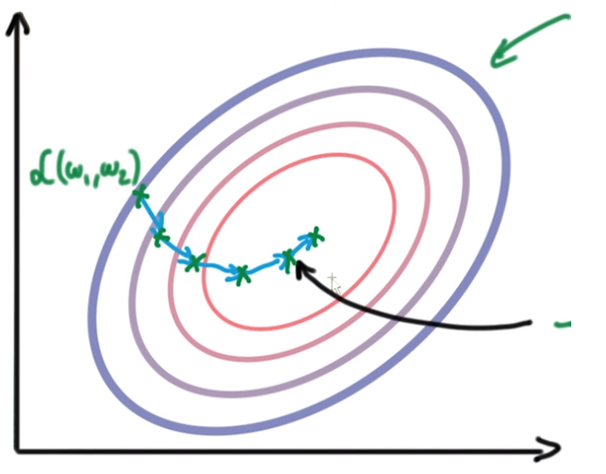
Why different optimization algorithms?
Due to the diversity of each training example, the gradient of the loss (L) changes quickly after each iteration. We are taking small steps but they are quite zig-zag (even though we slowly reach to a loss minima).
To overcome this, we introduce momentum. Basically taking knowledge from previous steps about where we should be heading. We are introducing a new hyperparameter:
Notes:
http://www.iro.umontreal.ca/~bengioy/papers/ftml.pdf

Slide 15
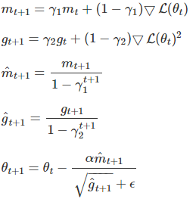
Adaptive Moment Estimation (Adam)
Adam is another method that computes adaptive learning rates for each parameter.
Like Adadelta and RMSprop, but in addition to storing an exponentially decaying average of past squared gradients $g_{t}$, Adam also keeps an exponentially decaying average of past gradients $m_{t}$, similar to momentum:
Notes:
http://www.iro.umontreal.ca/~bengioy/papers/ftml.pdf

Slide 16
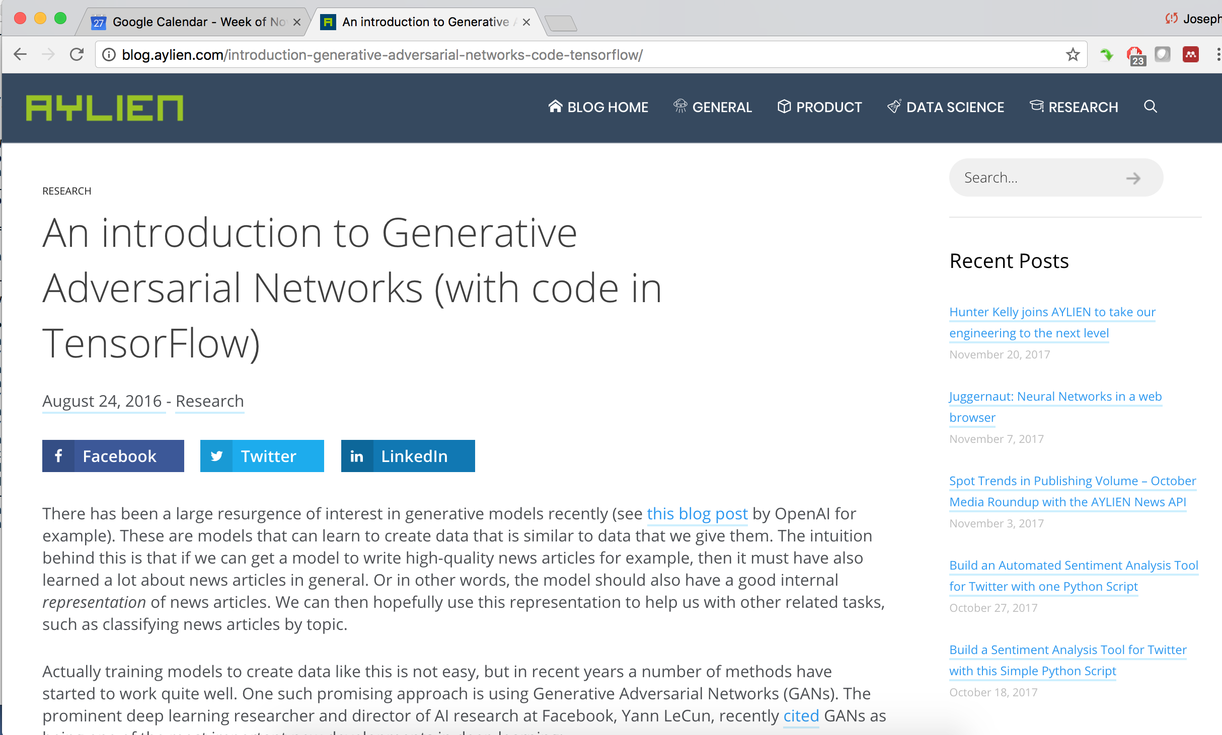
Generative Adversarial Networks
Notes:
http://www.iro.umontreal.ca/~bengioy/papers/ftml.pdf

Slide 17
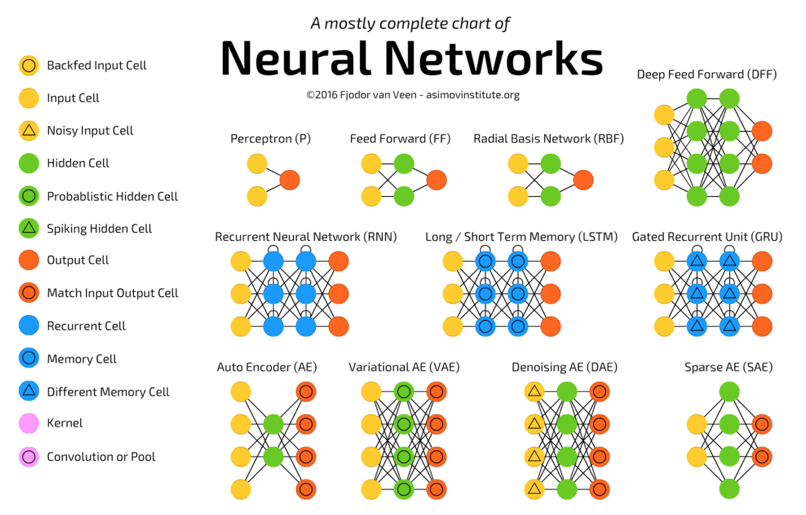
A Taxonomy of Architectures
Notes:
http://www.iro.umontreal.ca/~bengioy/papers/ftml.pdf

Slide 18
Summary
Convolutional Neural Networks (CNN) attempt to exploit local correlations (e.g., spatial and temporal context).
Many deep learning systems that process physical signals use CNNs for the first layer.
Optimization algorithms play an important role in allowing deep learning systems to converge.
Stochastic gradient descent and specifically Adam are popular approaches that are widely used.
Alternate training methodologies are emerging that combine generative and discriminative training (what used to be called analysis by synthesis methods).
Generative Adversarial Networks (GAN) are emerging as one such powerful approach.
Notes:
http://www.iro.umontreal.ca/~bengioy/papers/ftml.pdf

