Slide 1
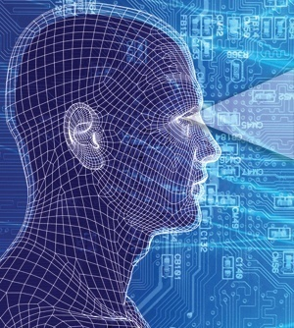
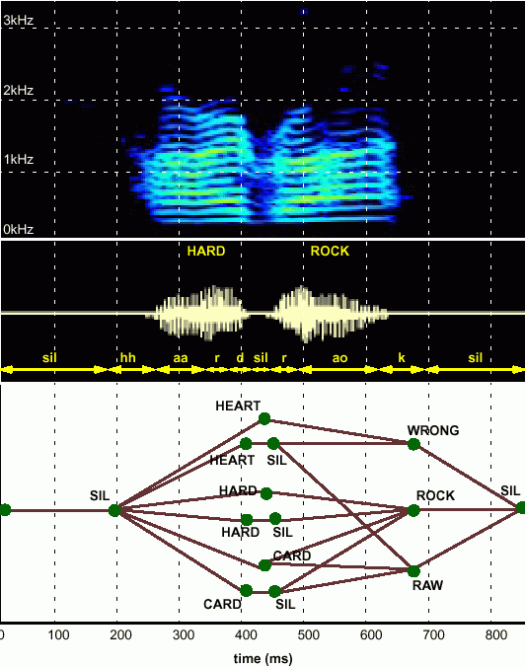
HUMAN LANGUAGE TECHNOLOGY: From Bits to Blogs
Joseph Picone, PhD
Professor and Chair
Department of Electrical and Computer Engineering
Temple University
URL:

Slide 2
Statistical Approach: Noisy Communication Channel Model

