Slide 1
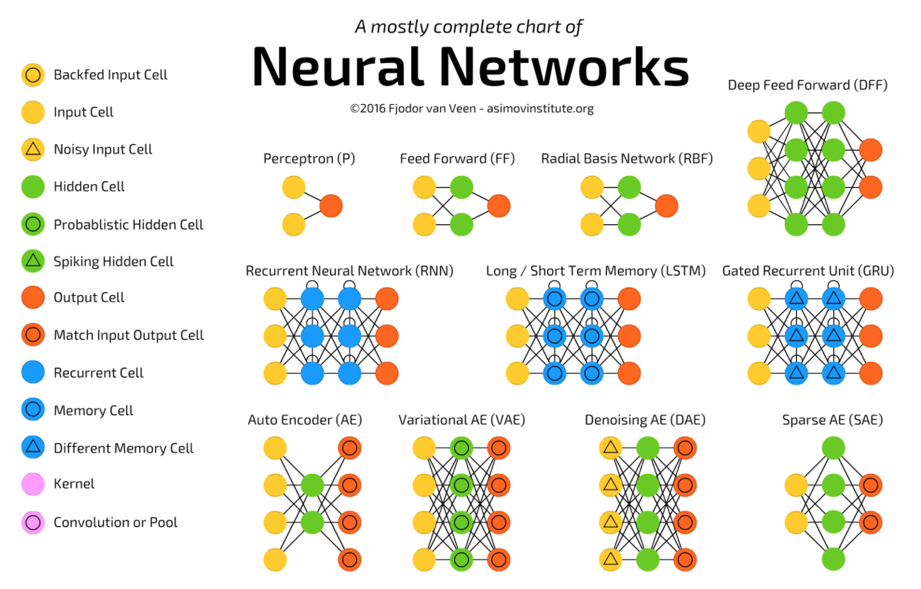
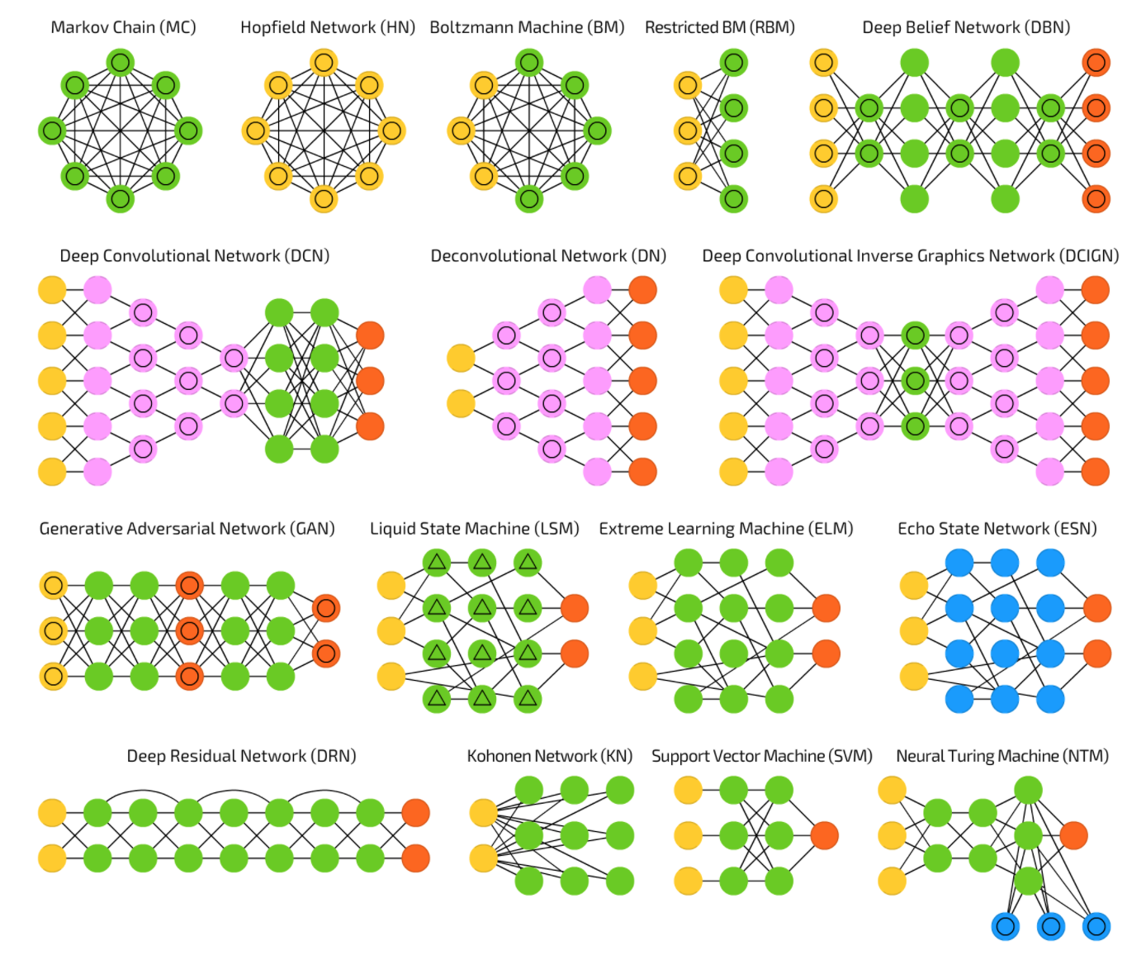
LECTURE 37: Alternative ARCHITECTURES
Objectives:
Perceptron Radial Basis Function Markov Chains
Resources:
AI: The Neural Network Zoo

Slide 2
A Taxonomy of Architectures
Notes:
http://www.iro.umontreal.ca/~bengioy/papers/ftml.pdf

