Slide 1
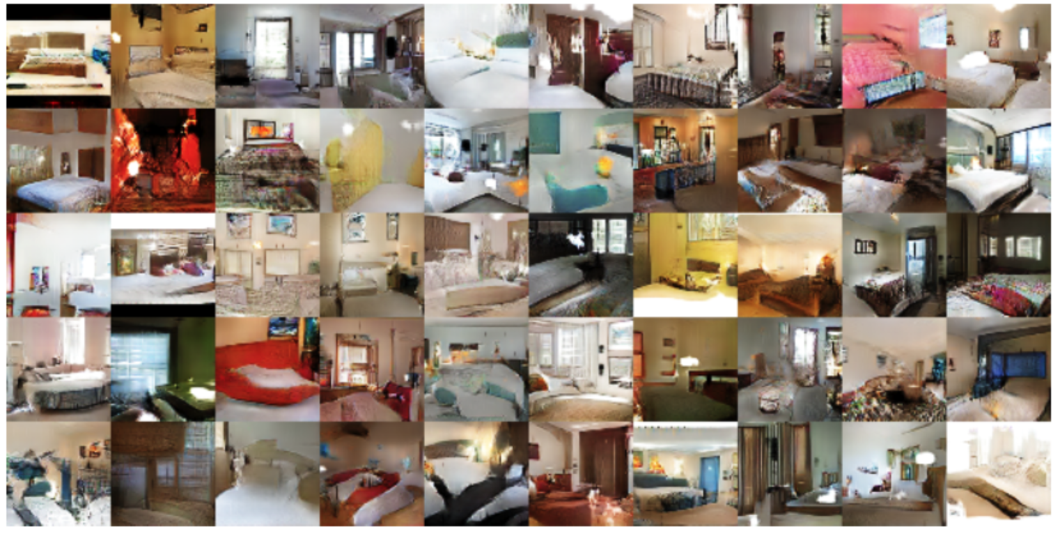
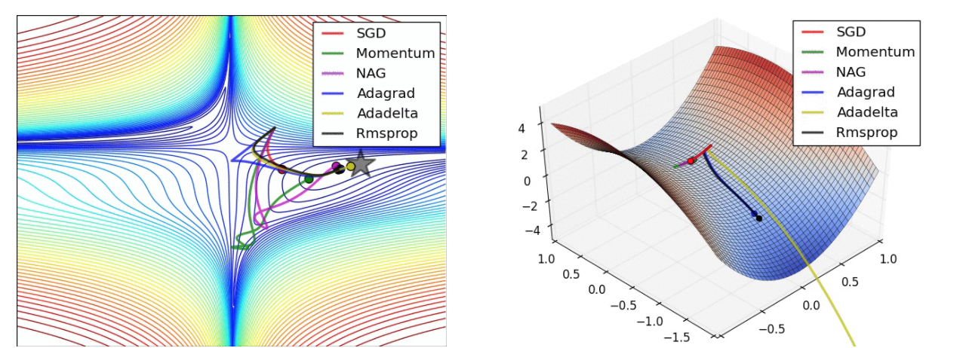
LECTURE 36: Alternative OPtimizers
Objectives:
Stochastic Gradient Descent Adaptive Moment Estimation Generative Adversarial Networks
Resources:
SR: Gradient Descent
Aylien: GAN

Slide 2
DRNN Training
Use stochastic gradient decent for optimization:
$θ\left(j+1\right)=θ\left(j\right)−η_{0}\left(1−\frac{j}{T}\right)\frac{∇_{θ}\left(j\right)}{\left\|∇_{θ}\left(j\right)\right\|}$
$θ\left(j\right):$the set of all trainable parameters after j updates
$∇_{θ}\left(j\right)$: the gradient of a cost function with respect to this parameter set, as computed on a randomly sampled part of the training set.
T: the number of batches
$η_{0}$: the learning rate is set at an initial value which decreases linearly with each subsequent parameter update.
Incremental layer-wise method: train the full network with BPTT and linearly reduce the learning rate to zero before a new layer is added. After adding a new layer the previous output weights will be discarded, and new output weights are initialized connecting from the new top layer.
For DRNN-AO, we test the influence of each layer by setting it to zero, assuring that model is efficiently trained.
Notes:
http://www.iro.umontreal.ca/~bengioy/papers/ftml.pdf

Slide 3
Gradient Descent Algorithms For Optimization
Notes:
http://www.iro.umontreal.ca/~bengioy/papers/ftml.pdf

Slide 4
Gradient Descent Algorithms For Optimization
SGD: Stochastic Gradient Descent http://ufldl.stanford.edu/tutorial/supervised/OptimizationStochasticGradientDescent/
RMSprop: Root Mean Square Propagation http://www.cs.toronto.edu/~tijmen/csc321/slides/lecture_slides_lec6.pdf)
Adagrad: Adaptive Gradient Algorithm http://jmlr.org/papers/v12/duchi11a.html
Adadelta: an extension of Adagrad that seeks to reduce its aggressive, monotonically decreasing learning rate https://arxiv.org/abs/1212.5701
Adam: Adaptive Moment Estimation – keeps separate learning rates for each weight as well as an exponentially decaying average of previous gradients. http://arxiv.org/abs/1412.6980v8
Adamax: A variant of Adam that scales the gradient inversely proportionally to the ℓ₂ norm of the past gradients https://arxiv.org/abs/1412.6980v8
Nadam: Nesterov-accelerated Adaptive Moment Estimation http://cs229.stanford.edu/proj2015/054_report.pdf
Notes:
http://www.iro.umontreal.ca/~bengioy/papers/ftml.pdf

Slide 5
Why different optimization algorithms?
The main difference is actually how they treat the learning rate.
Stochastic Gradient Descent:
Theta (weights) is getting changed according to the gradient of the loss with respect to theta.
alpha is the learning rate.
If alpha is very small, convergence will be very slow. On the other hand, large alpha will lead to divergence.
Notes:
http://www.iro.umontreal.ca/~bengioy/papers/ftml.pdf

Slide 6
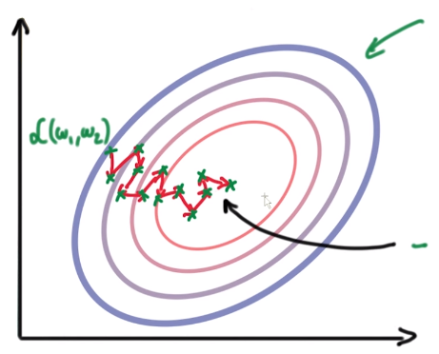
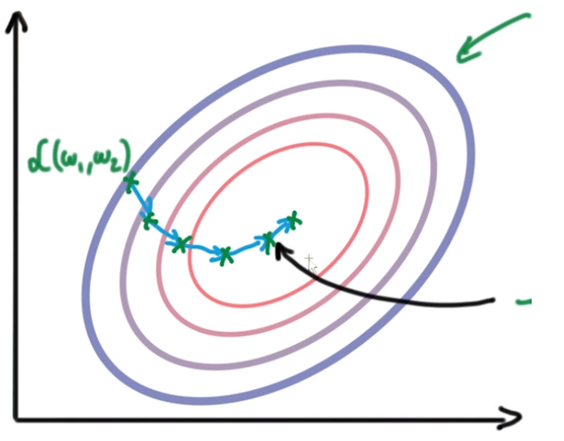
Why different optimization algorithms?
Due to the diversity of each training example, the gradient of the loss (L) changes quickly after each iteration. We are taking small steps but they are quite zig-zag (even though we slowly reach to a loss minima).
To overcome this, we introduce momentum. Basically taking knowledge from previous steps about where we should be heading. We are introducing a new hyperparameter:
Notes:
http://www.iro.umontreal.ca/~bengioy/papers/ftml.pdf

Slide 7
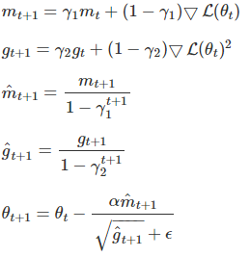
Adaptive Moment Estimation (Adam)
Adam is another method that computes adaptive learning rates for each parameter.
Like Adadelta and RMSprop, but in addition to storing an exponentially decaying average of past squared gradients $g_{t}$, Adam also keeps an exponentially decaying average of past gradients $m_{t}$, similar to momentum:
Notes:
http://www.iro.umontreal.ca/~bengioy/papers/ftml.pdf

Slide 8
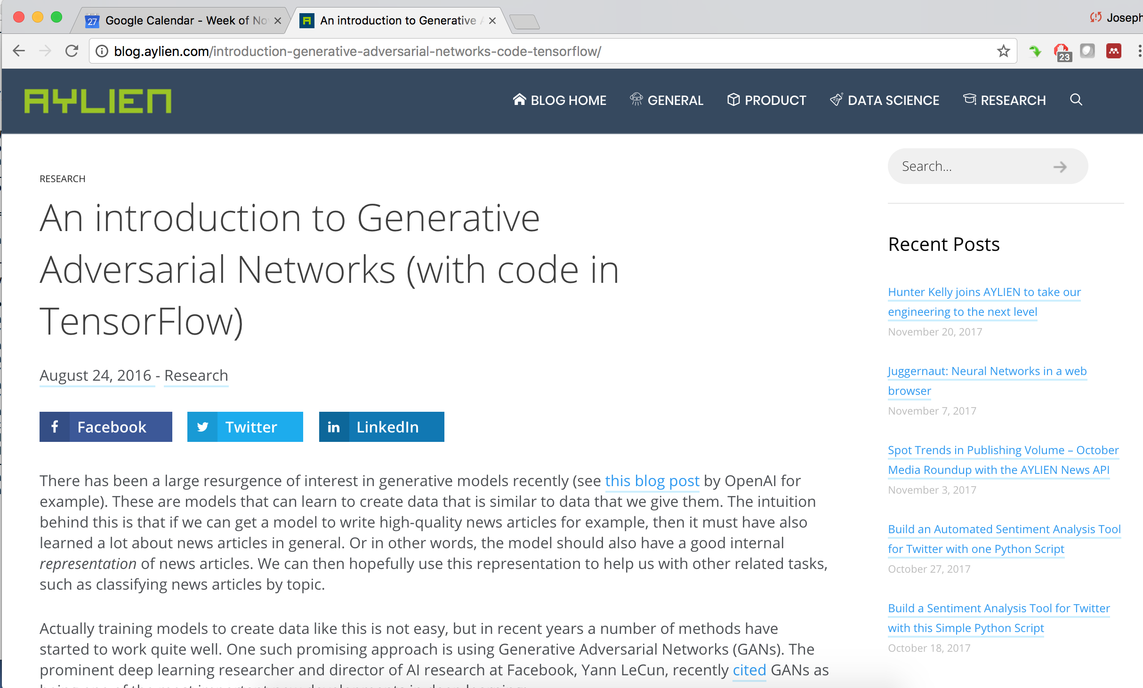
Generative Adversarial Networks
Notes:
http://www.iro.umontreal.ca/~bengioy/papers/ftml.pdf

Slide 9
Summary
Optimization algorithms play an important role in allowing deep learning systems to converge.
Stochastic gradient descent and specifically Adam are popular approaches that are widely used.
Alternate training methodologies are emerging that combine generative and discriminative training (what used to be called analysis by synthesis methods).
Generative Adversarial Networks (GAN) are emerging as one such powerful approach.
Notes:
http://www.iro.umontreal.ca/~bengioy/papers/ftml.pdf

