Slide 1

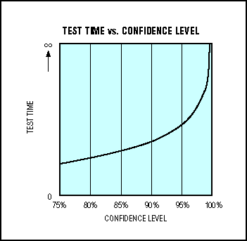
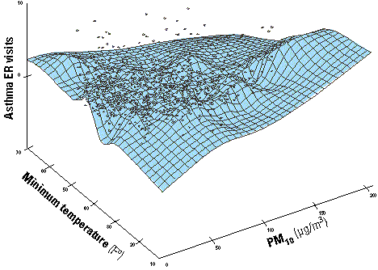
LECTURE 25: STATISTICAL SIGNIFICANCE
AND CONFIDENCE
Objectives:
Statistical Significance
Hypothesis Testing
Confidence Intervals
Applications
Confidence Measures
Word Posteriors
Resources:
Wiki: Statistical Significance
C.R.S.: Statistical Significance
Yale: Confidence Intervals
F.W.: Word Posteriors
NIST: Z-Statistics
ISIP: Experimental Design

Slide 2
Statistical Significance (Review)
A result is called statistically significant if it is unlikely to have occurred by chance.
A “statistically significant difference” means there is statistical evidence that there is a difference.
It does not mean the difference is necessarily large, important, or significant in the common meaning of the word.
The significance level of a test is traditionally based on the notion of hypothesis testing.
In simple cases, it is defined as the probability of making a decision to reject the null hypothesis when the null hypothesis is actually true (decisions we refer to as Type I errors, false positives, and Type II errors, false negatives).
The decision is often made using the p-value: the p-value is the probability of obtaining a value of the test statistic at least as extreme as the one that was actually observed, given that the null hypothesis is true.
if the p-value is less than the significance level, then the null hypothesis is rejected. The smaller the p-value, the more significant the result is said to be.
The notion of statistical significance, the probability that an experimental result could not have been determined by change, and confidence, how sure we are that this result did not occur by chance, are intimately related.

Slide 3
Example: Coin Toss
A coin flip is considered fair if there is 50% chance of landing heads or tails. How do we test this in practice since for any finite data set, one will occur more frequently than the other? What techniques have we studied this semester that can be used to test this hypothesis?
Since we consider both biased alternatives, a two-tailed test is performed. The null hypothesis is that the coin is fair, and that any deviations from the 50% rate can be ascribed to chance alone.
Suppose that the experimental results show the coin turning up heads 14 times out of 20 total flips. The p-value of this result would be the chance of a fair coin landing on heads at least 14 times out of 20 flips plus the chance of a fair coin landing on heads 6 or fewer times out of 20 flips.
In this case the random variable T has a binomial distribution. The probability that 20 flips of a fair coin would result in 14 or more heads is 0.0577. By symmetry, the probability that 20 flips of the coin would result in 14 or more heads or 6 or fewer heads is 0.0577 × 2 = 0.115.
Generally, one rejects the null hypothesis if the p-value is smaller than or equal to the significance level, often represented by the Greek letter α. If the significance level is 0.05, then the results are only 5% likely to be as extraordinary as just seen, given that the null hypothesis is true.
Earlier in the semester we studied a paper D. MacKay wrote on this topic.

Slide 4
Example: Coin Toss (Cont.)
For our example:
null hypothesis (H₀) – fair coin;
observation (O) – 14 heads out of 20 flips;
probability (p-value) of observation (O) given H₀ – p(O|H₀) = 0.0577x2 (two-tailed) = 0.1154 = 11.54%.
The calculated p-value exceeds 0.05, so the observation is consistent with the null hypothesis – that the observed result of 14 heads out of 20 flips can be ascribed to chance alone – as it falls within the range of what would happen 95% of the time were this in fact the case.
In our example, we fail to reject the null hypothesis at the 5% level. Although the coin did not fall evenly, the deviation from expected outcome is just small enough to be reported as being "not statistically significant at the 5% level.”
However, had a single extra head been obtained, the resulting p-value (two-tailed) would be 0.0414 (4.14%). This time the null hypothesis – that the observed result of 15 heads out of 20 flips can be ascribed to chance alone - is rejected. Such a finding would be described as being "statistically significant at the 5% level.”
Critics of p-values point out that the criterion is based on the somewhat arbitrary choice of level (often set at 0.05).

Slide 5
Confidence Intervals
A confidence interval gives an estimated range of values which is likely to include an unknown population parameter, the estimated range being calculated from a given set of sample data.
The level C of a confidence interval gives the probability that the interval produced by the method employed includes the true value of the parameter.
Consider another example: a student measuring the boiling temperature of a certain liquid observes the readings (in degrees Celsius) 102.5, 101.7, 103.1, 100.9, 100.5, and 102.2 on 6 different samples of the liquid. He calculates the sample mean to be 101.82. If he knows that the standard deviation for this procedure is 1.2 degrees, what is the confidence interval for the population mean at a 95% confidence level?
In other words, the student wishes to estimate the true mean boiling temperature of the liquid using the results of his measurements. (We have discussed many ways this semester of estimating this parameter.)
Assume the measurements follow a normal distribution, then the sample mean will have the distribution . Since the sample size is 6, the standard deviation of the sample mean is equal to .
For example, a 95% confidence interval covers 95% of the normal curve – the probability of observing a value outside of this area is less than 0.05.

Slide 6
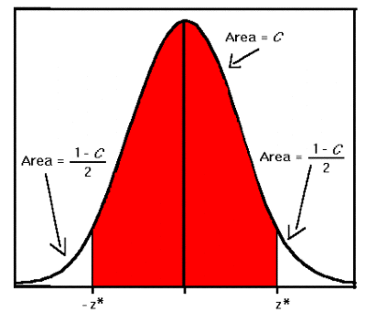
Confidence Intervals (Cont.)
Because the normal curve is symmetric,
half of the area is in the left tail of the curve,
and the other half of the area is in the right
tail of the curve.
As shown in the diagram to the right, for a
confidence interval with level C, the area in
each tail of the curve is equal to (1- C)/2. For
a 95% confidence interval, the area in each
tail is equal to 0.05/2 = 0.025.
The value z* representing the point on the
standard normal density curve such that
the probability of observing a value greater
than z* is equal to p is known as the upper p critical value of the standard normal distribution.
For example, if p = 0.025, the value z* such that P(Z > z*) = 0.025, or P(Z < z*) = 0.975, is equal to 1.96. For a confidence interval with level C, the value p is equal to (1- C)/2. A 95% confidence interval for the standard normal distribution, then, is the interval (-1.96, 1.96), since 95% of the area under the curve falls within this interval.
This connection between z and C is often referred to as the z-test or z-statistic.

Slide 7
Unknown Mean and Known Variance
For a population with unknown mean and known variance, a confidence interval for the population mean, based on a simple random sample (SRS) of size n, is . (Note: This interval is only exact when the population distribution is normal. For large samples from other population distributions, the interval is approximately correct by the Central Limit Theorem.)
In the example above, the student calculated the sample mean of the boiling temperatures to be 101.82, with standard deviation 0.49. The critical value for a 95% confidence interval is 1.96, where (1-0.95)/2 = 0.025. A 95% confidence interval for the unknown mean is ((101.82 - (1.96*0.49)), (101.82 + (1.96*0.49))) = (101.82 - 0.96, 101.82 + 0.96) = (100.86, 102.78).
As the level of confidence increases, the size of the corresponding interval will decrease. Suppose the student was interested in a 90% confidence interval for the boiling temperature. In this case, C = 0.90, and (1- C)/2 = 0.05. The critical value z* for this level is equal to 1.645, so the 90% confidence interval is ((101.82 - (1.645*0.49)), (101.82 + (1.645*0.49))) = (101.01, 102.63)
An increase in sample size will decrease the length of the confidence interval without reducing the level of confidence. This is because the standard deviation decreases as n increases.
The margin of error m of a confidence interval is defined to be the value added or subtracted from the sample mean which determines the length of the interval: m = z*.

Slide 8
Unknown Mean and Unknown Variance
When the standard deviation is not known, it is replaced by the estimated standard deviation s, also known as the standard error.
Since the standard error is an estimate for the true value of the standard deviation, the distribution of the sample mean is no longer normal with mean, µ, and and standard deviation .
The sample mean follows the t distribution with mean, µ, and stdev .
The t distribution is also described by its degrees of freedom. For a sample of size n, the t distribution will have n-1 degrees of freedom. The notation for a t distribution with k degrees of freedom is t(k).
Degrees of freedom are the number of independent pieces of information available to estimate another piece of information (the number of independent observations in a sample of data that are available to estimate a parameter of the population from which that sample is drawn).
As the sample size n increases, the t distribution becomes closer to the normal distribution, since the standard error approaches the true standard deviation for large n.
For a population with unknown mean and unknown standard deviation, a confidence interval for the population mean, based on a simple random sample (SRS) of size n, is , where t* is the upper (1-C)/2 critical value for the t distribution with n-1 degrees of freedom, t(n-1).

Slide 9
z-Statistic
A common task in hypothesis testing is to compare statistics computed over samples of two distributions to determine how likely it is that the two distributions are equivalent.
For example, we may want to compare the estimates of the means and variances of two sampled distributions, each of which is assumed Gaussian with means µ₁ and µ₂ and variances σ₁² and σ₂², respectively.
Consider the case for comparing the means of the two populations. We begin by forming the null hypothesis that the two means are equivalent:
Null Hypothesis: H₀: µ₁ = µ₂ or µ₁ - µ₂ = 0
Alternate Hypothesis: H₁: µ₁ ≠ µ₂ or |µ₁ - µ₂| > 0
We randomly select n₁ samples from the first population and then draw n₂ samples independently from the second population. The difference between the two sample means is an unbiased point estimate of the difference of the true population means µ₁ - µ₂.
Noting that this is a linear function of two random variables, the sampling distribution of the statistic is a normal distribution with a mean of
(µ₁ - µ₂) and a variance of (σ₁²/n₁ and σ₂²/n₂). (Note that the variances are additive!)

Slide 10
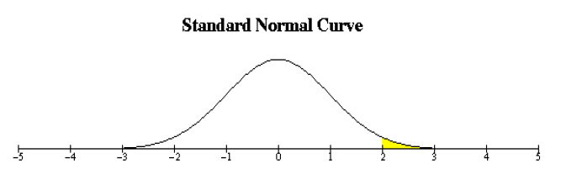
z-Statistics (Cont.)
The z-statistic is given by:
This test statistic’s distribution
can be approximated as a standard
normal distribution:
A single right tailed test can be used to reject the null hypothesis, H₀, when Z = z_{p} at a significance level of p.
The rejection region or the probability of falsely rejecting the true null hypothesis (Type I error) lies in the region from z_{p} to infinity. (This region as shown as yellow region above).
The problem in our work is to specify an upper limit for performance (probability of error) for which a new design would be considered to be statistically significantly better than the baseline.
A significance for proportions test is suitable since probability of error is defined as a proportion. This leads to the same form as the z-statistic.
As before, an assumption is made that the two experiments each consisting of N independent trials are run.

Slide 11
z-Statistics (Cont.)
To satisfy the independence assumption, it is necessary to consider each trial as the number of errors for each file (a file can contain several events). This requires the assumption that the files are independent of each other. (For example, in speech recognition, the files should not be derived from discussions where one file is a response to another.)
Note also we cannot use the events in each file as trials since we know that for syntactic pattern recognition systems like speech recognizers, the syntax processor (e.g., and n-gram language model) dictates that consecutive words are not independent of each other.
If, in our experiment, the first experiment resulted in y₁ trials in error while the second experiment resulted in y₂ trials in error, we can estimate the error rates, p₁ and p₂, from a sample of size N in the sample population:
Our goal is to determine if p₂ is significantly better than p₁, given N trials for each experiment.
We consider the difference of the word error rates (proportions) to be zero as the null hypothesis, H0:
Null Hypothesis: H₀: p₁ = p₂ or p₁ - p₂ = 0
Alternate Hypothesis: H₁: p₁ ≠ p₂ or |p₁ - p₂| > 0

Slide 12
z-Statistics (Cont.)
To prove that the second experiment p₂ is significantly better than the first experiment, we need to reject H0 at a given significance level. The normalized z-statistic for this test is given as:
The assumption for this test is that according to the Central Limit Theorem, the distribution of this z-statistic is approximately normal given a large sample size. The single-tailed significance test is used to reject the null hypothesis.
Note that the variance of (p₁ - p₂) is estimated in the denominator of the equation above.
As an example, consider p₁ = 15.4% for a test set consisting of 166 files. What is the upper limit on the error that would be accepted as significantly better?
With N=166, p₁=0.154, and a significance level of 1% (p=0.001), we iterate over a decreasing value of p₂ starting from 0.154 until the null hypothesis is rejected. It can be shown that when p₂ reaches an error rate of 0.073, Z=2.34.
Since z_{0.01} = 2.32 > 2.34 and z_{0.02} = 2.05 < 2.34, we reject the null hypothesis at the 1% significance level. Similarly, it can be shown that at a 10% significance level, p₂ = 10.6% error.

Slide 13
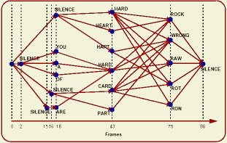
Confidence Measures
In many pattern recognition systems in which an overall judgment about an event is composed of a series (or product) of individual judgments, it is desirable to know how sure we are about this individual judgments.
For example, in a speech recognition system, we output sentences, but would like to spot words that are likely to be in error.
The overall likelihood of the sentence given the words is a product of the individual word probabilities.
Hence, we would like to use “word” or event posteriors as the confidence measure.
There are a number of practical issues associated with this. Perhaps the most significant one is the need to know all possible word hypotheses for all time.
This can be approximated using a
“word graph”:
There are assorted practical issues
associated with this approach, including
the “depth” of the word graph, time
registration, and “acoustic” (e.g., HMM)
vs. “grammar” (e.g., language model)
weights.

Slide 14
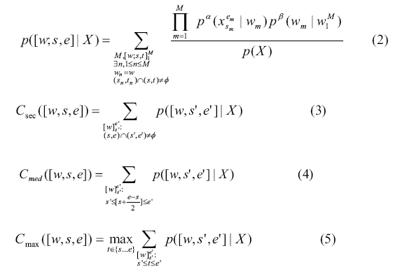
Confidence Measures Using Word Posteriors
There are many approximations to the exact computation of a word posteriors:

Slide 15
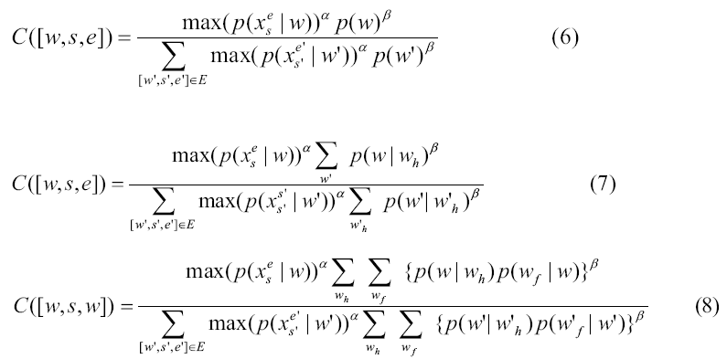
Approximations For Posteriors In Confidence Measures
More practical and successful approximations are:
Other techniques to approximate the posterior have been tried (neural networks, support vector machines, etc.) and have not been as successful.

Slide 16
Summary
Reviewed basic concepts in statistics such as statistical significance and confidence measures.
Introduced a test to determine with a classification experiment produces a statistically significant result.
Discussed the need for confidence measures in pattern recognition systems.
Introduced the concept of an event, or word, posterior and discussed how this can be estimated in practical applications such as a speech recognition.

