Slide 1
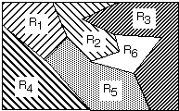
LECTURE 05: THRESHOLD DECODING
• Objectives: Gaussian Random Variables Maximum Likelihood Decoding Threshold Decoding Receiver Operating Curves
Resources: D.H.S: Chapter 2 (Part 3) K.F.: Intro to PR X. Z.: PR Course A.N. : Gaussian Discriminants T.T. : ROC Curves NIST: DET Curves

Slide 2
Multicategory Decision Surfaces
Define a set of discriminant functions: g_{i}(x), i = 1,…, c
Define a decision rule:
choose ω_{i} if: g_{i}(x) > g_{j}(x) ∨j ≠ i
For a Bayes classifier, let g_{i}(x) = -R(ω_{i}|x) because the maximum discriminant function will correspond to the minimum conditional risk.
For the minimum error rate case, let g_{i}(x) = P(ω_{i}|x), so that the maximum discriminant function corresponds to the maximum posterior probability.
Choice of discriminant function is not unique:
multiply or add by same positive constant
Replace g_{i}(x) with a monotonically increasing function, f(g_{i}(x)).

Slide 3
Gaussian Classifiers
The discriminant function can be reduced to:
Since these terms are constant w.r.t. the maximization:
We can expand this:
The term x^{t}x is a constant w.r.t. i, and μ_{i}^{t}μ_{i} is a constant that can be precomputed.

Slide 4
Threshold Decoding
This has a simple geometric interpretation:
The decision region when the priors are equal and the support regions are spherical is simply halfway between the means (Euclidean distance).

Slide 5
General Case for Gaussian Classifiers

Slide 6
Arbitrary Covariances

Slide 7
Receiver Operating Characteristic (ROC)
How do we compare two decision rules if they require different thresholds for optimum performance?
Consider four probabilities:

Slide 8
General ROC Curves
An ROC curve is typically monotonic but not symmetric:
One system can be considered superior to another only if its ROC curve lies above the competing system for the operating region of interest.

Slide 9
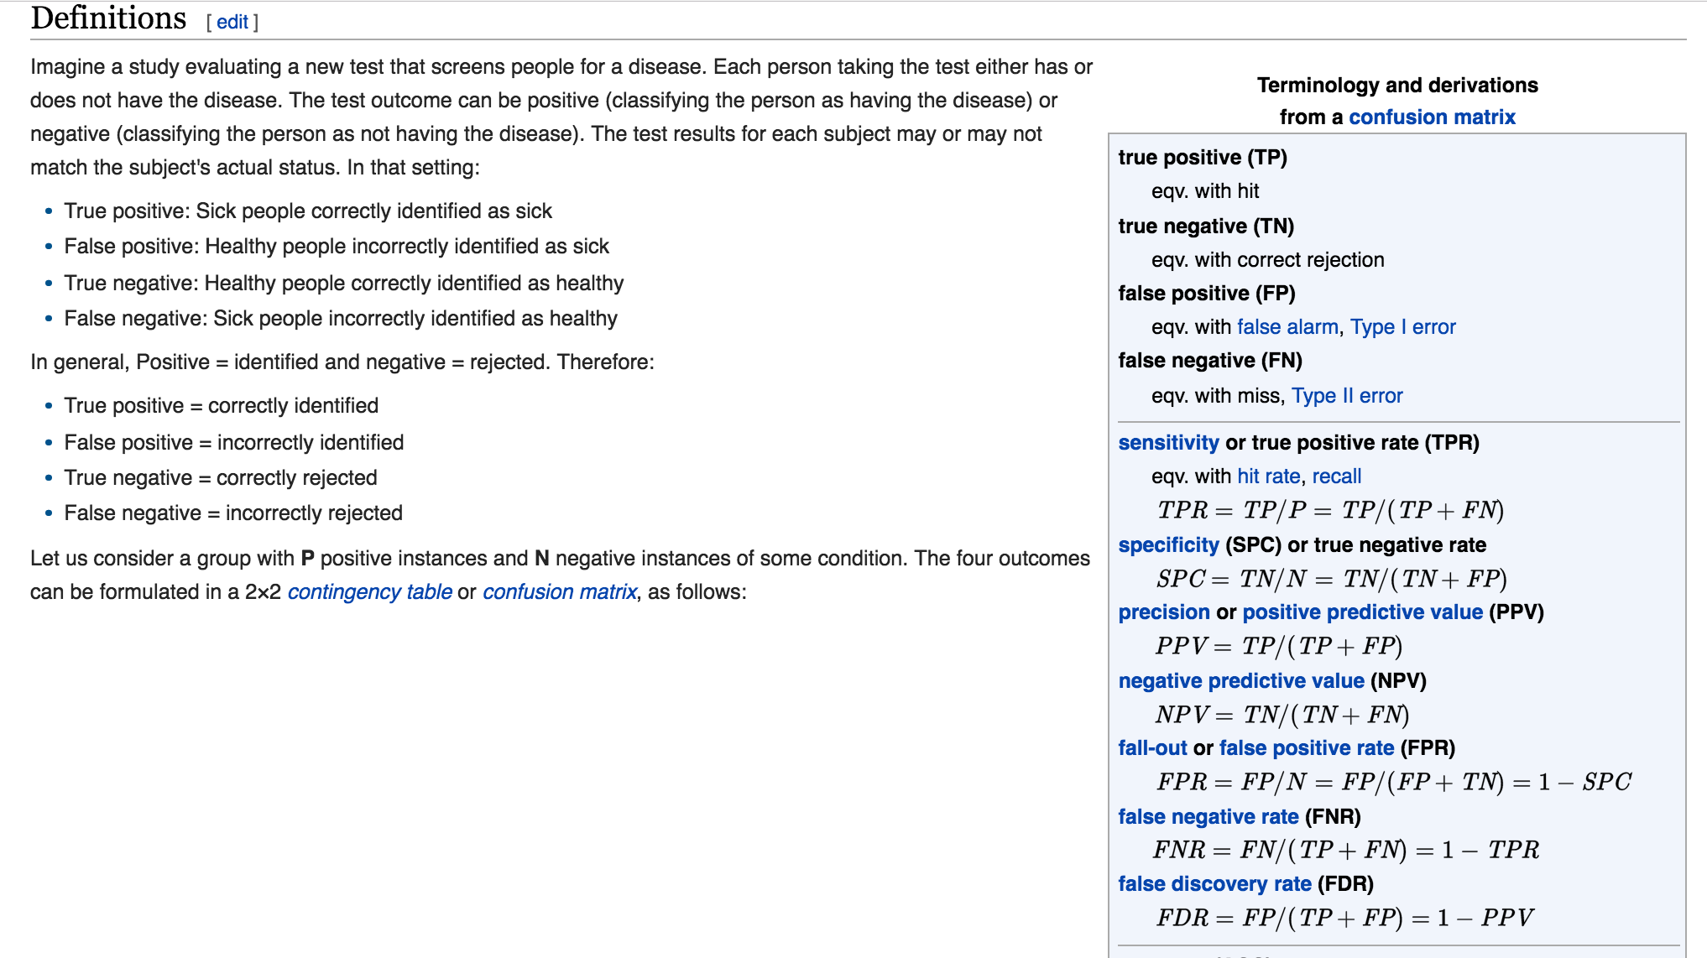
Sensitivity and Specificity

Slide 10
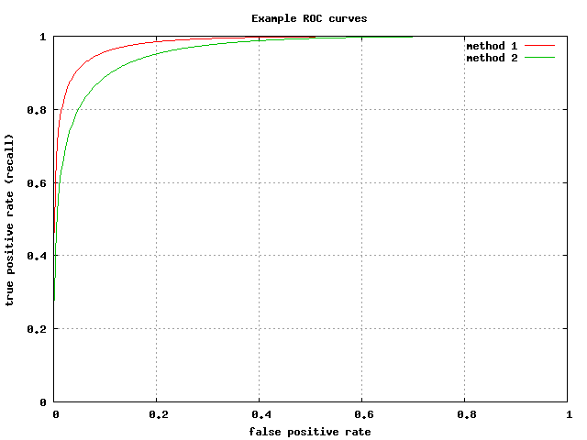
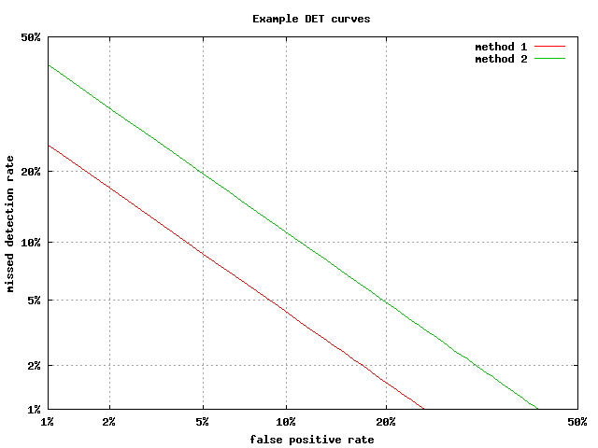
ROC Curves vs. Detection Error Tradeoff Curves
Receiver Operating Characteristic (ROC): the true positive rate (TPR) against the false positive rate (FPR)
Detection Error Tradeoff (DET) Curve: the false rejection rate vs. false acceptance rate

Slide 11
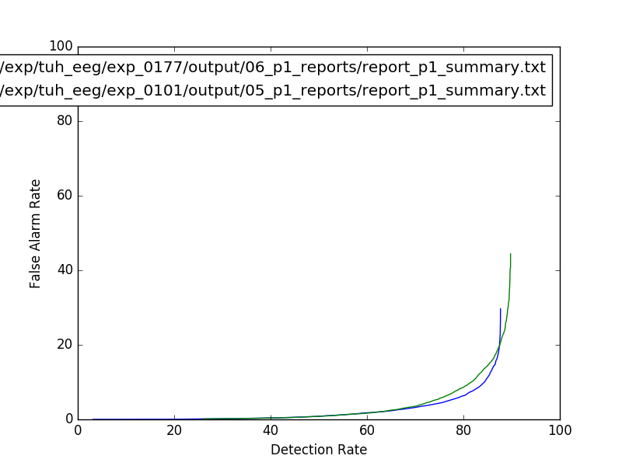
Detection Error Tradeoff Curves
Real applications can be messy:

Slide 12
Typical Examples of 2D Classifiers

Slide 13
Summary
Threshold Decoding: Data modeled as a multivariate Gaussian distribution can be classified using a simple threshold decoding scheme. The threshold is a function of the priors, means, and covariances.
Receiver Operating Curve: a visualization that evaluates performance over a range of operating conditions. Only the ’customer’ can decide ultimately what is the correct operating point.
Performance Evaluation: one algorithm can only be considered superior to another if the ROC curves are mutually exclusive (don’t overlap). In practice, this is rarely the case and specific operating points (e.g., equal error rates) are considered.
Gaussian data can be classified using decision surfaces based on smooth polynomials (e.g. parabolas, lines). However, if the data is not Gaussian, more complicated decisions surfaces are required.
In this class, we will explore many algorithms that can achieve arbitrarily complex decision surfaces. The price paid for this is a computationally-intensive training process and an optimization process that is very sensitive to initial conditions.

Slide 14
Discrete Features
For problems where features are discrete:
Bayes formula involves probabilities (not densities):
where
Bayes rule remains the same:
The maximum entropy distribution is a uniform distribution:

Slide 15
Discriminant Functions For Discrete Features
Consider independent binary features:
Assuming conditional independence:
The likelihood ratio is:
The discriminant function is:

Slide 16
Error Bounds
Bayes decision rule guarantees lowest average error rate
Closed-form solution for two-class Gaussian distributions
Full calculation for high dimensional space difficult
Bounds provide a way to get insight into a problem and engineer better solutions.
Need the following inequality:
Assume a > b without loss of generality: min[a,b] = b.
Also, a^{β}b^{(1- β)} = (a/b)^{β}b and (a/b)^{β} > 1.
Therefore, b < (a/b)^{β}b, which implies min[a,b] < a^{β}b^{(1- β)} .
Apply to our standard expression for P(error).

Slide 17
Chernoff Bound
Recall:
Note that this integral is over the entire feature space, not the decision regions (which makes it simpler).
If the conditional probabilities are normal, this expression can be simplified.

Slide 18
Chernoff Bound for Normal Densities
If the conditional probabilities are normal, our bound can be evaluated analytically:
where:
Procedure: find the value of β that minimizes exp(-k(β ), and then compute P(error) using the bound.
Benefit: one-dimensional optimization using β

Slide 19
Bhattacharyya Bound
The Chernoff bound is loose for extreme values
The Bhattacharyya bound can be derived by β = 0.5:
where:
These bounds can still be used if the distributions are not Gaussian (why? hint: Occam’s Razor). However, they might not be adequately tight.

