Slide 1
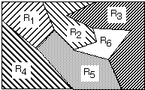
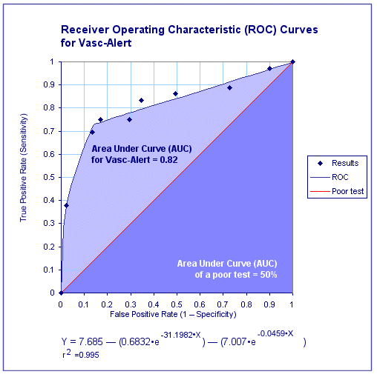
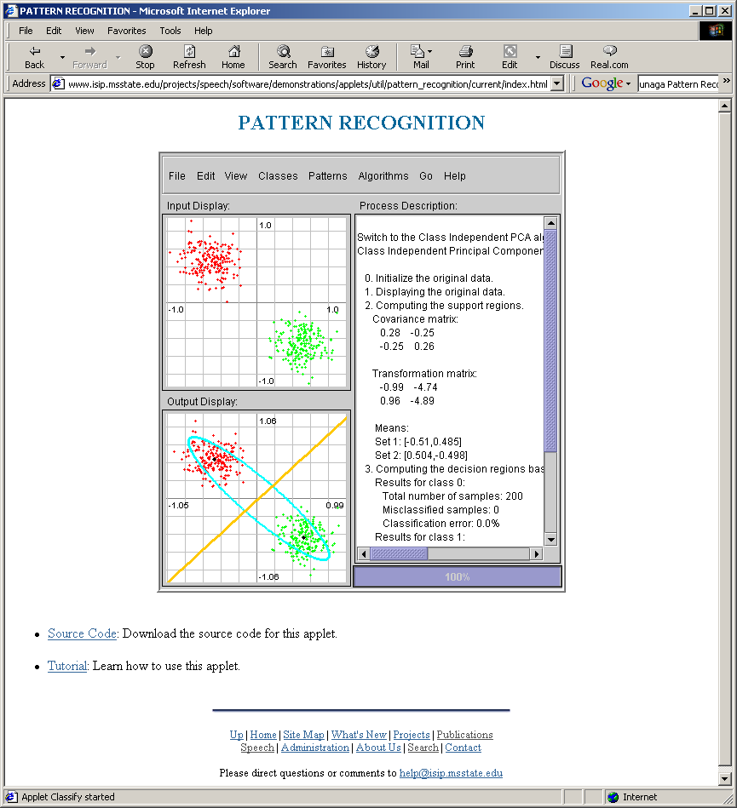
LECTURE 04: DECISION SURFACES
• Objectives:
Multi-category Decision Surfaces
Discriminant Functions
Mahalanobis Distance
Principal Component Analysis
Gaussian Distributions
Threshold Decoding
Resources:
D.H.S: Chapter 2 (Part 3)
K.F.: Intro to PR
X. Z.: PR Course
A.N. : Gaussian Discriminants
M.R.: Chernoff Bounds
S.S.: Bhattacharyya

Slide 2
Likelihood
By employing Bayes formula, we can replace the posteriors by the prior probabilities and conditional densities:
choose ω₁ if:
(λ₂₁- λ₁₁) p(x|ω₁) P(ω₁) > (λ₁₂- λ₂₂) p(x|ω₂) P(ω₂);
    otherwise decide ω₂
If λ₂₁- λ₁₁ is positive, our rule becomes:
If the loss factors are identical, and the prior probabilities are equal, this reduces to a standard likelihood ratio:

Slide 3
Multicategory Decision Surfaces
Define a set of discriminant functions: g_{i}(x), i = 1,…, c
Define a decision rule:
    choose ω_{i} if: g_{i}(x) > g_{j}(x) ∨j ≠ i
For a Bayes classifier, let g_{i}(x) = -R(ω_{i}|x) because the maximum discriminant function will correspond to the minimum conditional risk.
For the minimum error rate case, let g_{i}(x) = P(ω_{i}|x), so that the maximum discriminant function corresponds to the maximum posterior probability.
Choice of discriminant function is not unique:
    multiply or add by same positive constant
    Replace g_{i}(x) with a monotonically increasing function, f(g_{i}(x)).

Slide 4
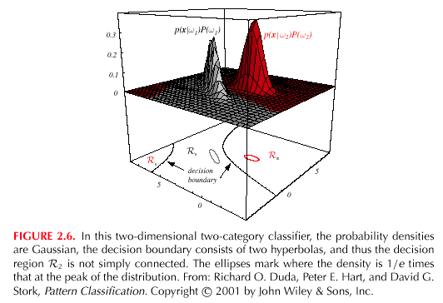
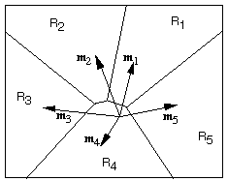
Decision Surfaces
We can visualize our decision rule several ways:
    choose ω_{i} if: g_{i}(x) > g_{j}(x) ∨j ≠ i

Slide 5
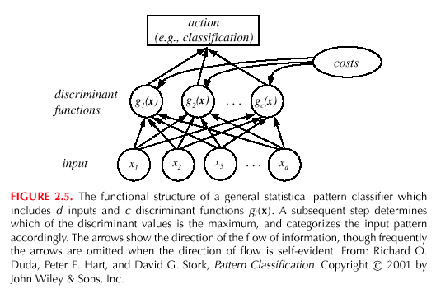
Network Representation of a Classifier
A classifier can be visualized as a connected graph with arcs and weights:
What are the advantages of this type of visualization?

Slide 6
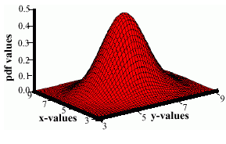
Multivariate Normal Distributions
A multivariate distribution is defined as:
where μ represents the mean (vector) and Σ represents the covariance (matrix).
Note the exponent term is really a dot product or
weighted Euclidean distance.
The covariance is always symmetric and positive semidefinite.
How does the shape vary as a function of the covariance?

Slide 7
Coordinate Transformations
Why is it convenient to convert an arbitrary distribution into a spherical one? (Hint: Euclidean distance)
Consider the transformation: A_{w}= Φ Λ^{-1/2}
where Φ is the matrix whose columns are the orthonormal eigenvectors of Σ and Λ is a diagonal matrix of eigenvalues (Σ= Φ Λ Φ^{t}). Note that Φ is unitary.
What is the covariance of y=A_{w}x?
E[yy^{t}] = (A_{w}x)(A_{w}x)^{t} =(Φ Λ^{-1/2}x) (Φ Λ^{-1/2}x)^{t}
= Φ Λ^{-1/2}x x^{t} Λ^{-1/2} Φ^{t} = Φ Λ^{-1/2} Σ Λ^{-1/2} Φ^{t}
= Φ Λ^{-1/2} Φ Λ Φ^{t} Λ^{-1/2} Φ^{t}
= (Φ Φ^{t}) (Λ^{-1/2} Λ Λ^{-1/2} )(ΦΦ^{t})
= I
This is known as Principal Component Analysis (PCA). Examining the eigenvectors of the covariance matrix provides information about the relationships between features.

Slide 8
Mahalanobis Distance
The weighted Euclidean distance:
is known as the Mahalanobis distance, and represents a statistically normalized distance calculation that results from our whitening transformation.
Consider an example using our Java Applet.
This distance measure plays an important role in Gaussian mixture modeling of data, hidden Markov models, etc.

Slide 9
Discriminant Functions
Recall our discriminant function for minimum error rate classification:
For a multivariate normal distribution:
Consider the case: Σ_{i} = σ²I
(statistical independence, equal variance, class-independent variance)

Slide 10
Gaussian Classifiers
The discriminant function can be reduced to:
Since these terms are constant w.r.t. the maximization:
We can expand this:
The term x^{t}x is a constant w.r.t. i, and μ_{i}^{t}μ_{i} is a constant that can be precomputed.

Slide 11
Linear Machines
We can use an equivalent linear discriminant function:
w_{i0} is called the threshold or bias for the i^{th} category.
A classifier that uses linear discriminant functions is called a linear machine.
The decision surfaces defined by the equation:

Slide 12
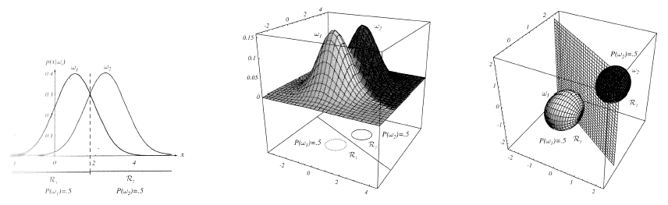
Threshold Decoding
This has a simple geometric interpretation:
The decision region when the priors are equal and the support regions are spherical is simply halfway between the means (Euclidean distance).

Slide 13
General Case for Gaussian Classifiers

Slide 14
Identity Covariance
Case: Σ_{i} = σ²I
This can be rewritten as:

Slide 15
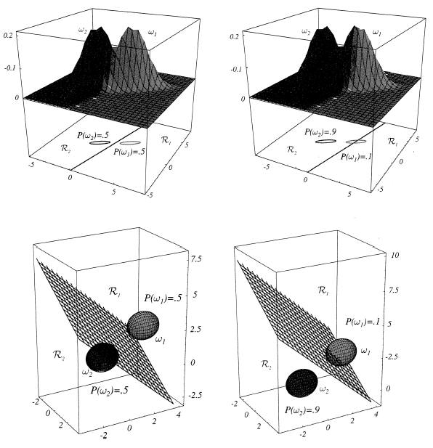
Equal Covariances
Case: Σ_{i} = Σ

Slide 16
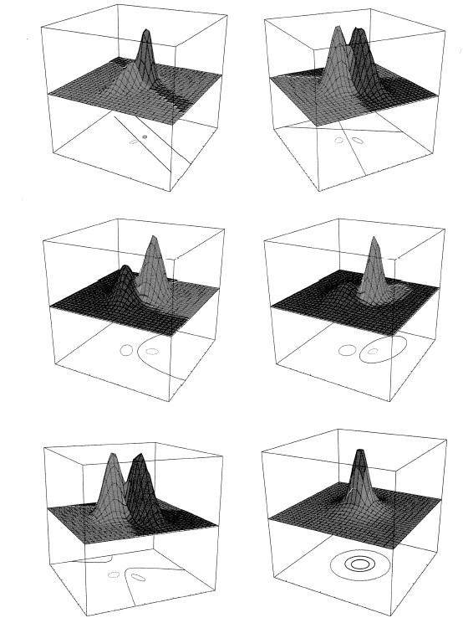
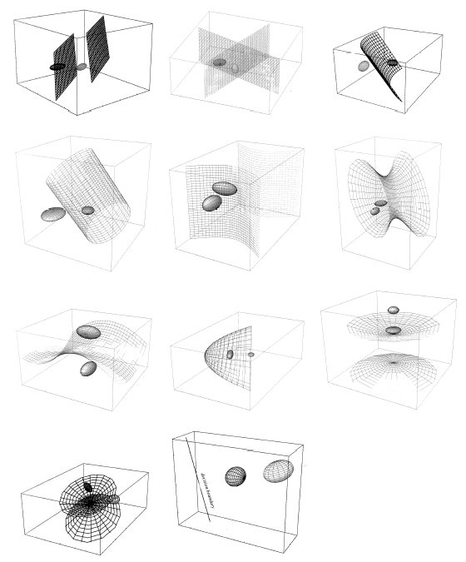
Arbitrary Covariances

Slide 17
Typical Examples of 2D Classifiers

Slide 18
Summary
Decision Surfaces: geometric interpretation of a Bayesian classifier.
Gaussian Distributions: how is the shape of the distribution influenced by the mean and covariance?
Threshold Decoding: Data modeled as a multivariate Gaussian distribution can be classified using a simple threshold decoding scheme.
Bayesian classifiers for Gaussian distributions: how does the decision surface change as a function of the mean and covariance?

