Slide 1
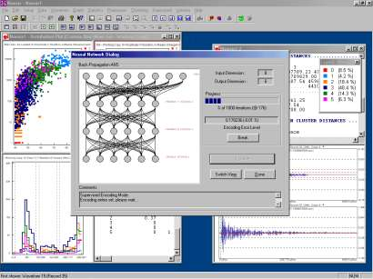
LECTURE 01: COURSE OVERVIEW
Objectives:
Terminology
The Design Cycle
Generalization and Risk
The Bayesian Approach
Resources:
Syllabus
Internet Books and Notes
D.H.S: Chapter 1
Glossary

Slide 2
Terminology
Pattern Recognition: “the act of taking raw data and taking an action based on the category of the pattern.”
Common Applications: speech recognition, fingerprint identification (biometrics), DNA sequence identification
Related Terminology:
  Machine Learning: The ability of a machine to improve its performance based on previous results.
  Machine Understanding: acting on the intentions of the user
  generating the data.
Related Fields: artificial intelligence, signal processing and discipline-specific research (e.g., target recognition, speech recognition, natural language processing).

Slide 3



Recognition or Understanding?
Which of these images are most scenic?
How can we develop a system to automatically determine scenic beauty? (Hint: feature combination)
Solutions to such problems require good feature extraction and good decision theory.

Slide 4
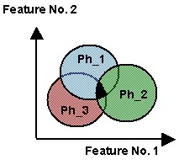
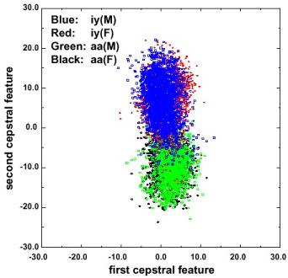
Features Are Confusable
Regions of overlap represent the classification error
Error rates can be computed with knowledge of the joint probability distributions (see OCW-MIT-6-450Fall-2006).
Context is used to reduce overlap.
In real problems, features are confusable and represent actual variation in the data.
The traditional role of the signal processing engineer has been to develop better features (e.g., “invariants”).

Slide 5
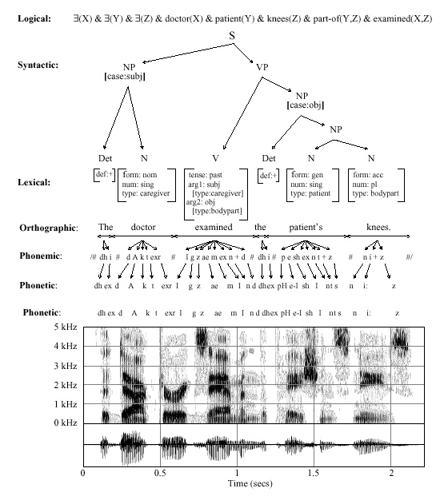
Decomposition
Decision
Post-Processing
Classification
Feature Extraction
Segmentation
Sensing
Input

Slide 6
The Design Cycle
Start
Collect Data
Key issues:
  “There is no data like more data.”
  Perceptually-meaningful features?
  How do we find the best model?
  How do we estimate parameters?
  How do we evaluate performance?
Goal of the course:
  Introduce you to mathematically rigorous ways to train and evaluate models.
Choose Features
Choose Model
Train Classifier
Evaluate Classifier
End

Slide 7
Common Mistakes
I got 100% accuracy on...
  Almost any algorithm works some of the time, but few real-world problems have ever been completely solved.
  Training on the evaluation data is forbidden.
  Once you use evaluation data, you should discard it.
My algorithm is better because...
  Statistical significance and experimental design play a big role in determining the validity of a result.
  There is always some probability a random choice of an algorithm will produce a better result.
Hence, in this course, we will also learn how to evaluate algorithms.

Slide 8
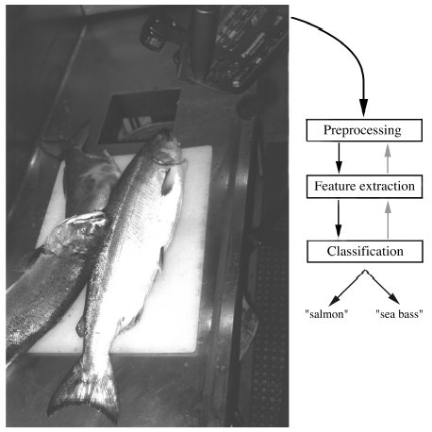
Image Processing Example
Sorting Fish: incoming fish are sorted according to species using optical sensing (sea bass or salmon?)
Problem Analysis:
  set up a camera and take some sample images to extract features
  Consider features such as length, lightness, width, number and shape of fins, position of mouth, etc.
Sensing
Segmentation
Feature Extraction

Slide 9
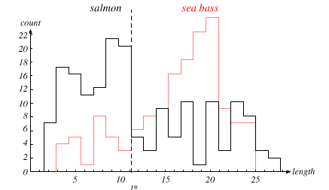
Length As A Discriminator
Conclusion: Length is a poor discriminator

Slide 10
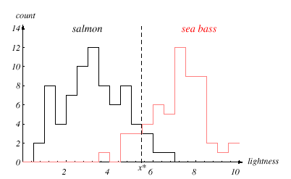
Add Another Feature
Lightness is a better feature than length because it reduces the misclassification error.
Can we combine features in such a way that we improve performance?
(Hint: correlation)

Slide 11
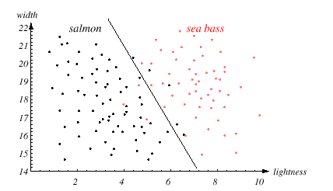
Width And Lightness
Treat features as a N-tuple (two-dimensional vector)
Create a scatter plot
Draw a line (regression) separating the two classes

Slide 12
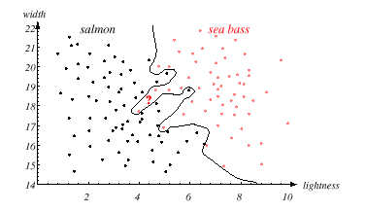
Decision Theory
Can we do better than a linear classifier?
What is wrong with this decision surface?
(Hint: generalization)

Slide 13
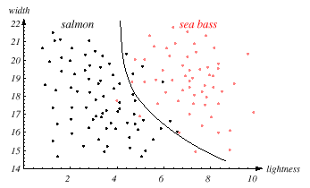
Generalization and Risk
Why might a smoother decision surface be a better choice?
(Hint: Occam’s Razor).
This course investigates how to find such “optimal” decision surfaces and how to provide system designers with the tools to make intelligent
trade-offs.

Slide 14
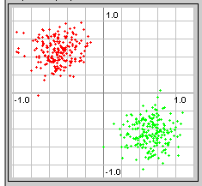
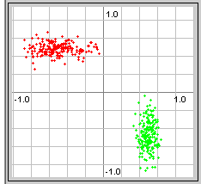

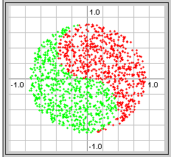
Correlation
Degrees of difficulty:
Real data is often much harder:

Slide 15
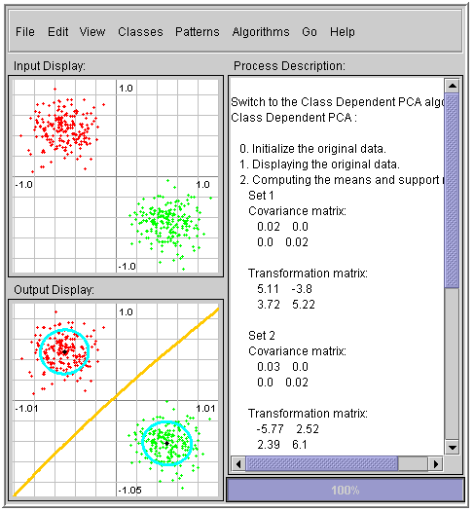
First Principle
There are many excellent resources on the Internet that demonstrate pattern recognition concepts.
There are many MATLAB toolboxes that implement state of the art algorithms.
One such resource is a Java Applet that lets you quickly explore how a variety of algorithms process the same data.
An important first principle is:
  There are no magic equations or algorithms.
  You must understand the properties of your data and what a priori knowledge you can bring to bear on the problem.
….

Slide 16
Bayesian Formulations
Message
Source
Linguistic
Channel
Articulatory
Channel
Acoustic
Channel
Message
Words
Phones
Features
Bayesian formulation for speech recognition:
Objective: minimize the word error rate by maximizing
Approach: maximize (training)
  acoustic model (hidden Markov models, Gaussian mixtures, etc.
  language model (finite state machines, N-grams)
  acoustics (ignored during maximization)
  Bayes Rule allows us to convert the problem of estimating an unknown posterior probability to a process in which we can postulate a model, collect data under controlled conditions, and estimate the parameters of the model.

Slide 17
Summary
Pattern recognition vs. machine learning vs. machine understanding
First principle of pattern recognition?
We will focus more on decision theory and less on feature extraction.
This course emphasizes statistical and data-driven methods for optimizing system design and parameter values.
Second most important principle?

Slide 18
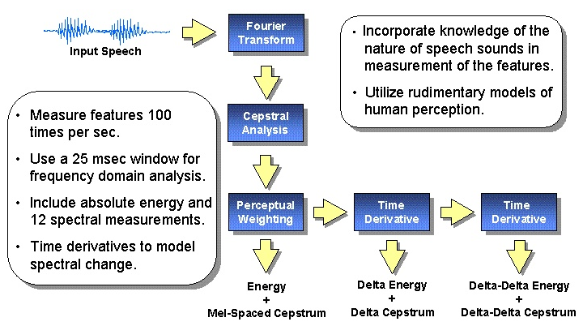
Feature Extraction

Slide 19
Generalization And Risk
How much can we trust isolated data points?
Optimal decision surface is a line
Optimal decision surface still a line
Optimal decision surface changes abruptly
Can we integrate prior knowledge about data, confidence, or willingness to take risk?

Slide 20
Review
Normal (Gaussian) Distributions
Multivariate Normal (Gaussian) Distributions
Support Regions: a convenient visualization tool

Slide 21
Normal Distributions
Recall the definition of a normal distribution (Gaussian):
Why is this distribution so important in engineering?
Mean:
Covariance:
Statistical independence?
Higher-order moments? Occam’s Razor?
Entropy?
Linear combinations of normal random variables?
Central Limit Theorem?

Slide 22
Univariate Normal Distribution
A normal or Gaussian density is a powerful model for modeling continuous-valued feature vectors corrupted by noise due to its analytical tractability.
Univariate normal distribution:
where the mean and covariance are defined by:
The entropy of a univariate normal distribution is given by:

Slide 23
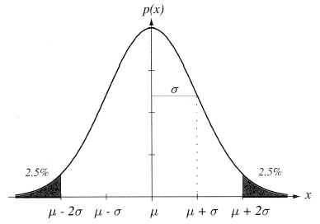
Mean and Variance
A normal distribution is completely specified by its mean and variance:
The peak is at:
66% of the area is within one σ; 95% is within two σ; 99% is within three σ.
A normal distribution achieves the maximum entropy of all distributions having a given mean and variance.
Central Limit Theorem: The sum of a large number of small, independent random variables will lead to a Gaussian distribution.

Slide 24
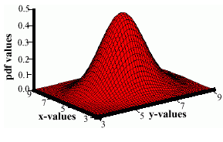
Multivariate Normal Distributions
A multivariate distribution is defined as:
where μ represents the mean (vector) and Σ represents the covariance (matrix).
Note the exponent term is really a dot product or
weighted Euclidean distance.
The covariance is always symmetric and positive semidefinite.
How does the shape vary as a function of the covariance?

Slide 25
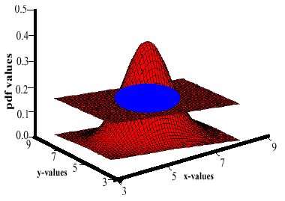
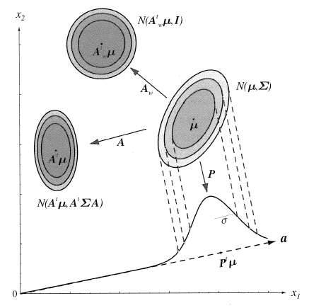
Support Regions
A support region is the obtained by the intersection of a Gaussian distribution with a plane.
For a horizontal plane, this generates an ellipse whose points are of equal probability density.
The shape of the support region is defined by the covariance matrix.

Slide 26
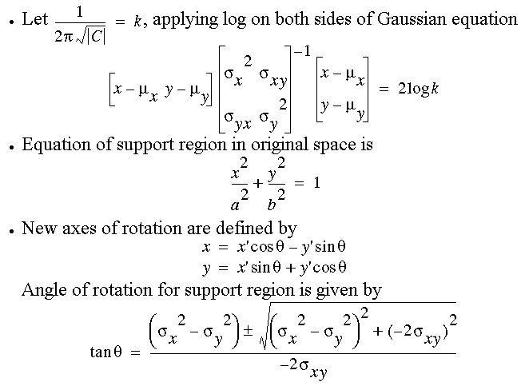
Derivation

Slide 27
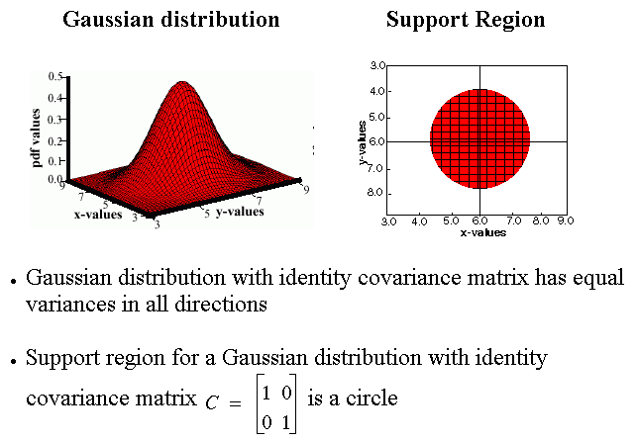
Identity Covariance

Slide 28
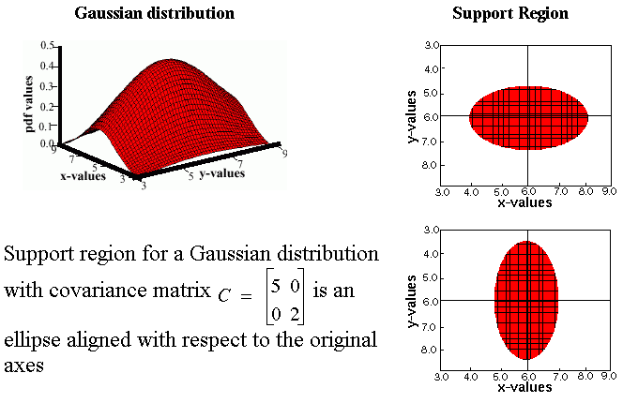
Unequal Variances

Slide 29
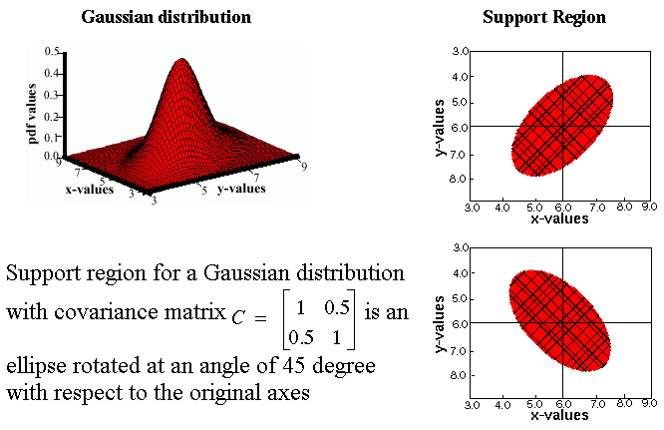
Nonzero Off-Diagonal Elements

Slide 30
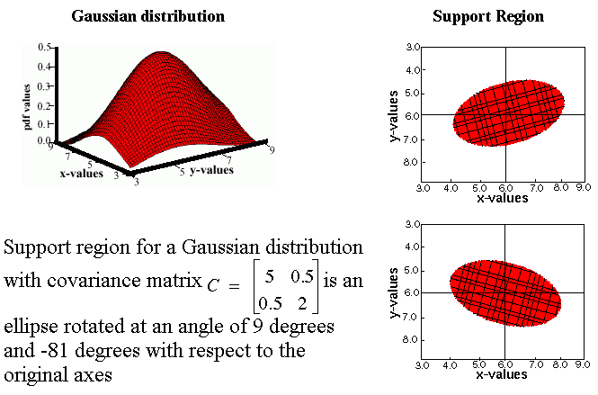
Unconstrained or “Full” Covariance

