Slide 1
LECTURE 19: Data Structures
Topics:
Single Linked List
Templates
Memory Management
I/O
Example
Resources:
C++: Class Definitions
Java: Class Definitions
Python: Class Definitions ISIP: Data Structures
Boost: Template Libraries

Slide 2
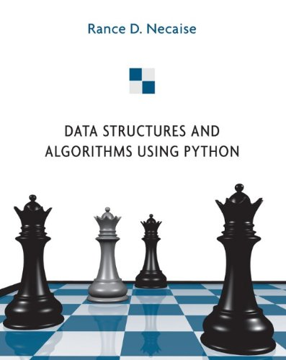
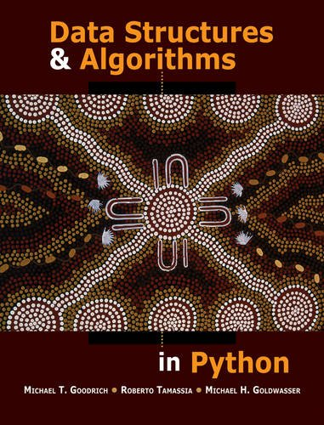
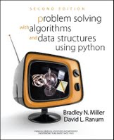
LECTURE 19a: More Data Structures
Topics:
Types of Data Structures Ordered Lists
Hash Tables
Dictionary
Sets
Queues and Stacks
Resources:
Udacity: Hash Tables
Hofstra: Python Dictionaries
TP: Advanced Data Structures
Python: Queues and Stacks

