Slide 1
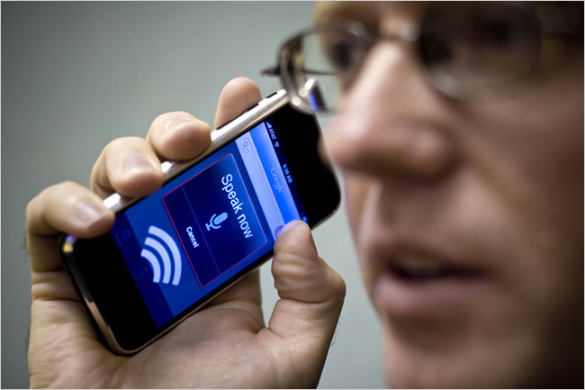

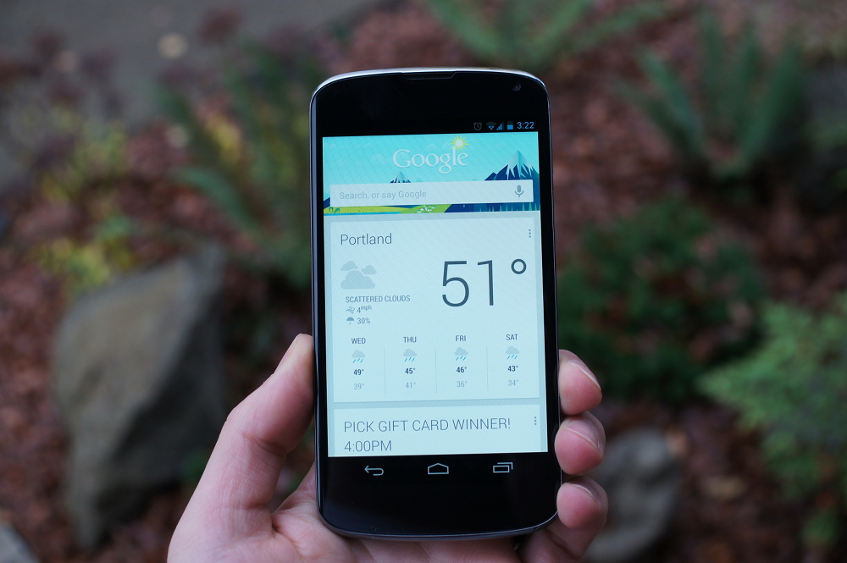
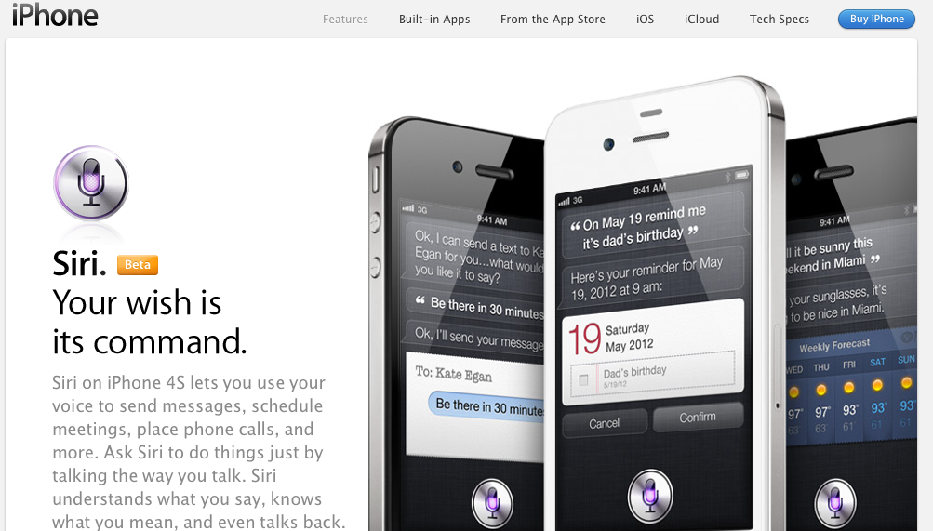

Emerging Directions in
Statistical Modeling in Speech Recognition
Joseph Picone and Amir Harati
Institute for Signal and Information Processing
Temple University
Philadelphia, Pennsylvania, USA

Slide 2
Abstract
Balancing unique acoustic or linguistic characteristics, such as a speaker's identity and accent, with general behaviors that describe aggregate behavior, is one of the great challenges in acoustic modeling in speech recognition.
  The goal of Bayesian analysis is to reduce the uncertainty about unobserved variables by combining prior knowledge with observations.
  A fundamental limitation of any statistical model, including Bayesian approaches, is the inability to adapt to new modalities in the data.
Nonparametric Bayesian methods are one popular alternative because the complexity of the model is not fixed a priori. Instead a prior is placed over the complexity that biases the system towards sparse or low complexity solutions.
  Neural networks based on deep learning have recently emerged as a popular alternative to traditional acoustic models based on hidden Markov models and Gaussian mixture models due to their ability to automatically self-organize and discover knowledge.
In this talk, we will review emerging directions in statistical modeling in speech recognition and briefly discuss the application of these techniques to a range of problems in signal processing and bioengineering.

Slide 3
Fundamental Challenges: Generalization and Risk
What makes the development of human language technology so difficult?
“In any natural history of the human species, language would stand out as the preeminent trait.”
“For you and I belong to a species with a remarkable trait: we can shape events in each other’s brains with exquisite precision.”
S. Pinker, The Language Instinct: How the Mind Creates Language, 1994
Some fundamental challenges:
Diversity of data, much of which defies simple mathematical descriptions or physical constraints (e.g., Internet data).
Too many unique problems to be solved (e.g., 6,000 language, billions of speakers, thousands of linguistic phenomena).
Generalization and risk are fundamental challenges (e.g., how much can we rely on sparse data sets to build high performance systems).
Underlying technology is applicable to many application domains:
Fatigue/stress detection, acoustic signatures (defense, homeland security);
EEG/EKG and many other biological signals (biomedical engineering);
Open source data mining, real-time event detection (national security).

Slide 4
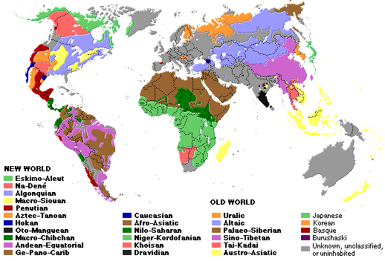
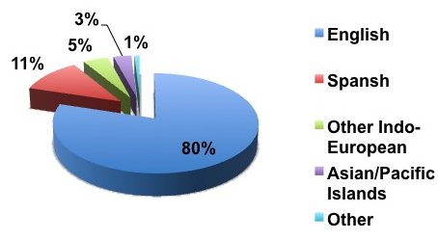
The World’s Languages
There are over 6,000 known languages in the world.
A number of these languages are vanishing spurring interest in new ways to use digital media and the Internet to preserve these languages and the cultures that speak them.
The dominance of English is being challenged by growth in Asian and Arabic languages.
In Mississippi, approximately 3.6% of the population speak a language other than English, and 12 languages cover 99.9% of the population.
Common languages are used to facilitate communication; native languages are often used for covert communications.
Philadelphia (2010)

Slide 5


Finding the Needle in the Haystack… In Real Time!
There are 6.7 billion people in the world representing over 6,000 languages.
300 million are Americans. Who worries
about the other 6.4 billion?
Ilocano ( ) Tagalog ( )
Over 170 languages are spoken in the
Philippines, most from the Austronesian
family. Ilocano is the third most-spoken.
This particular passage can be roughly translated as:
Ilocano¹: Suratannak iti lizardfish3@yahoo.com maipanggep iti amin nga imbagada iti taripnnong. Awagakto isuna tatta.
English: Send everything they said at the meeting to lizardfish@yahoo.com and I'll call him immediately.
Human language technology (HLT) can be used to automatically extract such content from text and voice messages. Other relevant technologies are speech to text and machine translation.
Language identification and social networking are two examples of core technologies that can be integrated to understand human behavior.
1. The audio clip was provided by Carl Rubino, a world-renowned expert in Filippino languages.

Slide 6
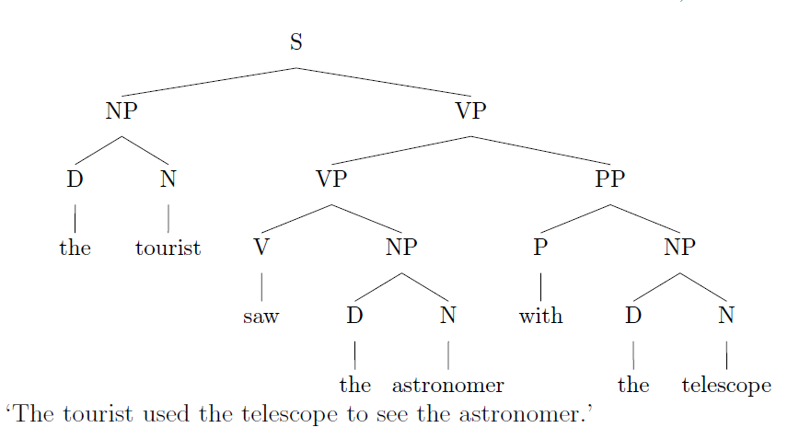
Language Defies Conventional Mathematical Descriptions
According to the Oxford English Dictionary, the 500 words used most in the English language each have an average of 23 different meanings. The word “round,” for instance, has 70 distinctly different meanings.
(J. Gray, http://www.gray-area.org/Research/Ambig/#SILLY )
Are you smarter than a 5th grader?
“The tourist saw the astronomer on the hill with a telescope.”
Hundreds of linguistic phenomena we must take into account to understand written language.
Each can not always be perfectly identified (e.g., Microsoft Word)
95% x 95% x … = a small number
D. Radev, Ambiguity of Language
Is SMS messaging even a language? “y do tngrs luv 2 txt msg?”

Slide 7
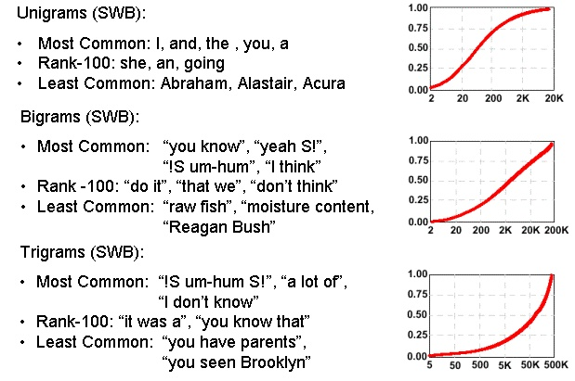
Communication Depends on Statistical Outliers
A small percentage of words constitute a large percentage of word tokens used in conversational speech:
Conventional statistical approaches are based on average behavior (means) and deviations from this average behavior (variance).
Consider the sentence:
“Show me all the web pages about Franklin Telephone in Oktoc County.”
Key words such as “Franklin” and “Oktoc” play a significant role in the meaning of the sentence.
What are the prior probabilities of these words?
Consequence: the prior probability of just about any meaningful sentence is close to zero. Why?

Slide 8
Human Performance is Impressive
Human performance exceeds machine performance by a factor ranging from 4x to 10x depending on the task.
On some tasks, such as credit card number recognition, machine performance exceeds humans due to human memory retrieval capacity.
The nature of the noise is as important as the SNR (e.g., cellular phones).
A primary failure mode for humans is inattention.
A second major failure mode is the lack of familiarity with the domain (i.e., business terms and corporation names).
Word Error Rate
20%
Wall Street Journal (Additive Noise)
15%
Machines
10%
5%
Human Listeners (Committee)
0%
10 dB
16 dB
22 dB
Quiet
Speech-To-Noise Ratio

Slide 9

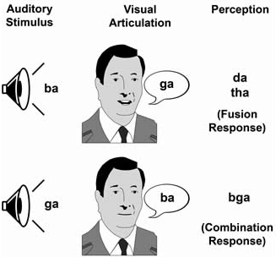
Human Performance is Robust
Cocktail Party Effect: the ability to focus one’s listening attention on a single talker among a mixture of conversations and noises.
McGurk Effect: visual cues of a cause a shift in perception of a sound, demonstrating multimodal speech perception.
Sound localization is enabled by our binaural hearing, but also involves cognition.
Suggests that audiovisual integration mechanisms in speech take place rather early in the perceptual process.

Slide 10
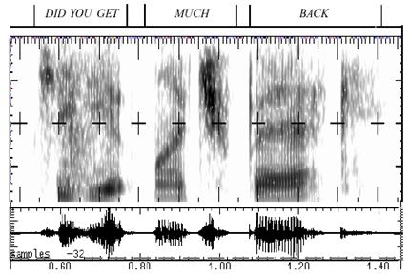
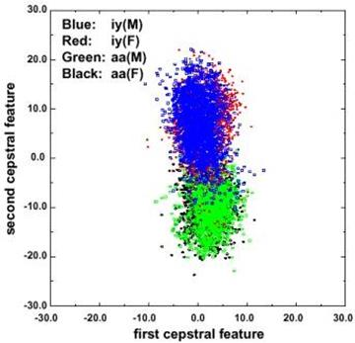
Fundamental Challenges in Spontaneous Speech
Common phrases experience significant reduction (e.g., “Did you get” becomes “jyuge”).
Approximately 12% of phonemes and 1% of syllables are deleted.
Robustness to missing data is a critical element of any system.
Linguistic phenomena such as coarticulation produce significant overlap in the feature space.
Decreasing classification error rate requires increasing the amount of linguistic context.
Modern systems condition acoustic probabilities using units ranging from phones to multiword phrases.

Slide 11
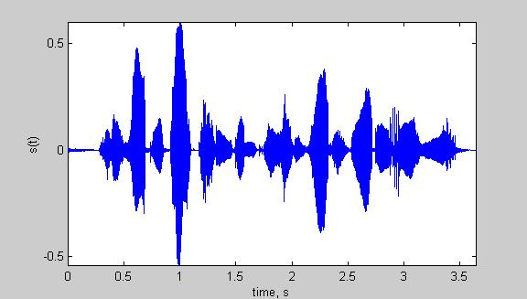
Speech Recognition Overview
Based on a noisy communication channel
model in which the intended message is
corrupted by a sequence of noisy models
Bayesian approach is most common:
Objective: minimize word error rate by
maximizing P(W|A)
P(A|W): Acoustic Model
P(W): Language Model
P(A): Evidence (ignored)
Acoustic models use hidden Markov
models with Gaussian mixtures.
P(W) is estimated using probabilistic
N-gram models.
Parameters can be trained using generative (ML)
or discriminative (e.g., MMIE, MCE, or MPE) approaches.
Input
Speech
Feature
Extraction
Acoustic
Front-end
Acoustic Models
P(A/W)
Language Model
P(W)
Search
Recognized Utterance

Slide 12
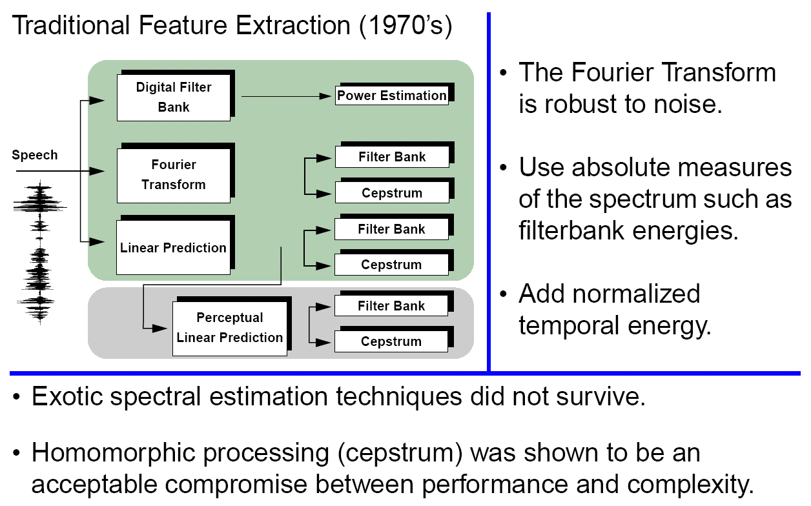
Signal Processing in Speech Recognition

Slide 13
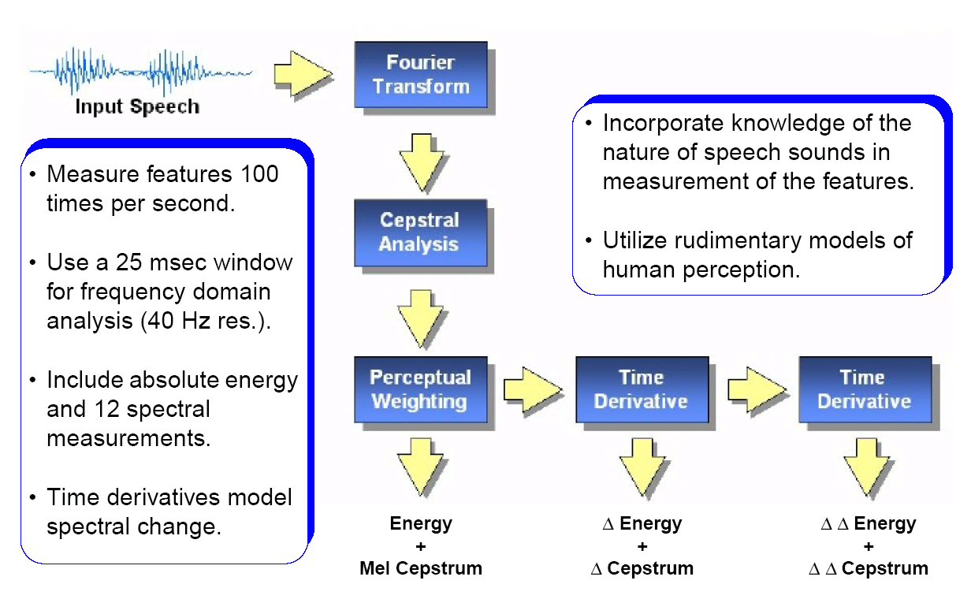
Features: Convert a Signal to a Sequence of Vectors

Slide 14
iVectors: Towards Invariant Features
The i-vector representation is a data-driven approach for feature extraction that provides a general framework for separating systematic variations in the data, such as channel, speaker and language.
The feature vector is modeled as a sum of three (or more) components:
M = m + Tw + ε
where M is the supervector, m is a universal background model, ε is a noise term, and w is the target low-dimensional feature vector.
M is formed as a concatenation of consecutive feature vectors.
This high-dimensional feature vector is then mapped into a low-dimensional space using factor analysis techniques such as Linear Discriminant Analysis (LDA).
The dimension of T can be extremely large (~20,000 x 100), but the dimension of the resulting feature vector, w, is on the order of a traditional feature vector (~50).
The i-Vector representation has been shown to give significant reductions (20% relative) in EER on speaker/language identification tasks.

Slide 15
Speech Recognition Overview
Based on a noisy communication channel
model in which the intended message is
corrupted by a sequence of noisy models
Bayesian approach is most common:
Objective: minimize word error rate by
maximizing P(W|A)
P(A|W): Acoustic Model
P(W): Language Model
P(A): Evidence (ignored)
Acoustic models use hidden Markov
models with Gaussian mixtures.
P(W) is estimated using probabilistic
N-gram models.
Parameters can be trained using generative (ML)
or discriminative (e.g., MMIE, MCE, or MPE) approaches.
Input
Speech
Acoustic
Front-end
Research Focus
Acoustic Models
P(A/W)
Language Model
P(W)
Search
Recognized Utterance

Slide 16
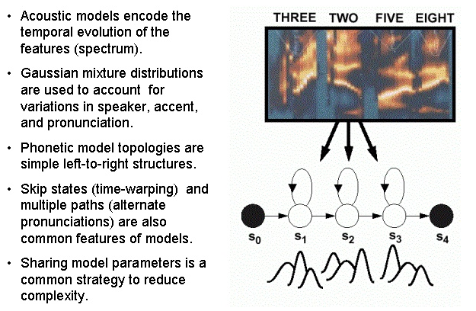
Acoustic Models: Capture the Time-Frequency Evolution

Slide 17
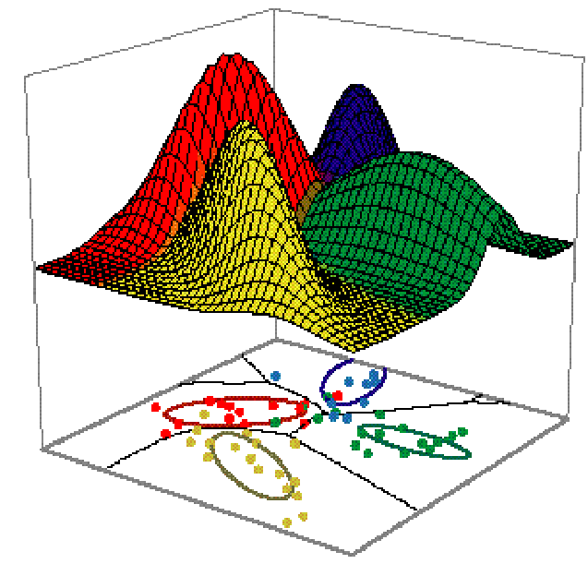
The Motivating Problem – A Speech Processing Perspective
A set of data is generated from multiple distributions but it is unclear how many.
    Parametric methods assume the number of distributions is known a priori
        Nonparametric methods learn the number of distributions from the data, e.g. a model of a distribution of distributions
Notes:
Don’t discuss parametric and non-parametric methods here

Slide 18
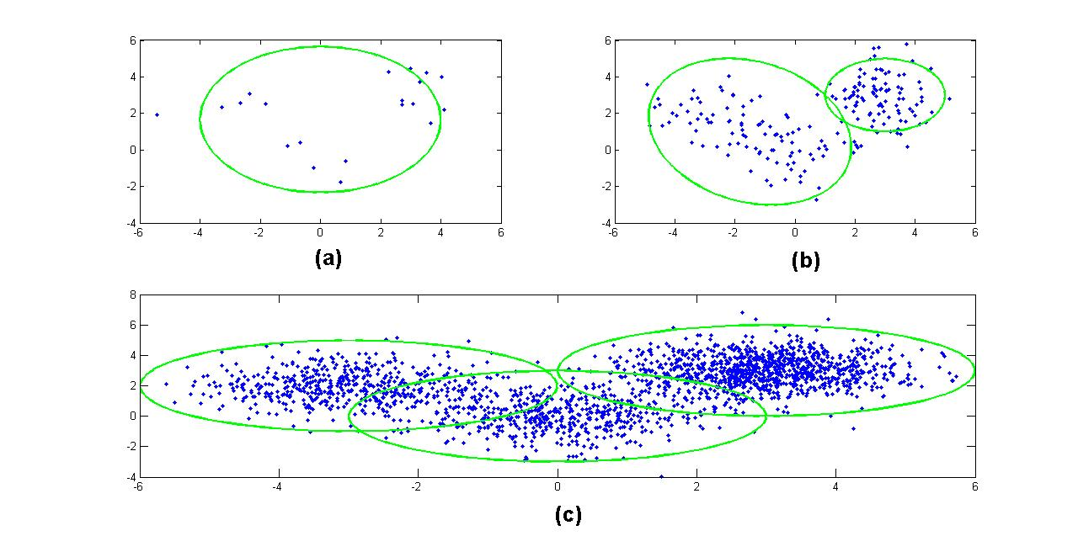
Bayesian Approaches
Bayes Rule:
Bayesian methods are
sensitive to the choice
of a prior.
Prior should reflect the beliefs about the model.
Inflexible priors (and models) lead to wrong conclusions.
Nonparametric models are very flexible — the number of parameters can grow with the amount of data.
Common applications: clustering, regression, language modeling, natural language processing

Slide 19
Parametric vs. Nonparametric Models
Parametric | Nonparametric
Requires a priori assumptions about data structure | Do not require a priori assumptions about data structure
Underlying structure is approximated with a limited number of mixtures | Underlying structure is learned from data
Number of mixtures is rigidly set | Number of mixtures can evolve Distributions of distributions Needs a prior!
Complex models frequently require inference algorithms for approximation!
Notes:
-Averaging across distributions is ok for capturing general acoustic features for phone identification but can’t capture unique acoustic traits.

Slide 20
Taxonomy of Nonparametric Models
Nonparametric Bayesian Models
Regression
Density Estimation
Survival Analysis
Neural Networks
Wavelet-Based Modeling
Dirichlet Processes
Hierarchical Dirichlet Process
Proportional Hazards
Competing Risks
Multivariate Regression
Spline Models
Pitman Process
Dynamic Models
Neutral to the Right Processes
Dependent Increments
Inference algorithms are needed to approximate
these infinitely complex models
Notes:
-survival analysis focuses on modeling time before an event

Slide 21
Deep Learning and Big Data
A hierarchy of networks is used o automatically
learn the underlying structure and hidden states.
Restricted Boltzmann machines (RBM) are used to
implement the hierarchy of networks (Hinton, 2002).
An RBM consists of a layer of stochastic binary
“visible” units that represent binary input data.
These are connected to a layer of stochastic binary
hidden units that learn to model significant
dependencies between the visible units.
For sequential data such as speech, RBMs are often combined with conventional HMMs using a “hybrid” architecture:
  Low-level feature extraction and signal modeling is performed using the RBM, and higher-level knowledge processing is performed using some form of a finite state machine or transducer (Sainath et al., 2012).
Such systems model posterior probabilities directly and incorporate principles of discriminative training.
Training is computationally expensive and large amounts of data are needed.

Slide 22
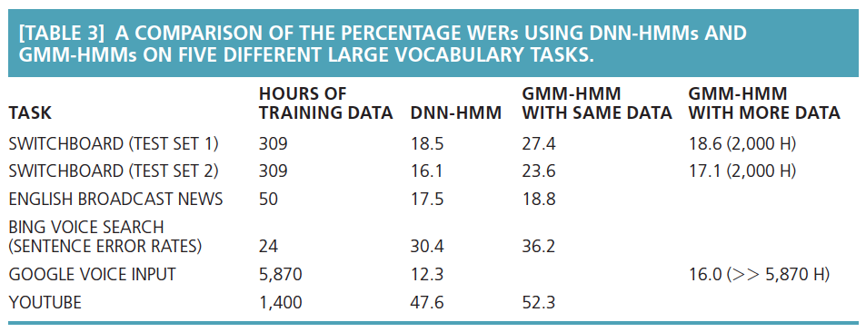
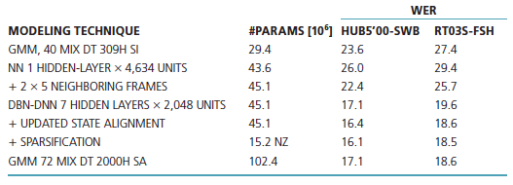
Speech Recognition Results Are Encouraging
(from Hinton et al., “Deep Neural Networks for Acoustic Modeling in Speech Recognition, 2012)

Slide 23
Nonparametric Bayesian Models: Dirichlet Distributions
Functional form:
  q ϵ ℝ^{k}: a probability mass function (pmf)
  α: a concentration parameter
The Dirichlet Distribution is a conjugate prior for a multinomial distribution.
Conjugacy: Allows a posterior to remain in the same family of distributions as the prior.
Notes:
-example, 3 hidden dice to model probability of (1,2, …, 6)
-Dirichlet Dist. are distributions over pmfs
-α is similar to inverse variance

Slide 24
Dirichlet Processes (DPs)
A Dirichlet Process is a Dirichlet distribution split infinitely many times
q₂₂
q₂
q₂₁
q₁₁
q₁
q₁₂
These discrete probabilities are used as a prior for our infinite mixture model

Slide 25
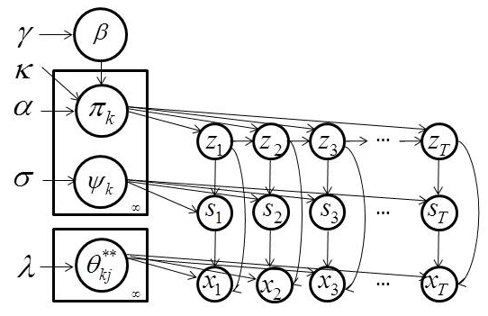
Hierarchical Dirichlet Process-Based HMM (HDP-HMM)
Mathematical Definition:
Markovian Structure:
Inference algorithms are used to infer the values of the latent variables (z_{t} and s_{t}).
A variation of the forward-backward procedure is used for training.
z_{t}, s_{t} and x_{t} represent a state, mixture component and observation respectively.
Notes:
DP essentially clusters data into groups
HDP shares class labels amongst clusters (e.g., words clustered to topics; topics shared to form documents)
Pi_j are the transition matrices
Each state has an infinite number of mixtures per state
Theta is the mean and covariance for each Gaussian component
These are sampled from H(lambda)
Kappa is zero makes no preference for staying or transitioning
Kappa greater than zero biases models to stay in each state for multiple observations
System is biased towards remaining in a state

Slide 26
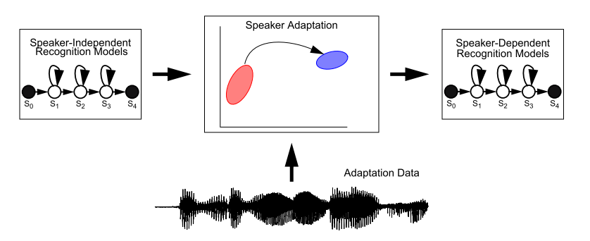
Speaker Adaptation: Transform Clustering
Goal is to approach speaker dependent performance using speaker independent models and a limited number of mapping parameters.
The classical solution is to use a binary regression tree of transforms constructed using a Maximum Likelihood Linear Regression (MLLR) approach.
Transformation matrices are clustered using a centroid splitting approach.

Slide 27
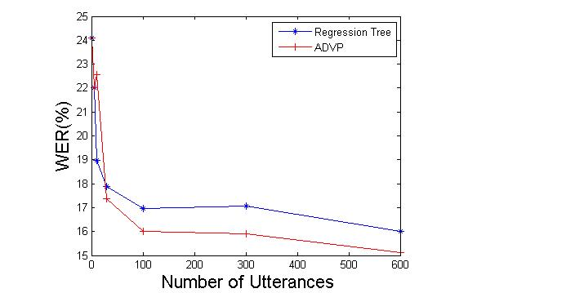
Speaker Adaptation: Monophone Results
Experiments used DARPA’s
Resource Management (RM)
corpus (~1000 word vocabulary).
Monophone models used a
single Gaussian mixture model.
12 different speakers with
600 training utterances
per speaker.
Word error rate (WER) is reduced
by more than 10%.
The individual speaker error rates generally
follow the same trend as the average behavior.
DPM finds an average of 6 clusters
in the data while the regression tree finds only 2 clusters.
The resulting clusters resemble broad phonetic classes (e.g., distributions related to the phonemes “w” and “r”, which are both liquids, are in the same cluster.

Slide 28
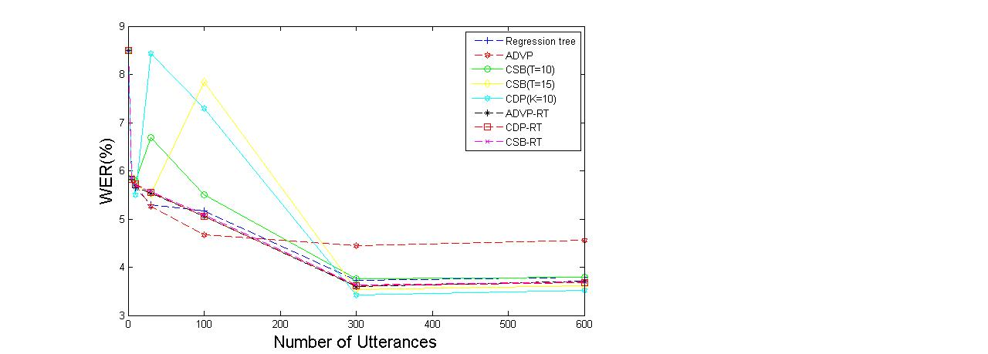
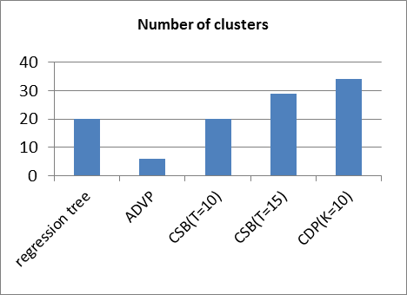
Speaker Adaptation: Crossword Triphone Results
Crossword triphone models use a single Gaussian mixture model.
Individual speaker error rates follow the same trend.
The number of clusters per speaker did not vary significantly.
The clusters generated using DPM have acoustically and phonetically meaningful interpretations.
ADVP works better for moderate amounts of data while CDP and CSB work better for larger amounts of data.

Slide 29
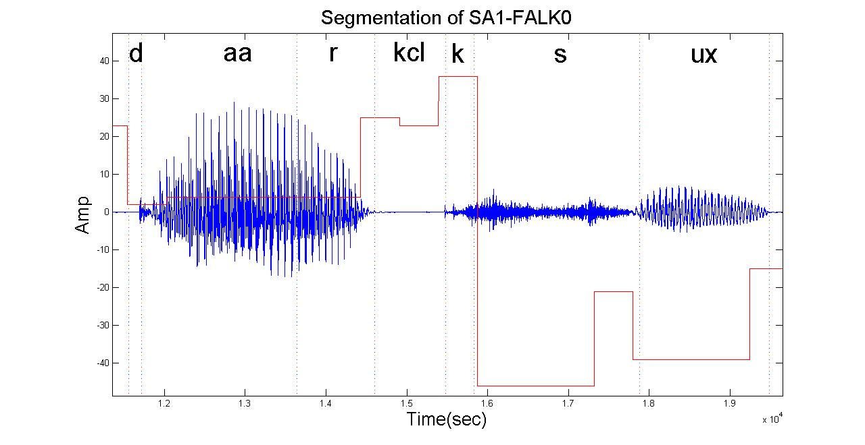
Speech Segmentation: Finding Acoustic Units
Approach: compare automatically derived segmentations to manual TIMIT segmentations
Use measures of within-class and out-of-class similarities.
Automatically derive the units through the intrinsic HDP clustering process.

Slide 30
Speech Segmentation: Results
Algorithm | Recall | Precision | F-score
Dusan & Rabiner (2006) | 75.2 | 66.8 | 70.8
Qiao et al. (2008) | 77.5 | 76.3 | 76.9
Lee & Glass (2012) | 76.2 | 76.4 | 76.3
HDP-HMM | 86.5 | 68.5 | 76.6
Experiment | Params. (N_{s} / N_{c}) | Manual Segmentations | HDP-HMM
K_{z}=100, K_{s}=1, L=1 | 70/70 | (0.44,0.72) | (0.82,0.73)
K_{z}=100, K_{s}=1, L=2 | 33/33 | (0.44,0.72) | (0.77,0.73)
K_{z}=100, K_{s}=1, L=3 | 23/23 | (0.44,0.72) | (0.75,0.72)
K_{z}=100, K_{s}=5, L=1 | 55/139 | (0.44,0.72) | (0.90,0.72)
K_{z}=100, K_{s}=5, L=2 | 53/73 | (0.44,0.72) | (0.87,0.72)
K_{z}=100, K_{s}=5, L=3 | 43/51 | (0.44,0.72) | (0.83,0.72)
HDP-HMM automatically finds acoustic units consistent with the manual segmentations (out-of-class similarities are comparable).

Slide 31
Summary and Future Directions
A nonparametric Bayesian framework provides two important features:
complexity of the model grows with the data;
automatic discovery of acoustic units can be used to find better acoustic models.
Performance on limited tasks is promising.
Our future goal is to use hierarchical nonparametric approaches (e.g., HDP-HMMs) for acoustic models:
acoustic units are derived from a pool of shared distributions with arbitrary topologies;
models have arbitrary numbers of states, which in turn have arbitrary number of mixture components;
nonparametric Bayesian approaches are also used to segment data and discover new acoustic units.

Slide 32
For the Graduate Students…
Large amounts of data that accurately represent your problem are critical to good machine learning research.
Never start a project unless the data is already in place (corollary: it takes much longer than you think to reach a point where you can run meaningful experiments).
Features must contain information relevant to your problem.
No robust machine learning technique is necessarily better; the difference is often in the details of how you configure the system.
Expert knowledge of the problem space still plays a critical role in achieving high performance and more importantly, a useful system.
Statistical significance!

Slide 33
Brief Bibliography of Related Research
Dehak, N., Kenny, P., Dehak, R., Dumouchel, P., & Ouellet, P. (2011). Front-End Factor Analysis for Speaker Verification. IEEE Transactions on Audio, Speech, and Language Processing. 19(4), 788-798.
Harati, A., Picone, J., & Sobel, M. (2013). Speech Segmentation Using Hierarchical Dirichlet Processes. Proceedings of INTERSPEECH (pp. 637-641). Lyon, France.
Harati, A., Picone, J., & Sobel, M. (2012). Applications of Dirichlet Process Mixtures to Speaker Adaptation. Proceedings of the IEEE International Conference on Acoustics, Speech and Signal Processing (pp. 4321–4324). Kyoto, Japan.
Hinton, G., Deng, L., Yu, D., Dahl, G., Mohammed, A., Jaitly, N., … Kingsbury, B. (2012). Deep Neural Networks for Acoustic Modeling in Speech Recognition. IEEE Signal Processing Magazine, 29(6), 83–97.
Steinberg, J. (2013). A Comparative Analysis of Bayesian Nonparametric Variational Inference Algorithms For Speech Recognition. Department of Electrical and Computer Engineering, Temple University, Philadelphia, Pennsylvania, USA.

Slide 34


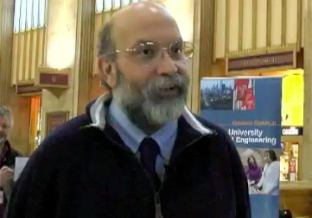
Biography
Joseph Picone received his Ph.D. in Electrical Engineering in 1983
from the Illinois Institute of Technology. He is currently a professor
in the Department of Electrical and Computer Engineering at
Temple University. He has spent significant portions of his career in academia (MS State), research (Texas Instruments, AT&T) and the government (NSA), giving him a very balanced perspective on the challenges of building sustainable R&D programs.
His primary research interests are machine learning approaches to acoustic modeling in speech recognition. For almost 20 years, his research group has been known for producing many innovative open source materials for signal processing including a public domain speech recognition system (see www.isip.piconepress.com).
Dr. Picone’s research funding sources over the years have included NSF, DoD, DARPA as well as the private sector. Dr. Picone is a Senior Member of the IEEE, holds several patents in human language technology, and has been active in several professional societies related to HLT.

Slide 35
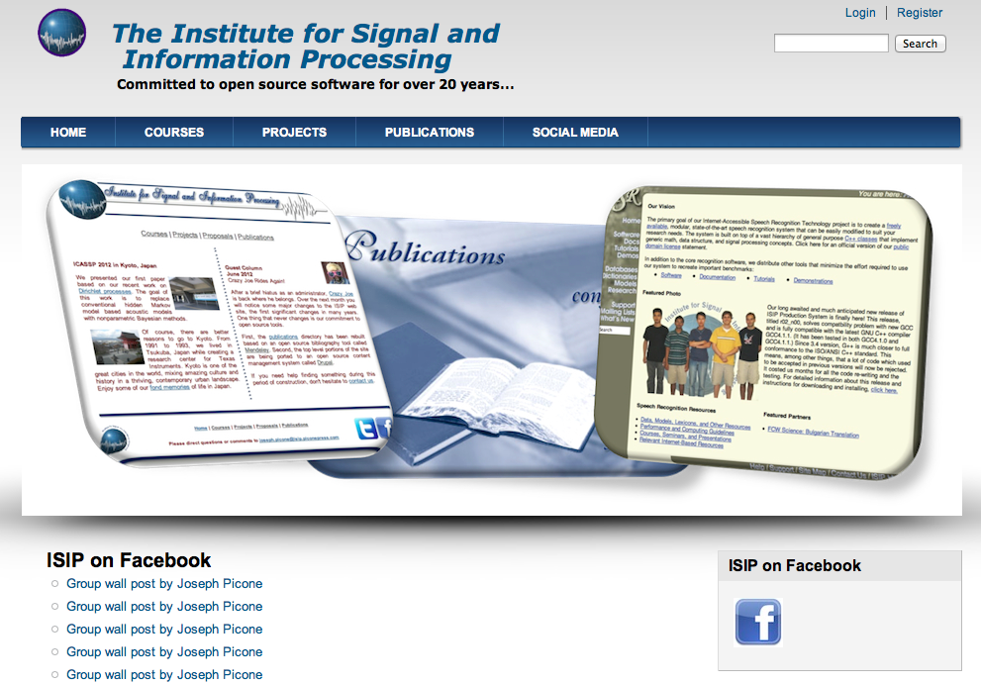

Slide 36

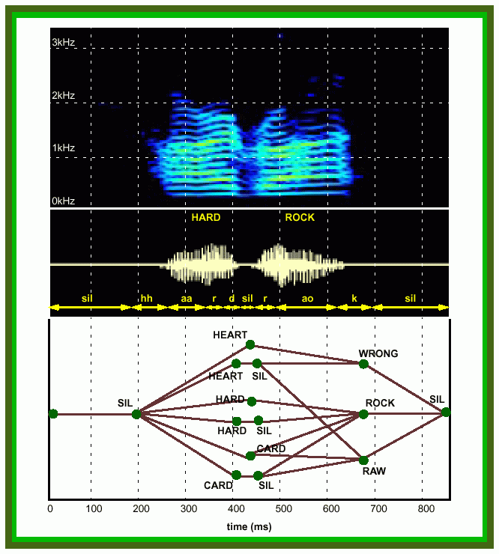
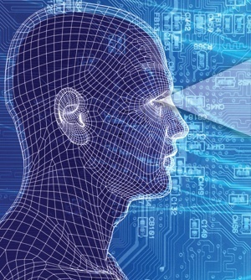
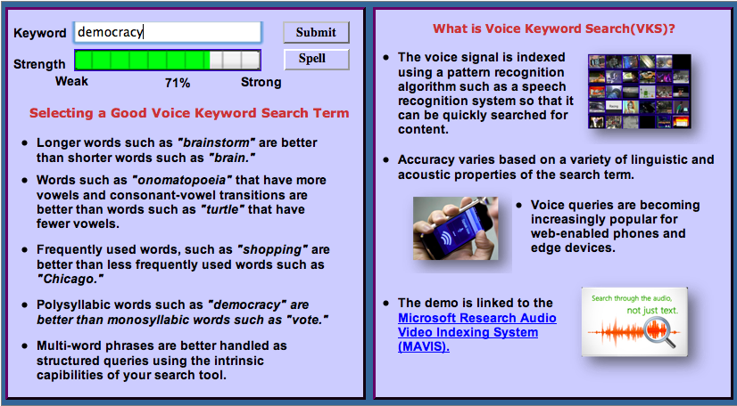
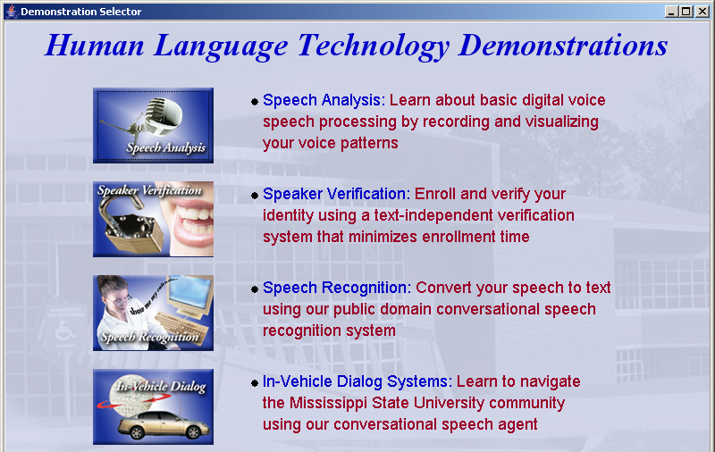
Information and Signal Processing
Mission: Automated extraction and organization of information using advanced statistical
models to fundamentally advance the level of integration, density, intelligence and performance
of electronic systems. Application areas include speech recognition, speech enhancement and biological systems.
Impact:
  Real-time information extraction from large audio resources such as the Internet
  Intelligence gathering and automated processing
  Next generation biometrics based on nonparametric statistical models
  Rapid generation of high performance systems in new domains involving untranscribed big data using models that self-organize information
Expertise:
  Statistical modeling of time-varying data sources in human language, imaging and bioinformatics
  Speech, speaker and language identification for defense and commercial applications
  Metadata extraction for enhanced understanding
  and improved semantic representations
  Intelligent systems and machine learning
  Data-driven and corpus-based methodologies utilizing big data resources have been proven to result in consistent incremental progress

Slide 37
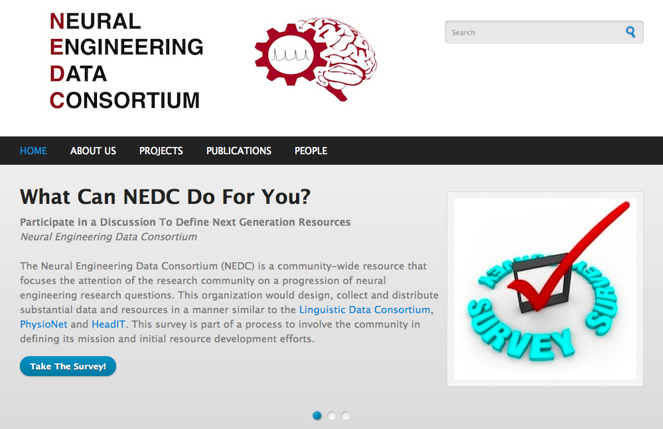

Slide 38
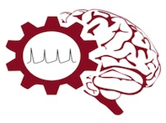
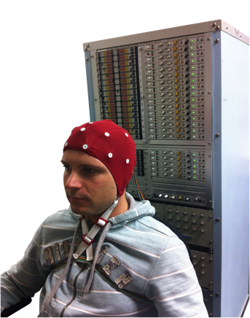
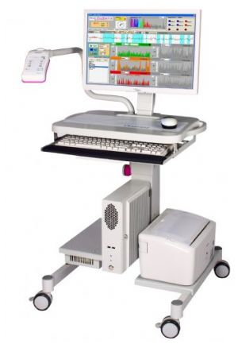
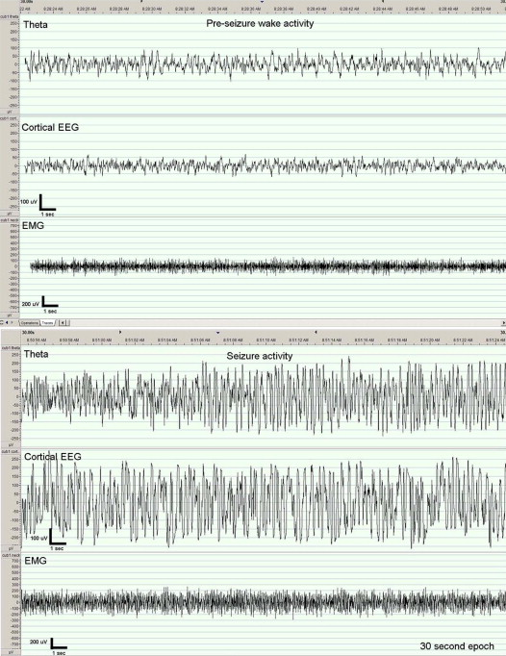
The Neural Engineering Data Consortium
Mission: To focus the research community on a progression of research questions and to
generate massive data sets used to address those questions. To broaden participation by making
data available to research groups who have significant expertise but lack capacity for data generation.
Impact:
  Big data resources enables application of state of the art machine-learning algorithms
  A common evaluation paradigm ensures consistent progress towards long-term research goals
  Publicly available data and performance baselines eliminate specious claims
  Technology can leverage advances in data collection to produce more robust solutions
Expertise:
  Experimental design and instrumentation of bioengineering-related data collection
  Signal processing and noise reduction
  Preprocessing and preparation of data for distribution and research experimentation
  Automatic labeling, alignment and sorting of data
  Metadata extraction for enhancing machine learning applications for the data
  Statistical modeling, mining and automated interpretation of big data
  To learn more, visit www.nedcdata.org

Slide 39
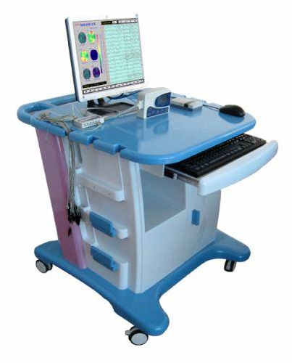
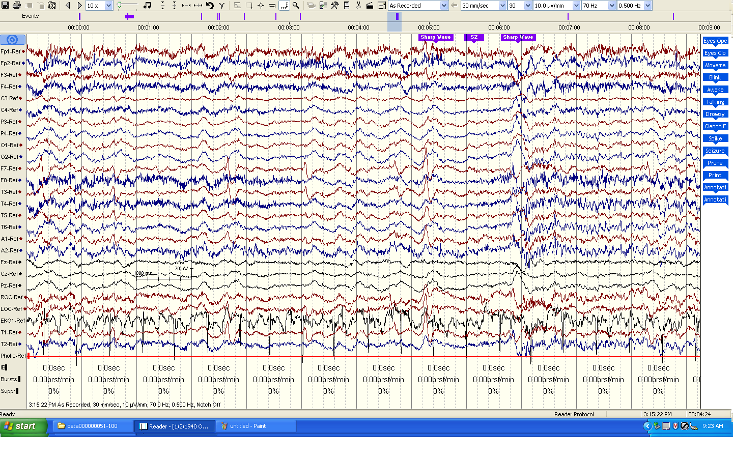
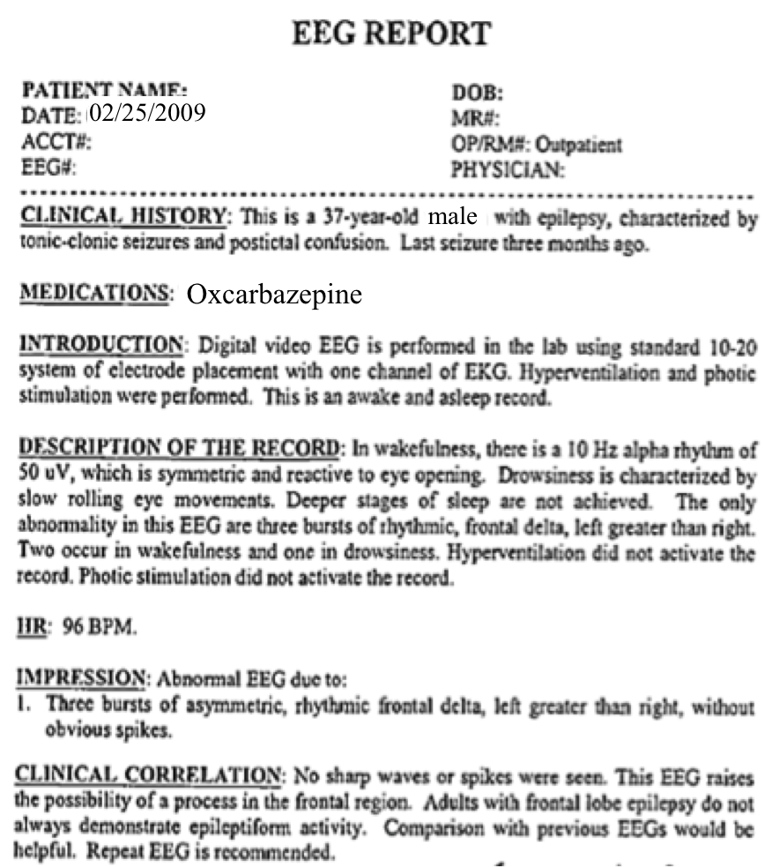
The Temple University Hospital EEG Corpus
Synopsis: The world’s largest publicly available EEG corpus consisting of 20,000+ EEGs collected
from 15,000 patients, collected over 12 years. Includes physician’s diagnoses and patient medical
histories. Number of channels varies from 24 to 36. Signal data distributed in an EDF format.
Impact:
  Sufficient data to support application of state of the art machine learning algorithms
  Patient medical histories, particularly drug treatments, supports statistical analysis of correlations between signals and treatments
  Historical archive also supports investigation of EEG changes over time for a given patient
  Enables the development of real-time monitoring
Database Overview:
  21,000+ EEGs collected at Temple University Hospital from 2002 to 2013 (an ongoing process)
  Recordings vary from 24 to 36 channels of signal data sampled at 250 Hz
  Patients range in age from 18 to 90 with an average of 1.4 EEGs per patient
  Data includes a test report generated by a technician, an impedance report and a physician’s report; data from 2009 forward inlcudes ICD-9 codes
  A total of 1.8 TBytes of data
  Personal information
  has been redacted
  Clinical history and medication history are included
  Physician notes are captured in three fields: description, impression and correlation fields.

Slide 40
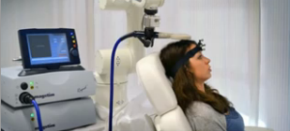
Automated Interpretation of EEGs
Goals: (1) To assist healthcare professionals in interpreting electroencephalography (EEG) tests,
thereby improving the quality and efficiency of a physician’s diagnostic capabilities; (2) Provide
a real-time alerting capability that addresses a critical gap in long-term monitoring technology.
Impact:
  Patients and technicians will receive immediate feedback rather than waiting days or weeks for results
  Physicians receive decision-making support that reduces their time spent interpreting EEGs
  Medical students can be trained with the system and use search tools make it easy to view patient histories and comparable conditions in other patients
  Uniform diagnostic techniques can be developed
Milestones:
  Develop an enhanced set of features based on temporal and spectral measures (1Q’2014)
  Statistical modeling of time-varying data sources in bioengineering using deep learning (2Q’2014)
  Label events at an accuracy of 95% measured on the held-out data from the TUH EEG Corpus (3Q’2014)
  Predict diagnoses with an F-score (a weighted average of precision and recall) of 0.95 (4Q’2014)
  Demonstrate a clinically-relevant system and assess the impact on physician workflow (4Q’2014)

Slide 41
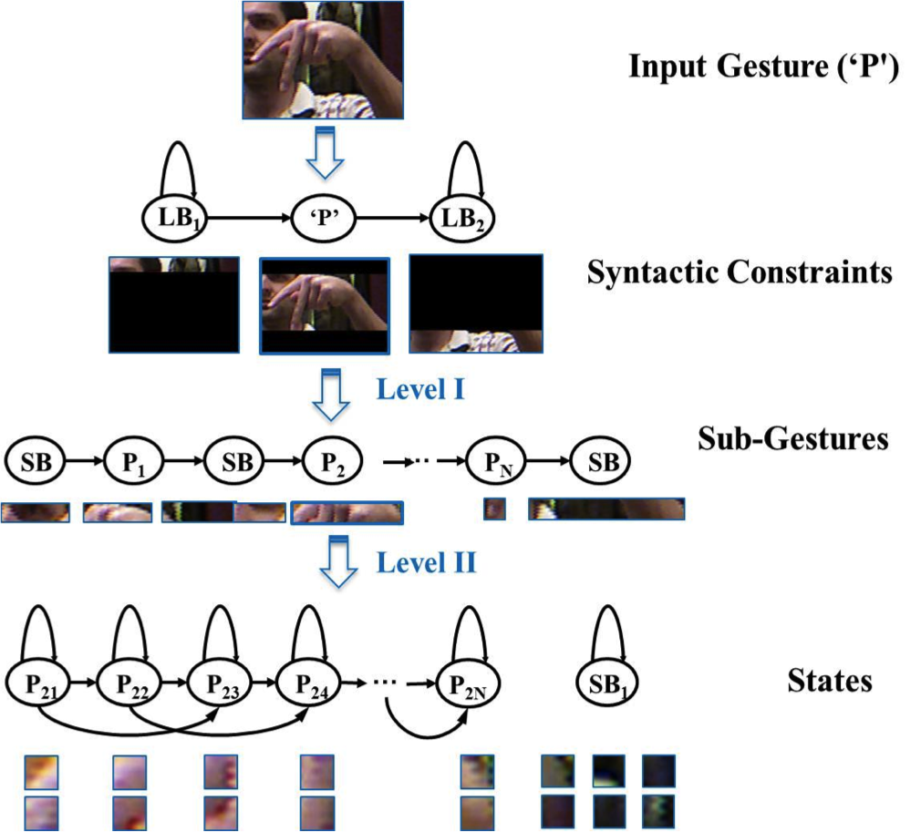
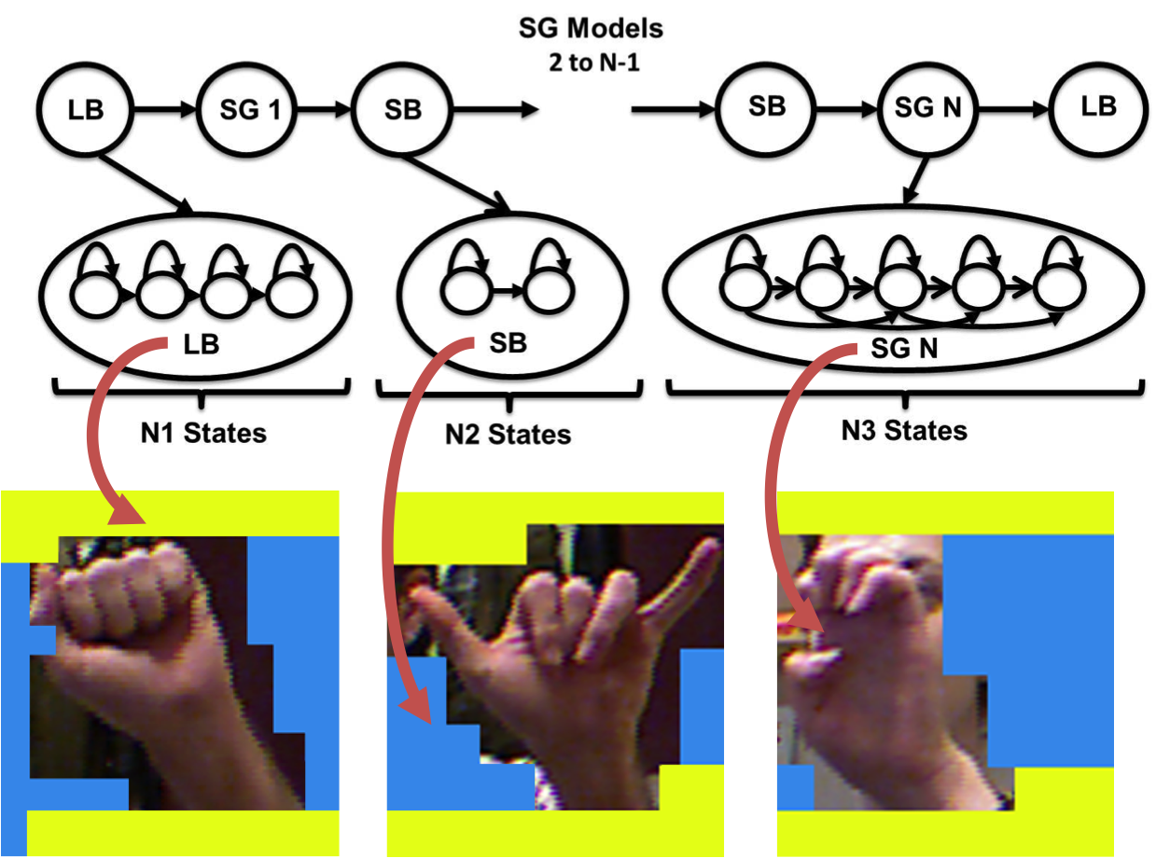
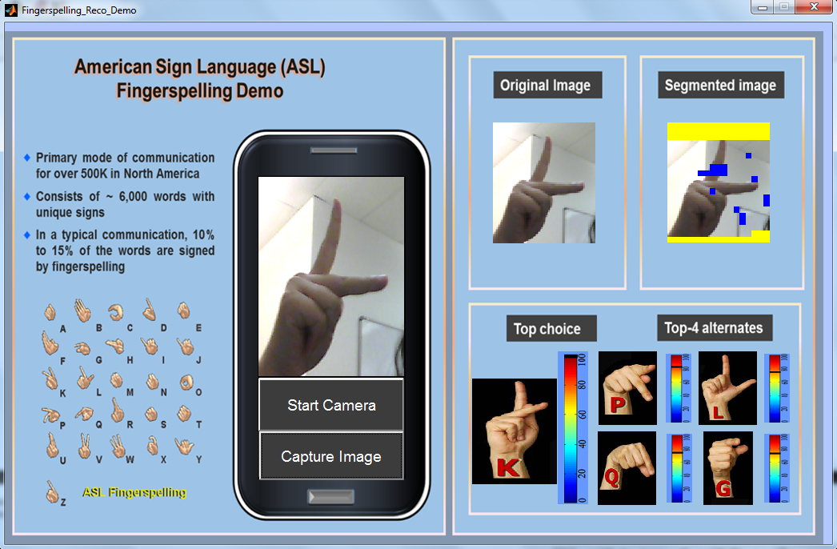
ASL Fingerspelling Recognition
Mission: (1) To fundamentally advance the performance of American Sign Language fingerspelling
recognition to enable more natural and efficient gesture-based human computer interfaces. (2) To deliver improved performance using standard, low-cost video cameras such as those in laptops and smartphones.
Impact:
  Best published results on the ASL-FS dataset (2% IER on an SD task and 46.7% on an SI task)
  Represents an 18% reduction over state of the art on the signer-independent (SI) task
  Integrated segmentation of images into background and image
  Image segmentation and background modeling remain the most significant challenges on this task
Overview:
  Apply a two-level hidden Markov model (HMM) based approach to simultaneously model spatial and color information in terms of sub-gestures
  Use Histogram of Gradient (HOG) features
  Frame-based analysis that processes the image in a sequential fashion with low latency
  Use unsupervised training to learn sub-gesture models and background models
  Short and long background models to better isolate hand segments and finger positions

Slide 42
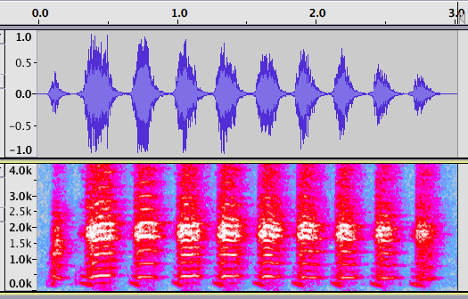

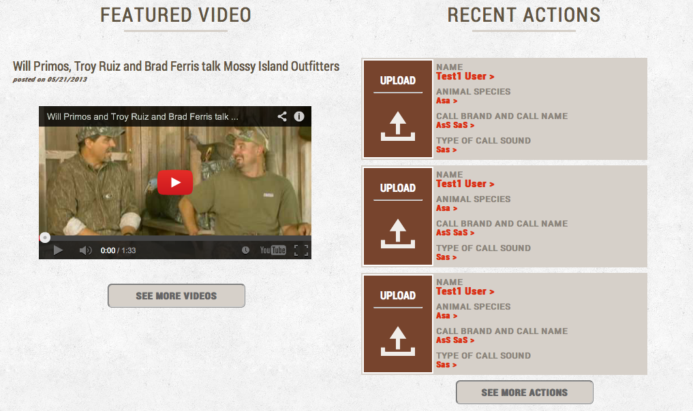
Hunter’s Game Call Trainer
Goals: To provide a smartphone-based platform that can be used to train hunters to make expert
game calls using commercially-available devices. Deliver a client/server architecture that allows a
library of game calls to be extended by expert contributors, and users can leverage social media to learn.
Impact:
  Automates the training process so that an expert is not needed for live instruction
  Creates industry-standard references for many well-known calls
  Sharing of data promotes social networking within the game call community
  Provides an excellent forum for call manufacturers to demonstrate and promote their products
Feature
Extraction
Reference
Model
Perceptually-Motivated Score
Compare
Overview:
  Expert provides 3 to 5 typical examples of a sound, from which a model is built based on the time/frequency profile
  Expert models are available in a web-based library
  A novice selects a model, records a call, and submits the token for evaluation
  The system analyzes the sound and produces a score in the range [0,100] indicating the degree of similarity
  The algorithm emphasizes temporal properties such as cadence and frequency properties such as pitch
Reference Models
Matching Score

