Slide 1
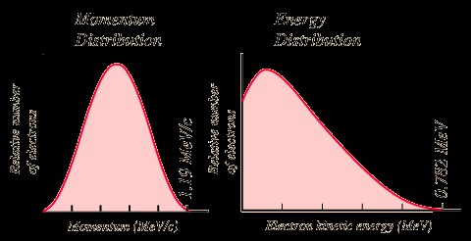
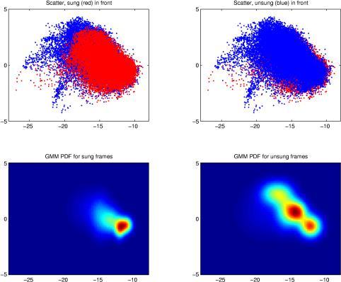
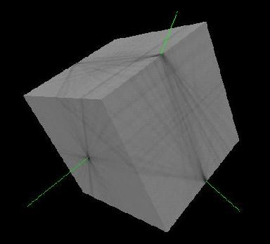
LECTURE 20: REESTIMATION, EM AND MIXTURES
Objectives: Reestimation Equations Continuous Distributions Gaussian Mixture Models EM Derivation of Reestimation
Resources: D.H.S.: Chapter 3 (Part 3) F.J.: Statistical Methods D.L.D.: Mixture Modeling R.S.: Semicontinuous HMMs C.C.: Ten Years of HMMs ISIP: HMM Overview ISIP: Software

Slide 2
Case Study: Speech Recognition
Based on a noisy communication channel model in which the intended message is corrupted by a sequence of noisy models
Bayesian approach is most common:
Objective: minimize word error rate by maximizing P(W|A)
P(A|W): Acoustic Model
P(W): Language Model
P(A): Evidence (ignored)
Acoustic models use hidden Markov models with Gaussian mixtures.
P(W) is estimated using probabilistic N-gram models.
Parameters can be trained using generative (ML) or discriminative (e.g., MMIE, MCE, or MPE) approaches.
Input Speech
Acoustic Front-end
Acoustic Models P(A/W)
Language Model P(W)
Search
Recognized Utterance

Slide 3
Case Study: Acoustic Modeling in Speech Recognition

Slide 4
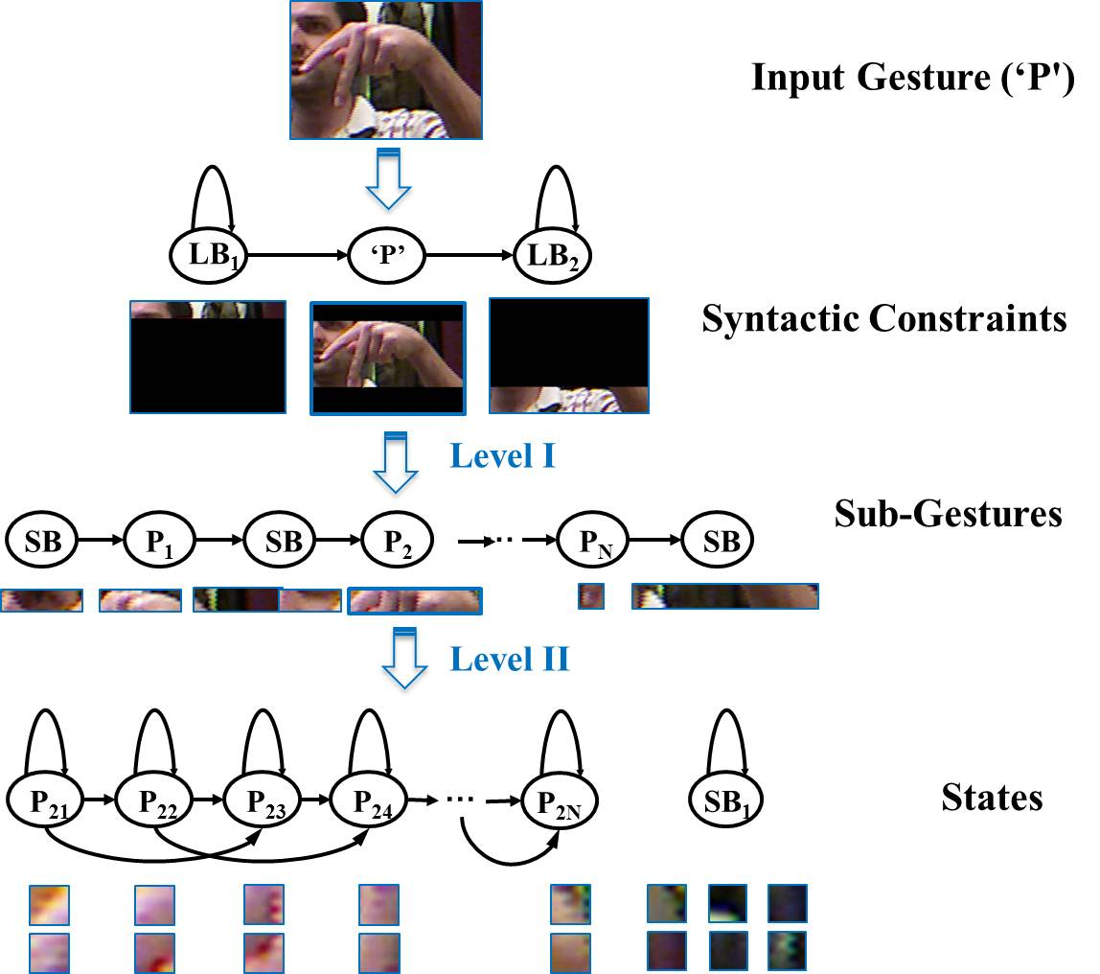
Case Study: Fingerspelling Recognition

Slide 5
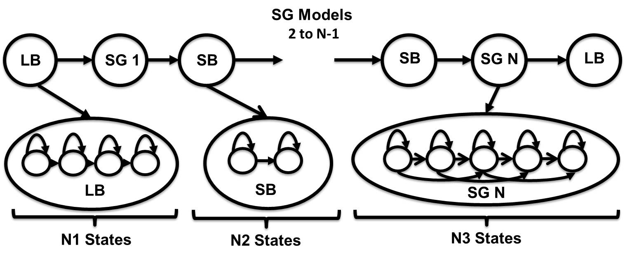
Case Study: Fingerspelling Recognition

Slide 6
Summary
Hidden Markov Model: a directed graph in which nodes, or states, represent output (emission) distributions and arcs represent transitions between these nodes. Emission distributions can be discrete or continuous.
Continuous Density Hidden Markov Models (CDHMM): the most popular form of HMMs for many signal processing problems. Gaussian mixture distributions are commonly used (weighted sum of Gaussian pdfs).
Subproblems: Practical implementations of HMMs require computationally efficient solutions to:
Evaluation: computing the probability that we arrive in a state a time t and produce a particular observation at that state.
Decoding: finding the path through the network with the highest likelihood (e.g., best path).
Learning: estimating the parameters of the model from data.
The EM algorithm plays an important role in learning because it proves the model will converge if trained iteratively.
There are many generalizations of HMMs including Bayesian networks, deep belief networks and finite state automata.
HMMs are very effective at modeling data that has a sequential structure.

