Slide 1
LECTURE 10: PRINCIPAL COMPONENTS ANALYSIS
• Objectives: Mean-Square Error Objective Function Projection Operator Whitening Transformation Class-Independent PCA Class-Dependent PCA Examples
Resources:
D.H.S.: Chapter 3 (Part 2) JL: Layman’s Explanation QT: PCA Introduction JP: Speech Processing KF: Fukunaga, Pattern Recognition

Slide 2
Component Analysis
Component analysis is a technique that combines features to reduce the dimension of the feature space.
It can also be the basis for a classification algorithm.
Features of this approach include:
Statistical decorrelation of the data.
Linear combinations are simple to compute and tractable.
Project a high dimensional space onto a lower dimensional space.
Gain insight into the relative importance of each feature.
Three classical approaches for finding the optimal transformation:
Principal Components Analysis (PCA): projection that best represents the data in a least-square sense.
Multiple Discriminant Analysis (MDA): projection that best separates the data in a least-squares sense.
Independent Component Analysis (IDA): projection that minimizes the mutual information of the components.

Slide 3
Principal Component Analysis
Consider representing a set of n d-dimensional samples x₁,…,x_{n} by a single vector, x₀.
Define a squared-error criterion:
The solution to this problem is given by:
The sample mean is a zero-dimensional representation of the data set.
Consider a one-dimensional solution:
In other words, the best one-dimensional projection of the data (in the least mean-squared error sense) is the projection of the data onto a line through the sample mean in the direction of the eigenvector of the scatter matrix having the largest eigenvalue (hence the name Principal Component).
For the Gaussian case, the eigenvectors are the principal axes of the hyperellipsoidally shaped support region!

Slide 4
Alternate View: Coordinate Transformations
Why is it convenient to convert an arbitrary distribution into a spherical one? (Hint: Euclidean distance)
Consider the transformation: A_{w}= Φ Λ^{-1/2}
where Φ is the matrix whose columns are the orthonormal eigenvectors of Σ and Λ is a diagonal matrix of eigenvalues (Σ= Φ Λ Φ^{t}). Note that Φ is unitary.
What is the covariance of y=A_{w}x?
E[yy^{t}] = (A_{w}x)(A_{w}x)^{t} =(Φ Λ^{-1/2}x) (Φ Λ^{-1/2}x)^{t}
= Φ Λ^{-1/2}x x^{t} Λ^{-1/2} Φ^{t} = Φ Λ^{-1/2} Σ Λ^{-1/2} Φ^{t}
= Φ Λ^{-1/2} Φ Λ Φ^{t} Λ^{-1/2} Φ^{t}
= (Φ Φ^{t}) (Λ^{-1/2} Λ Λ^{-1/2} )(ΦΦ^{t})
= I
Why is this significant?

Slide 5
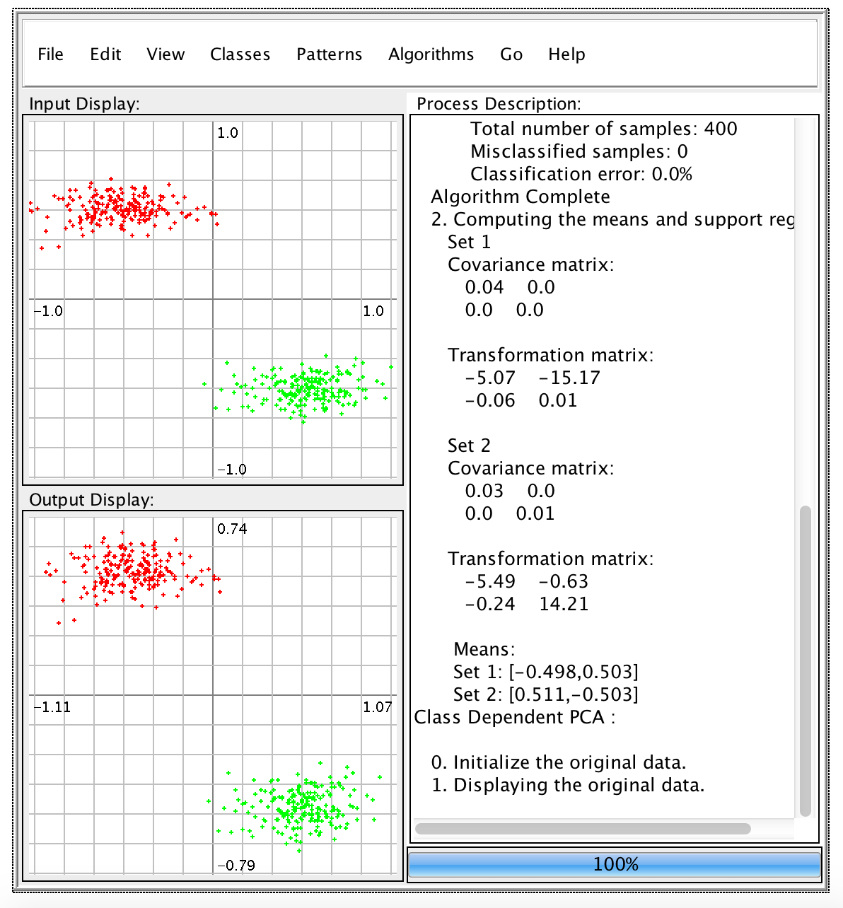
Examples of Maximum Likelihood Classification
For the Gaussian case, the eigenvectors are the principal axes of the hyperellipsoidally shaped support region!
Let’s work some examples (class-independent and class-dependent PCA).
In class-independent PCA, a global covariance matrix is computed:
In this case, the covariance will be an ellipsoid.
The first principal component will be the major axis of this ellipsoid.
The second principal component will be the minor axis.
In class-dependent PCA, which requires labeled training data, transformations are computed independently for each class.
The ML decision surface is a line (or a parabola in this case).

Slide 6
Summary
Introduction of PCA as a whitening transformation.
Demonstration of class-dependent vs. class-independent.
Note that the eigenvectors of the covariance matrix provide insight into your features (since the eigenvectors represent a weighted sum of your features).
The eigenvalues provide insight into the proportion of the variance explained by each eigenvector (ratio of an eigenvalue to the sum of the eigenvalues).

