Slide 1
Deep Learning
Early Work
Why Deep Learning
Stacked Auto Encoders
Deep Belief Networks

Slide 2
Deep Learning Overview
Train networks with many layers (vs. shallow nets with just a couple of layers)
Multiple layers work to build an improved feature space
First layer learns 1st order features (e.g. edges…)
2nd layer learns higher order features (combinations of first layer features, combinations of edges, etc.)
In current models layers often learn in an unsupervised mode and discover general features of the input space – serving multiple tasks related to the unsupervised instances (image recognition, etc.)
Then final layer features are fed into supervised layer(s)
And entire network is often subsequently tuned using supervised training of the entire net, using the initial weightings learned in the unsupervised phase
Could also do fully supervised versions, etc. (early BP attempts)

Slide 3
Deep Learning Tasks
Usually best when input space is locally structured – spatial or temporal: images, language, etc. vs arbitrary input features
Images Example: view of vision layer (Basis)

Slide 4
Why Deep Learning
Biological Plausibility – e.g. Visual Cortex
Hastad proof - Problems which can be represented with a polynomial number of nodes with k layers, may require an exponential number of nodes with k-1 layers (e.g. parity)
Highly varying functions can be efficiently represented with deep architectures
Less weights/parameters to update than a less efficient shallow representation
Sub-features created in deep architecture can potentially be shared between multiple tasks
Type of Transfer/Multi-task learning

Slide 5
Early Work
Fukushima (1980) – Neo-Cognitron
LeCun (1998) – Convolutional Neural Networks
Similarities to Neo-Cognitron
Many layered MLP with backpropagation
Tried early but without much success
Very slow
Diffusion of gradient
Very recent work has shown significant accuracy improvements by "patiently" training deeper MLPs with BP using fast machines (GPUs)
We will focus on deep networks with unsupervised early layers

Slide 6
Convolutional Neural Networks
Convolution Example
Each layer combines (merges, smoothes) patches from previous layers
Typically tries to compress large data (images) into a smaller set of robust features
Basic convolution can still create many features
Pooling – Pooling Example
This step compresses and smoothes the data
Usually takes the average or max value across disjoint patches
Often convolution filters and pooling are hand crafted – not learned, though tuning can occur
After this hand-crafted/non-trained/partial-trained convolving the new set of features are used to train a supervised model
Requires neighborhood regularities in the input space (e.g. images, stationary property)
Natural images have the property of being stationary, meaning that the statistics of one part of the image are the same as any other part
Notes:
http://ufldl.stanford.edu/wiki/index.php/UFLDL_Tutorial
http://ufldl.stanford.edu/wiki/images/6/6c/Convolution_schematic.gif – adds corners and itself
http://ufldl.stanford.edu/wiki/images/0/08/Pooling_schematic.gif - average/max ??

Slide 7
Convolutional Neural Network Examples
C layers are convolutions, S layers pool/sample

Slide 8
Training Deep Networks
Build a feature space
Note that this is what we do with SVM kernels, or trained hidden layers in BP, etc., but now we will build the feature space using deep architectures
Unsupervised training between layers can decompose the problem into distributed sub-problems (with higher levels of abstraction) to be further decomposed at subsequent layers

Slide 9
Training Deep Networks
Difficulties of supervised training of deep networks
Early layers of MLP do not get trained well
Diffusion of Gradient – error attenuates as it propagates to earlier layers
Leads to very slow training
Exacerbated since top couple layers can usually learn any task "pretty well" and thus the error to earlier layers drops quickly as the top layers "mostly" solve the task– lower layers never get the opportunity to use their capacity to improve results, they just do a random feature map
Need a way for early layers to do effective work
Often not enough labeled data available while there may be lots of unlabeled data
Can we use unsupervised/semi-supervised approaches to take advantage of the unlabeled data
Deep networks tend to have more local minima problems than shallow networks during supervised training

Slide 10
Greedy Layer-Wise Training
One answer is greedy layer-wise training
Train first layer using your data without the labels (unsupervised)
Since there are no targets at this level, labels don't help. Could also use the more abundant unlabeled data which is not part of the training set (i.e. self-taught learning).
Then freeze the first layer parameters and start training the second layer using the output of the first layer as the unsupervised input to the second layer
Repeat this for as many layers as desired
This builds our set of robust features
Use the outputs of the final layer as inputs to a supervised layer/model and train the last supervised layer(s) (leave early weights frozen)
Unfreeze all weights and fine tune the full network by training with a supervised approach, given the pre-processed weight settings
Notes:
If do supervised, we may not bet the benefits of building up the incrementally abstracted feature space

Slide 11
Greedy Layer-Wise Training
Greedy layer-wise training avoids many of the problems of trying to train a deep net in a supervised fashion
Each layer gets full learning focus in its turn since it is the only current "top" layer
Can take advantage of the unlabeled data
When you finally tune the entire network with supervised training the network weights have already been adjusted so that you are in a good error basin and just need fine tuning. This helps with problems of
Ineffective early layer learning
Deep network local minima
We will discuss the two most common approaches
Stacked Auto-Encoders
Deep Belief Networks

Slide 12
Self Taught vs Unsupervised Learning
When using Unsupervised Learning as a pre-processor to supervised learning you are typically given examples from the same distribution as the later supervised instances will come
Assume the distribution comes from a set containing just examples from a defined set up possible output classes, but the label is not available (e.g. images of car vs trains vs motorcycles)
In Self-Taught Learning we do not require that the later supervised instances come from the same distribution
e.g., Do self-taught learning with any images, even though later you will do supervised learning with just cars, trains and motorcycles.
These types of distributions are more readily available than ones which just have the classes of interest
However, if distributions are very different…
New tasks share concepts/features from existing data and statistical regularities in the input distribution that many tasks can benefit from
Note similarities to supervised multi-task and transfer learning
Both approaches reasonable in deep learning models

Slide 13
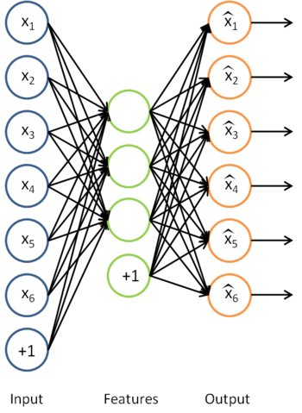
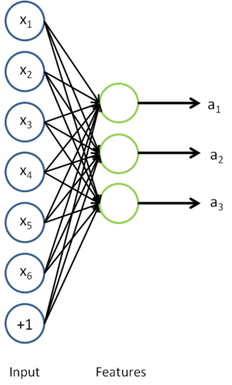
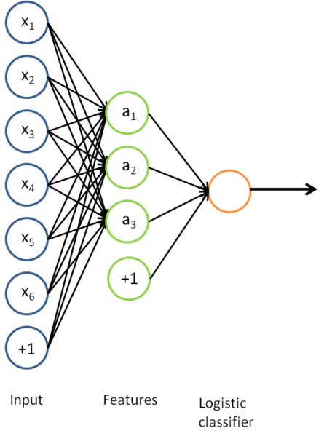
Auto-Encoders
A type of unsupervised learning which tries to discover generic features of the data
Learn identity function by learning important sub-features (not by just passing through data)
Compression, etc.
Can use just new features in the new training set or concatenate both
Notes:
Mention Zipser auotencoder with reverse engineering, then Cottrell compression where unable to reverse engineer
Point out that don't have to have less hidden nodes in the next layer, but careful, if train too long, will just learn to pass through, more on that in a bit

Slide 14
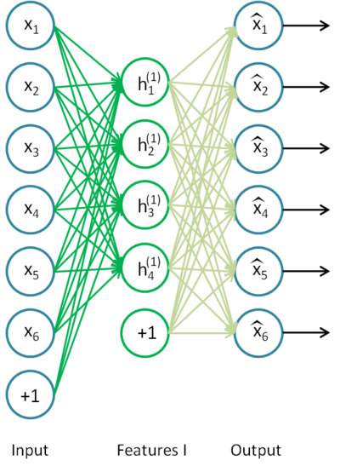
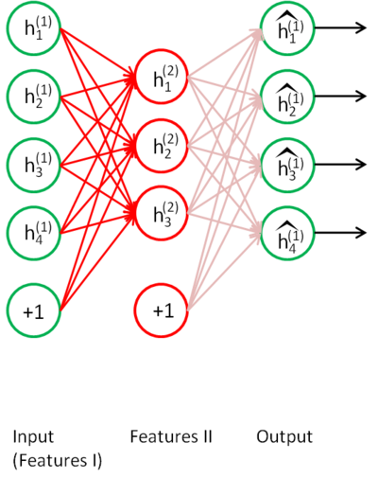
Stacked Auto-Encoders
Bengio (2007) – After Deep Belief Networks (2006)
Stack many (sparse) auto-encoders in succession and train them using greedy layer-wise training
Drop the decode output layer each time

Slide 15
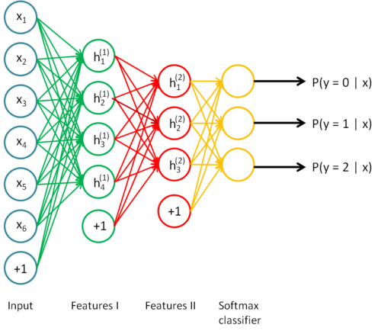
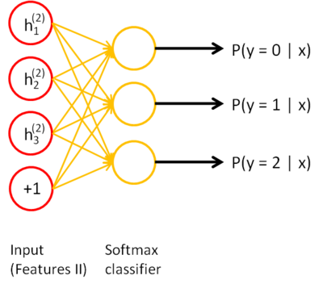
Stacked Auto-Encoders
Do supervised training on the last layer using final features
Then do supervised training on the entire network to fine- tune all weights
Notes:
Shows softmax, but could use BP or any other variation

Slide 16
Sparse Encoders
Auto encoders will often do a dimensionality reduction
PCA-like or non-linear dimensionality reduction
This leads to a "dense" representation which is nice in terms of parsimony
All features typically have non-zero values for any input and the combination of values contains the compressed information
However, this distributed and entangled representation can often make it more difficult for successive layers to pick out the salient features
A sparse representation uses more features where at any given time a significant number of the features will have a 0 value
This leads to more localist variable length encodings where a particular node (or small group of nodes) with value 1 signifies the presence of a feature (small set of bases)
A type of simplicity bottleneck (regularizer)
This is easier for subsequent layers to use for learning

Slide 17
How do we implement a sparse Auto-Encoder?
Use more hidden nodes in the encoder
Use regularization techniques which encourage sparseness (e.g. a significant portion of nodes have 0 output for any given input)
Penalty in the learning function for non-zero nodes
Weight decay
etc.
De-noising Auto-Encoder
Stochastically corrupt training instance each time, but still train auto-encoder to decode the uncorrupted instance, forcing it to learn conditional dependencies within the instance
Better empirical results, handles missing values well
Notes:
And make sure it doesn't just learn the pass through identity

Slide 18
Sparse Representation
For bases below, which is easier to see intuition for current pattern - if a few of these are on and the rest 0, or if all have some non-zero value?
Machines can learn more easily if sparse

Slide 19
Stacked Auto-Encoders
Concatenation approach (i.e. using both hidden features and original features in final (or other) layers) can be better if not doing fine tuning. If fine tuning, the pure replacement approach can work well.
Always fine tune if there is a sufficient amount of labeled data
Stacked Auto-Encoders empirically not quite as accurate as DBNs (Deep Belief Networks)
(with De-noising auto-encoders, stacked auto-encoders competitive with DBNs)
Not generative like DBNs, though recent work with de-noising auto-encoders may allow generative capacity

Slide 20
Deep Belief Networks (DBN)
Geoff Hinton (2006)
Uses Greedy layer-wise training but each layer is an RBM (Restricted Boltzmann Machine)
RBM is a constrained
Boltzmann machine with
No lateral connections between
hidden (h) and visible (x) nodes
Symmetric weights
Does not use annealing/temperature, but that is all right since each RBM not seeking a global minima, but rather an incremental transformation of the feature space
Typically uses probabilistic logistic node, but other activations possible
Notes:
Remember Hinton was also the Boltzmann guy

Slide 21
RBM Sampling and Training
Initial state typically set to a training
example x (can be real valued)
Sampling is an iterative back and forth process
P(h_{i} = 1|x) = sigmoid(W_{i}x + c_{i}) = 1/(1+e^{-net(hi)}) // c_{i} is hidden node bias
P(x_{i} = 1|h) = sigmoid(W'_{i}h + b_{i}) = 1/(1+e^{-net(xi)}) // b_{i} is visible node bias
Contrastive Divergence (CD-k): How much contrast (in the statistical distribution) is there in the divergence from the original training example to the relaxed version after k relaxation steps
Then update weights to decrease the divergence as in Boltzmann
Typically just do CD-1 (Good empirical results)
Since small learning rate, doing many of these is similar to doing fewer versions of CD-k with k > 1
Note CD-1 just needs to get the gradient direction right, which it usually does, and then change weights in that direction according to the learning rate
Notes:
Since x starts as a training example, after a bit of training, it should already be close to/in an energy well

Slide 22
Notes:
Q and P are probability distribution vectors, for hidden(h) and visible/input (x) vectors respectively
Do a small example on the board, at least one x value real and not all same weights (set it up like HW)
Why back to Q?, need a p1, q1, p2. q2 then can update
Note W update based on when they are both simultaneously on as in standard Boltzmann If h1 and x1 both 1 then weight change >= 0, else <=0, if x2 = 0, then no weight change, else change by c*Q(h2), real or sampled
Delta w works both ways for h and x. Delta w = initial product of x1 and h1 – final product of xk and Qk)
binomial is standard MLP sigmoid unit

Slide 23
RBM Update Notes and Variations
Binomial unit is standard MLP sigmoid unit
Q and P are probability distribution vectors for hidden (h) and visible/input (x) vectors respectively
During relaxation/weight update can alternatively do updates based on the real valued probabilities (sigmoid(net)) rather than the 1/0 sampled logistic states
Always use binary values from initial x -> h
Doing this makes the hidden nodes a sparser bottleneck and is a regularizer helping to avoid overfit
Could use probabilities on the h -> x and/or final x -> h
in CD-k the final update of the hidden nodes can use the probability value to decrease the final arbitrary sampling variation (sampling noise)
Lateral restrictions of RBM allow this fast sampling
Notes:
No lateral – allows set up and back passes
Optional: Persistent MCMC for free (negative) phase – Just keep sampling from a long-term chain (ignoring the weight updates)
trade-off long term chain accuracy vs updated weights
Early sampling can be a type of de-noise which could aid sparseness

Slide 24
RBM Update Variations and Notes
Initial weights, small random, 0 mean, sd ~ .01
Don't want hidden node probabilities early on to be close to 0 or 1, else slows learning, since less early randomness/mixing? Note that this is a bit like annealing/temperature in Boltzmann
Set initial x bias values as a function of how often node is on in the training data, and h biases to 0 or negative to encourage sparsity
Better speed when using momentum (~.5)
Weight decay good for smoothing and also encouraging more mixing (hidden nodes more stochastic when they do not have large net magnitudes)
Also a reason to increase k over time in CD-k as mixing decreases as weight magnitudes increase

Slide 25
Deep Belief Network Training
Same greedy layer-wise approach
First train lowest RBM (h⁰ – h¹) using RBM update algorithm (note h⁰ is x)
Freeze weights and train subsequent RBM layers
Then connect final outputs to a supervised model and train that model
Finally, unfreeze all weights, and train full DBN with supervised model to fine-tune weights
During execution typically iterate multiple times at the top RBM layer
Notes:
Picture above is for generative model (so ignore solid vs dotted lines at this point

Slide 26
Can use DBN as a Generative model to create sample x vectors
Initialize top layer to an arbitrary vector
Gibbs sample (relaxation) between the top two layers m times
If we initialize top layer with values obtained from a training example, then need less Gibbs samples
Pass the vector down through the network, sampling with the calculated probabilities at each layer
Last sample at bottom is the generated x value (can be real valued if we use the probability vector rather than sample)
Alternatively, can start with an x at the bottom, relax to a top value, then start from that vector when generating a new x, which is the dotted lines version. More like standard Boltzmann machine processing.
Notes:
Alternatively, Can start with an x at bottom, relax to a top value, then start from that vector when generating a new x, which is the dotted lines added version

Slide 27
Notes:
Initial x can be real valued
Note that nodes have two sets of biases. Only one is used at a time depending on if node is visible or hidden for that layer
While loop does RBM weight training until convergence for the kth layer
second for loop samples from x up to k-1 so that we can then do RBM update at the kth layer
Mean_field_computation just a flag on whether we sample or use the real values – Lots of wiggle room here, could do it different for different layers or even randomly, etc.

Slide 28
DBN Learning Notes
Each layer updates weights so as to make training sample patterns more likely (lower energy) in the free state (and non-training sample patterns less likely).
This unsupervised approach learns broad features (in the hidden/subsequent layers of RBMs) which can aid in the process of making the types of patterns found in the training set more likely. This discovers features which can be associated across training patterns, and thus potentially helpful for other goals with the training set (classification, compression, etc.)
Note still pairwise weights in RBMs, but because we can pick the number of hidden units and layers, we can represent any arbitrary distribution

Slide 29
DBN Notes
Can use lateral connections in RBM (no longer RBM) but sampling becomes more difficult – ala standard Boltzmann requiring longer sampling chains.
Lateral connections can capture pairwise dependencies allowing the hidden nodes to focus on higher order issues. Can get better results.
Deep Boltzmann machine – Allow continual relaxation across the full network
Receive input from above and below rather than sequence through RBM layers
Typically for successful training, first initialize weights using the standard greedy DBN training with RBM layers
Requires longer sampling chains ala Boltzmann
Conditional and Temporal RBMs – allow node probabilities to be conditioned by some other inputs – context, recurrence (time series changes in input and internal state), etc.

Slide 30
Discrimination with Deep Networks
Discrimination approaches with DBNs (Deep Belief Net)
Use outputs of DBNs as inputs to supervised model (i.e. just an unsupervised preprocessor for feature extraction)
Basic approach we have been discussing
Train a DBN for each class. For each clamp the unknown x and iterate m times. The DBN that ends with the lowest normalized free energy (softmax variation) is the winner.
Train just one DBN for all classes, but with an additional visible unit for each class. For each output class:
Clamp the unknown x, initiate the visible node for that class high, relax, and then see which final state has lowest free energy – no need to normalize since all energies come from the same network.
Or could just clamp x, relax, and see which class node ends up with the highest probability
See http://deeplearning.net/demos/
Notes:
The Demo shows generated instance first with just one iteration from the top RBN. In practice would not do bottom generation until after m iterations. (i.e. after top has settled into a lower energy state)
Should improve in the discrimination variation also after m steps, though seems to get good results sooner
Using Hinton's generating digits demo

Slide 31
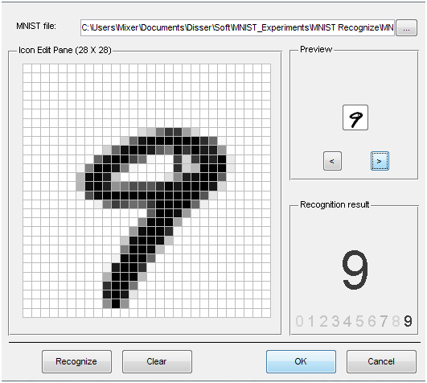
MNIST
Notes:
Go to project page
Mnist 28x28 (784) grey scale (0-255) values.
Could do some smarter preprocessing of features!
Just use straight data as our baseline.

Slide 32
DBN Project Notes
To be consistent just use 28×28 (764) data set of gray scale values (0-255)
Normalize to 0-1
Could try better preprocessing if want, but start with this
Small random initial weights
Last year only slight improvements over baseline MLP (which gets high 90's)
Best results when using real net values vs. sampling
Fine tuning helps
Parameters
Hinton Paper, others – do a little searching and e-mail me a reference for extra credit points
Still figuring out

Slide 33
Conclusion
Much recent excitement, still much to be discovered
Biological Plausibility
Potential for significant improvements
Good in structured/Markovian spaces
Important research question: To what extent can we use Deep Learning in more arbitrary feature spaces?
Recent deep training of MLPs with BP shows potential in this area

