Slide 1
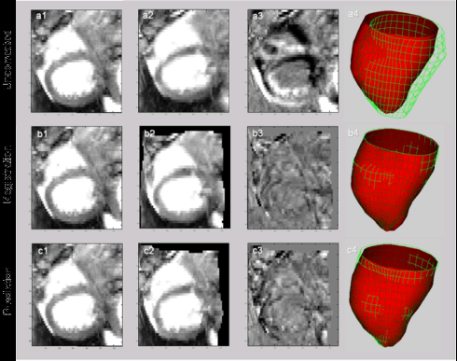
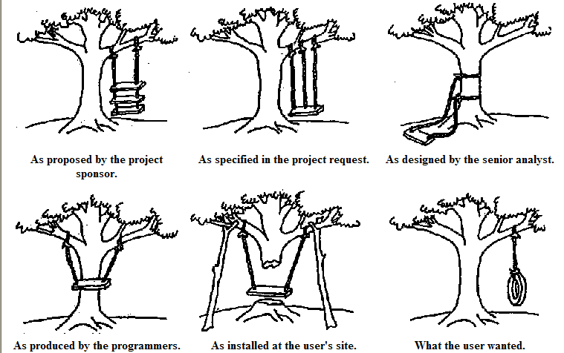
LECTURE 19: FOUNDATIONS OF MACHINE LEARNING
Objectives: Occam’s Razor No Free Lunch Theorem Minimum Description Length Bias and Variance Jackknife Bootstrap
Resources: WIKI: Occam's Razor CSCG: MDL On the Web MS: No Free Lunch TGD: Bias and Variance CD: Jackknife Error Estimates KT: Bootstrap Sampling Tutorial
URL:
Audio:
Notes:
MS Equation 3.0 was used with settings of: 18, 12, 8, 18, 12.

Slide 2
Introduction
With such a wide variety of algorithms to choose from, which one is best?
Are there any reasons to prefer one algorithm over another?
Occam’s Razor: if performance of two algorithms on the same training data is the same, choose the simpler algorithm.
Do simpler or smoother classifiers generalize better?
In some fields, basic laws of physics or nature, such as conservation of energy, provide insight. Are there analogous concepts in machine learning?
The Bayes Error Rate is one such example. But this is mainly of theoretical interest and is rarely, if ever, known in practice. Why?
In this section of the course, we seek mathematical foundations that are independent of a particular classifier or algorithm.
We will discuss techniques, such as jackknifing or cross-validation, that can be applied to any algorithm.
No pattern classification method is inherently superior to any other. It is the type of problem, prior distributions and other application-specific information that determine which algorithm is best.
Can we develop techniques or design guidelines to match an algorithm to an application and to predict its performance?
Can we combine classifiers to get better performance?

Slide 3
Probabilistic Models of Learning
If one algorithm outperforms another, it is a consequence of its fit to the particular problem, not the general superiority of the algorithm.
Thus far, we have estimated performance using a test data set which is sampled independently from the problem space. This approach has many pitfalls, since it is hard to avoid overlap between the training and test sets.
We have learned about methods that can drive the error rate to zero on the training set. Hence, using held-out data is important.
Consider a two-category problem where the training set, D, consists of patterns, x^{i}, and associated category labels, y_{i} = ±1, for i=1,…n, generated by the unknown target function to be learned, F(x), where y_{i} = F(x^{i}).
Let H denote a discrete set of hypotheses or a possible set of parameters to be learned. Let h(x) denote a particular set of parameters, h(x) ∈ H.
Let P(h) be the prior probability that the algorithm will produce h after training.
Let P(h|D) denote the probability that the algorithm will produce h when training on D.
Let E be the error for a zero-one or other loss function.
Where have we seen this before? (Hint: Relevance Vector Machines)

Slide 4
No Free Lunch Theorem
A natural measure of generalization is the expected value of the error given D:
where δ() denotes the Kronecker delta function (value of 1 if the two arguments match, a value of zero otherwise).
The expected off-training set classification error when the true function F(x) and the probability for the kth candidate learning algorithm is P_{k}(h(x)|D) is:
No Free Lunch Theorem: For any two learning algorithms P₁(h|D) and P₂(h|D), the following are true independent of the sampling distribution P(x) and the number of training points:
Uniformly averaged over all target functions, F, E₁(E|F,n) – E₂(E|F,n) = 0.
For any fixed training set D, uniformly averaged over F, E₁(E|F,n) – E₂(E|F,n) = 0.
Uniformly averaged over all priors P(F), E₁(E|F,n) – E₂(E|F,n) = 0.
For any fixed training set D, uniformly averaged over P(F), E₁(E|F,n) – E₂(E|F,n) = 0.

Slide 5
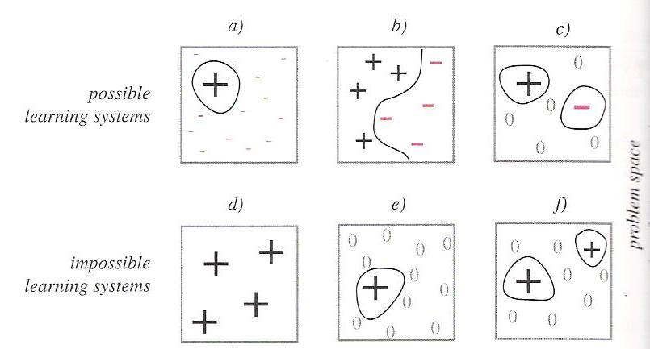
Analysis
The first proposition states that uniformly averaged over all target functions the expected test set error for all learning algorithms is the same:
Stated more generally, there are no i and j such that for all F(x), E_{i}(E|F,n) > E_{j}(E|F,n).
Further, no matter what algorithm we use, there is at least one target function for which random guessing Is better.
The second proposition states that even if we know D, then averaged over all target functions, no learning algorithm yields a test set error that is superior to any other:
The six squares represent all possible classification problems. If a learning system performs well over some set of problems (better than average), it must perform worse than average elsewhere.

Slide 6
Algorithmic Complexity
Can we find some irreducible representation of all members of a category?
Algorithmic complexity, also known as Kolmogorov complexity, seeks to measure the inherent complexity of a binary string.
If the sender and receiver agree on a mapping, or compression technique, the pattern x can be transmitted as y and recovered as x=L(y).
The cost of transmission is the length of y, |y|.
The least such cost is the minimum length and denoted:
A universal description should be independent of the specification (e.g., the programming language or machine assembly language).
The Kolmogorov complexity of a binary string x, denoted K(x), is defined as the size of the shortest program string y, that, without additional data, computes the string x:
where U represents an abstract universal Turing machine.
Consider a string of n 1s. If our machine is a loop that prints 1s, we only need log₂n bits to specify the number of iterations. Hence, K(x) = O(log₂n).

Slide 7
Minimum Description Length (MDL)
We seek to design a classifier that minimizes the sum of the model’s algorithmic complexity and the description of the training data, D, with respect to that model:
Examples of MDL include:
Measuring the complexity of a decision tree in terms of the number of nodes.
Measuring the complexity of an HMM in terms of the number of states.
We can view MDL from a Bayesian perspective:
The optimal hypothesis, h*, is the one yielding the highest posterior:
Shannon’s optimal coding theorem provides a link between MDL and Bayesian methods by stating that the lower bound on the cost of transmitting a string x is proportional to log₂P(x).

Slide 8
Bias and Variance
Two ways to measure the match of alignment of the learning algorithm to the classification problem involve the bias and variance.
Bias measures the accuracy in terms of the distance from the true value of a parameter – high bias implies a poor match.
Variance measures the precision of a match in terms of the squared distance from the true value – high variance implies a weak match.
For mean-square error, bias and variance are related.
Consider these in the context of modeling data using regression analysis. Suppose there is an unknown function F(x) which we seek to estimate based on n samples in a set D drawn from F(x).
The regression function will be denoted g(x;D). The mean square error of this estimate is (see lecture 5, slide 12):
The first term is the bias and the second term is the variance.
This is known as the bias-variance tradeoff since more flexible classifiers tend to have lower bias but higher variance.

Slide 9
Bias and Variance For Classification
Consider our two-category classification problem:
Consider a discriminant function:
Where ε is a zero-mean random variable with a binomial distribution with variance:
The target function can be expressed as .
Our goal is to minimize .
Assuming equal priors, the classification error rate can be shown to be:
where y_{B} is the Bayes discriminant (1/2 in the case of equal priors).
The key point here is that the classification error is linearly proportional to , which can be considered a boundary error in that it represents the incorrect estimation of the optimal (Bayes) boundary.

Slide 10
Bias and Variance For Classification (Cont.)
If we assume p(g(x;D)) is a Gaussian distribution, we can compute this error by integrating the tails of the distribution (see the derivation of P(E) in Chapter 2). We can show:
The key point here is that the first term in the argument is the boundary bias and the second term is the variance.
Hence, we see that the bias and variance are related in a nonlinear manner.
For classification the relationship is multiplicative. Typically, variance dominates bias and hence classifiers are designed to minimize variance.
See Fig. 9.5 in the textbook for an example of how bias and variance interact for a two-category problem.

Slide 11
Resampling For Estimating Statistics
How can we estimate the bias and variance from real data?
Suppose we have a set D of n data points, x_{i} for i=1,…,n.
The estimates of the mean/sample variance are:
Suppose we wanted to estimate other statistics, such as the median or mode. There is no straightforward way to measure the error.
Jackknife and Bootstrap techniques are two of the most popular resampling techniques to estimate such statistics.
Use the “leave-one-out” method:
This is just the sample average if the ith point is deleted.
The jackknife estimate of the mean is defined as:
The variance of this estimate is:
The benefit of this expression is that it can be applied to any statistic.

Slide 12
Jackknife Bias and Variance Estimates
We can write a general estimate for the bias as:
The jackknife method can be used to estimate this bias. The procedure is to delete points x_{i} one at a time from D and then compute: .
The jackknife estimate is:
We can rearrange terms:
This is an unbiased estimate of the bias.
Recall the traditional variance:
The jackknife estimate of the variance is:
This same strategy can be applied to estimation of other statistics.

Slide 13
Bootstrap
A bootstrap data set is one created by randomly selecting n points from the training set D, with replacement.
In bootstrap estimation, this selection process is repeated B times to yield B bootstrap data sets, which are treated as independent sets.
The bootstrap estimate of a statistic, , is denoted and is merely the mean of the B estimates on the individual bootstrap data sets:
The bootstrap estimate of the bias is:
The bootstrap estimate of the variance is:
The bootstrap estimate of the variance of the mean can be shown to approach the traditional variance of the mean as .
The larger the number of bootstrap samples, the better the estimate.

Slide 14
Summary
Discussed some foundations of machine learning that are common to many algorithms.
Introduced the No Free Lunch Theorem.
Introduced Minimum Description Length.
Discussed bias and variance using regression as an example.
Introduced a class of methods based on resampling to estimate statistics.
Introduced the Jackknife and Bootstrap methods.
Next: Introduce similar techniques for classifier design.

