Slide 1
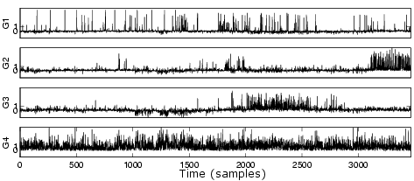
LECTURE 10: Heteroscedastic Linear Discriminant Analysis and Independent Component Analysis
• Objectives: Generalization of LDA Log-Likelihood Distance Measures Information Theoretic Approaches Independent Component Analysis Examples
Resources: D.H.S.: Chapter 3 (Part 2) N.K.: HLDA P.S.: ICA Resources
URL:
Audio:

Slide 2
Linear Discriminant Analysis (Review)
Linear Discriminant Analysis (LDA) seeks to find the transformation:
that maximizes separation between the classes. This is done by maximizing a ratio of the between-class scatter and the within-class scatter:
The solution to this maximization is found by performing an eigenvalue analysis:
which produces a matrix, W, that is of dimension (c-1) rows x d columns.
Recall, however, that there was an implicit assumption of “equal covariances” – all classes had the same covariance structure:
Is there an approach that frees us from this constraint? At what cost?

Slide 3
Heteroscedastic Linear Discriminant Analysis (HLDA)
Heteroscedastic: when random variables have different variances.
When might we observe heteroscedasticity?
Suppose 100 students enroll in a typing class — some of which have typing experience and some of which do not.
After the first class there would be a great deal of dispersion in the number of typing mistakes.
After the final class the dispersion would be smaller.
The error variance is non-constant — it decreases as time increases.
An example is shown to the right. The two classes have nearly the same mean, but different variances, and the variances differ in one direction.
LDA would project these classes onto a line that does not achieve maximal separation.
HLDA seeks a transform that will account for the unequal variances.
HLDA is typically useful when classes have significant overlap.

Slide 4
Partitioning Our Parameter Vector
Let W be partitioned into the first p columns corresponding to the dimensions we retain, and the remaining d-p columns corresponding to the dimensions we discard.
Then the dimensionality reduction problem can be viewed in two steps:
A non-singular transform is applied to x to transform the features, and
A dimensionality reduction is performed where reduce the output of this linear transformation, y, to a reduced dimension vector, y_{p}.
Let us partition the mean and variances as follows:
where is common to all terms and are different for each class.

Slide 5
Density and Likelihood Functions
The density function of a data point under the model, assuming a Gaussian model (as we did with PCA and LDA), is given by:
where is an indicator function for the class assignment for each data point. (This simply represents the density function for the transformed data.)
The log likelihood function is given by:
Differentiating the likelihood with respect to the unknown means and variances gives:

Slide 6
Optimal Solution
Substituting the optimal values into the likelihood equation, and then maximizing with respect to θ gives:
These equations do not have a closed-form solution. For the general case, we must solve them iteratively using a gradient descent algorithm and a two-step process in which we estimate means and variances from θ and then estimate the optimal value of θ from the means and variances.
Simplifications exist for diagonal and equal covariances, but the benefits of the algorithm seem to diminish in these cases.
To classify data, one must compute the log-likelihood distance from each class and then assign the class based on the maximum likelihood.
Let’s work some examples (class-dependent PCA, LDA and HLDA).
HLDA training is significantly more expensive than PCA or LDA, but classification is of the same complexity as PCA and LDA because this is still essentially a linear transformation plus a Mahalanobis distance computation.

Slide 7
Independent Component Analysis (ICA)
Goal is to discover underlying structure in a signal.
Originally gained popularity for applications in blind source separation (BSS), the process of extracting one or more unknown signals from noise (e.g., cocktail party effect).
Most often applied to time series analysis though it can also be used for traditional pattern recognition problems.
Define a signal as a sum of statistically independent signals:
If we can estimate A, then we can compute s by inverting A:
This is the basic principle of blind deconvolution or BSS.
The unique aspect of ICA is that it attempts to model x as a sum of statistically independent non-Gaussian signals. Why?

Slide 8
Objective Function
Unlike mean square error approaches, ICA attempts to optimize the parameters of the model based on a variety of information theoretic measures:
Mutual information:
Negentropy:
Maximum likelihood:
Mutual information and Negentropy are related by:
It is common in ICA to zero mean and prewhiten the data (using PCA) so that the technique can focus on the non-Gaussian aspects of the data. Since these are linear operations, they do not impact the non-Gaussian aspects of the model.
There are no closed form solutions for the problem described above, and a gradient descent approach must be used to find the model parameters. We will need to develop more powerful mathematics to do this (e.g., the Expectation Maximization algorithm).

Slide 9
FastICA
One very popular algorithm for ICA is based on finding a projection of x that maximizes non-Gaussianity.
Define an approximation to Negentropy:
Use an iterative equation solver to find the weight vector, w:
Choose an initial random guess for w.
Compute:
Let:
If the direction of w changes, iterate.
Later in the course we will see many iterative algorithms of this form, and formally derive their properties.
FastICA is very similar to a gradient descent solution of the maximum likelihood equations.
ICA has been successfully applied to a wide variety of BSS problems including audio, EEG, and financial data.

Slide 10
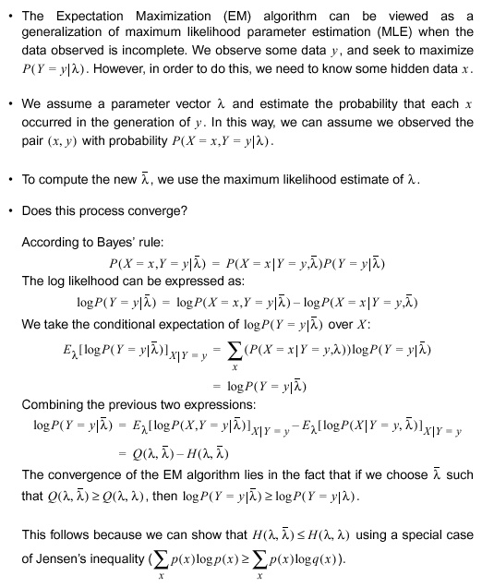
The Expectation Maximization Algorithm (Preview)

Slide 11
The Expectation Maximization Algorithm (Cont.)

Slide 12
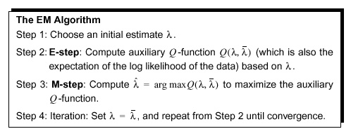
The Expectation Maximization Algorithm

Slide 13
Summary
Introduced alternatives to PCA and LDA:
Heteroscedastic LDA: LDA for classes with unequal covariances
Introduced alternatives to mean square error approaches:
Independent Component Analysis: probabilistic approaches that attempt to uncover hidden structure or deal with non-Gaussian data
Many other forms of PCA-like algorithms exist that are based on kernels (kPCA). See Risk Minimization for more details.
Introduced the Expectation Maximization (EM) algorithm.

