Slide 1
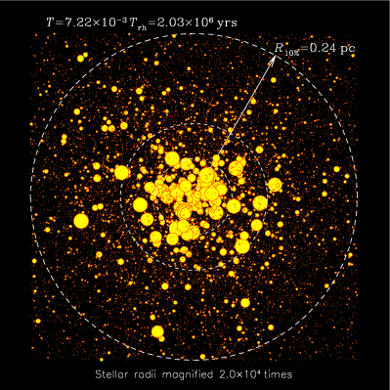
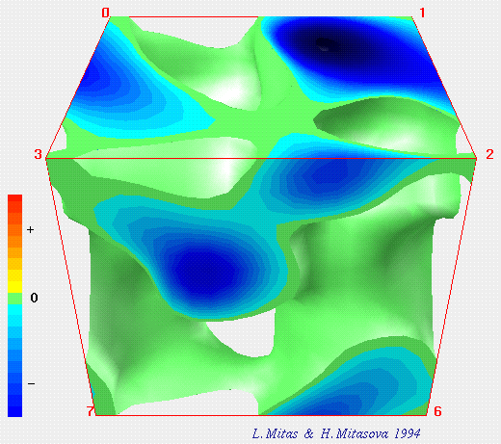
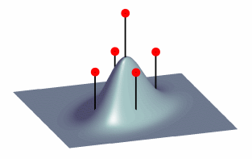
LECTURE 26: PARTICLE FILTERS
Objectives: Bayes Rule (Again!) Sequential Bayesian Estimation Monte Carlo Methods State Space Formulations Kalman Filters Bayesian Particle Filters
Resources: J.C.: Bootstrap Particle Filtering P.D.: Particle Filtering Z.C. Bayesian Filtering Wiki: Particle Filters F.W.: Tracking Demos
• URL: .../publications/courses/ece_8443/lectures/current/lecture_26.ppt
Notes:
MS Equation 3.0 was used with settings of: 18, 12, 8, 18, 12.

Slide 2
Overview
Particle filtering is a sequential Monte Carlo methodology in which the relevant probability distributions are iteratively estimated using the concepts of importance sampling and approximation of probability distributions with discrete random measures.
The earliest applications of sequential Monte Carlo methods were in the area of growing polymers, and later they expanded to other fields including physics and engineering.
Sequential Monte Carlo methods found limited use in the past primarily due to their very high computational complexity.
Particle filtering is particularly useful in dealing with nonlinear and non-Gaussian problems (because it is a nonparametric approach).
Particle filters are usually used to estimate Bayesian models and are the sequential ('on-line') analog of Markov chain Monte Carlo (MCMC) batch methods.
They are often an alternative to the Extended Kalman filter (EKF) or Unscented Kalman filter (UKF) with the advantage that, with sufficient samples, they approach the Bayesian optimal estimate, so they can be made more accurate than either the EKF or UKF.
The approaches can also be combined by using a version of the Kalman filter as a “proposal distribution” for the particle filter.

Slide 3
Bayesian Methods
The particle filter approach estimates the sequence of hidden parameters, X_{t}={x_{t} }, for t = 0, …, N, based only on the observed data (measurements), Y_{t} ={y_{t}}, t = 0, …, N.
All Bayesian estimates of X_{t} follow from the posterior distribution for x_{t} : p(x_{t}|Y_{t}) = p(x_{t} |y₀, y₁,…, y_{N}).
In contrast, the MCMC or importance sampling approach attempts to model the full posterior p(X_{t}|Y_{t}) = p(x₀, x_{1,} …, x_{N}|y₀, y₁,…, y_{N}).
Recall Bayes’ Rule:
We often model the hidden state sequence using a Markovian process:
where the weight, w(t,t-1), is defined by:
To compute the posterior at time t, we only need to know the posterior at time t-1 and the corresponding weight.
Of course, we must know the distribution in closed form and compute complex integrals or sums.

Slide 4
Bayesian Methods (cont.)
A more useful solution involves the marginal posterior distribution:
where the weight, w_{u}(t,t-1) is defined as:
The sequential Bayesian processor can be summarized as:

Slide 5
Monte Carlo Methods
Monte Carlo (MC) methods were historically motivated by games of chance and played an instrumental role in the Manhattan project.
MC techniques are based on the concept that through random sampling, the resulting empirical distributions will converge to the desired distribution.
Markov Chain MC techniques are based on sampling from probability distributions based on a Markov chain.
For example, for some function f(x), with respect to some underlying distribution, p(x), we can compute an expectation:
Instead of using numerical integration, we can represent the required distribution as a set of random samples, and compute the mean empirically.
The essential step in integration of MC methods involves drawing samples from the required distribution to create an empirical distribution:
Substituting this into our expression for the expectation:
This is referred to as the MC estimate of E_{x}[f(x)].

Slide 6
Importance Sampling
A generalization of the MC approach is importance sampling. We can express this integral in terms of an arbitrary function, q(x):
q(x) is referred to as the importance sampling distribution since it samples the target distribution, p(x), nonuniformly giving more importance to some values of p(x).
q(x) can be approximated by drawing N samples:
This integral can be estimated by:
The art in importance sampling is in carefully choosing the importance distribution, q(x), which approximates p(x).
This is the principal factor affecting performance.
We can use importance sampling to approximate the posterior we calculate in Bayesian estimation.

Slide 7
Posterior Estimation
Returning to our example, we can estimate the mean of f(x):
We can apply Bayes rule to the posterior and define a weighting function:
Unfortunately, the weight estimate requires knowledge of the evidence:
Nevertheless, we can combine these to produce an estimate of the mean:
We can define a new weighting function:
This can be used to estimate the evidence, allowing us to simplify our estimate for the mean:
Drawing samples from and applying MC, we can derive a new expression for the mean. We start with the importance sampling distribution:

Slide 8
Importance Estimation
We can substitute this into our expression for the mean and obtain:
As N →∞, the asymptotic optimal estimate of the posterior is:
which is significant because it defines the estimate of the posterior in terms of the values of the hidden states.
We can modify this to obtain a sequential estimate of the posterior:
Ignoring the evidence (denominator) in our formulation for the posterior:
We can write a new expression for the weight:

Slide 9
Bayesian Sequential Importance Estimation
We can rearrange terms to write:
We can now describe a formal procedure:
Draw samples from the proposed importance distribution:
Determine the required conditional distributions:
Calculate the unnormalized weights W_{i}(t) with x(t) = x_{i}(t)
Estimate the posterior distribution:
The key point here is that the posterior is being estimated from the samples, and the knowledge of our model is wrapped up in the weights. Where have we seen this type of approximation before?

Slide 10
Bayesian Approach to State Space
Bayes estimation relative to state-space models is based on extracting the unobserved or hidden dynamic internal variables (states) from noisy measurement data.
The Markovian state vector with initial distribution p(x(0)) propagates temporally through the state space according to p(x(t)|x(t-1)).
The conditionally independent measurements evolve from p(y(t)|x(t)).
The dynamic state variable at time t is obtained from the previous state, x(t-1), and the transition probabilities (which also must be estimated).
Once propagated, the dynamic state variable is used to update or correct based on the likelihood or new measurement, y(t).
We can summarize this as: x(t-1) ~ p(x(t)|x(t-1)) and [x(t),y(t)] ~ p(y(t)|x(t)).
The usual state space formulation is:
where w and v are the respective process and measurement noise sources, and u is the unknown input.
A() is the nonlinear dynamic state transition function and C() is the corresponding measurement function.

Slide 11
Bayesian Approach to State Space (cont.)
We can summarize this as:
To generate the model-based version of the sequential Bayesian processor, we replace the transition and likelihood distributions with the conditionals.
We seek to estimate the posterior p(x(t)|Y_{t-1}):
This is based on the well-known Chapman-Kolmogorov integration solution to the state space equations.
We can incorporate the model-based likelihood into the posterior equation:
Thus, it is possible to integrate notions of Bayesian estimation into the state space equations.
There are many alternate approaches to the state space equations based on well-known algorithms such as Kalman filtering.

Slide 12
Bayesian Particle Filters
Particle filtering is a sequential MC method employing the sequential estimation of relevant probability distributions using the concepts of importance sampling and the approximations of distributions with discrete random measures (e.g., Parzen windows).
The key idea is to represent the required posterior distribution by a set of N_{p} random samples, the particles, and associated weights: {x_{i}(t), W_{i}(t)} i = 1,…, N_{p}.
As the number of particles become large, the estimate converges, and hence particle filtering can be regarded as a technique to implement sequential Bayesian estimation by MC simulation.
Continuous distributions are approximated by mixtures of these weighted particles, as shown to the right.

Slide 13
Bayesian Particle Filters (cont.)
We can illustrate the evolution of the MAP estimate over time:

Slide 14
Bayesian Particle Filters (cont.)
The minimum mean-squared error (MMSE) estimate can be determined by averaging over x_{i}(t):
The MAP estimate is found by maximizing the posterior across each time step:
The reestimation equations for the weights are:

Slide 15
Prediction Using Bayesian Particle Filters

Slide 16
Historical Perspective

Slide 17
Summary
Introduced importance sampling and Monte Carlo methods.
Described particle filtering as an integration of Bayesian methods and Monte Carlo Methods.
There are many types of particle filters: Auxiliary particle filter, Gaussian particle filter, Unscented particle filter, Monte Carlo particle filter, Gauss-Hermite particle filter and the Cost Reference particle filter.
The best known algorithm to solve the problem of non-Gaussian, nonlinear estimation is the extended Kalman filter.
This filter is based upon the principle of linearizing the measurements and evolution models using Taylor series expansions. The series approximations in the EKF algorithm can, however, lead to poor representations of the nonlinear functions and probability distributions of interest.
The Unscented Kalman filter (UKF) is based on the intuition that it is easier to approximate a Gaussian distribution than it is to approximate arbitrary nonlinear functions.
The UKF leads to more accurate results than the EKF and, in particular, generates much better estimates of the covariance of the states. The UKF has, however, the limitation that it does not apply to general non-Gaussian distributions.

