Slide 1
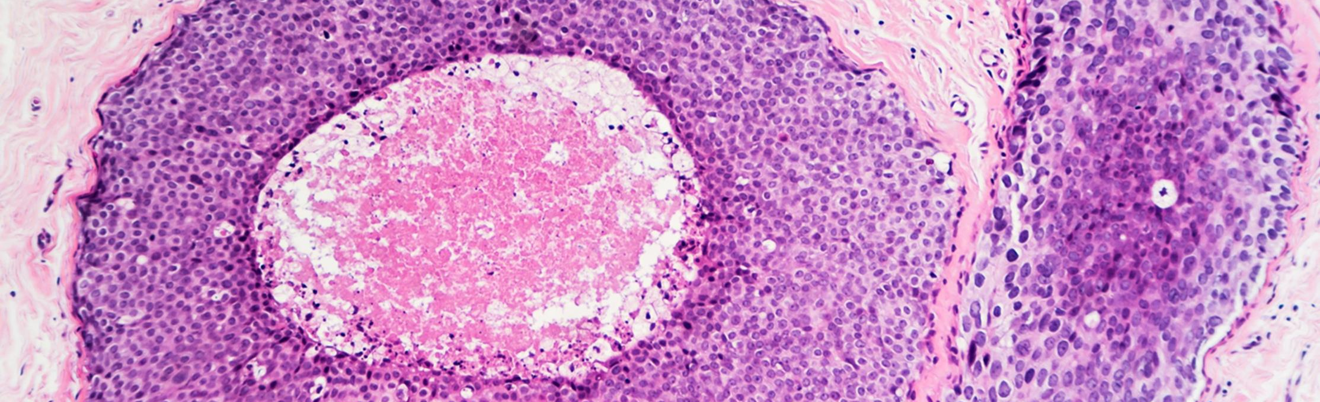
Histopathology Patch Classification Using Gradient Boosting and a Multilayer Perceptron
Jackson Walker
Department of Electrical and Computer Engineering, Temple University
5/1/2026

Slide 2
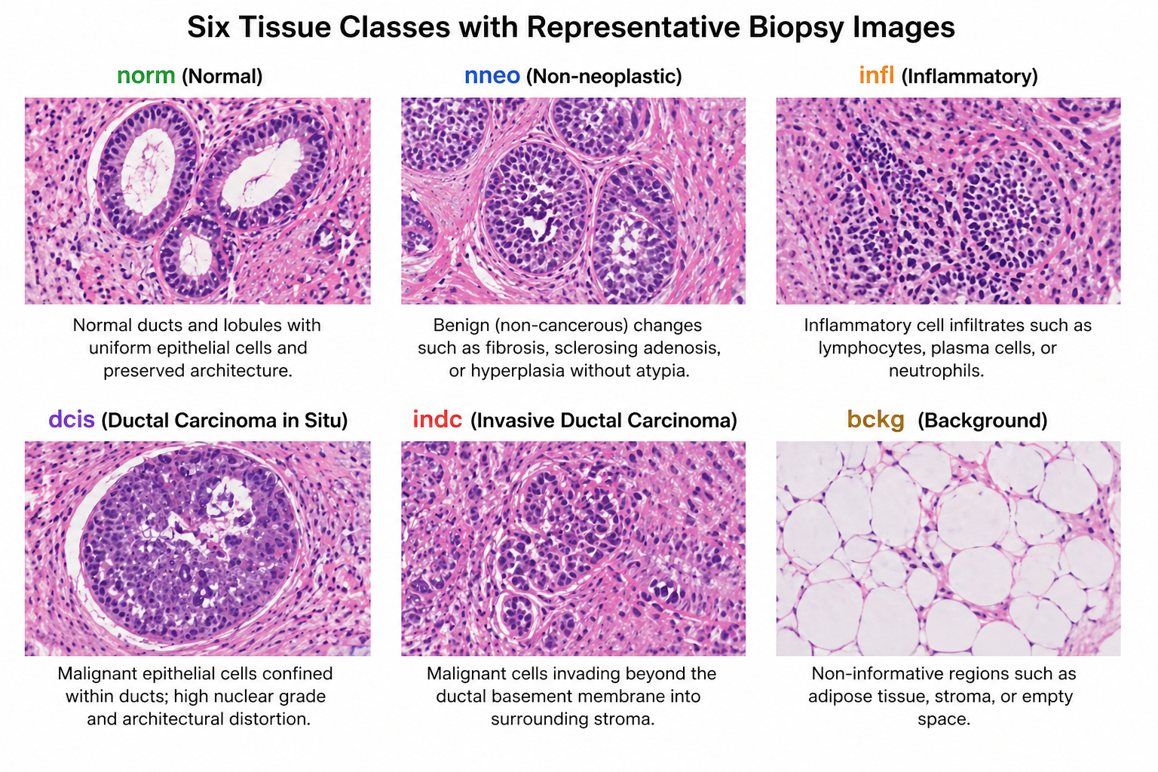
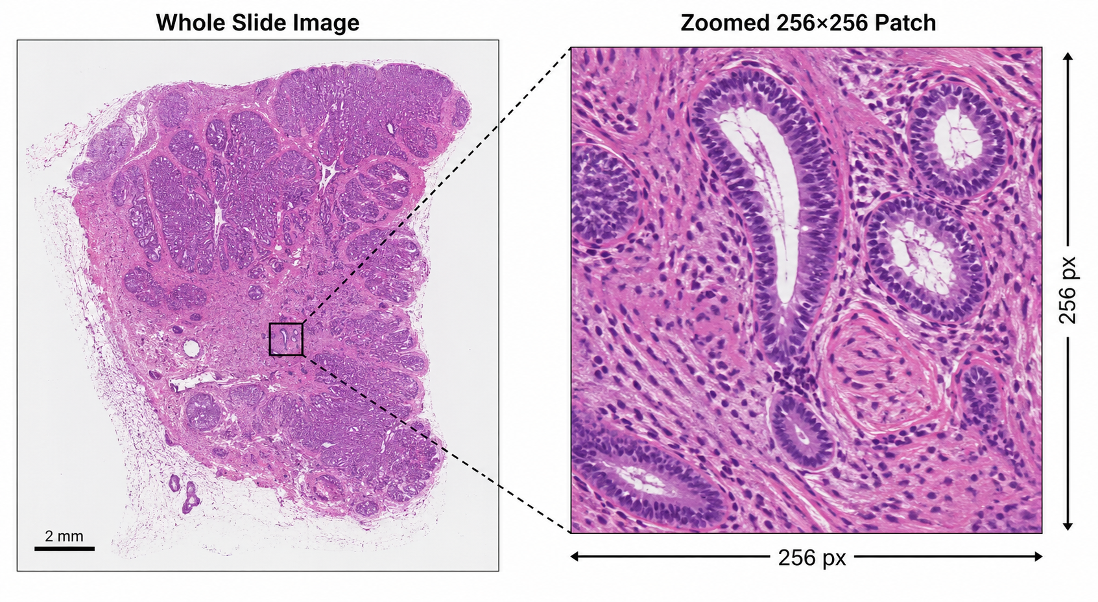
What is the Problem?
Given a patch, predict which tissue type it is

Slide 3
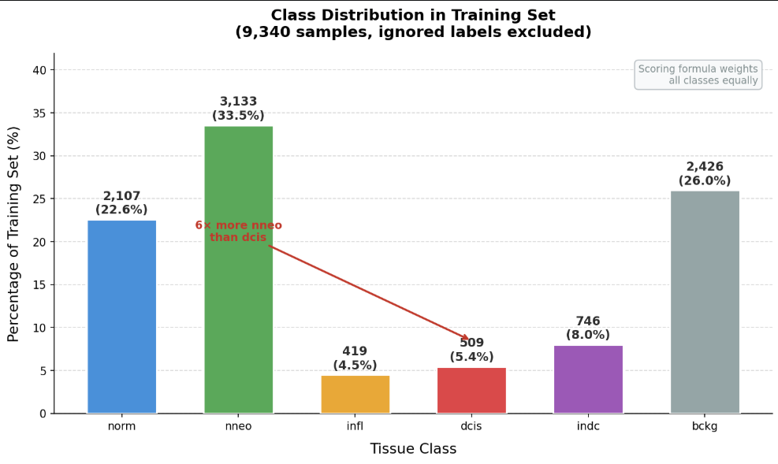
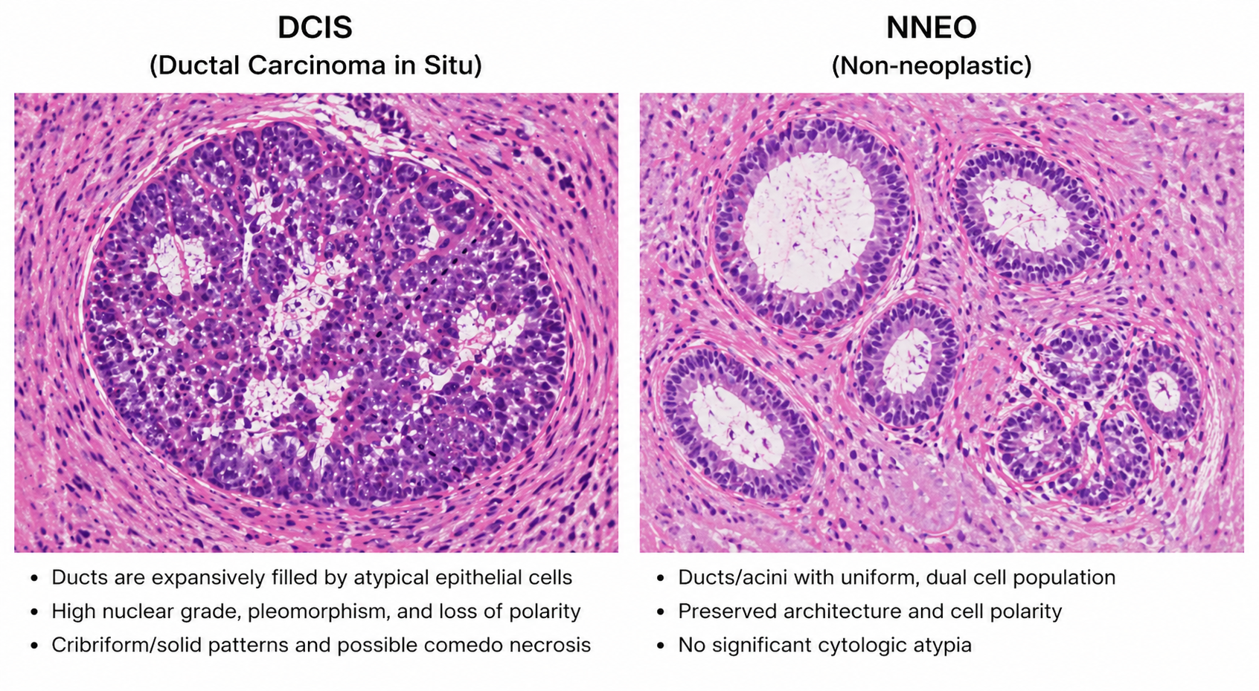
Why is This Hard?
Binary dcis vs nneo classifier: only 41% recall
training a model whose only job was to tell dcis and nneo apart — the simplest possible test — and it still failed 59% of the time
dcis and nneo patches genuinely look almost identical in DCT feature space
Score = 0.90 × average_error(norm, nneo, infl, dcis, indc) + 0.10 × error(bckg)
score punishes you just as much for missing dcis as for missing nneo

Slide 4
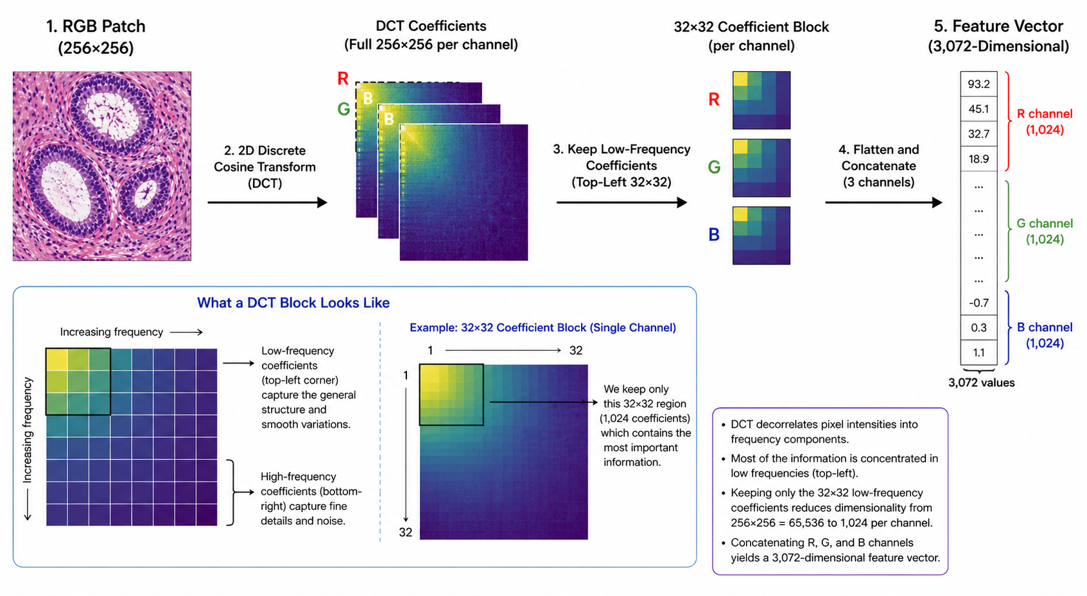






Data Representation
Low frequencies = the big broad shapes and colors in the image (the overall structure of the tissue)
3072 raw DCT coefficients per patch, then engineered into 6262 features (IDCT)

Slide 5
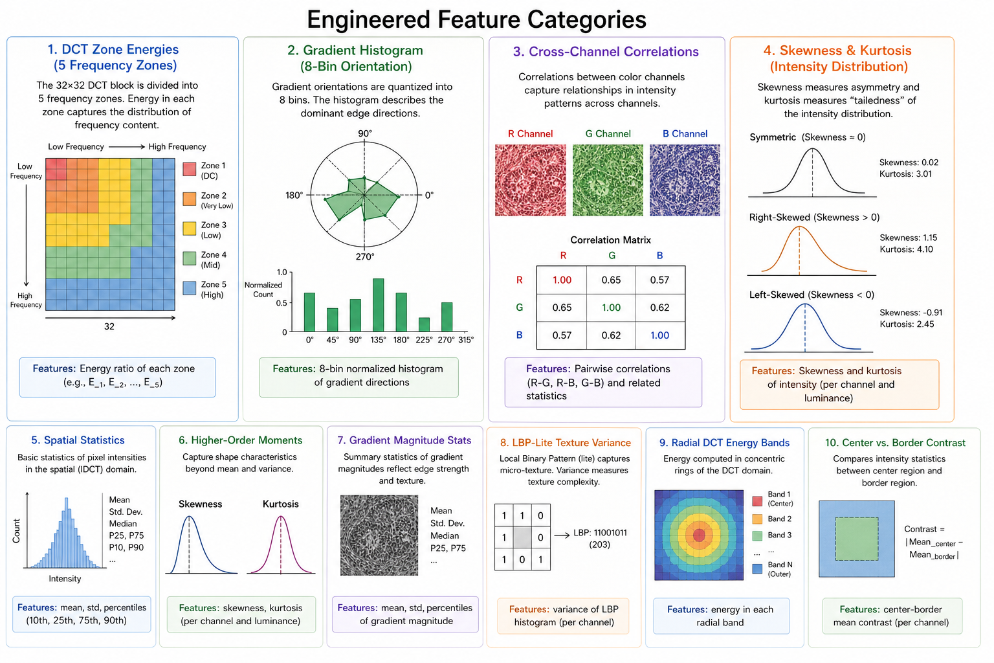
Feature Engineering

Slide 6



Algorithm 1: Hierarchical Gradient Boosting
Stage 1
norm
Parallel flat model blended in for hard classes
(dcis 50%, infl/indc 30%)
Acts as a second opinion to help out the harder classes
non-cancer
Stage 2a
nneo
Post-training rescaling
Start
bckg
infl
cancer
dcis
Stage 2b
$$F_{M}\left(x\right)=\sum_{m=1}^{M}{γ_{m}h_{m}\left(x\right)}$$
$$r_{i}^{\left(m\right)}=−\frac{∂L\left(y_{i} , F\left(x_{i}\right)\right)}{∂F\left(x_{i}\right)}$$
indc

Slide 7
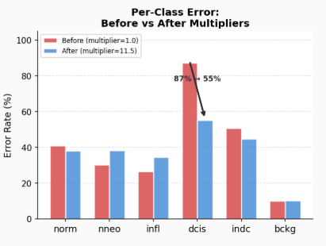
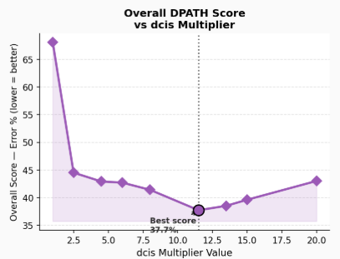
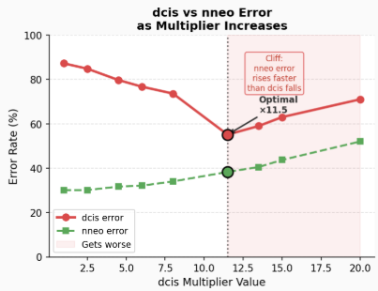
Why the Multipliers?
The scoring formula treats a dcis mistake the same as a nneo mistake, but we have 6x fewer dcis samples — so we shift the decision boundary

Slide 8
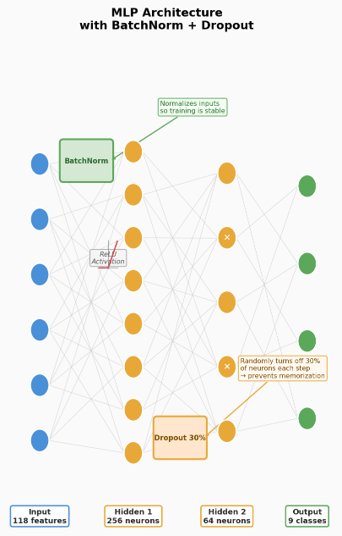
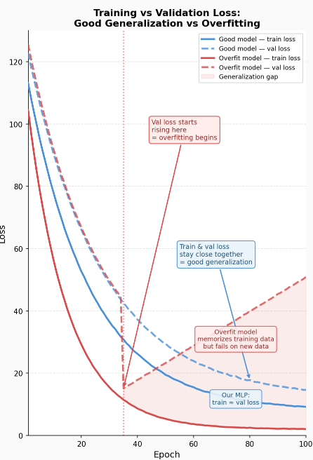
Algorithm 2: Multilayer Perceptron
Not the full 6262 feature set! Overfitting!
$$h^{\left(l\right)}=σ\left(W^{\left(l\right)}h^{\left(l−1\right)}+b^{\left(l\right)}\right)$$
Multiply inputs by weights
Add bias
Apply activation
Pass
Regularization
Drop out
Weight Decay
Gaussian Noise

Slide 9
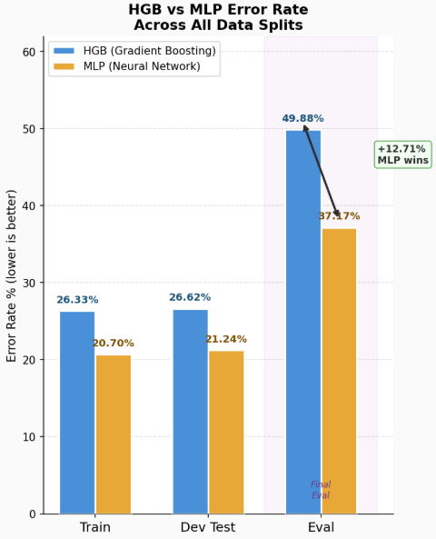
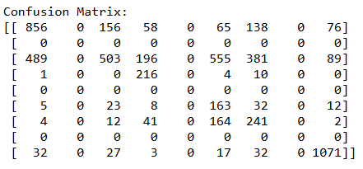
Results
 | Data Set
Algorithm | Train | Dev Test | Eval
HGB | 26.33% | 26.62% | 49.88%
MLP | 20.70% | 21.24% | 37.17%
MLP generalizes better
dcis
32.92%

Slide 10



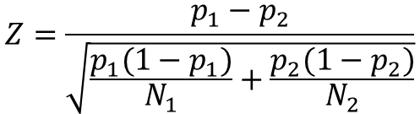



Statistical Significance
Z-test
$$Z=\frac{p_{1}−p_{2}}{\sqrt{\frac{p_{1}(1−p_{1})}{N_{1}}+\frac{p_{2}(1−p_{2})}{N_{2}}}}$$
$$Z=\frac{0.0536}{0.00848}=6.32$$
$$Significance level α=0.05$$
$$My MLP=p_{1}=0.3717$$
$$Best 2025 \left(EB7\right)=p_{2}=0.3181$$
$$Critical Z±1.96$$
$$Eval set=N_{1}=N_{2}=6260$$
My model is significantly worse

Slide 11
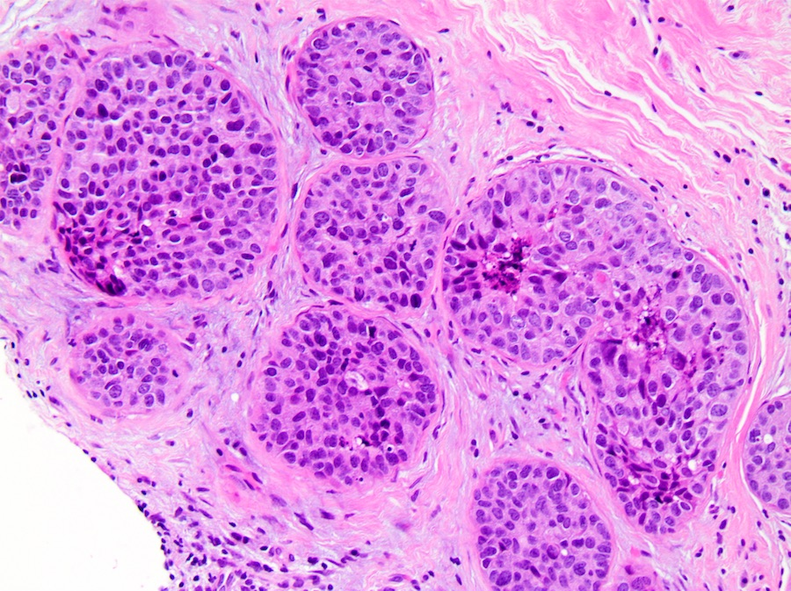

Conclusions
Hierarchical structure improved the separation of background and cancer classes
Compact features + regularization made MLP competitive on small data
Dcis/nneo overlap is a fundamental limit of single-patch DCT features

