Slide 1
DCT Classification
Sarker Mohammed
ECE 8527 – Machine Learning Final Project

Slide 2
Outline
Data Analysis
Non-Neural Network
Neural Network

Slide 3
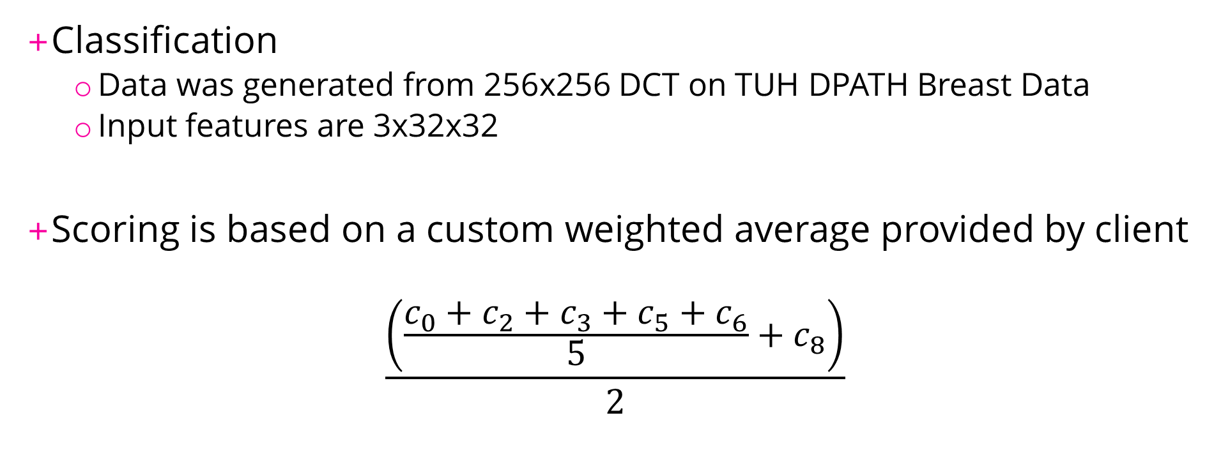
Objective
Classification
  Data was generated from 256x256 DCT on TUH DPATH Breast Data
  Input features are 3x32x32
Scoring is based on a custom weighted average provided by client
$$\frac{\left(\frac{c_{0}+c_{2}+c_{3}+c_{5}+c_{6}}{5}+c_{8}\right)}{2}$$

Slide 4
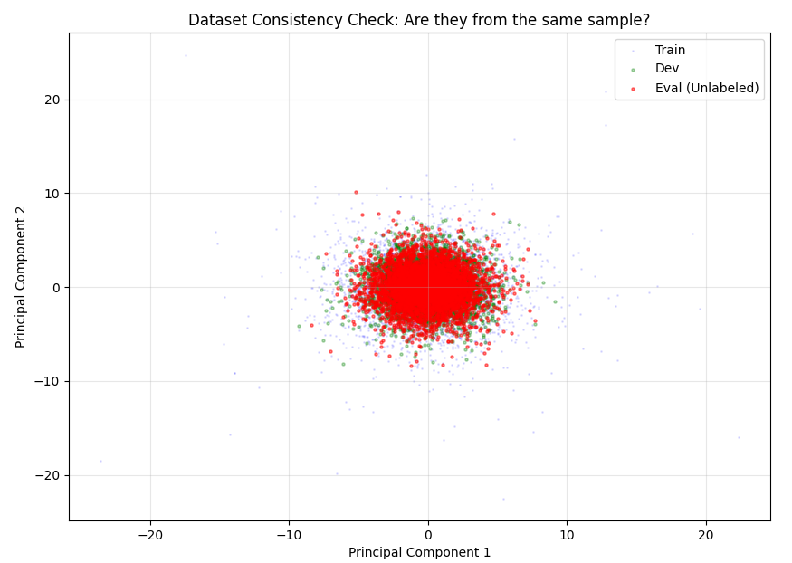
Data Analysis – Data Consistency
Notes:
We are given an anonymized eval data. We just wanted to check if they weren’t from the same

Slide 5
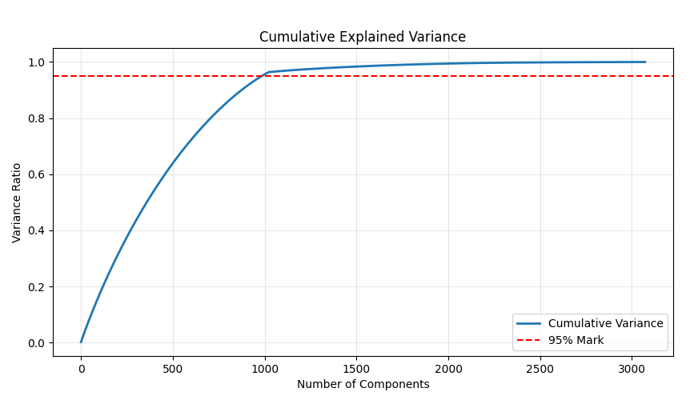
Data Analysis – Scree Plot
--- Variance Statistics ---
90% Variance: 876 components
95% Variance: 986 components
99% Variance: 1748 components
Notes:
PCA Cumulative Explained Variance
Essentially Map how much real information vs noise
PCA is defined by principal components. This plot essentially says that it needs roughly 1000 features to describe 95% of the data
If the line was diagonal it would mean that every single feature is important. However, in this case, we can disregard about 2000 features.
Essentially, This means that the data is compressible but it doesn’t mean good generalization

Slide 6
Non-Neural Network – PCA + SVM
Initial Test – Data Reduction
  Trained using Train Set ONLY
N | TRAIN | DEV
3072 | 23.4708 / 22.8179 | 67.7371 / 63.8023
986 | 23.6487 / 22.8832 | 67.8551 / 63.7588
300 | 30.1532 / 28.8485 | 78.1173 / 72.8374

Slide 7
Non-Neural Network – PCA + SVM
Initial Test – Grid Search
  Trained using Train Set ONLY
  Introduce Mask to remove Class 1, 4, 7
  Test across C={0.1, 0.5, 0.8, 1} and gamma={‘scale’, ‘auto’}
 | 0.1 | 0.5 | 0.8 | 1
‘scale’ | 0.6887 | 0.5841 | 5477 | 0.5440
‘auto’ | 0.7719 | 0.6091 | 0.6033 | 0.6007
TRAIN | DEV
8.3092 / 8.6530 | 72.3464 / 67.6661

Slide 8
Non-Neural Network – PCA + SVM
Results
  Trained using Train + Dev
  Introduce Mask to remove Class 1, 4, 7
  Used kernel=‘rbf’, C=0.5 and gamma=‘scale’
TRAIN | DEV | EVAL
24.1319 / 23.2315 | 26.2924 / 26.0002 | 67.1934 / 62.6484

Slide 9
Neural Network – CNN
Initial Test – Model Selection
  Google “DCT Deep Learning”
    Multiple examples using CNN
    In Ju’s Paper, they suggested a dual CNN structure using a modified ResNet-50
  Debated ResNet-50 usage
  Switched to Simple CNN
S. Ju, Y. Lee and S. Lee, "Convolutional Neural Networks With Discrete Cosine Transform Features" in IEEE Transactions on Computers, vol. 71, no. 12, pp. 3389-3395, Dec. 2022, doi: 10.1109/TC.2022.3150574.
URL: https://doi.ieeecomputersociety.org/10.1109/TC.2022.3150574

Slide 10
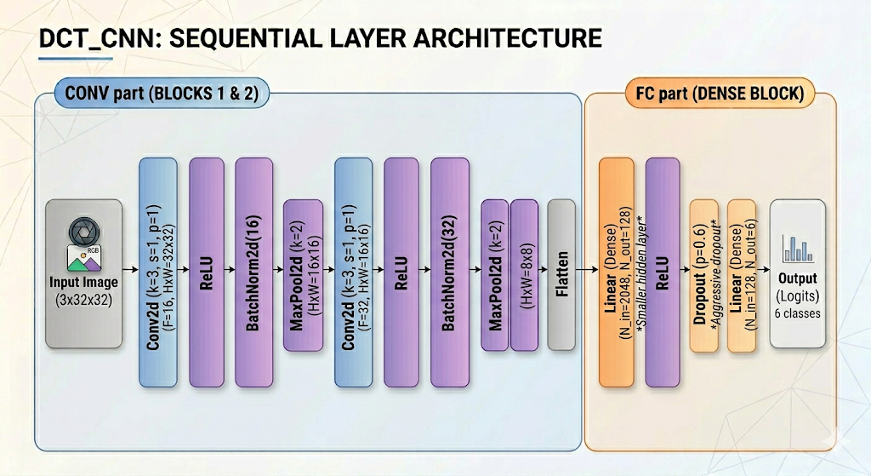
Neural Network – CNN

Slide 11
Neural Network – CNN
Tests – Preventing Overfitting
  Dropout (0.6)
  Data Augmentation
  Batch = 128, Epochs = 80, LearningRate = 0.001
TRAIN | DEV
27.6380 / 24.9402 | 63.0049 / 57.3711

Slide 12
Neural Network – CNN
Results
  Trained using Train + Dev
  Batch = 128, Epochs = 500, LearningRate = 0.001
TRAIN | DEV | EVAL
12.2152 / 11.1215 | 12.3391 / 11.1651 | 63.7219 / 58.2803

Slide 13
Conclusion
Overfitting
Class Rank
Improvements?
 | Dataset
Algorithm | TRAIN | DEV | EVAL
PCA + SVM | 24.1319 / 23.2315 | 26.2924 / 26.0002 | 67.1934 / 62.6484
CNN | 12.2152 / 11.1215 | 12.3391 / 11.1651 | 63.7219 / 58.2803

