Slide 1

Breast Cancer Pathology Classification Using machine learning
Liam McLaughlin

Slide 2
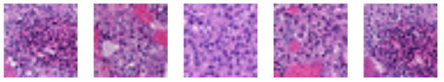
What is this project about?
Breast pathology classification using DCT-compressed microscope image patches from the TUH DPATH
Breast dataset Each sample represents a 256×256 tissue patch transformed into 3,072 frequency coefficients across RGB channels
6-class diagnostic problem: normal, non-neoplastic, inflammatory, DCIS, invasive ductal carcinoma, and background
Severe class imbalance: dominant class (nneo) has 7× more samples than rarest diagnostic class (infl), yet all classes weighted equally in scoring
Scoring metric: 90% weight on average error across 5 diagnostic classes, 10% on background
Two submissions required — one non-neural, one neural network algorithm
Key challenge: building models that generalize to unseen patient data, while not memorizing training data

Slide 3
Flow path
Non-Neural
Raw CSV Input
3,072 DCT features per row
StandardScaler
fit on train only — normalizes all 3,072 features
PCA
3,072 → 471 components
Full Feature
Space
all 3,072 dimensions retained
LightGBM DART
DART boosting, 452 rounds
PCA(471) features
num_leaves=18, lr=0.013
RF + Extra Trees
410 + 372 trees
full standardized features
balanced class weights
Stacking Meta Learner
Logistic Regression on 18 (6 from each algorithm) OOF probs
Post-Processing
Temperature scaling → Per-class threshold tuning
tuned on dev set only

Slide 4
Preprocessing & Training
Non-Neural
StandardScaler fit on training data only
LGBM path: PCA on standardized features — retains high-variance DCT components for boosting
RF + ET path: full standardized features, balanced class weights
5-fold Out Of Fold (OOF) stacking: RF + ET + LGBM each produce 6 class probabilities → 18 features fed to meta-learner
LightGBM: 452 rounds, num_leaves=18, lr=0.013, bagging_fraction=0.477
Random Forest: 410 trees, max_depth=16, max_features=0.374 | Extra Trees: 372 trees, max_depth=20
Meta-learner: Logistic Regression (C=1.0, balanced) trained on OOF predictions — learns to weight each model per class

Slide 5
Postprocessing & Results
Non-Neural
Temperature scaling to correct probability calibration T=0.5 was used (T<1 makes the model more confident)
Per-class threshold tuning on dev set — directly compensates for class imbalance in scoring metric
Per-class thresholds: [1.05, 1.25, 0.65, 1.15, 1.0, 1.95], to help with rebalancing the model's confidence per class to compensate for the imbalance it learned during training
Train: 18.22% — Dev: 44.97%
Train/dev gap of 26.75% indicates overfitting

Slide 6
Flow path
Neural
Raw CSV Input
3,072 DCT features per row
StandardScaler
fit on train only — normalizes all 3,072 features
Inverse DCT
3x32×32 coefficients → 224×224 spatial image
DCT Reshape
3×32×32 → resized to 224×224
ViT-B/16 (spatial)
196 patches × 768 dims
self-attention across tissue
sees reconstructed signal shape
ViT-B/16 (frequency)
196 patches × 768 dims
self-attention across frequencies
sees frequency energy patterns
pretrained ImageNet weights
Weighted Blend
Score weighting
Post-Processing
Temperature scaling → Per-class threshold tuning
tuned on dev set only

Slide 7
Preprocessing & Training
Neural
StandardScaler fit on training data only
Model A: Inverse DCT reconstructs the actual 224×224 tissue image — ViT sees real tissue morphology, purple nuclei, pink cytoplasm, glandular structures
Model B: Raw DCT coefficients reshaped directly into a 224×224 image — ViT sees the frequency energy distribution as a visual pattern, no reconstruction
ViT-B/16 architecture: 86 million parameters, image split into 196 patches of 16×16 each, full self-attention across all patches simultaneously
Pretrained ImageNet weights loaded locally
Train up to 20 epochs with early stopping (patience=5) on dev set — revert to best checkpoint
Final models retrained on combined train+dev for exactly the number of epochs where best performance was found

Slide 8
Postprocessing & Results
Neural
Model A (spatial) and Model B (frequency) probability outputs blended weighting; better performing model automatically receives higher weight.
ViT-A (spatial, 28.11%) outperformed ViT-B (frequency, 39.95%) individually. However, both were retained in the blend since ViT-B's frequency domain view captures complementary information that spatial reconstruction cannot
ViT-A weight: 0.459, ViT-B weight: 0.541
Temperature scaling sweeps T from 0.1 to 3.0 on calibration split to correct probability overconfidence from the blended output. Best T=0.50
Dev score: 31.65% — calibration and early stopping on separate dev splits to prevent postprocessing leakage
Train: 0.42% after retraining on combined train+dev; expected near-zero as model has seen all training samples
Calibrations (30% of dev) and early stopping split (70%) kept fully separate. The Calibration score 31.56% vs full dev 31.65%

Slide 9
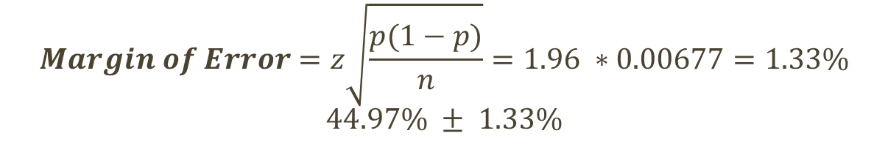

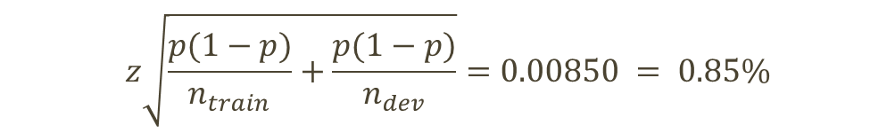
Statistical significance
Non-Neural
$$Margin of Error=z\sqrt{\frac{p(1−p)}{n}}=1.96 ∗0.00677=1.33\%$$
$$44.97\% ± 1.33\%$$
p = 0.4497 (dev error rate)
n_dev = 5410
n_train = 9340
Expected train/dev gap from sampling variance alone:
$$z\sqrt{\frac{p(1−p)}{n_{train}}+\frac{p(1−p)}{n_{dev}}}=0.00850 = 0.85\%$$
The actual gap of 26.75% is an astronomical 31.47 standard deviations above expected sampling noise.
This confirms genuine overfitting — the model learned training data but failed to generalize
The large gap is explained by severe class imbalance on rare classes
Actual Gap = 44.97% - 18.22% = 26.75%
$$z=\frac{Act_{gap}}{σ_{gap}}=31.47$$

Slide 10
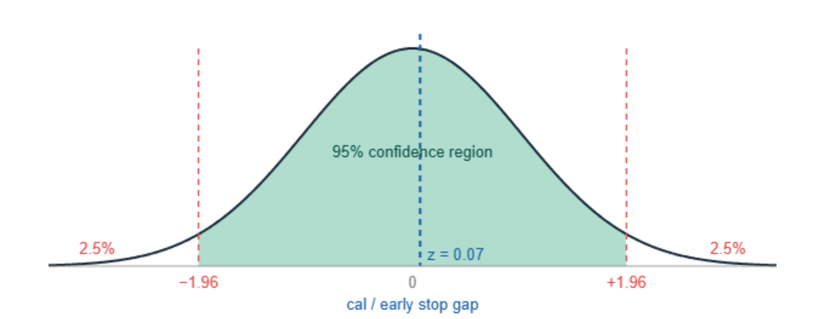
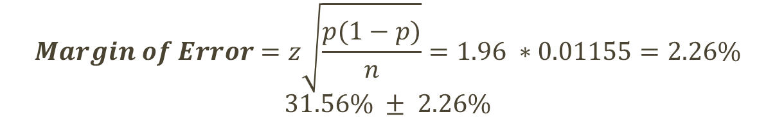

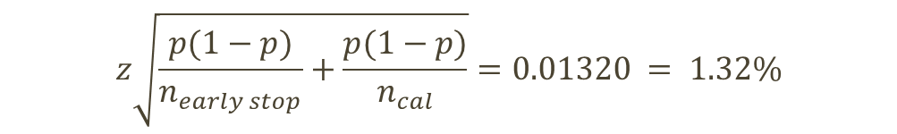
Statistical significance
Neural
$$Margin of Error=z\sqrt{\frac{p(1−p)}{n}}=1.96 ∗0.01155=2.26\%$$
$$31.56\% ± 2.26\%$$
z=1.96 for 95% confidence
p = 0.3165
n = 5410 (dev samples)
Expected calibration/early stop from sampling variance alone:
$$z\sqrt{\frac{p(1−p)}{n_{early stop}}+\frac{p(1−p)}{n_{cal}}}=0.01320 = 1.32\%$$
The actual gap of 0.09% is far smaller than expected random noise; the two splits are statistically indistinguishable
z = 0.07 sits well within the 95% confidence region, confirming the calibration is stable
If the gap was very large like on my non neural that would suggest calibration overfit to its split and won't generalize
Actual gap = 31.65% − 31.56% = 0.09%
$$z=\frac{Act_{gap}}{σ_{gap}}=0.07$$

Slide 11
SUMMARY
Breast cancer affects 1 in 8 women — this project classified breast tissue patches from DCT-compressed microscope images into 6 diagnostic categories
After consulting Dr. Picone, pursued a diverse ensemble approach for both submissions rather than duplicating effort
Non-neural: LightGBM DART on PCA features. Random Forest + Extra Trees on full features. Stacked via logistic regression meta-learner trained on out-of-fold predictions. hyperparameters tuned via Optuna across 400+ trials. Eval 50.26%
Neural: Two ViT-B/16 models on complementary data views. Spatial reconstruction via inverse DCT and raw DCT coefficients as frequency image honest dev error 31.65%. Eval 35.80%
“We once pooled all the algorithms from the entire class using Rover. We did not get significantly better performance.”
“… unless your two algorithms don't share a lot of information, you might not get the mileage you think out of that approach.”
-Dr. Joseph Picone

Slide 12
THANK YOU
Liam McLaughlin

