Slide 1
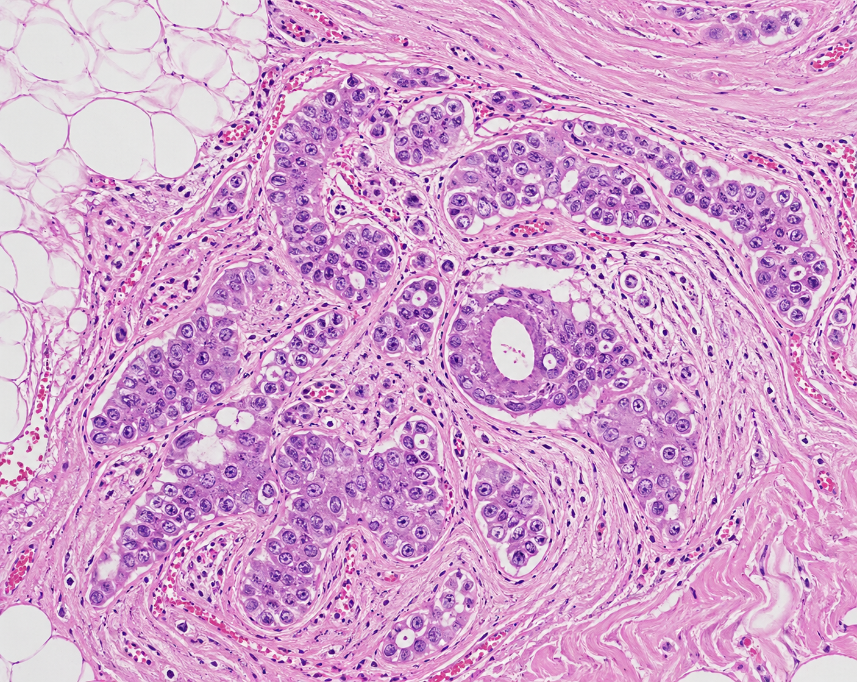
FINAL PROJECT
INTRODUCTION TO MACHINE LEARNING & PATTERN RECOGNITION
ROLENSKY LOUIS

Slide 2




Project Overview
Input Format
Classes
1 label column +
3,072 DCT coefficients
9 class labels (0–8)
Breast pathology patches
Structure
Challenge
3072
coefficients per sample
Class imbalance &
overlapping classes 3, 5, 6

Slide 3
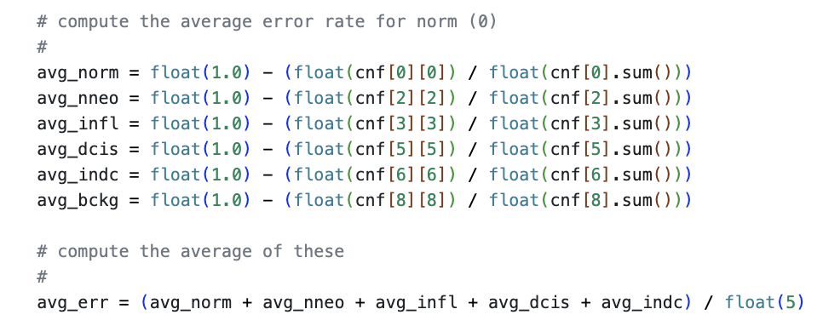

Scoring & Project Goal
Classes 1,4,7
Ignored in score
Classes 0,2,3,5,6
Scored (90%)
Class 8
Background (10%)

Slide 4
Models Selected
RF
RANDOM FOREST
Robust to class imbalance
Model complex decision boundaries
CNN
CONVOLUTIONAL NEURAL NETWORK
Data represents images
Exploit spatial structure
Learn patterns more effectively

Slide 5

Modeling Strategy
1
Step
2
Step
3
Step
4
Step
Start Simple
Analyze Errors
Targeted Fixes
Final Models
Flat RF baseline
& simple CNN
Inspect confusion matrix,
identify weak classes
Hierarchical structure,
regularization, weights
Hierarchical RF &
Improved CNN

Slide 6
Random Forest — Baseline
Architecture:
Flat single model → 9 classes
Baseline RF — Code
model = Pipeline([
('imputer', SimpleImputer(
strategy='median')),
('rf', RandomForestClassifier(
n_estimators=200,
class_weight=
'balanced_subsample',
random_state=42
))
])
Input:
All 3,072 DCT features
Preprocessing:
Median imputation for missing values
Class Balance:
class_weight='balanced_subsample'
Why n_estimators=200? Enough trees for stability without being too slow. | Why balanced_subsample? Prevents model from ignoring rare classes.

Slide 7

RF Baseline — Results & Findings
Model | Train Score (%) | Dev Score (%)
RF Baseline V1 | 10.89 | 85.61
RF Baseline V2 | 5.01 | 60.47
Confusion Analysis
Classes 3, 5, and 6 frequently misclassified
High feature-space overlap between these classes
Conclusion
Single-model approach struggles with 9-class task
A flat 9-class model is too ambitious in a single step.
The failure was useful — it showed exactly where to focus next: the 3/5/6 overlap problem.
Notes:
Split the problem into simpler sub-problems instead of solving all 9 classes at once.

Slide 8
Hierarchical Random Forest — Design
Stage 1
Stage 2
Stage 3
Model | Train Score (%) | Dev Score (%)
RF Baseline V1 | 10.89 | 85.61
RF Baseline V2 | 5.01 | 60.47
Hierarchical RF v2 | 42.73 | 64.95
Hierarchical RF v1 (BEST) | 26.53 | 52.12
Broad Split
Fine Split
Specialist
Scored classes
{0,2,3,5,6}
vs
Background+Ignored
{1,4,7,8}
Class 0
vs
Class 2
vs
Group {3,5,6}
Class 3
vs
Class 5
vs
Class 6

Slide 9
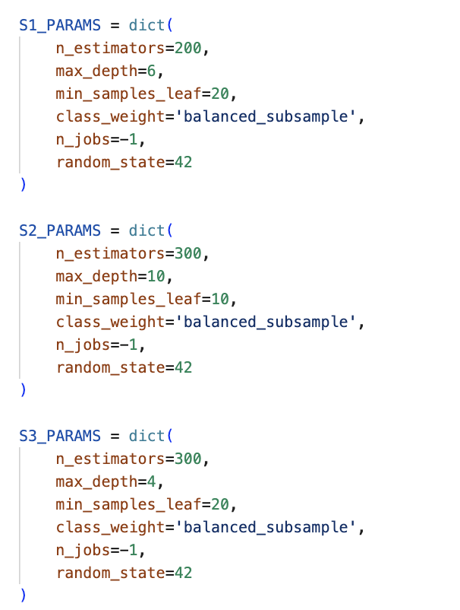
RF Tuning — Parameters & Rationale
Stage
max_depth
n_estimators
min_samples_leaf
Stage 1
6
200
20
Stage 2
10
300
10
Stage 3
4
300
20

Slide 10
CNN — Baseline
Input
3,072 values
Reshape
3×32×32
Conv2D
3→32
Conv2D
32→64
Conv2D
64→128
FC
Classifier
Output
9 classes
Why CNN?
CNN Architecture — Code
DCT coefficients can be reshaped into a 3×32×32 spatial structure. This lets the CNN learn local patterns.
x = x.reshape(3, 32, 32)
self.features = nn.Sequential(
nn.Conv2d(3, 32,
kernel_size=3, padding=1),
nn.Conv2d(32, 64,
kernel_size=3, padding=1),
nn.Conv2d(64, 128,
kernel_size=3, padding=1)
)

Slide 11
CNN Tuning — Decisions
Learning Rate
0.0005 (5e-4)
Smaller updates → stable training, avoids overshooting
Model | Train Score (%) | Dev Score (%)
CNN Baseline v1 | 35.53 | 62.18
CNN tuned | 41.0869 | 50.8402
Dropout + Weight Decay
weight_decay=1e-3
Regularization to reduce overfitting on training set
Class Weights
×1.5 (3,6), ×2.5 (5)
Give more importance to difficult classes
Early Stopping
patience=8 epochs
Stop training when performance stops improving

Slide 12




What I Would Improve
Better Classes Handling
Combine models
Classes 3,5,6 remained difficult for RNF, and class 2 for CNN. Targeted feature engineering or a dedicated sub-model could reduce its error rate.
Combining predictions could outperform either model alone.
Inverse DCT Transform
Hierarchical CNN
Convert coefficients back to image space. May help the CNN learn more natural spatial patterns.
Apply the same stage-by-stage decomposition that improved the RF to the CNN model.

Slide 13


Questions?
Happy to discuss:
Dataset & DCT feature structure
Scoring function and class weighting
Hierarchical Random Forest design
CNN regularization & training choices

Slide 14
Thank You

