Slide 1
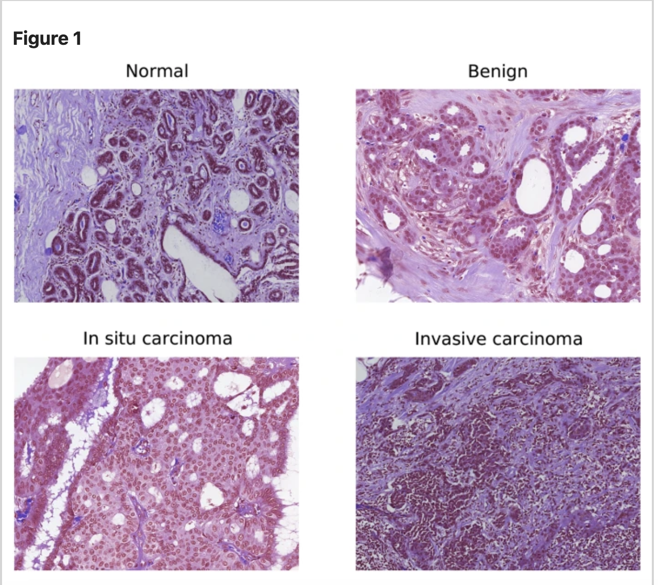
Histopathology Oncology Image Classification
CNN vs RNF
- Bernard Krasnisky

Slide 2
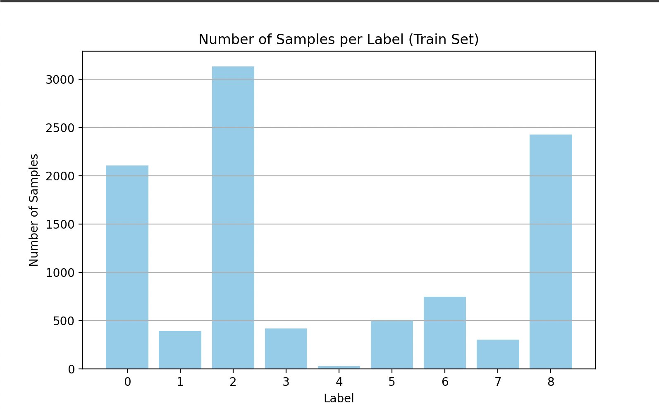
:
Dataset: v4.0.0 TUH DPATH Breast data:
-Pre-processed with 256x256
Discrete Cosine Transform
- 9 Classes
-Colsanitas dataset (544 whole slide images – University Bogata Columbia)
Breast Cancer Image Classification
Global Cancer Statistics 2020:
- Most common cause of cancer-related mortalities in female population worldwide
- Manual interpretation of histopathology time consuming, error prone, slow results led to disease progression and poor prognosis.
- Machine Learning to the rescue.
- CNNs most successful. Historical CNNs - AlexNet (ImageNet dataset 2012), VGG (smaller kernels/filters 2014), ResNet

Slide 3
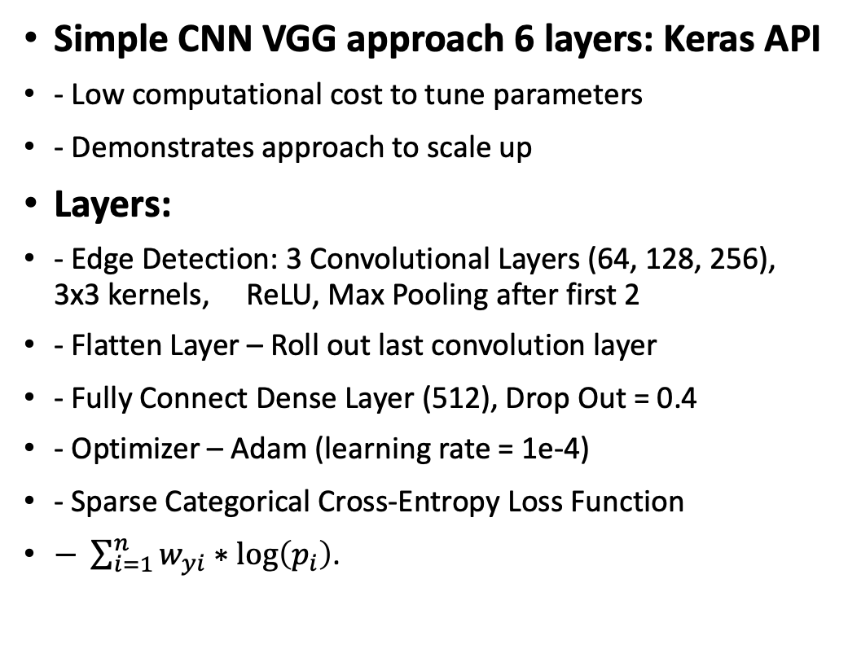
CNN Structure
Simple CNN VGG approach 6 layers: Keras API
- Low computational cost to tune parameters
- Demonstrates approach to scale up
Layers:
- Edge Detection: 3 Convolutional Layers (64, 128, 256), 3x3 kernels, ReLU, Max Pooling after first 2
- Flatten Layer – Roll out last convolution layer
- Fully Connect Dense Layer (512), Drop Out = 0.4
- Optimizer – Adam (learning rate = 1e-4)
- Sparse Categorical Cross-Entropy Loss Function
$− \sum_{i=1}^{n}{w_{yi}∗\log\left(p_{i}\right)}$.
Batch Sizes: 32, 64, 128
- 32 had the best results
Class weights: Applied to each class during Loss calculation in Stochastic Gradient Decent
- Based on frequency and heuristics
Learning Rate Scheduler:
- Slow rate 0.00008 for epochs 1-4
- Increase learning epochs 5-15
- Slow learning for fine-tuning weights in final epoch.

Slide 4
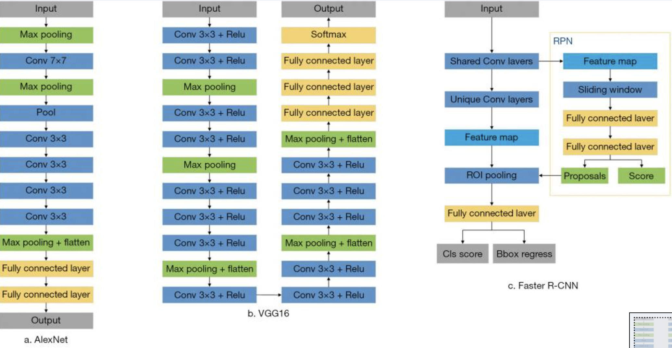
CNNs Visual
CNN Layers
Edges and Textures
Shapes and patterns
Objects
Structures
5. Fully Connected Layer
6. Output for Classification
Citation: Cai L, Gao J, Zhao D. A review of the application of deep learning in medical image classification and segmentation. Ann Transl Med. 2020 Jun;8(11):713. doi: 10.21037/atm.2020.02.44. PMID: 32617333; PMCID: PMC7327346.

Slide 5
RNF Model
Traditional Classifier
  Histogram of Oriented Gradients (HOG) – allows model to detect irregular shapes and cell borders
Parameters:
  500 – 1500 n_estimators (1000 trees optimal)
    Increases stability by averaging out outliers e.g. staining artifacts
  Maximum Depth 15
    Max questions/branches per tree (prevents overfitting)
  Balanced Class weights
    Accounts for classes with lower frequencies

Slide 6
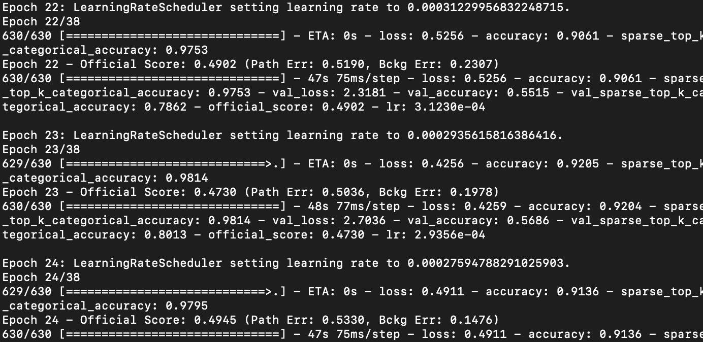
CNN vs RNF Results
Algorithm | Train | Dev | Eval
CNN | 3.5636% | 52.8652% | 54.7711%
RNF | 19.0201% | 53.9701% | 53.9789%
Results:
  Model results are comparable
  RNF is generalizing better
  CNN is overfitting during Training but has some ability to generalize
  Small models can classify pathology data with 9 classes and are extremely efficient.
  Scale up the approach, introduce segmentation and encoder/decoder loops.

Slide 7
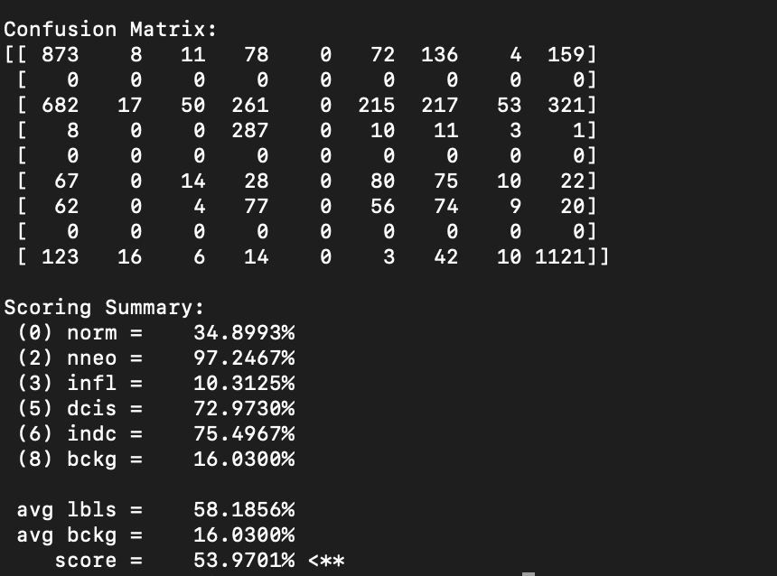
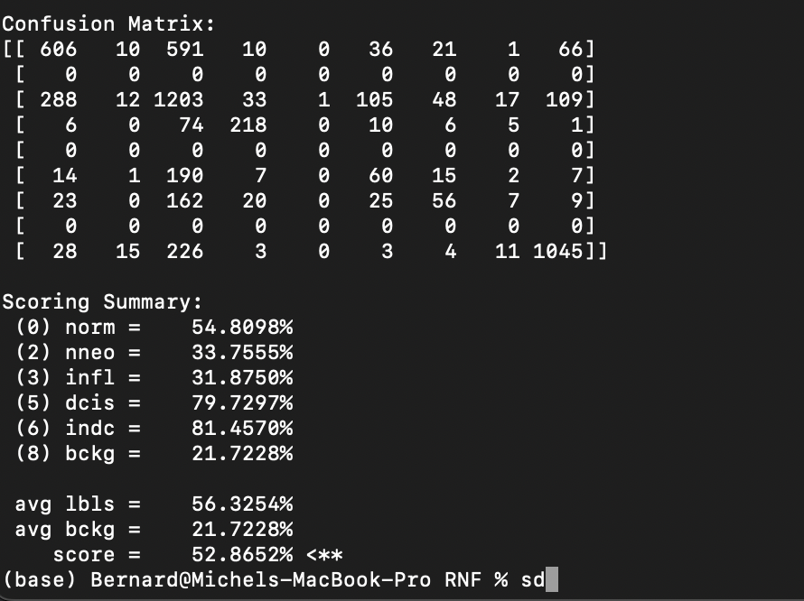
CNN Individual Class Errors
RNF result by Class
CNN results by Class
CNN and RNF models had high error for dcis and indic (cancers)

Slide 8
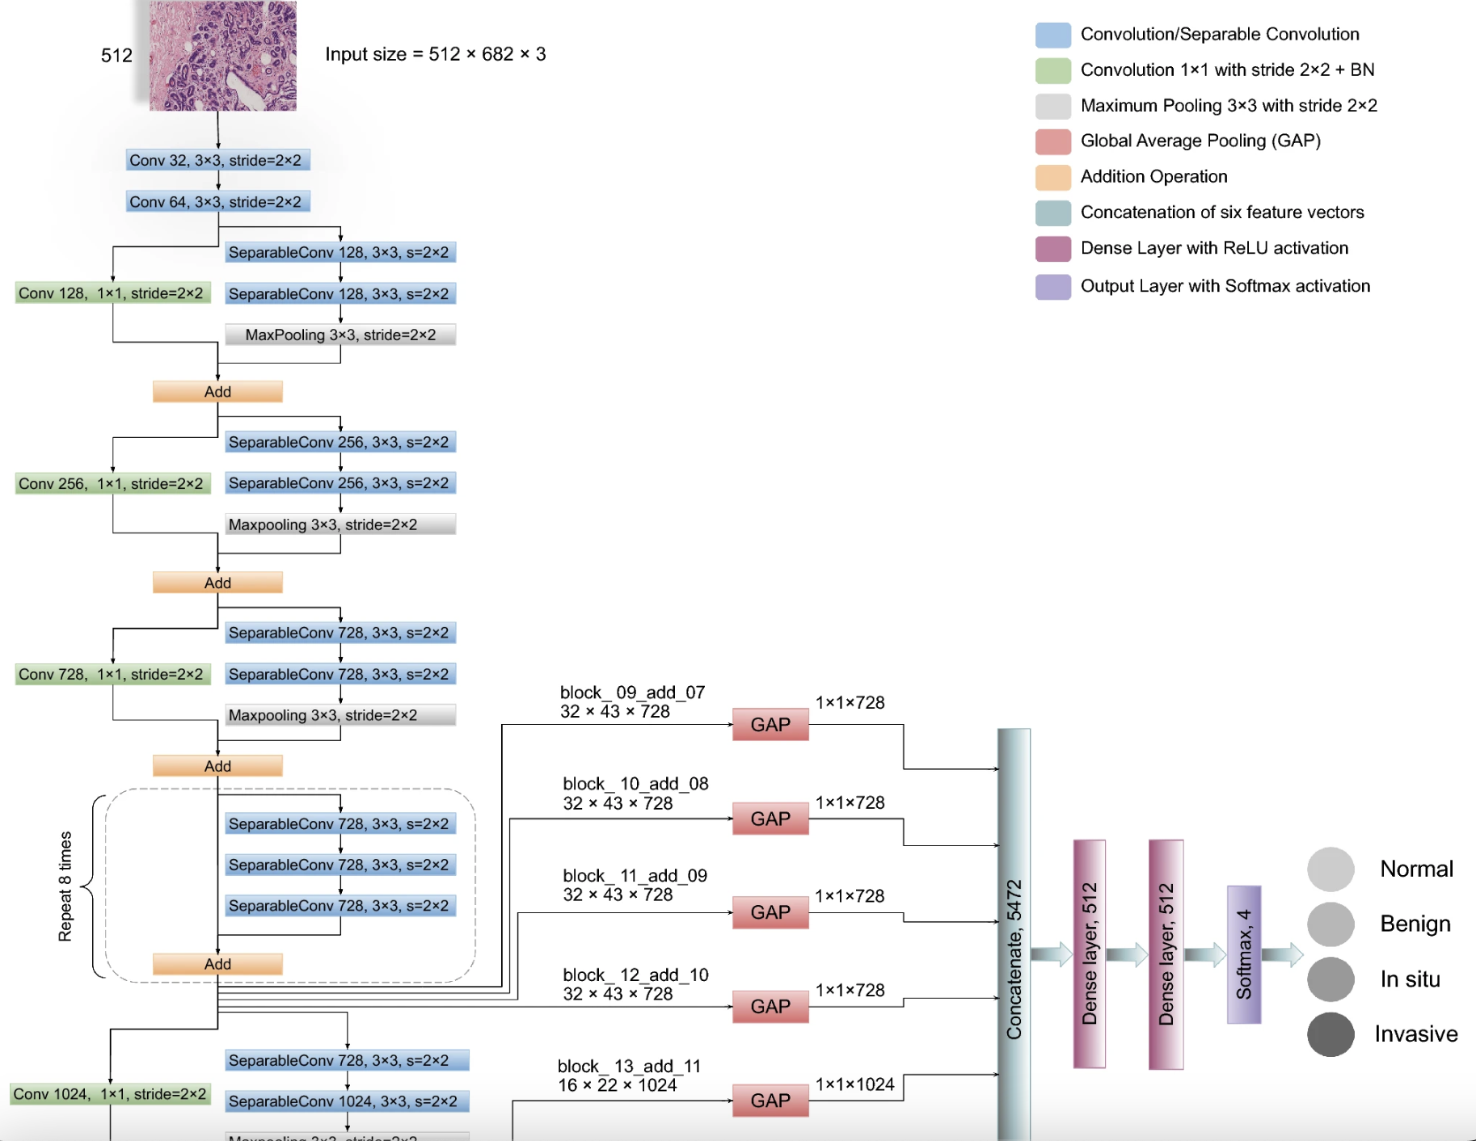
Paths Forward
EB7, EB3 Vision System for InnoScan
ViT
DenseNet121
Encode/Decoder Architextures
Exception (97% Acc and above)
  Short cuts between convolution blocks similar to ResNEt.
Citation: Hameed, Z., Garcia-Zapirain, B., Aguirre, J.J. et al. Multiclass classification of breast cancer histopathology images using multilevel features of deep convolutional neural network. Sci Rep 12, 15600 (2022). https://doi.org/10.1038/s41598-022-19278-2

Slide 9
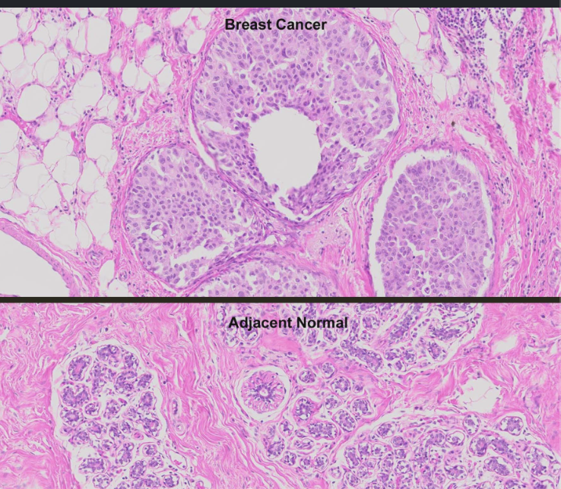
Conclusions
CNF and RNF similar in performance.
Both models have high errors for particular classes.
Pathologists can use SOTA models to assist in classification to ID cancer patients earlier increasing probability of good propnosis.
Combine models, add date, Transfer Learning with SOTA models.

