Slide 1
ML Models for DCT Data
ECE 8527 Final Project
Zephan Joseph

Slide 2
Project Overview
256x256 DCT of a digital pathology image
8 coefficients:
  0 = 'norm'
  1 = 'artf'
  2 = 'nneo'
  3 = 'infl'
  4 = 'susp'
  5 = 'dcis'
  6 = 'indc'
  7 = 'null'
  8 = 'bckg’
Our goal: develop a non-NN and NN based systems to classify data to be non-cancerous or data of interest

Slide 3
1st Model: Random Forest

Slide 4
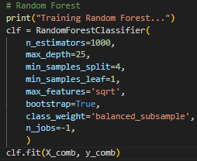

Random Forest
  1000 Trees
    More trees to improve stability and accuracy, useful for this data
  25 levels deep, split control, $\sqrt{features}$ at each split
    Prevents overfitting, promote generalization, complex decision boundaries
    Introduce more randomness, improve generalization
  Bootstrapping
    Each tree is trained on bootstrapped sample
    Helps to diversify the trees
  Class weighting
    Adjusts weights to fight against class imbalance (bias)

Slide 5
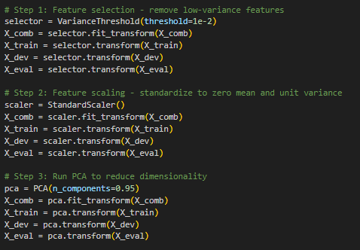
Pre-Processing
  Remove low-variance features
    Noise, negatively impacts generalization
  Standardization
    Scales each feature to have 0 mean and similar variance
    Necessary for PCA
  PCA
    Reduces dimensionality, helps with faster training and less overfitting

Slide 6
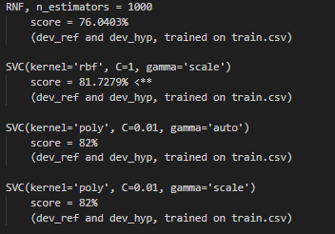
Model Selection
  Previous models
  RNF over SVC
    Better for high-dimensional data
    Handles data with multiple classes better
    Easily allows for bootstrapping

Slide 7
Results
Train: 0.61%
Dev: 0.78%

Slide 8
2nd Model: Convolutional Neural Network

Slide 9
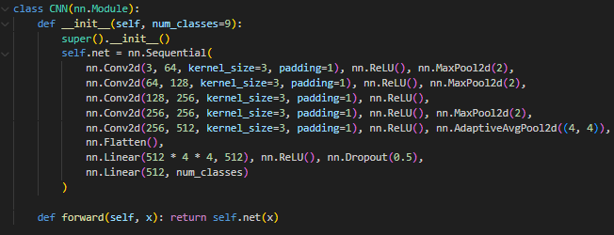
CNN
  5 layer Convolutional Neural Network
  Increased input and output layers incrementally between each layer
  Maxpooling
    Prevent overfitting, keep strongest activation within each region, noise reduction
  Implemented average pooling in deepest layer to keep a consistent output size
  Use ReLU for non-linear decision boundaries
  Dropout to prevent overfitting

Slide 10
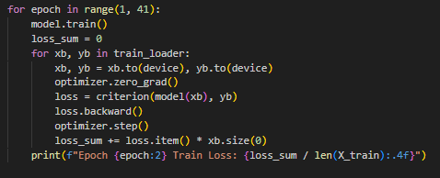
Training Loop
  Trained over 40 epochs
  xb and yb
  Smaller batches of features and labels
  Compute cross-entropy loss in each iteration, comparing predictions to true labels
  Perform backpropagation to compute loss
  Use adamW (optimizer.step())
  Computes total loss and prints average loss for the epoch

Slide 11
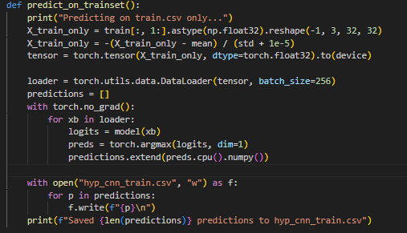
Predictions
  Load and reshape training features into tensors
  Applies normalization like the training loop
  Argmax takes the predicted class label for each sample from logits

Slide 12
Results
Train: score = 12.2269%
Dev: score = 12.2074%

