Slide 1
Final Exam Data Challenge
ECE 8527
Jahtega Djukpen

Slide 2
Overview…
Dataset…
  32x32 DCT coefficients computed from TUH DPATH Breast tissue image patches
  8 total classes, 5 classes of interest(norm, nneo, infl, dcis, & indc)
D
Models Chosen…
  Random Forest
  Convolutional Neural Network(CNN)

Slide 3
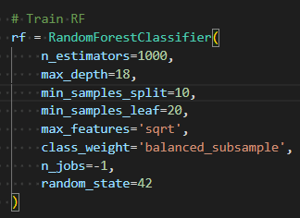
Random Forest…
Parameters
  N_estimators…Number of trees
  Max_depth…Each tree’s depth
  Min_samples split…samples needed to split a node
  Min_sample_leaf…samples needed in a leaf node
  Max_features…feature count per split node
  Class_weight…handles class imbalances
Notes:
Number of estimators
More trees in the forest leads to more stable predictions. More trees means more trees are likely to come to similar decisions
More trees does mean slower training and classification time
Max depth: essentially how complex a tree can be
Deeper, more complex trees can capture more complex relationships, but run the risk of overfitting
Min_samples_split=10
Higher value means for smoother more generalized trees
Smaller values make trees more detailed and risks overfitting
Min_samples_leaf=20
Determines how much data a leaf represents
Larger values mean large leaves for smoother decision boundaries
Small Leaver are more precise, but the predictions are noisier
Max_features
Lower feature count per spit will lead to more randomness and opens up for better generalization but risks underfitting
Higher feature count has stronger individual trees and can lead to overfitting
Class Weights
This helps handle class imbalances
Helps prevent model’s bias

Slide 4

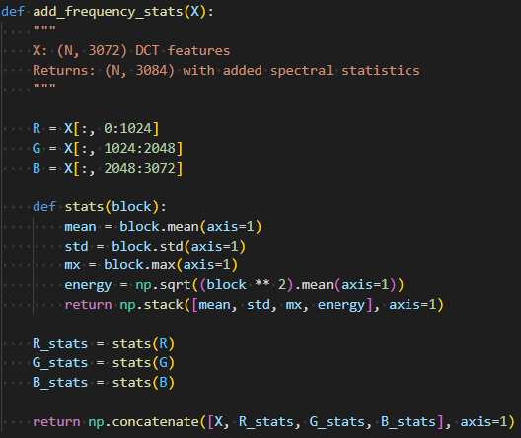
Random Forest…
Preprocessing
  This preprocessing step takes the raw DCT features and computes spectral statistics
  These statistics help make patterns in the data more recognizable
Notes:
Overall idea is to essentially describe the raw features
These descriptions help make it easier to learn
For example, you could list the features of an apple for someone, but describing where on the apple they appear is more informative
Blocks are the three color channels

Slide 5


Random Forest…
Results: Not Great Overall
  This implementation did not perform well
  Despite the poor performance, RNF is a relatively simple model to handle and is useful as a baseline
Train…
Dev…
Notes:
I would have like to try more optimization stragetives like bagging, boosting, and boostraping, but I ran out of time chasing bugs(mostly due to my own errors)

Slide 6
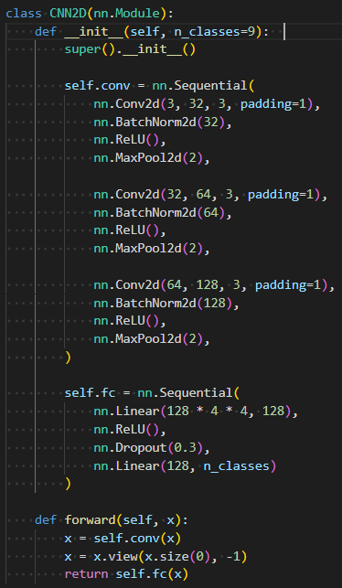
Convolutional Neural Network…
Parameters
  3-layer CNN
  3 input channels correspond to the RGB DCT features and expands to 32 output channel feature detectors
  Maxpooling down samples dimensions to force the network to keep most vital information
  Channel progression(32 to 64 to 128) is analogous to zooming out on a picture
Notes:
The 3 layers each help learn different features at differing levels of representation. From low level feaures like edges and local patterns all the way up to textures and shapes.
Like seeing the lines on a road, then an intersection or two, then looking at a satellite map of a city

Slide 7

Convolutional Neural Network…
Results: Better than RNF
  This implementation performed much better than RNF
  Even with the improvement on RNF, more optimization strategies were available
Dev…
Notes:
I would have like to try more optimization strategies with this one as well. I did use the AdamW optimization function, but I didn’t get to experiment with it all that much.
Overall, there’s a lot I did get to explore

Slide 8
Takeaways
Machine Learning is hard(shocker)
Understanding of the features/problem space is crucial
Lots of room for experimentation and improvement in my implementations
Notes:
It’s less of a blanket statement and more of a comment on how many knobs and levers there are available to adjust and adjusting one might really improve performance while adjusting another completely breaks everything
Understanding what algorithms and optimization strategize are available for a given problem space makes
The classic “I ran out of time”

