Slide 1
Digital Pathology Classification using CNN and GBM
Faezeh Bohlool
ECE 8527, final project

Slide 2
Problem Definition
Goal: classify pathology patches into 6 classes
Input is DCT coefficients (not raw images)
Multi-class classification problem
Classes: norm, nneo, infl, dcis, indc, bckg
Ignored labels: artf, susp, null

Slide 3
Data Representation
Each image → 256x256 → DCT transform
Keep 32x32 low-frequency coefficients
3 channels (RGB): 3 x 1024 = 3072 features
Preserves important structure while reducing size

Slide 4
Dataset & Workflow
Train: ~10,000 samples
Dev: ~6,000 samples
Eval: ~6,000 samples
Workflow:
Train → learn parameters
Dev → select best model
Eval → final unbiased performance

Slide 5
Challenges
High-dimensional input (3072 features)
Class imbalance across categories
Data not in the spatial domain initially
Potential overfitting due to dimensionality

Slide 6
Methods Overview
Two models implemented:
1. LightGBM (Non-Neural Network)
2. CNN (Neural Network)
Comparison based on dev set performance

Slide 7
LightGBM Approach
Input: raw DCT feature vector
Gradient boosting decision trees
Handles nonlinear relationships
Uses sample weighting to handle imbalance
Fast training and strong baseline performance

Slide 8
CNN Approach
Reconstruct images using inverse DCT
Resize to 64x64 resolution
Normalize using training statistics
Train a convolutional neural network
Captures spatial patterns after reconstruction

Slide 9
Training Strategy
Used class weights to handle imbalance
Early stopping based on dev score
Learning rate scheduling
Batch training with DataLoader
Optimization using AdamW

Slide 10
Debugging & Fixes
Initial issue: data parsed incorrectly
Features collapsed into a few columns
Fixed parsing → restored 3072 features
Significant impact on model performance
Ensured correct train/dev split usage

Slide 11
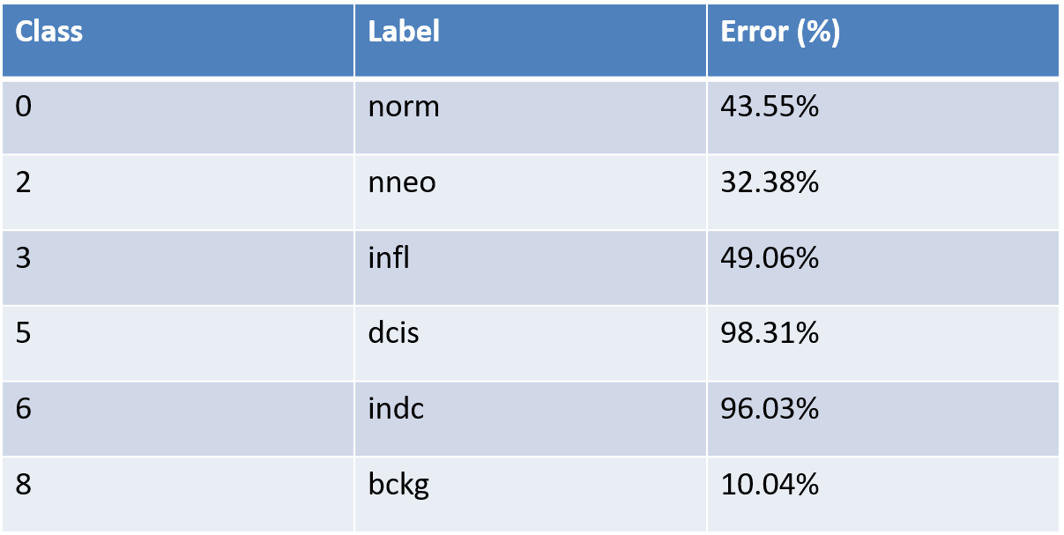
LightGBM Detailed Results

Slide 12
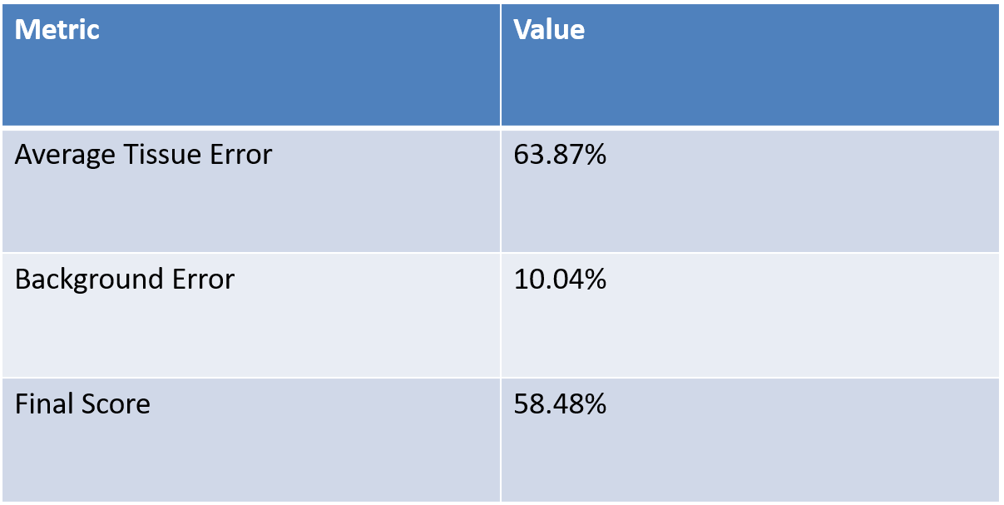
LightGBM Summary

Slide 13
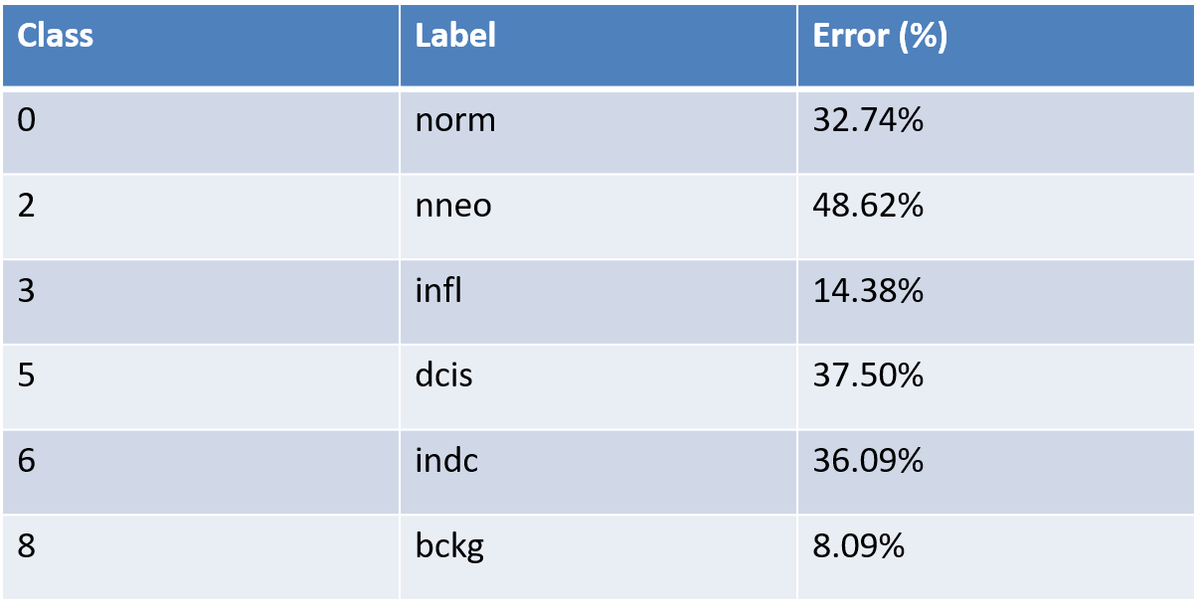
CNN Detailed Results

Slide 14
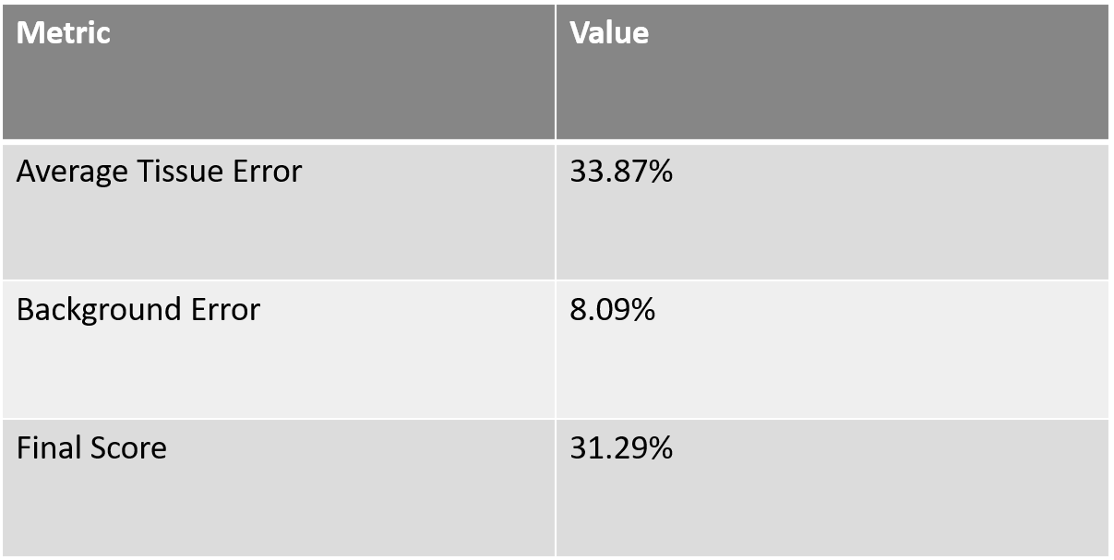
CNN Summary

Slide 15
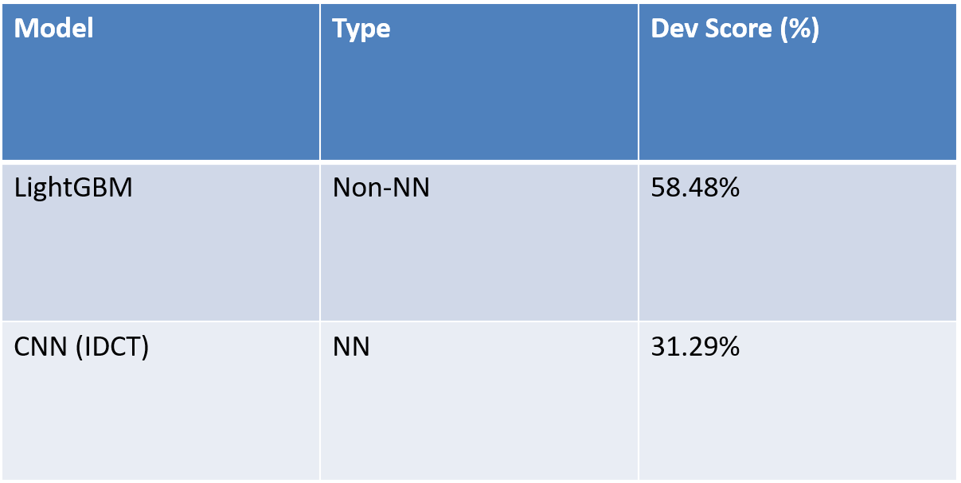
Model Comparison (Dev Performance)

Slide 16
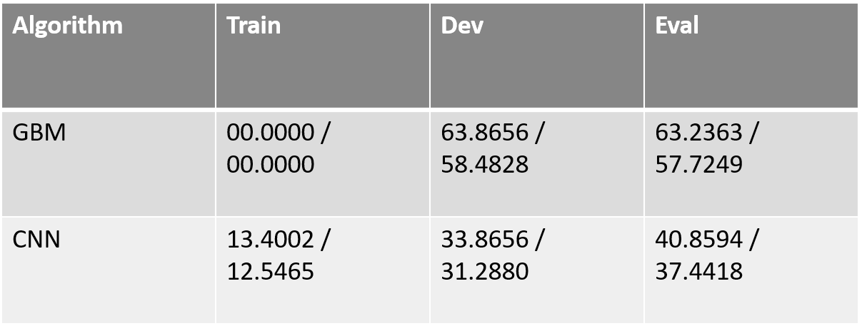
Final results

Slide 17
Key Insights
DCT features behave differently from images
Reconstruction enables CNN usage
Evaluation metric must guide model design
Proper data handling is critical
Both models provide complementary strengths

Slide 18
Conclusion
Successfully implemented two approaches
Compared NN vs non-NN methods
Dev set used for fair comparison
Final model selection based on score
Pipeline ready for evaluation

Slide 19
THANK YOU

