Slide 1
ECE8527 Final Project:
Detecting Cardiovascular Disease Using Machine Learning
By Abraham Paroya

Slide 2
About the Data – Header File
TNMG1025128_N1 8 300 2200 17:35:57 23/04/2015
TNMG1025128_N1.dat 16 200.0(0)/mV 16 0 -8 271 0 DI
TNMG1025128_N1.dat 16 200.0(0)/mV 16 0 -23 3734 0 DII
TNMG1025128_N1.dat 16 200.0(0)/mV 16 0 30 338 0 V1
TNMG1025128_N1.dat 16 200.0(0)/mV 16 0 16 64563 0 V2
TNMG1025128_N1.dat 16 200.0(0)/mV 16 0 -5 64825 0 V3
TNMG1025128_N1.dat 16 200.0(0)/mV 16 0 -6 65041 0 V4
TNMG1025128_N1.dat 16 200.0(0)/mV 16 0 -9 61413 0 V5
TNMG1025128_N1.dat 16 200.0(0)/mV 16 0 -3 60743 0 V6

Slide 3
**Important Values**
TNMG1025128_N1 8 300 2200 17:35:57 23/04/2015
TNMG1025128_N1.dat 16 200.0(0)/mV 16 0 -8 271 0 DI
8 | Number of Channels
300 | Frequency (samples/second)
2200 | Total Number of Samples per Record
16 | Bits per Sample
200 mV | ADC Units Per mV

Slide 4
Data Processing
def read_ecg_signal(file_path):
    # Read ECG signal
    signals, fields = wfdb.rdsamp(file_path)
    return signals

Slide 5
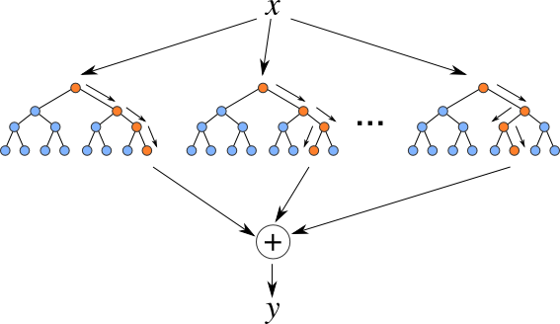
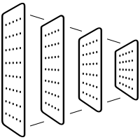
Two Approaches
Random Forest
Convolutional Neural Network (CNN)

Slide 6

Approach #1: Random Forest
RBBB
1dAVB
Parameters:
Number of Trees → 100 Estimators
Trained using Train + Dev
One Classifier Trained per Disease
LBBB
SB
ST
AF

Slide 7
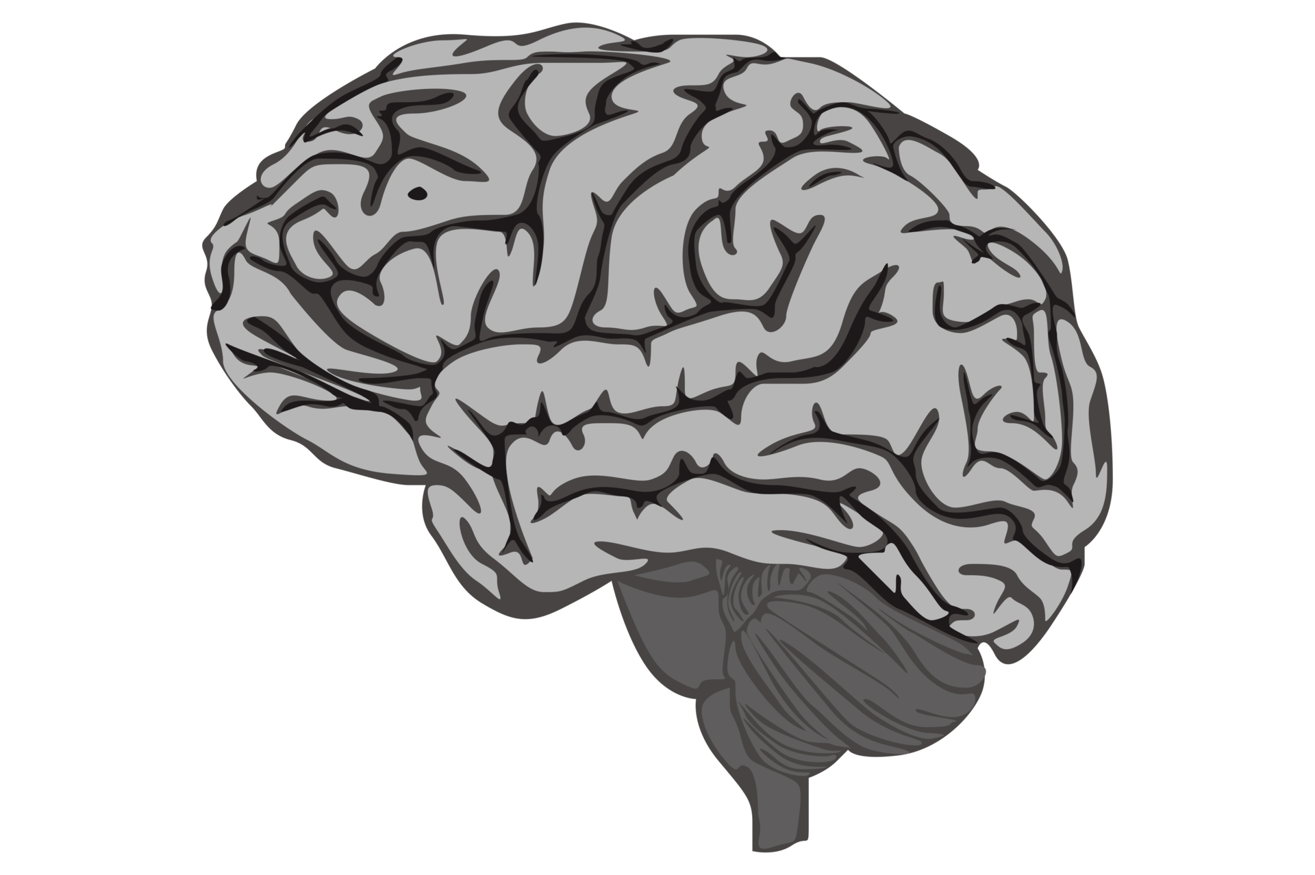
Approach #2: CNN
LSTM
Dense
Conv1D
Dropout
Max Pooling

Slide 8
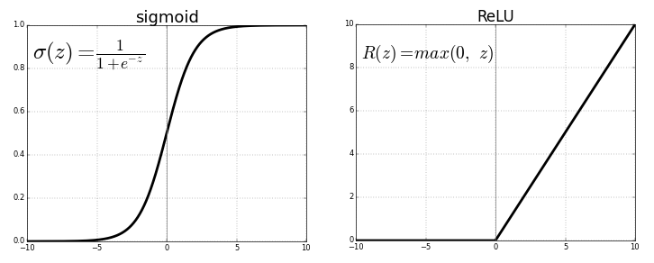
Approach #2: CNN Model Architecture
Input Layer
Conv1D
Filters = 32
kernel size = 5
DENSE
128 Units
Start Here
Max Pooling
Pool Size = 2
Output Layer
DENSE
6 Units
Dropout
Rate = 0.5
Conv1D
Filters = 32
kernel size = 5
LSTM
64 Memory Cells
Max Pooling
Pool Size = 2

Slide 9
CNN Full Architecture Description
1. Input Layer (Conv1D):
  Input Shape Convolutional Layer:
    Filters: 32
    Kernel Size: 5
    Activation Function: ReLU
MaxPooling1D Layer:
  Pool Size: 2
Conv1D Layer:
  Filters: 64
  Kernel Size: 3
  Activation Function: ReLU
MaxPooling1D Layer:
  Pool Size: 2
LSTM Layer:
  Units: 64
  Return Sequences: True (output for each timestep)
Flatten Layer
Dense Layer:
  Units: 128
  Activation Function: ReLU
Dropout Layer:
  Dropout Rate: 0.5
Output Layer (Dense):
  Units: 6 (for 6 parameters)
  Activation Function: Sigmoid

Slide 10
Why LSTM?
Temporal Dependencies: LSTM layers are well-suited for capturing long-term dependencies in sequential data. They can effectively model the temporal patterns present in signals, allowing the model to learn from the sequential nature of the data.
Memory of Past Information: LSTM units maintain an internal state that allows them to remember information over long sequences. Cardiovascular diseases may occur over multiple time steps. The LSTM layer can retain important information from past time steps.
Irregular Sampling Rates: ECG signals may have irregular sampling rates due to variations in recording equipment or patient conditions. LSTM layers can handle irregular time intervals between data points effectively.

Slide 11
Results – Random Forest
Disease | /train - F1 Score | /dev - F1 Scores
1dAVB | 0.8796 | 0.0286
RBBB | 0.9773 | 0.8746
LBBB | 0.9600 | 0.8258
SB | 0.9453 | 0.6246
ST | 0.9329 | 0.0473
AF | 0.8796 | 0.0286

Slide 12
Results – CNN
Disease | /train - F1 Score | /dev - F1 Scores
1dAVB | 0.9710 | 0.7606
RBBB | 0.9857 | 0.9373
LBBB | 0.9796 | 0.9020
SB | 0.9782 | 0.8531
ST | 0.9729 | 0.8620
AF | 0.9710 | 0.7606

Slide 13
Future Improvements
Random Forest:
  Train with different amounts of estimators
  Train using the Fourier transform of the signals
CNN:
  Train with more epochs
  Train using less “healthy” data points

