Slide 1
Ece 8527: Final Project
ECE 8527
Anna Chau

Slide 2
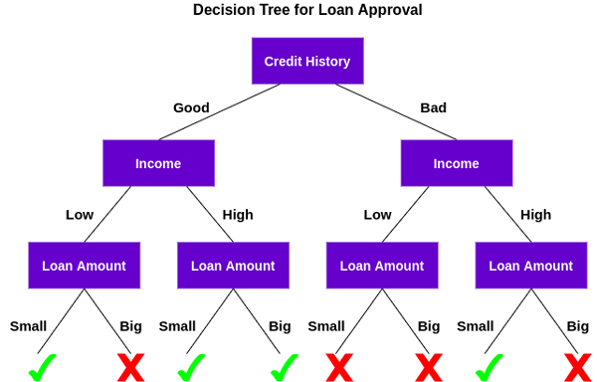
Approach #1: Random Forest classifier
Series of
If-Else choices

Slide 3
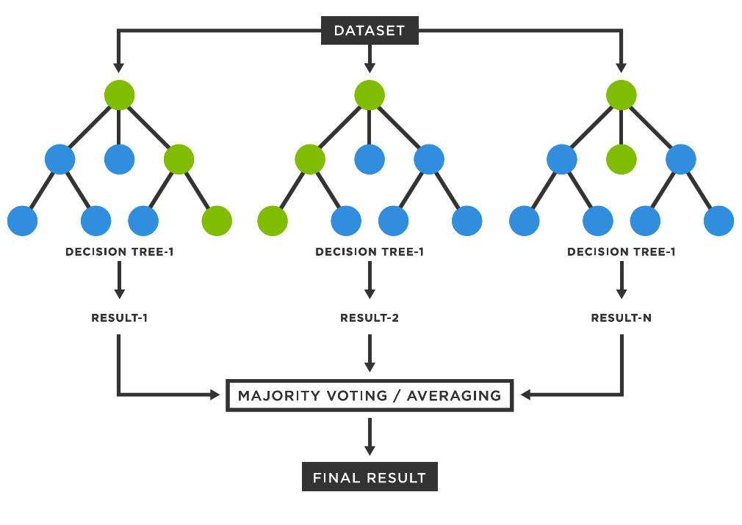
Random forest classifier

Slide 4
Training 6 individual random forests
Randomly chooses features during training process by utilizing bootstrapping
1. ) Grabs a random subset of input data and generate bootstrapped dataset
2.) Randomly select subset of features from ECG signals for each node (n_estimators = 100)
3.) Each bootstrap dataset has a decision tree built
4.) Once all trees are constructed, they form an ensemble (Random Forest Classifier)
5.) New test sample goes through all decision trees and uses majority vote for classification
By doing this for each disease independently, rnf can focus on learning one disease instead of juggling all six

Slide 5
Random forest: disease F1 SCORE results
 | Data | 1dAVb | RBBB | LBBB | SB | AF | ST
RNF | /train | 0.9992 | 0.9996 | 0.9994 | 0.9993 | 0.0197 | 0.0198
RNF | /dev | 0.0296 | 0.8759 | 0.8209 | 0.6250 | 0.0046 | 0.0021
Random forest: MACRO results
 | TRAIN | DEV | EVAL
RNF | 0.6728 | 0.3932 | 0.4043

Slide 6
How could these rnf results improve?
https://www.analyticsvidhya.com/blog/2020/03/beginners-guide-random-forest-hyperparameter-tuning/

Slide 7
Approach #2: Convolutional neural network

Slide 8
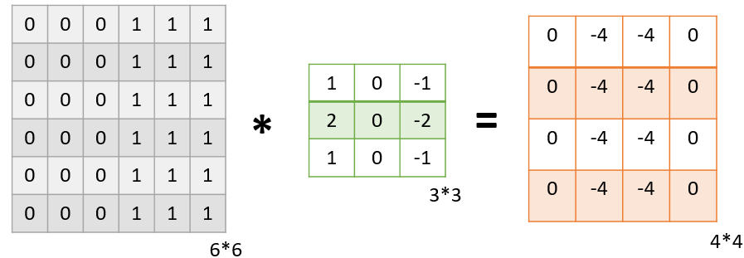
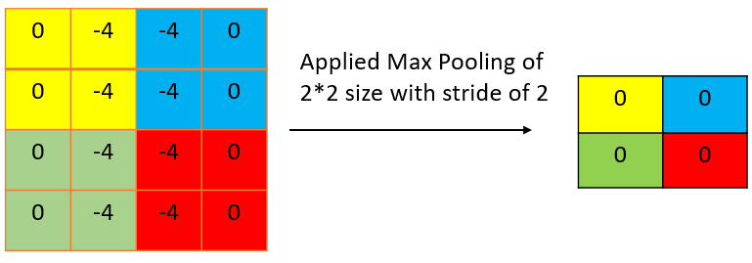
Layers of CNN: Feature extraction
1.) Convolutional Activation Layer → obtains the feature map of the input signal and applies ‘relu’ activation function
32 convolution filters
Kernel size: 3
Stride: 1
2.) MaxPooling Layer → taking maximum value from an area of feature map
Output: 2x2 max pooling window
3.) Flatten Layer → Flattening feature map

Slide 9
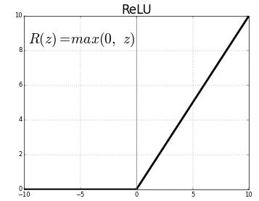
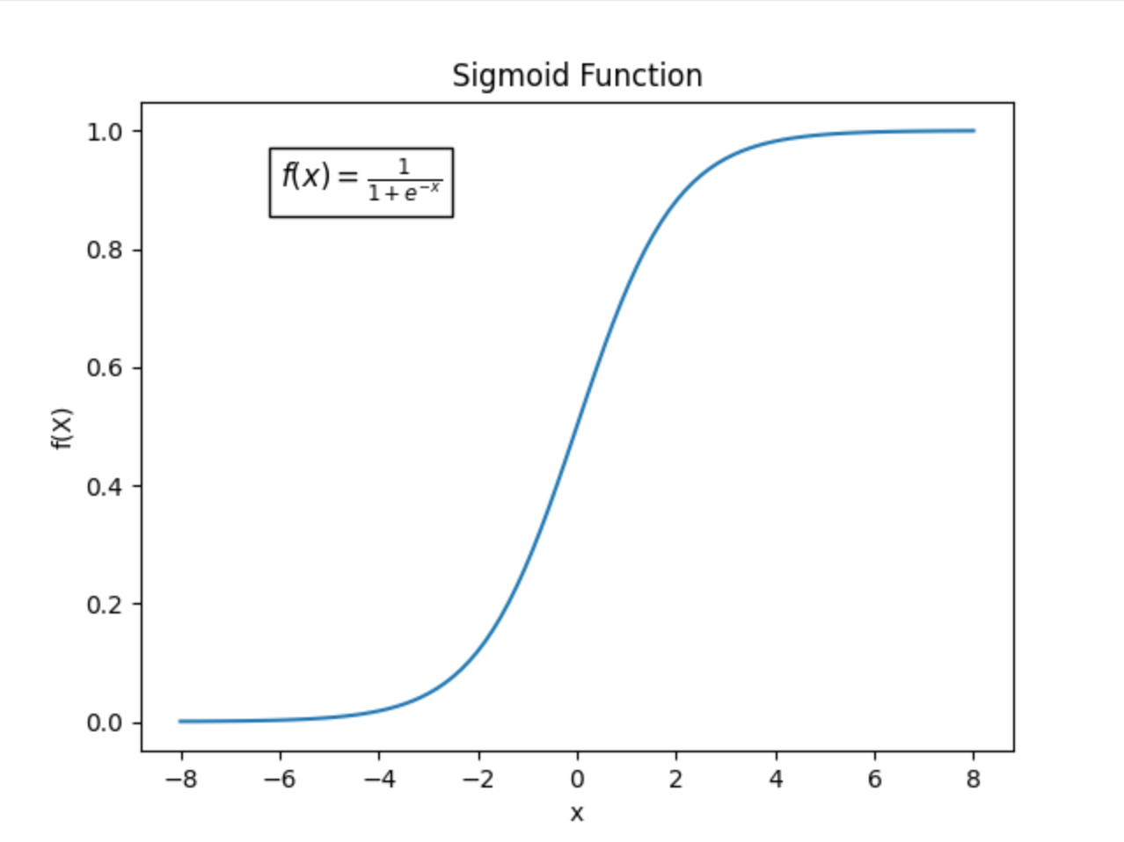
Layers of CNN: classification
) (2) Dense Layer → learning different sets of weights and biases
64 units for first dense, 6 units for second dense
Activation: ‘relu’ → outputs the input if it is positive, and zero otherwise
Activation: ‘sigmoid’ → used in binary classification and predicts probability of each class
Optimizer: Adam → adjusts the weights and biases to minimize the loss function (to minimize prediction error)
Loss function: binary cross-entropy → measures how well the model’s predictions match the actual target labels during training, measures performance

Slide 10
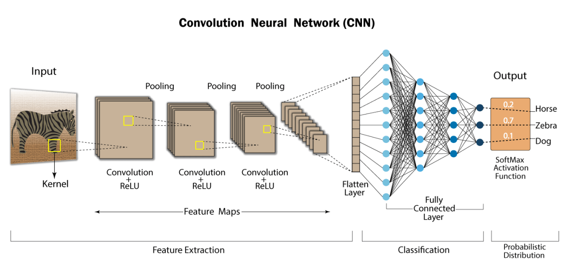
CNN: Overall system

Slide 11
CNN: disease F1 SCORE results
 | Data | 1dAVb | RBBB | LBBB | SB | AF | ST
CNN | /train | 0.9919 | 0.9971 | 0.9956 | 0.9948 | 0.9931 | 0.9919
CNN | /dev | 0.3124 | 0.9134 | 0.8610 | 0.8015 | 0.6890 | 0.3119
CNN: MACRO results
 | TRAIN | DEV | EVAL
CNN | 0.9333 | 0.6482 | 0.6458

Slide 12
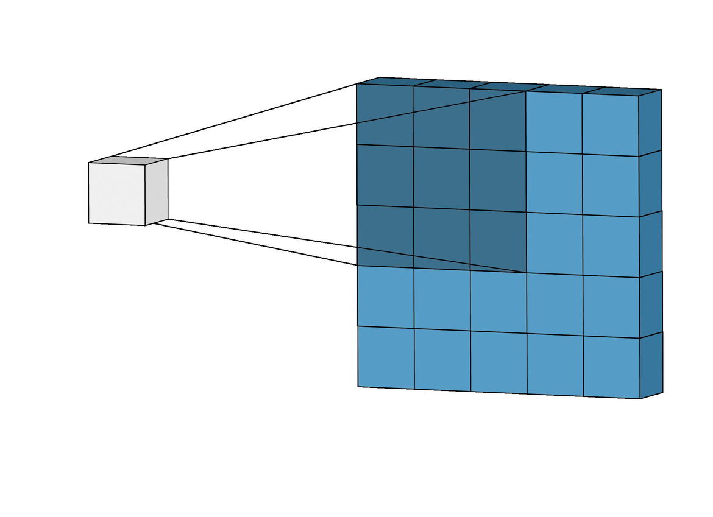
How could these CNN results improve?
Adding more layers to the system
More convolutional layers to get more of a detailed feature extraction
More dropout layers to avoid overfitting when in the fully connected layer

Slide 13
Thank you! Questions?

