Slide 1
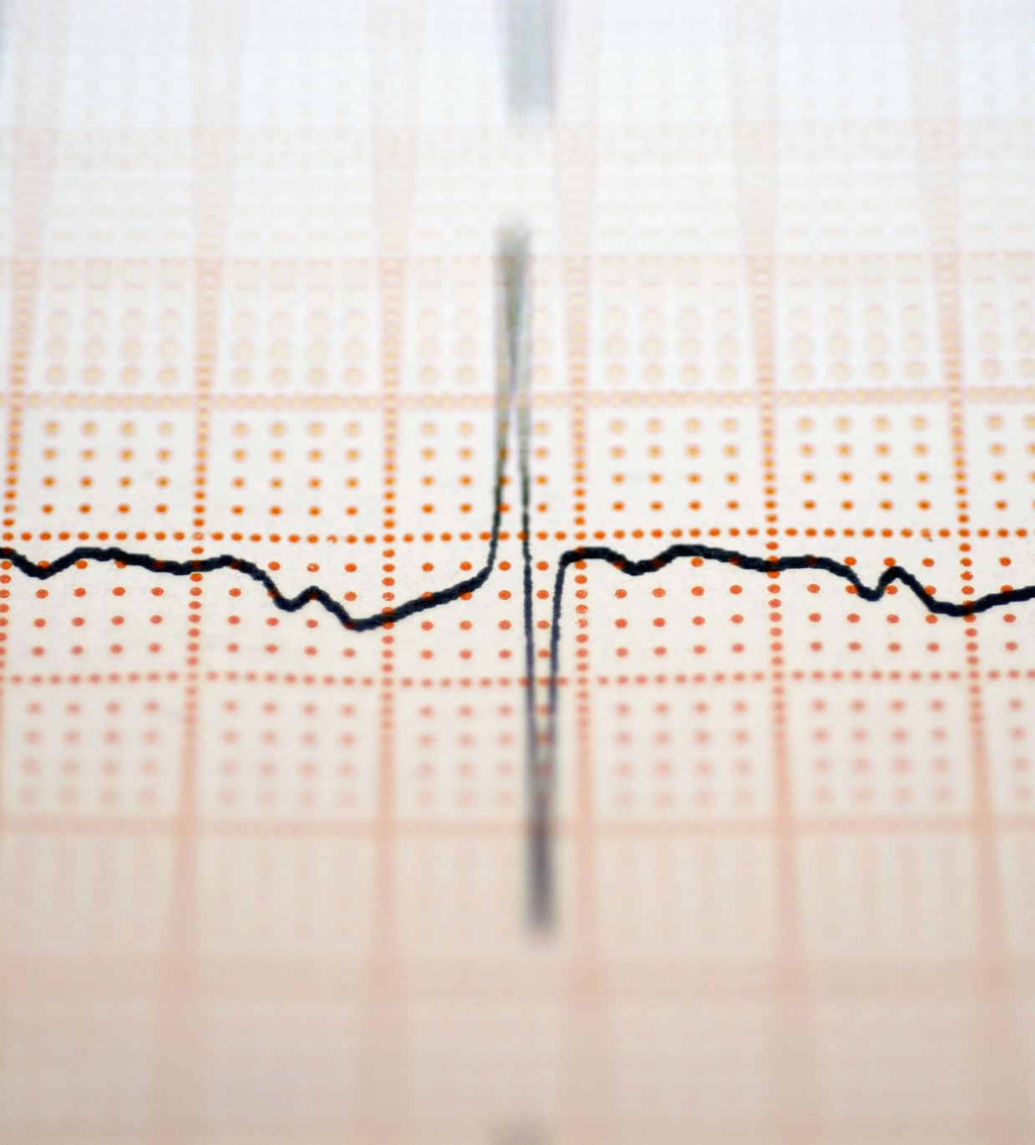
Machine Learning on 8 Channel EEG Data
Leo Berman

Slide 2
Algorithm One CNN
Base Layer
Flattening Layer
Final Prediction
Dense Layer
Pooling Layer

Slide 3
CNN Results
Datasets
Train | Dev | Eval
94.80 % | 94.74 % | TBD

Slide 4
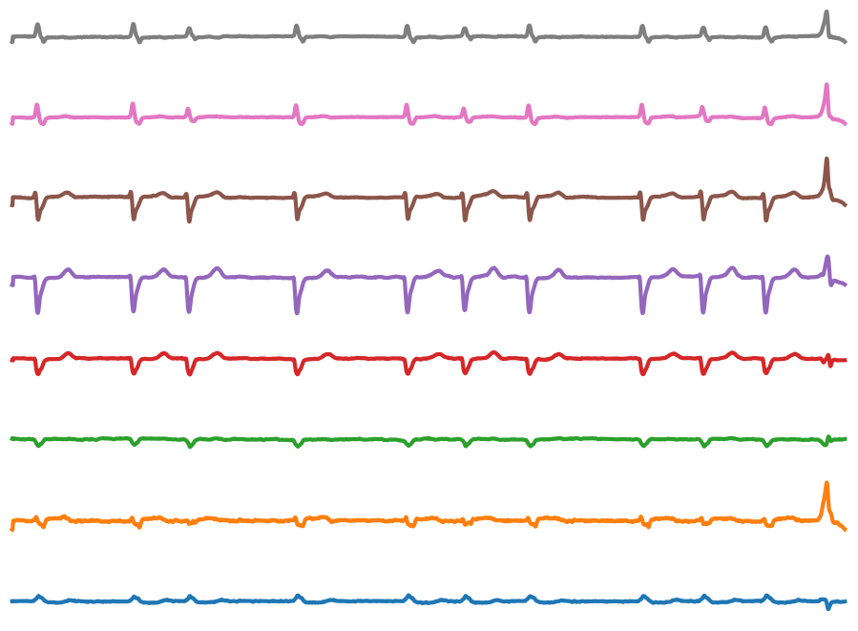
ResNet Data Generation
8 Vectors of 2D Points

Slide 5
Algorithm Two ResNet50
Base Layer
Flattening Layer
Final Prediction
Dense Layer
Pooling And Dense Layers

Slide 6
ResNet50 Results
Datasets
Train | Dev | Eval
TBD | TBD | TBD

