Slide 1
Machine Learning Final
EEG Classification Using Machine and Deep Learning Models
Presented by: Shelley Su
Department of Electrical and Computer Engineering
College of Engineering
Temple University

Slide 2
Pre-Processing
Feature Extraction
Noise Reduction

Slide 3
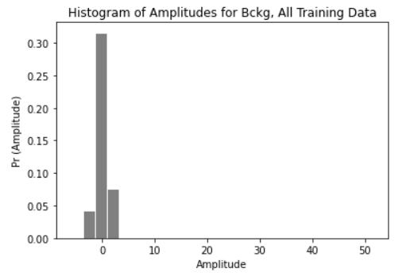
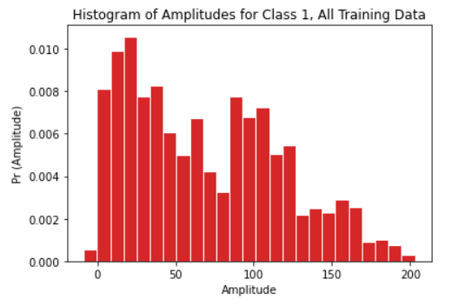
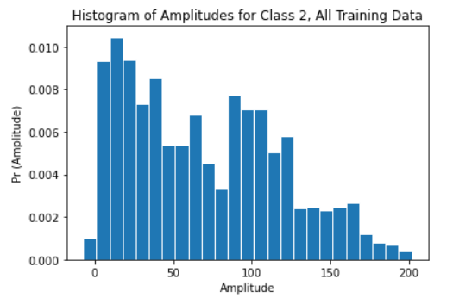
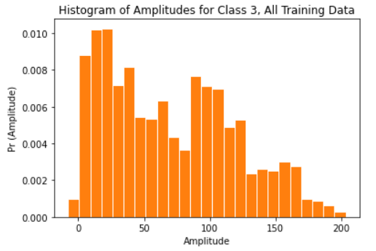
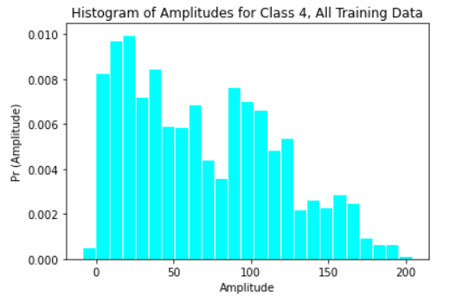
Pre-processing: Dataset Statistics
Difficult to identify distinguishing features when solely reviewing amplitudes by class
Gaussian mixture models but the distributions overlap, not a distinguishing feature

Slide 4
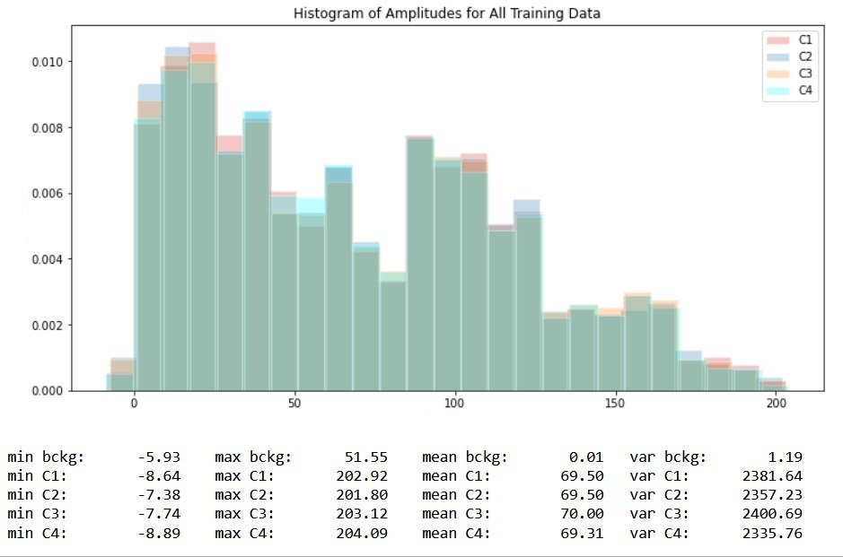
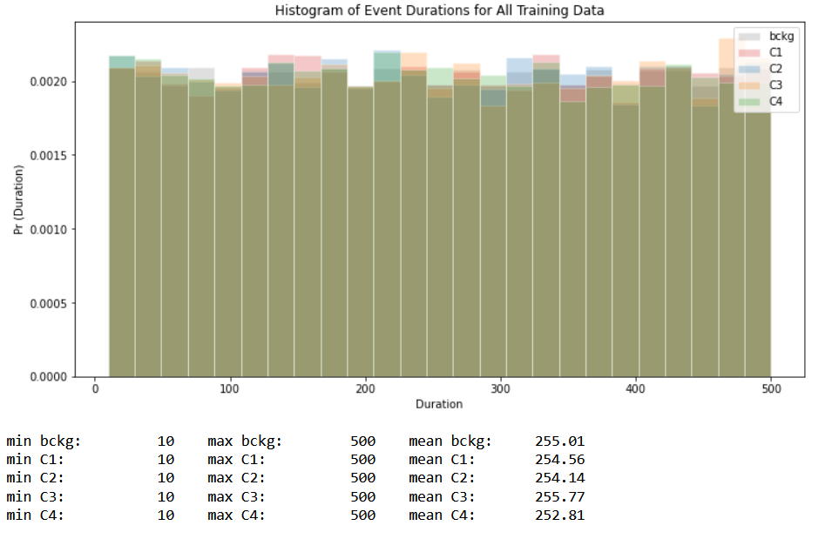
Pre-processing: Dataset Statistics
Another view: no distinguishing or defining points of separation (min, max, mean, var) and overlapping distributions for amplitude
Event duration by class is also not a distinguishing feature, nearly uniformly distributed for all event times. Note, the minimum event duration is 10 s

Slide 5
Pre-processing: Times Series
“Frame” the problem in a different way: instead of input as a single amplitude at time t, use a sequence of amplitudes as inputs with an output of class value
Take sequences equal to or greater than the minimum time of an event
Move through the series using a pre-determined time step
Time | Ampl | Class
0 | -0.74 | 0
1 | 0.29 | 0
2 | 0.01 | 0
3 | 0.06 | 0
4 | 0.91 | 1
5 | -0.05 | 1
…
-0.74 | 0.29 | 0.01
Class 0
0.29 | 0.01 | 0.06
Class 0
0.01 | 0.06 | 0.91
Class 1
0.06 | 0.91 | -0.05
…

Slide 6
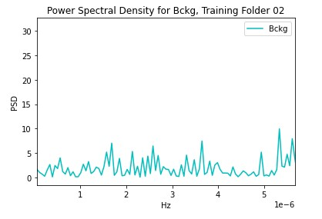
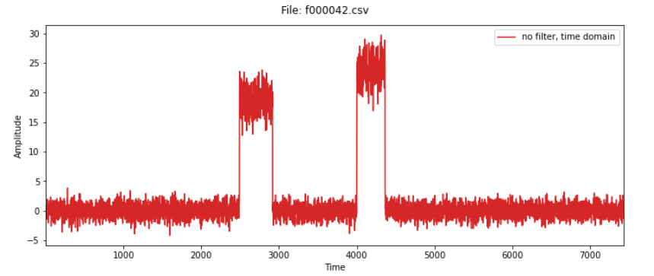
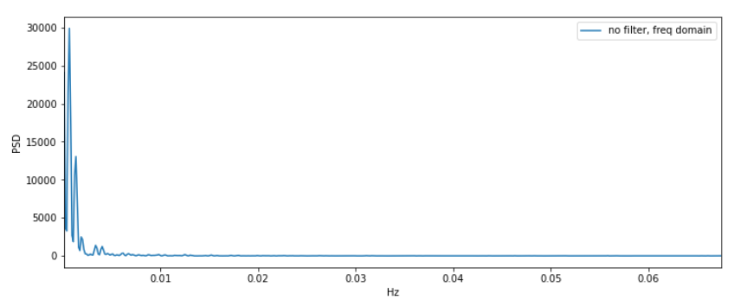
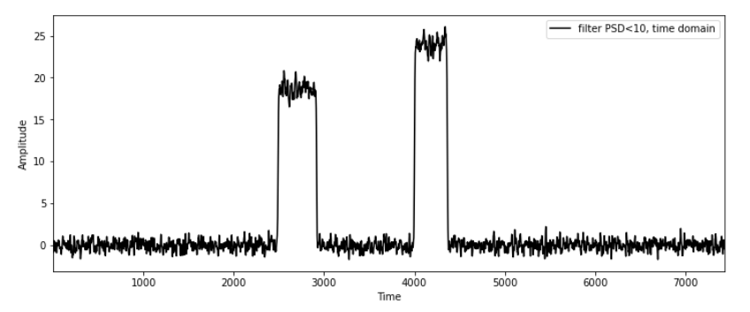
Pre-processing: Noise Reduction
Characterize the level of bckg noise (Class 0) and it out
Examine power spectral density in the frequency domain and threshold at values where there is low energy (threshold ~10 W/Hz) to remove noise
Take the IFFT to get a filtered signal. Hindsight: were features removed as a result?

Slide 7
Overview of Algorithms
Trainer
Decoder
Post-processor

Slide 8
Trainer: Random Forest
Construct a forest of decision trees; used Python’s GridSearchCV to find an optimal value of 35 trees
Benefits:
8000 files were processed into time series sequences of 15 elements (1.5x min window) that produced a 50 GB file
Random forest was able to handle this efficiently (other models, like KNN, did not but there were other background processes running while KNN model was running that may have affected)
Able to discover and interpret features well
Provides reasonable predictions without much hyper-parameter tuning (chose 1 parameter)

Slide 9
Trainer: K-Nearest Neighbor
Construct a K Nearest Neighbor model; used Python’s GridSearchCV to find an optimal value of 3 neighbors
Benefits:
Use the data to try and make a prediction
Drawbacks:
Prediction is based on distance to other datapoints in the file, output prediction for this model is slow (this method is implemented in code but output files were not generated in sufficient time for scoring)
5 GB training files from 1000 random files were used to train KNN

Slide 10
Trainer: Long Short Term Memory (LSTM)
Construct an LSTM model to make a prediction, process the information in a recurrent way
Forget gate: controls how much info from previous time step is kept in the current time step
Input gate: controls how much new info from the current time step is added to the cell state
Output gate: controls how much info from the cell state is used for output at the current time step
Cell state: contains info from previous and current time state, “memory”
Benefits:
Well suited for modeling sequences

Slide 11
Trainer: Long Short Term Memory (LSTM)
Drawbacks:
There are lots of hyperparameters to tune
Training period is longer than Random Forest or KNN
1000 random training files were used for training to try and cut back on time
The model wasn’t trained properly and produced predictions of only Class 0, bckg

Slide 12
Decoder
Reads model from a file
Applies bckg noise filter to input data and normalizes data
Make predictions on every sequence
Writes prediction to a csv file: outputs time, label, confidence level

Slide 13
Post-processor
Find indices in time series where amplitude of the signal is greater than 10, this is a good indication of the start and stop times for an event
This is an array in the post processing dataframe that indicates that the datapoint was likely part of an event with a flag of 1, 0 if bckg, but no logic was put in place to use flag 1 to smooth the data within that frame.
Maybe a majority vote within the flagged window could have been implemented.
Checks for duration values that are less that 10 s minimum window for an event (the decision-making process for this portion is incomplete)
Logic in place that says if the event < 10 s and the event flag is 0, then change the value to 0
Packages predictions from the model for the scoring software

Slide 14
Overview of Results
Scoring Results

Slide 15
Scoring Results
Model | Train | Dev
Random Forest | 66.97% accuracy | 71.95% accuracy
K Nearest Neighbor | na | na
Long Short Term Memory | na | na
RNF TEST SCORING SUMMARY:
Total: 1502734
Hits: 1227528
Misses: 275206
False Alarms: 2858168
Insertions: 2858168 <**
Deletions: 203252 <**
True Positives(TP): 1227528
False Positives (FP): 2858168
Sensitivity (TPR, Recall): 81.6863%
Miss Rate (FNR): 18.3137%
Accuracy: 66.9715%
Misclassification Rate: 33.0285%
Prevalence: 15.8401%
F1 Score: 0.3993
Matthews (MCC): 0.3384
RNF DEV SCORING SUMMARY:
Total: 290146
Hits: 274450
Misses: 15696
False Alarms: 529834
Insertions: 529834 <**
Deletions: 6604 <**
True Positives(TP): 274450
False Positives (FP): 529834
Sensitivity (TPR, Recall): 94.5903%
Miss Rate (FNR): 5.4097%
Accuracy: 71.9530%
Misclassification Rate: 28.0470%
Prevalence: 14.9171%
F1 Score: 0.4545
Matthews (MCC): 0.4527

