Slide 1
Anomaly Detection
MultiLayer Perceptron
Gavin Koma
Introduction to Pattern Recognition and Machine Learning

Slide 2
TABLE OF CONTENTS
01
02
03
Introduction
Preprocessing
Feature Engineering
04
05
Segmentation & GroupBy
Conclusion
Basics
EDA
Mean & Standard Dev
Hypothesis file generation
Results

Slide 3
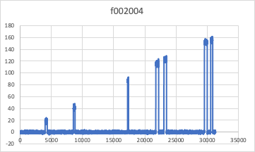
Brief Review
Train
10 directories (0-9)
10,000 files
Hashed metadata
Dev
2 directories (10-11)
2,000 files
Hashed metadata
Eval
2 directories (12-13)
Only signal data

Slide 4
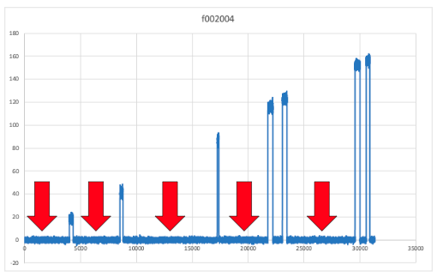
Brief Review
Uniform distributions before for signals
Pauses are variable and not consistent in length
Cannot consider for class predictions
No HMMs
Large amount of data & limited memory
RFC
Neural Network

Slide 5
MLP & RFC
MLP Classifier | RFC
4 Layers | n_estimators = unspecified
TanH Activation Func | max_depth = 3
4,000 training base (train & dev) | 2,000 training base (train & dev)

Slide 6
Data Processing
RFC
fail at training stage
If supplied <2000 training files
performance = heinous
MLP
Run on initial dataset
Error ~70%
Expected much lower due to bias towards Class 0

Slide 7
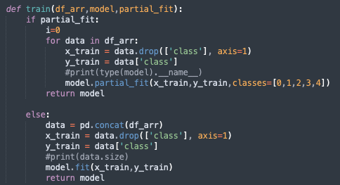
Decrease Error in MLP
Introduce partial fit training
Update existing model with new data incrementally
Useful for large datasets that might not fit into memory all at once
Updated with new observations and adjusts parameters accordingly

Slide 8
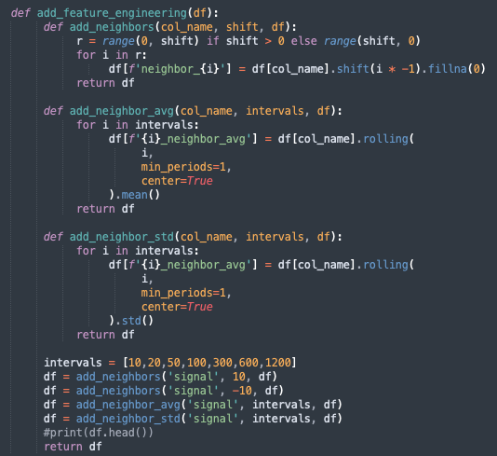
Decrease Error in MLP
Feature engineering
Goal: create a set of features that can capture important information in the data
Used as another input for the model
Interval based mean & std
[10, 20, 50, 100, 300, 600, 1200]

Slide 9
New DataFrame
Additional 26 columns of data were added
Notes:
T signal chunknum chunk start chunk start label

Slide 10
Segmentation & GroupBy
Iterative approach
grouped by start_time
Calculated mode of label segments for majority vote
Output

Slide 11
/eval Problems
Real trouble starts here
Prioritized /train + /dev
Treated /eval like a stranger
Dynamic coding facilitated training between /train + /dev
format changed in /eval (no longer works)
Without the chunk numbers →
Could not calculate my PDF /= entropy
Too many finals to debug this as much as I would have liked to
Performed randomized segmentation & hoped for the best

Slide 12
Conclusion & Results
Waiting to receive final results from Dr. Picone
/bin/python has a funky installation
Cannot make the hyp & ref compare to each other
Continue to get 100% accuracy (this cannot be right)
With better memory or GPU access
Would have tried a more computationally intensive algorithm like RFC
Might be worth translating my MLP code to PySpark to distributed processes
Might facilitate the training of my algorithm on BOTH /train + /dev instead of a random 3000 file selection between the two of them

Slide 13
Thank you!

